Slide 1
X Congresso Nazionale CLEO
Roma
28-29 Settembre 2017
NAFLD/NASH e
Sindrome Metabolica
Prof. Luigi E. Adinolfi

Slide 2


Slide 3
Major features of Metabolic Syndrome
  Central obesity
  Hypertriglyceridemia
  Low high density lipoprotein (HDL)
  Hyperglycemia
  Hypertension
Abdominal obesity plus two other components: elevated BP, low HDL, elevated TG, or impaired fasting glucose

Slide 4
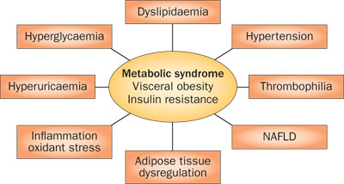

Slide 5
The association of NAFLD with IR and its close connection with the MetS was independently reported by three unrelated groups of investigators as early as 1999
Marchesini G et al. Am J Med 1999; 107: 450-455
Cortez-Pinto H et al. Clin Nutr 1999; 18: 353-358
Lonardo A Dig Dis 1999; 17: 80-89
NAFLD affected middle-aged men
with obesity,
altered glucose metabolism, hyperlipidemia, and hypertension
Lonardo A Dig Dis 1999; 17: 80-89

Slide 6
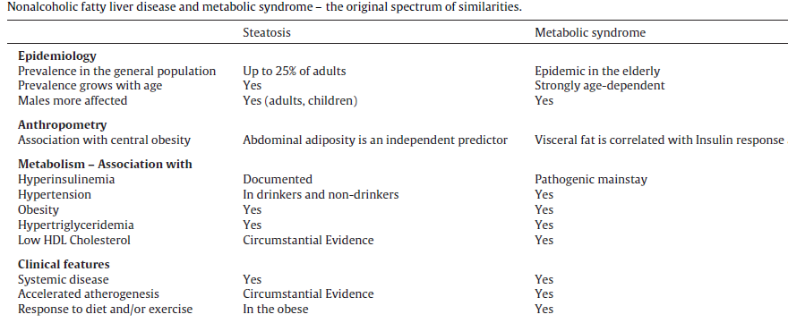
Yes

Slide 7
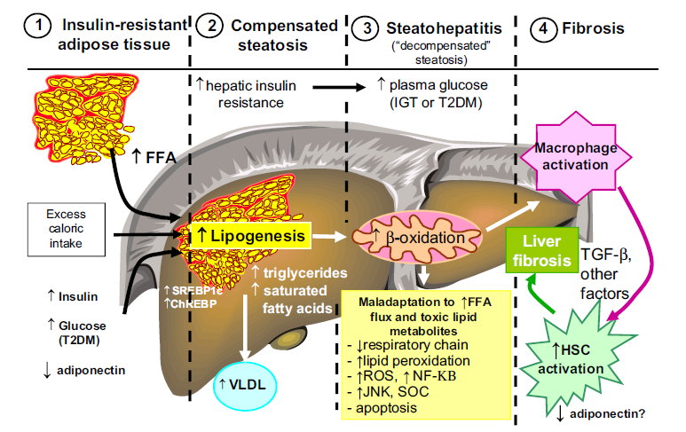
The common connection between MS and NAFLD is:
abnormal lipid traffic and its consequences, such as visceral adiposity and insulin resistance

Slide 8
Obesity is strongly associated with hepatic steatosis, excess body fat accumulation is not ‘a condition sine qua non’ for developing NAFLD.
Insulin resistance is a “necessary but not sufficient” morbid condition, which plays a role only in the early phases of NASH.

Slide 9
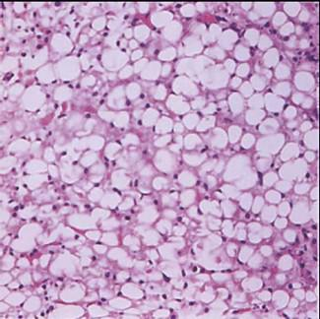
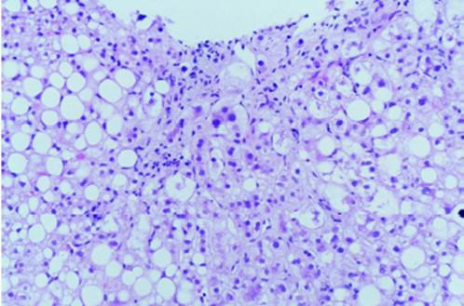
NAFLD features excess intrahepatic ectopic triglyceride deposition in patients who are free of competing etiologies of liver disease
NAFLD is a multi-factorial, non-communicable disease resulting from a complex interaction between multiple environmental and metabolic “hits” and a predisposing genetic/epigenetic background
Steatosis, namely a minimal threshold of 5% of hepatocytes containing fat droplets in biopsy specimen, is a prerequisite for the diagnosis of NAFLD. The histological definition of adult NASH is based on a combination of three elementary lesions, i.e., steatosis, hepatocellular ballooning and lobular inflammation

Slide 10
HOMA-IR, along with serum uric acid levels, is an independent predictor of both steatosis and ballooning
Waist circumference
predicts both ballooning and hepatic fibrosis
Ballestri S et al. Hepatol Res 2016; 46: 1074-1087

Slide 11
Epatiti croniche in Italia (dati ISS)

Slide 12

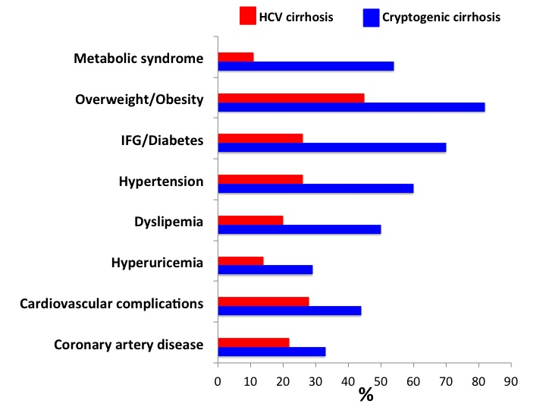
A large proportion of cryptogenic cirrhosis are ‘burnedout’ from NASH
Adinolfi et al. 2017 WJG

Slide 13
In the last years new evidence has accumulated on nonalcoholic fatty liver disease (NAFLD) challenging the paradigms that had been holding the scene
over the previous 30 years.

Slide 14
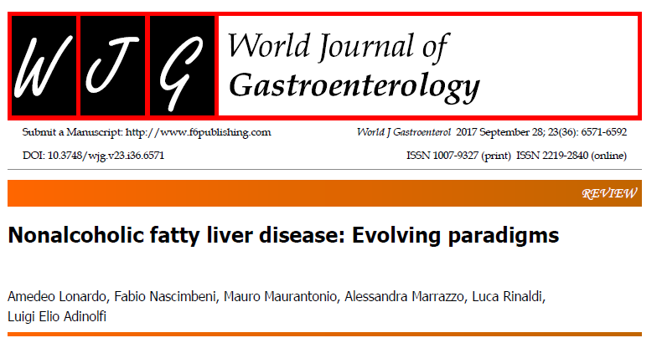

Slide 15
Epidemiology of NALFD
NAFLD is more frequent in men
- in diabetic: no differences M/F -
Current incidence rates: 20/10,000 person years, peaking in the sixth decade of life.
Current population based prevalence: 30–40% in men and 15–20% in women.

Slide 16
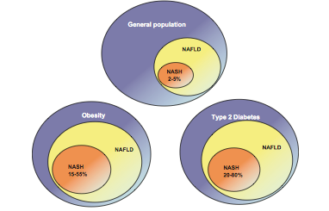
25-30%
80-90%
80-90%

Slide 17
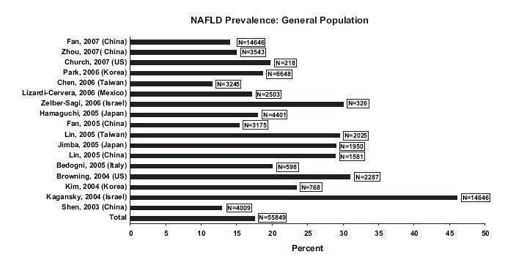

Slide 18
NAFLD has such an epidemic prevalence as to make it impossible to screen general population looking for NAFLD cases.
Focusing on those cohorts of individuals exposed to the highest risk of NAFLD could be a more rational approach

Slide 19
Identifying individuals who are particularly prone to developing NAFLD.
Male gender
Middle age
Hispanic ethnicity
Arterial hypertension
MetS
Obesity
Dyslipidemia
T2D
Lonardo et al. Dig Liver Dis 2015; 47: 997-1006

Slide 20
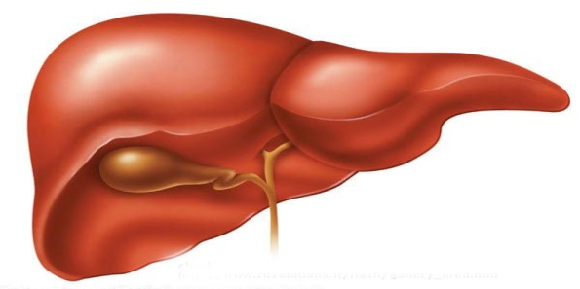
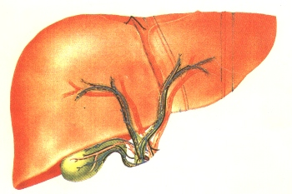
Original pathogenic “Two hit hypothesis“
First hit
(Steatosis/Insulin resistance)
Second hit
(Further insults)
Normal liver
steatosis
NASH
Endotoxins
Adipokines
Microbiota
Inflammation/
Insulin resistance
Genetics/
Epigenetics
TLRs
Diet
Present “Multiple parallel hits hypothesis “
Lonardo A, Adinolfi LE WJG 2017

Slide 21
‘Triple hit behavioural phenotype of NAFLD patient’
Sedentary
Low physical activity
Poor diet
Four phenotypes of NAFLD patients:
i) Obese
ii) Type 2 diabetes
iii) Metabolic syndrome
iv) Lean patients
Genetics/epigenetic

Slide 22

Overweight/Obesity - Lean NAFLD -
Sedentary lifestyle - High-calorie Diet - Genetics
> Insulin Resistance
< Insulin Resistance
Genetic Predisposition
with > Insulin Resistance
Genetic Predisposition
with < Insulin Resistance
Gut Microbiota:
Dysbiosis
Endotoxemia
> Inflamed Adipose
Tissue
NAFLD
< Inflamed Adipose
Tissue
> Type 2 Diabetes
NASH
< Type 2 Diabetes
> Cardio-Vascular
Diseases
< Cardio-
Vascular Diseases
CIRRHOSIS
> Chronic Kidney Diseases
Chronic Kidney Disease ?
HCC
> Cancer
> HCC
Lonardo A, Adinolfi LE WJG 2017

Slide 23
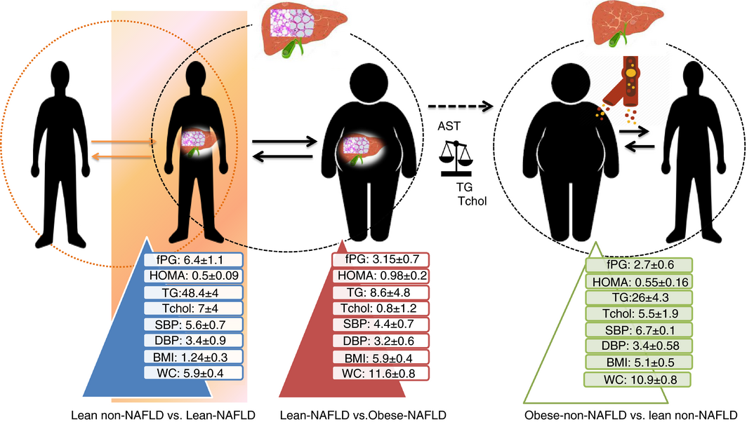
Systematic review with meta‐analysis: risk factors for non‐alcoholic fatty liver disease suggest a shared altered metabolic and cardiovascular profile between lean and obese patients
“metabolically obese,
normal weight”
Alimentary Pharmacology & Therapeutics
Volume 46, Issue 2, pages 85-95, 2 MAY 2017 DOI: 10.1111/apt.14112
http://onlinelibrary.wiley.com/doi/10.1111/apt.14112/full#apt14112-fig-0006
Notes:
Summary of main findings: The lean—non‐alcoholic fatty liver disease (NAFLD) paradox. The image illustrates the results yielded by the meta‐analysis of risk factors associated with the Metabolic Syndrome in lean vs obese patients classified by the presence of NAFLD; comparisons with the corresponding non‐NAFLD controls are also depicted. Values are expressed as differences in means ±SE; arrows indicate group comparisons. Dashed arrow indicates meta‐regression analysis using NAFLD as the moderator variable. fPG, fasting plasma glucose; HOMA, homoeostatic model assessment‐insulin resistance; SBP, systolic blood pressure; DBP, diastolic blood pressure; TG, triglycerides; Tchol, total cholesterol; BMI, body mass index; WC, waist circumference; ALT and AST, alanine and aspartate aminotransferase; GGT, gamma‐glutamyltransferase
IF THIS IMAGE HAS BEEN PROVIDED BY OR IS OWNED BY A THIRD PARTY, AS INDICATED IN THE CAPTION LINE, THEN FURTHER PERMISSION MAY BE NEEDED BEFORE ANY FURTHER USE. PLEASE CONTACT WILEY'S PERMISSIONS DEPARTMENT ON PERMISSIONS@WILEY.COM OR USE THE RIGHTSLINK SERVICE BY CLICKING ON THE 'REQUEST PERMISSIONS' LINK ACCOMPANYING THIS ARTICLE. WILEY OR AUTHOR OWNED IMAGES MAY BE USED FOR NON-COMMERCIAL PURPOSES, SUBJECT TO PROPER CITATION OF THE ARTICLE, AUTHOR, AND PUBLISHER.

Slide 24
The evidence that 90 % of NAFLD patients have one or more cardio-metabolic risk factors (hyperglycemia, dyslipidemia, hypertension and visceral adiposity), clustered in the definition of Metabolic Syndrome (MS)
NAFLD considered as:
“The liver manifestation of MS”
Marchesini G, Brizi M, Bianchi G et al (2001). Diabetes 50:1844–1850

Slide 25

Since then, a “chicken and egg” scientific debate has arisen, concerning the primacy of metabolic syndrome over NAFLD or, conversely, of NAFLD over the metabolic syndrome .

Slide 26
Prospective long-term study Baseline NAFLD predicts the development of incident T2D and MetS
Ballestri S et al. J Gastroenterol Hepatol 2016; 31: 936-944
These findings strongly support the notion that NAFLD should no longer be considered a mere
“hepatic manifestation of the MetS” but rather both a precursor and a consequence of the MetS
In particular, our understanding of the close and mutual relationship of NAFLD with the MetS has evolved and the bidirectional relationship among the two conditions is now largely acknowledged
Lonardo A et al. Dig Liver Dis 2015; 47: 181-190
Ballestri S et al. J Gastroenterol Hepatol 2016; 31: 936-944
Yki-Järvinen H. Lancet Diabetes Endocrinol 2014; 2: 901-910
Vanni E et al Dig Liver Dis 2010; 42: 320-330
Ma J et al. J Hepatol 2017; 66: 390-397
Zhang Y et al. BMJ Open 2015; 5: e008204

Slide 27
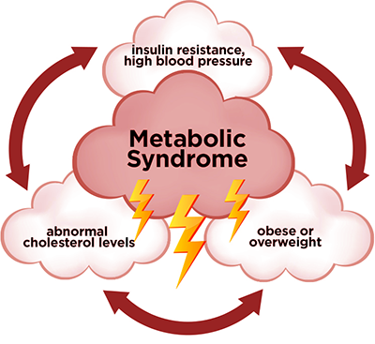
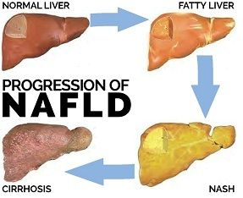
“Vicious circle”
NAFLD
Lonardo A, Adinolfi E WJG 2017

Slide 28
NAFLD is an example of ectopic fat accumulation and this lipid accumulation is accociated with secretion of diabetogenic hepatokines:
Retinol binding protein (RBP)-4
Fetuin-A
Fibroblast growth factor (FGF)-21
Inflammatory biomarkers:
C-reactive protein (CRP)
TNF-a
IL-6
directly affect risk of incident T2DM by adversely affecting hepatic gluconeogenesis, glycogen synthesis and insulin signaling.
NAFLD almost doubles the risk of incident T2D
Anstee QM et al. Nat Rev Gastroenterol Hepatol 2013; 10: 330-344
Ballestri S et al. J Gastroenterol Hepatol 2016; 31: 936-944

Slide 29
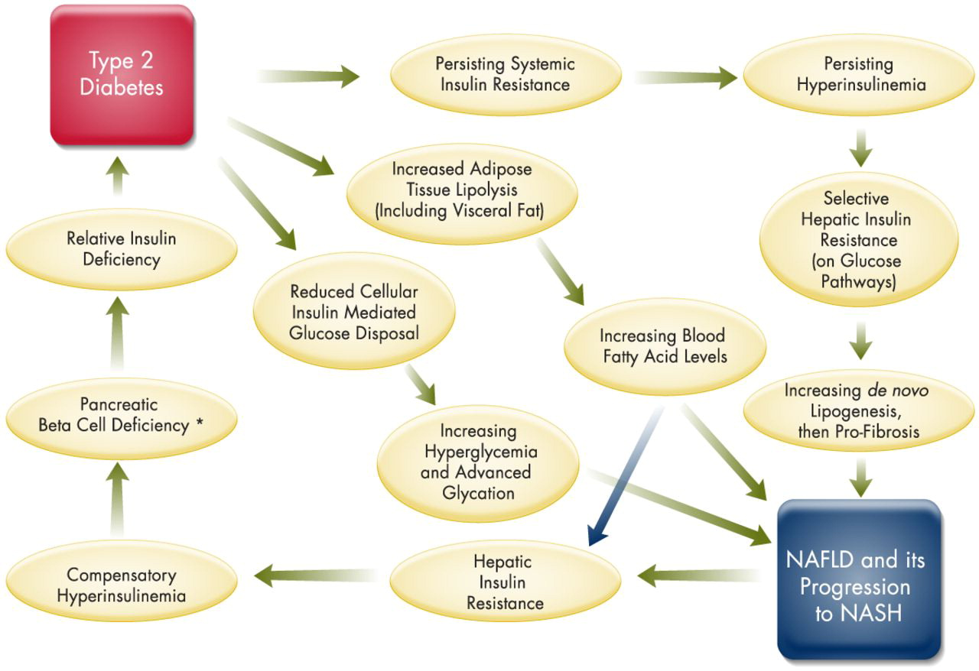
“Vicious circle”

Slide 30
NAFLD AS A MULTISYSTEM DISEASE: CARDIO-METABOLIC AND CANCER RISK
As early as 1995, was it first suggested that NAFLD was a systemic condition with a specific cardiometabolic involvement, a notion which is now universally accepted
AISF position paper on NAFLD. Dig Liver Dis 2017; 49: 471-483
Yki-Järvinen H. Lancet Diabetes Endocrinol 2014; 2: 901-910
Ma J et al.J Hepatol 2017; 66: 390-397
Zhang Y et al. BMJ Open 2015; 5: e008204

Slide 31
NAFLD patients usually die of extra-hepatic causes, frequently for cardiovascular diseases, which underpins the importance to early diagnose and aggressively treat CVD risk factors.
Lonardo A et al. Expert Rev Gastroenterol Hepatol 2015; 9: 629-650
Meta-analysis has shown a robust association between NAFLD and subclinical atherosclerosis coronary artery calcification carotid intima-media thickness impaired flow-mediated vasodilatation and arterial stiffness.
NAFLD is also associated with increased risk of atrial fibrillation and aortic valve sclerosis
Oni ET et al Atherosclerosis 2013; 230: 258-267
Targher G et al. Clin Sci(Lond) 2013; 125: 301-309
Targher G et al. PLoS One 2013; 8:e57183
Otto CM et al.. N Engl J Med 2014; 371: 744-756
Rossi A et al. Diabetes Care 2012; 35:1781-1786

Slide 32
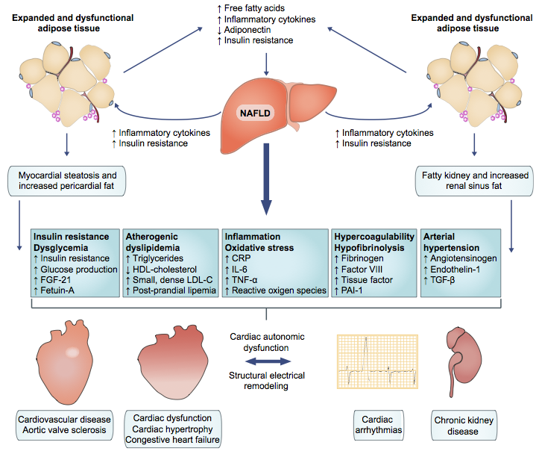

Slide 33
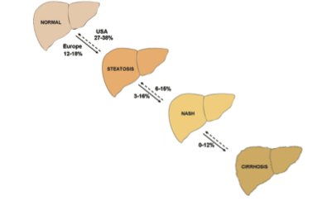
NAFLD is a slowly progressive disease but fibrosis rapidly progresses to cirrhosis in 20% of cases.
The natural history of simple steatosis was considered unremarkable
The rate of progression for 1 fibrosis stage is:
- 14 years in Steatosis (0.07/year)
- 7 years in NASH (0.14/year)
Singh S, et al: Clin Gastroenterol Hepatol 2015; 13: 643–654
HCC

Slide 34
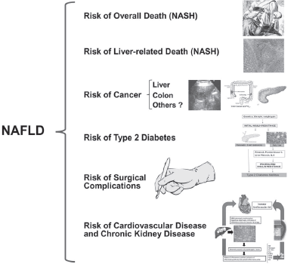

Slide 35
50% of cases HCC in NAFLD occur in the absence of cirrhosis
Awamura Y et al . American Journal of Gastroenterology 2011
Gallstones
Other NAFLD Association:
Psoriasis
Endocrine derangements: hypothyroidism
Polycystic ovarian syndrome
High prevalence of NOSA positivity in NAFLD
High-titer ANA was associated with IR

Slide 36
DIAGNOSTIC STRATEGIES
Histological examination of liver tissue specimens is the gold-standard for quantification of steatosis, direct diagnosis of NASH and staging of fibrosis
Steatosis is a prerequisite for the diagnosis of NAFLD, >5%.
The histological definition of NASH is based on a combination of three elementary lesions, i.e. steatosis, hepatocellular ballooning and lobular inflammation

Slide 37
Histological classification: what’s new?
Prosed Pathologic classifications of NAFLD: Matteoni , Brunt , Kleiner
NAFLD Activity Score (NAS)
Fatty Liver Inhibition of Progression (FLIP) algorithm with the Steatosis, Activity, and Fibrosis (SAF) score
NAS is recommended for defining and quantifying disease activity; is poorly correlated with metabolic risk factors and is unable to predict fibrosis progression and mortality
SAF score reliably for diagnose NASH, to assess disease severity and limit interobserver variation

Slide 38
Role of imaging techniques
Ultrasonography is safety, low cost, wide availability, accuracy for the diagnosis of steatosis higher than 20–30%
The controlled attenuation parameter (CAP) is a new promising screening method utilizing TE
ultrasound elastographic techniques have been implemented: acoustic radiation force impulse (ARFI) elastography, 2D shear-wave elastography and real-time strain elastography.
Magnetic resonance , particularly Magnetic Resonance Spectroscopy are truly quantitative methods for liver fat with the advantages of high sensitivity. High cost, not available

Slide 39
Serum Biomarker
Bedogni’s Fatty Liver Index (FLI): it can predict clinical outcomes related to MS
Hepatic Steatosis Index
To differentiate NASH from simple steatosis, several biomarkers (acute-phase proteins, cytokines, markers of oxidative stress and apoptosis, as is the case of cytokeratin-18 fragments) and multiple complex models have been investigated
NAFLD Fibrosis Score and Fib-4, can reliably exclude advanced fibrosis in a high proportion of NAFLD patients

Slide 40

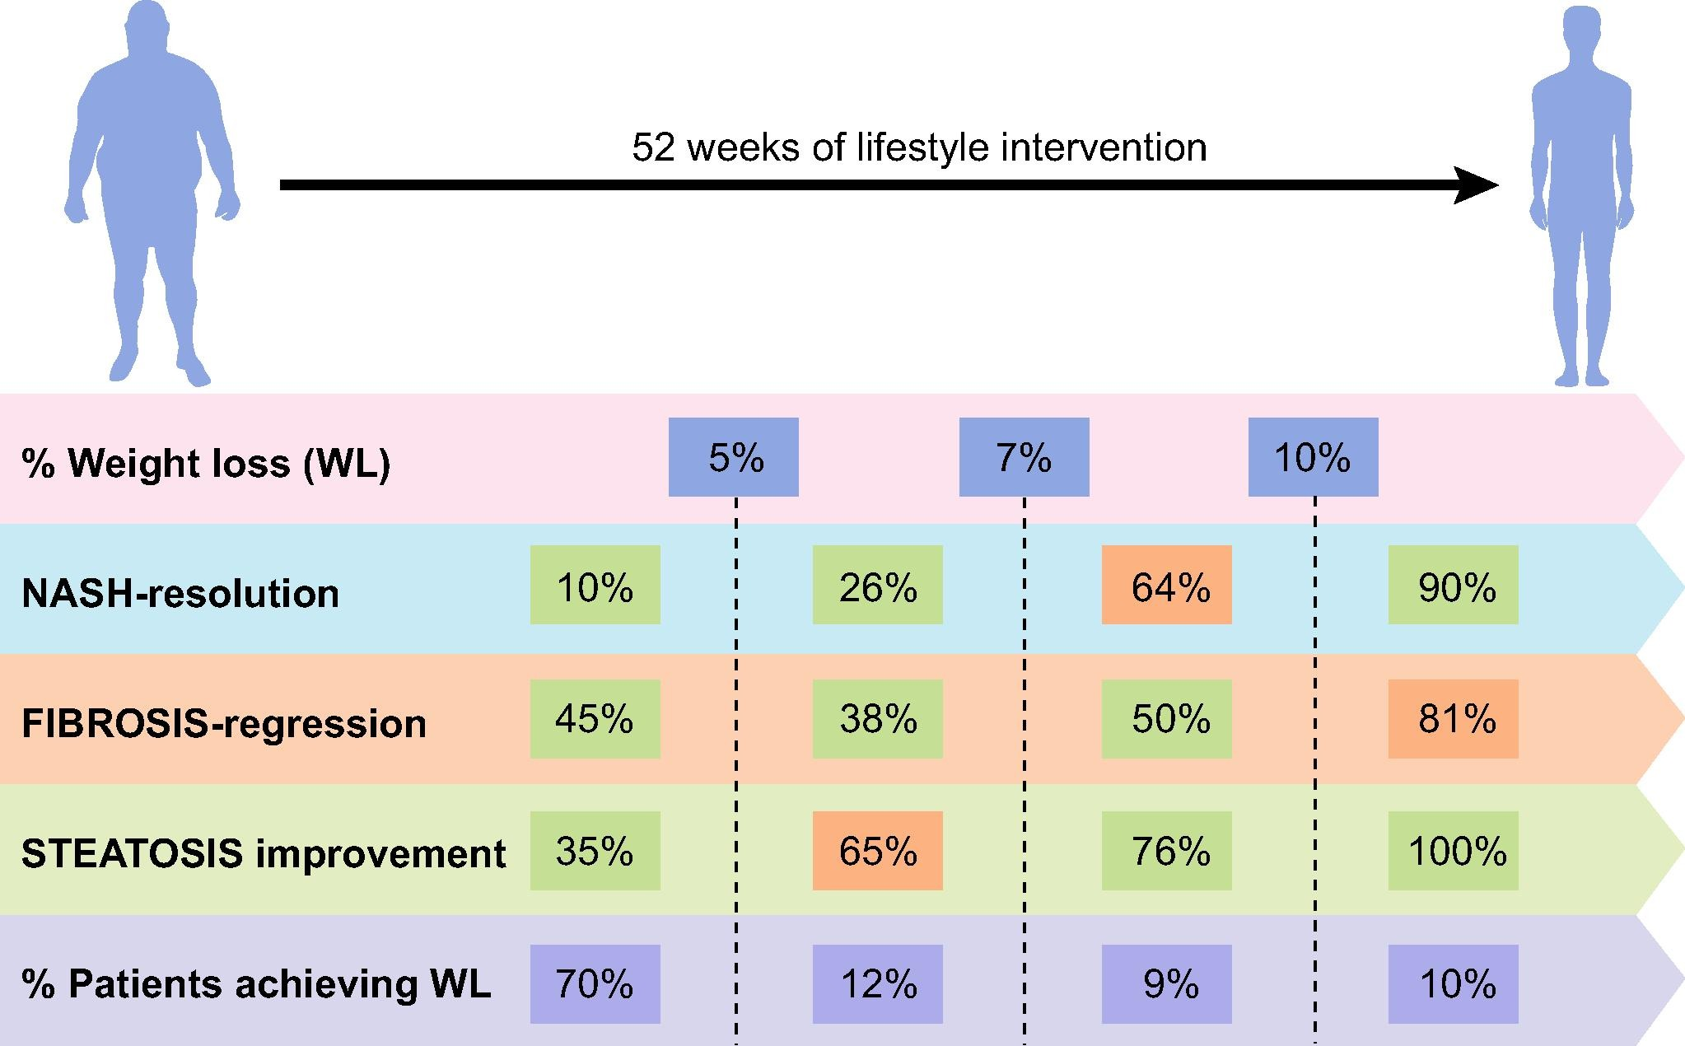
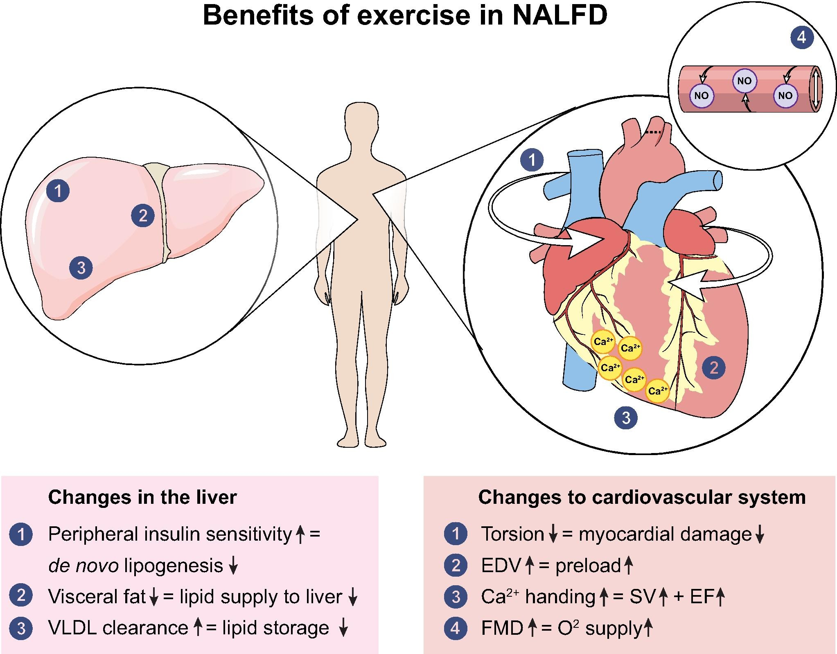
Similarity with Metabolic Syndrome
Diet and physical exercise are the mainstay of treatment of both conditions
Journal of Hepatology 2017 67, 829-846

Slide 41
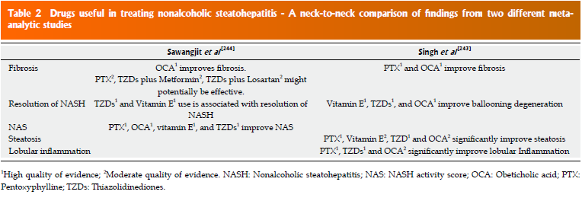
Drugs for metabolic disorders vs Specific Drugs
No drugs are specifically licensed for treatment of NAFLD
Drugs used to treat concurrent metabolic disorders (e.g., statins and antidiabetics)
Lonardo , Adinolfi et al. World J Gastroenterol 2017 September 28; 23(36): 6571-6592

Slide 42
NAFLD
Is an emerging hepatic disease
High epidemiological burden
Is both precursor and consequence of MetS and T2D
Significant morbidity and mortality
Multifaced systemic disease
Multifactorial pathogenesis
Highly prevalent in certain cohorts of individuals which are amenable to selective screening strategies, intensive follow-up schedules for early identification of liver-related and extrahepatic complications and in whom more aggressive treatment schedules should be implemented.

