Slide 1


QUINTA SESSIONE - HCV
Aspetti virologici nel fallimento terapeutico
Valeria Cento

Slide 2

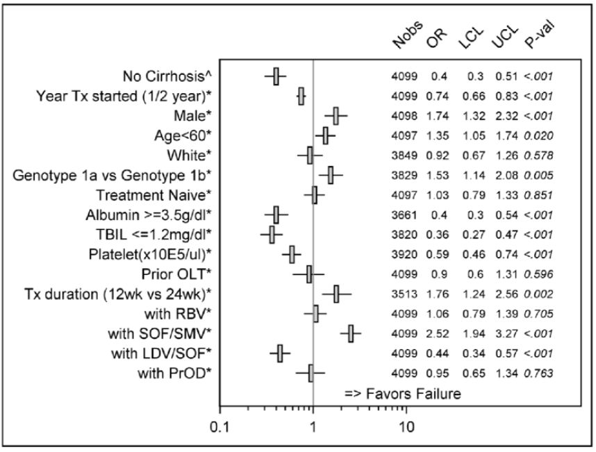
Baseline predictors of virological failure in HCV TARGET Cohort
Thinking about a DAA-failing patients, you have to expect:
Male
Cirrhotic
Low albumin
High bilirubin
Low platelet count
Treated with «subotimal» DAA combinations
Treated with short regimens
Sulkowski MS et al., EASL 2017
Notes:
Con i DAA usati finora i paramentri associati al fallimento sono sempre gli stessi, quindi non vanno trascurati.
Non è vero che non abbiamo più pazienti trattati con regimi brevi

Slide 3
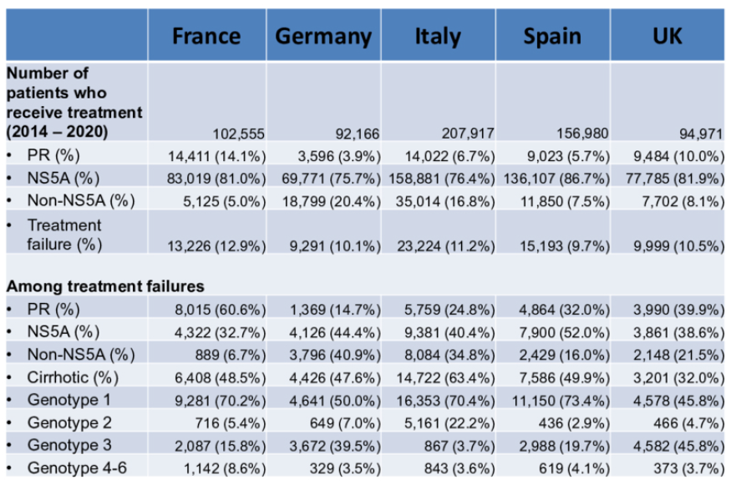
Even in the era of DAAs, ̴ 47,000 patients would fail to achieve SVR in Europe before 2020
Chhatwal J et al., EASL 2017 poster #FRI-233

Slide 4
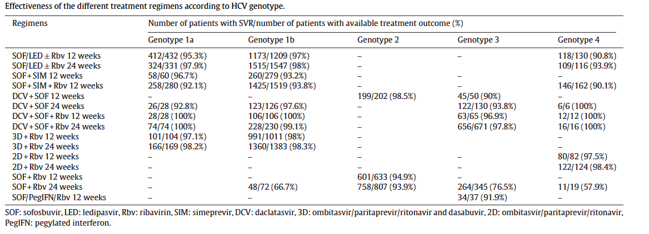
Overall real-life efficacy of DAA treatment in Italy is 95%
Data retrospectively collected within Campania, Lombardia, Sicilia and Veneto, including all CHC infected patients >18 years who consecutively received DAA-based treatment between January, 2015 and December, 2016.
23,384 patients treated → outcome available for 12,595 (54%)
SVR₁₂ rates were: 96% in GT1a (1447/1506); 97% in GT1b (7229/7482); 95% in GT2 (1558/1642); 91% in GT3 (1184/1298); and 93% in GT4 (620/667).
Viganò M. et al., DLD 2017

Slide 5
ALL 1st line DAA regimens include an NS5A inhibitor
HCV GT | Recommended Regimens
 | Treatment Naive | IFN/RBV Experienced
1a | EBR/GZR* LDV/SOF SOF/VEL | EBR/GZR* LDV/SOF + RBV SOF/VEL
1b | EBR/GZR LDV/SOF OBV/PTV/RTV/DSV ER OBV/PTV/RTV+ DSV BID SOF/VEL | EBR/GZR LDV/SOF + RBV OBV/PTV/RTV/DSV ER OBV/PTV/RTV+ DSV BID SOF/VEL
 | No Cirrhosis | Compensated Cirrhosis
2 | SOF/VEL | SOF/VEL
3 | DCV/SOF SOF/VEL | DCV/SOF ± RBV SOF/VEL ± RBV
4 | OBV/PTV/RTV + RBV SOF/VEL EBR/GZR* LDV/SOF | OBV/PTV/RTV + RBV SOF/VEL EBR/GZR* LDV/SOF ± RBV
5 or 6 | SOF/VEL LDV/SOF | SOF/VEL LDV/SOF
*Only if no baseline NS5A elbasvir RASs detected.
AASLD/IDSA. HCV guidance. April 2017.

Slide 6
67% of NS3-failures and 92% of NS5A-failures were associated with RASs emergence
RASs at failure
No RASs at failure
100%
8.1
80%
33.1
Both pre-existing and treatment-emergent NS5A RAVs show persistence >2 years post-treatment (Lahser F. et al., AASLD 2016).
59.6
60%
75.5
Prevalence (%)
91.9
40%
66.9
20%
40.4
24.5
0%
NS3
NS5A
NS5B NI
NS5B NNI
(N=133)
(N=198)
(N=261)
(N=47)
Di Maio VC et al., EASL 2017
Di Maio VC et al., accepted J Hepatol 2017
NI, Nucleotide inhibitor; NNI Non-Nucleoside Inhibitor

Slide 7
Broad Cross-Resistance With Currently Available NS5A Inhibitors
Fold Change | Genotype 1a |  |  |  | Genotype 1b
 | M28T | Q30R | L31M/V | Y93H/N | L31V | Y93H/N
Ledipasvir | 20x | > 100x | > 100x/ > 100x | > 1000x/ > 10,000x |  | > 100x/--
Ombitasvir | > 1000x | > 100x | < 3x | > 10,000x/ > 10,000x | < 10x | 20x/50x
 |  |  | > 100x
Daclatasvir | > 100x | > 1000x | > 100x/ > 1000x | > 1000x/ > 10,000x | < 10x | 20x/50x
Elbasvir | 20x | > 100x | > 10x | > 1000x/ > 1000x | < 10x | > 100x/--
 |  |  | > 100x
Velpatasvir | < 10x | < 3x | 20x/50x | > 100x/ > 1000x | < 3x | < 3x/--
Wang C, et al. Antimicrob Agents Chemother. 2012;56:1588-1590. Cheng G, et al. EASL 2012. Abstract 1172. Zhao Y, et al. EASL 2012. Abstract A845. Yang G, et al. EASL 2013. Abstract 1199. Ng T, et al. CROI 2014. Abstract 639. Asante-Appiah E, et al. AASLD 2014. Abstract 1979. Krishnan P, et al. Antimicrob Agents Chemother. 2015;59:979-987. Fridell RA, et al. Hepatology. 2011;54:1924-1935. Liu R, et al. Antimicrob Agents Chemother. 2015;59:6922-6929. Lawitz EJ, et al. Antimicrob Agents Chemother. 2016;60:5368-5378.

Slide 8
Key Clinical Questions in DAA-Experienced Paients
How did the pt fail?
What DAA classes were included in the prior regimen?
Did he/she get ribavirin, and how long were he/she treated for?
Should additional testing be done?
  What is the role of resistance testing in retreatment?
Should you wait and retreat once other treatment options are available?
  What is the chance his/her liver disease will progress?
What options are available to me (authorization considerations)?

Slide 9
In our real-life experience, 88% of 310 DAA-failures were relapsers
88.1
→ 24.3% of breakthroughs and non-responses were related to wrong GT assignments …
Prevalence (%)
6.1
5.8
Recommended DAA treatment
SMV+SOF+/-RBV (N=84)
3D+/-RBV (N=47)
2D+/-RBV (N=2)
LDV+SOF+/-RBV (N=91)
DCV+SOF+/-RBV (N=58)
SOF+RBV (N=28, HCV-2)
Di Maio VC et al., EASL 2017
Di Maio VC et al., accepted J Hepatol 2017

Slide 10
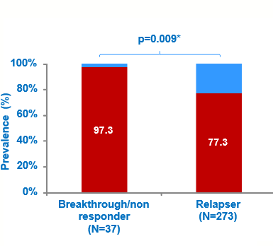
RASs prevalence at failure was significantly higher in breakthrough/non-responders
100% of patients with wrong GT-assignment presented RASs at failure
Di Maio VC et al., EASL 2017
Di Maio VC et al., accepted J Hepatol 2017

Slide 11
Relapse and resistance during DAA-based anti-HCV therapy
10⁷
77% resistance
10⁶
10⁵
Area of viral replication
under low drug
concentrations
10⁴
10³
[DAA]
HCV viral load
10²
EC₅₀
10
TND
Undetectability
threshold
Off therapy
CURE
Week 01
Week 02
Week 03
Week 04
Week 05
Week 06
Week 07
Week 08
Week 09
Week 10
Week 11
Week 12
Week +1
Week +2
Week +3
Week +4
Week +5
Week +6
Notes:
Resistenza che avviene sotto un tempo di pressione farmacologica subottimale piuttosto limitato

Slide 12
No response/Breakthrough and resistance during DAA-based anti-HCV therapy
10⁷
97% resistance
10⁶
10⁵
Area of viral replication under drug pressure
10⁴
10³
[DAA]
HCV viral load
10²
EC₅₀
10
Undetectability
threshold
TND
CURE
Off therapy
Week 01
Week 02
Week 03
Week 04
Week 05
Week 06
Week 07
Week 08
Week 09
Week 10
Week 11
Week 12
Week +1
Week +2
Week +3
Week +4
Week +5
Week +6

Slide 13
HCV … more than 100 RASs have been reported
Sorbo MC et al., manuscript submitted

Slide 14


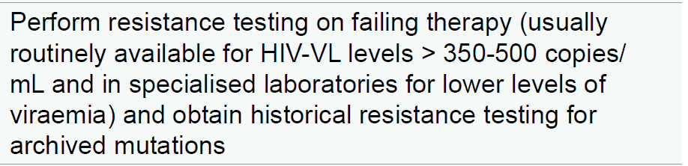


In HIV treatment, resistance testing at failure is recommended by all guidelines
    Drug-resistance testing is recommended in patients on combination ART with HIV RNA levels >1,000 copies/mL (AI). In patients with HIV RNA levels >500 copies/mL but <1,000 copies/mL, Testing may not be successful but should still be considered (DHHS adult & adolescent guidelines, 2016).
European Guidelines, 2015
Italian Guidelines, December 2015

Slide 15
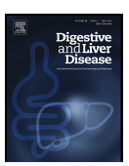
RASs at virological failure and retreatment options - Statements
Resistance testing after treatment failure in all 3 genes (NS3, NS5A, NS5B [for the two different classes of nucleoside and non-nucleoside inhibitors] independently from the failure regimen) is mandatory in order to optimize retreatment strategy.
HCV sequencing can be based on Sanger population method or by ultra-deep sequencing using a cut-off of 15% prevalence. It can confirm the previous genotype and subtype assignment, but can also attribute a different HCV-genotype highlighting cases of previous wrong genotype assignation by commercial assays or occurrence of potential re-infection instead of virological relapse, avoiding then inappropriate retreatment regimens.
Resistance testing should be performed as soon as possible after documentation of failure, provided that HCV RNA has reached a value of at least 1000 IU/mL, according to the threshold limits for virology laboratories for HCV sequencing.
Clinical and virological information required for resistance test performance and interpretation should be provided contextually with blood samples.
Viganò M, Perno CF, and Craxì A on behalf of AdHoc Working Party, Dig Liv Dis 2017

Slide 16
NS5A RASs Associated With Retreatment Failure With a
Cross-Resistant Regimen
8-wk or 12-wk LDV/SOF-based treatment failures retreated with LDV/SOF for 24 wks (N = 41)
SVR12 (%)
SVR12 (%)
n/N =
29/41
11/11
18/30
n/N =
5/5
4/5
2/6
All
No
Yes
BL NS5A RASs
BL RASs
Lawitz E, et al. EASL 2015. Abstract O005.

Slide 17
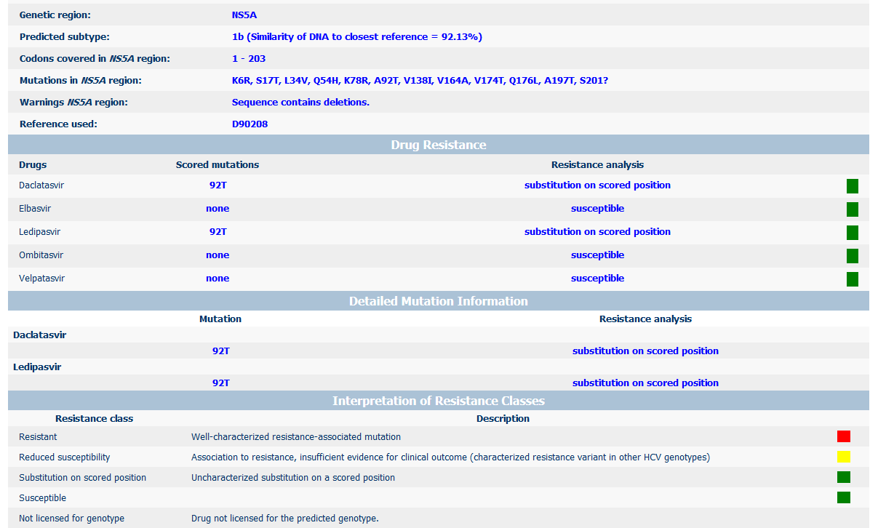
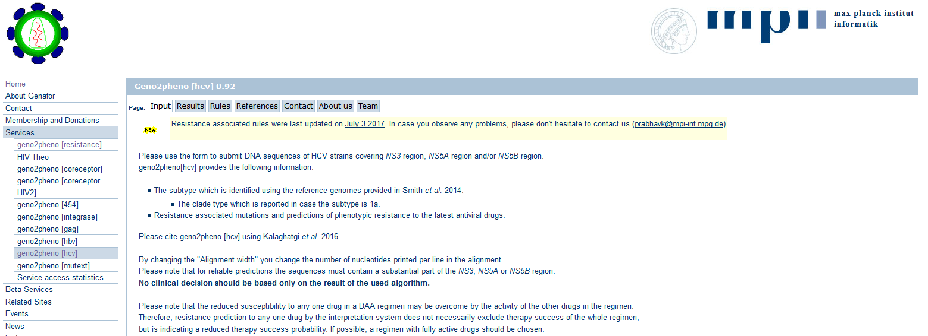
Retreatment framework for GT1 DAA failures
GT1
DAA failure
Consider waiting, even if cirrhotic
Genotypic resistance testing
New therapies Q2 2017:
GLE/PIB
SOF/VEL/VOX
http://hcv.geno2pheno.org/index.php

Slide 18
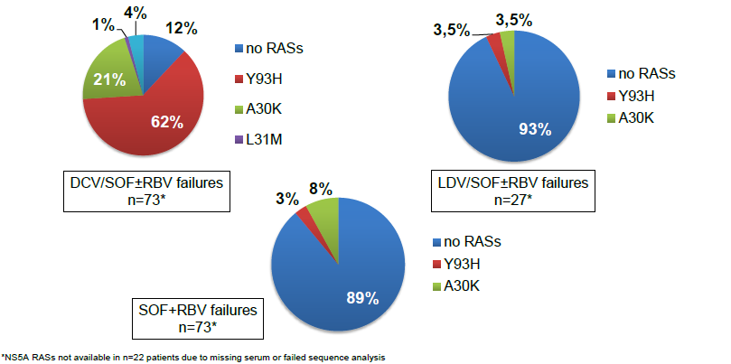
Y93H RAS is commonly observed after NS5Ai-failure, making retreatment challenging
Vermehren J et al., EASL 2017

Slide 19
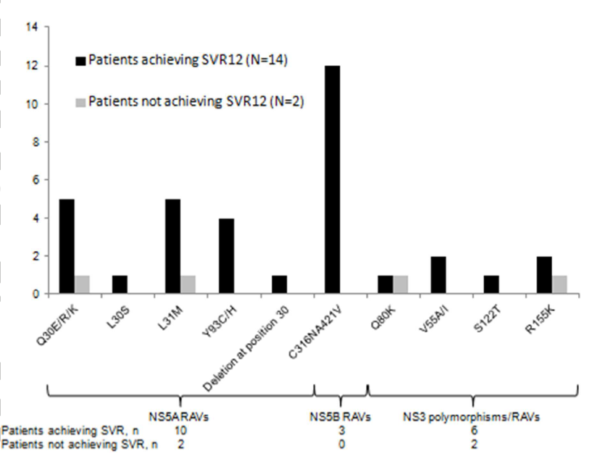
To avoid cross-resistance, patients who have failed an NS5A inhibitors may be retreated with sofosbuvir combined with simeprevir
Real world study of 16, NS5A-experied patients, re-treated for 12 weeks with sofosbuvir plus simeprevir, without ribavirin.
- SVR was achieved in 14/16 (88%) patients.
Hezode C, Hepatology 2016; AASLD/IDSA guidelines, December 2015

Slide 20
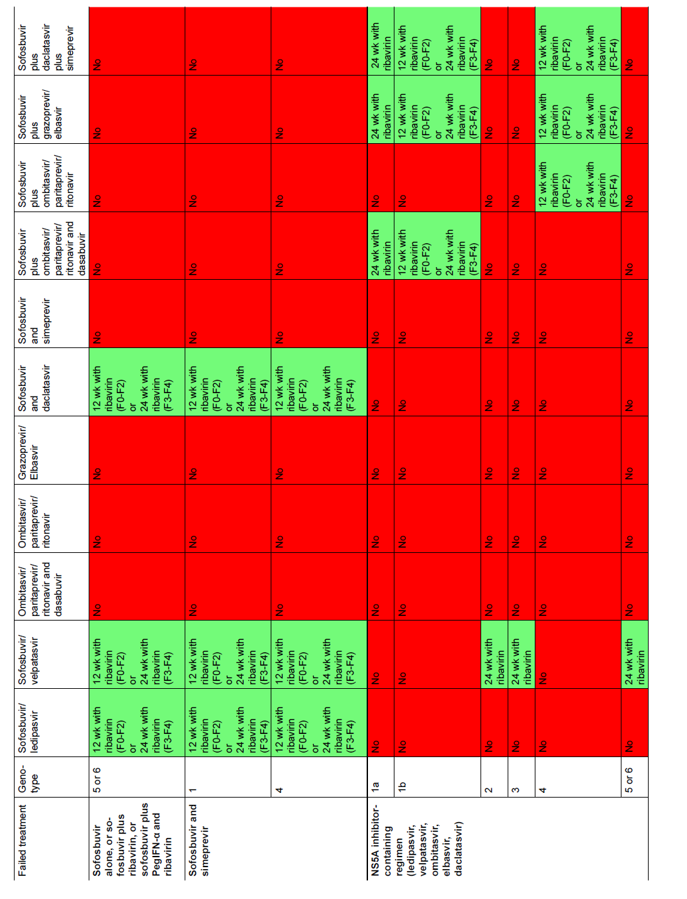
Roles of RBV and Longer Tx Duration in Overcoming Resistance in DAA-experienced pts Treated with VEL/SOF
Single-arm trial
Cirrhosis: 26%; previous relapse: 99%
Only 18% of GT1 with NS5A RASs
Previous treatment: 41% VEL 25 mg, 74% < 12 wks
Overall SVR₁₂: GT1 (n = 34): 97%; GT2 (n = 14): 91%; GT3 (n = 17): 76%
100
100
100
100
Wk 24
100
96
HCV-infected pts without SVR in previous phase II trials of SOF/VEL (n = 41) or SOF/VEL + VOX (n = 28)
SOF/VEL 400/100 mg + RBV
(N = 69)
77
80
60
SVR12 (%)
40
20
n/N =
27/28
6/6
5/5
8/8
3/3
10/13
0
NS5A
RASs:
No
Yes
No
Yes
No
Yes
Gane EJ, et al. EASL 2016. Abstract PS024
EASL Recommendations on Treatment of Hepatitis C 2016
GT1
GT2
GT3

Slide 21
Retreatment of Previous Short Duration SOF + EBR/GZR Failure
25 pts who experienced failure of short course SOF + EBR/GZR (4-8 wks)
  22 GT1a, 3 GT1b
    20 experienced failure with 4 wks
  5 (20%) cirrhosis
  80% with NS5A RASs
  52% NS3 RASs
  44% NS3/NS5A RASs
100
100
100
100
100
100
100
100
80
60
SVR12, % (95% CI)
40
20
n/N =
23/
23
18/
18
5/
5
15/
15
8/
8
5/
5
18/
18
0
All
No
Yes
4 Wks
6 or 8 Wks
No
Yes
Pts retreated with SOF + EBR/GZR + RBV for 12 wks
100% SVR12 (9/9) in pts with dual RASs
Cirrhosis
Previous
Treatment Duration
Baseline
NS5A
RASs
Lawitz E, et al. AASLD 2015. Abstract LB-12.

Slide 22
QUARTZ-I: OBV/PTV/RTV + DSV + SOF ± RBV for DAA-Experienced Pts With GT1 HCV
Wk 12
Wk 24
Noncirrhotic GT1a
OBV/PTV/RTV + DSV
+ SOF + RBV
(n = 14)
100
100
100
95
93
Cirrhotic
GT1a
OBV/PTV/RTV + DSV + SOF + RBV
(n = 6)
80
GT1b
±cirrhosis
OBV/PTV/RTV + DSV
+ SOF
(n = 2)
60
SVR12 (%)
40
Multicenter, open-label phase II study
14/20 GT1a had previous OBV/PTV/RTV + DSV failure; no previous LDV/SOF failure
BL RASs: D168E/V (n = 5); Y93C/F/H (4); Q30E/H/R (n = 12)
20
0
All
GT1a
No Cirrhosis
GT1a
Cirrhosis
GT1b
±cirrhosis
Poordad F, et al. EASL 2016. Abstract SAT-156.
Notes:
BL, baseline; DAA, direct-acting antiviral; DSV, dasabuvir; GT, genotype; LDV, ledipasvir; OBV, ombitasvir; PTV, paritaprevir; RAS, resistance-associated substitution; RBV, ribavirin; RTV, ritonavir; SOF, sofosbuvir.

Slide 23
Retreatment framework for GT1 DAA failures
GT1
DAA failure
Consider waiting, even if cirrhotic
Genotypic resistance testing
New therapies Q2 2017:
GLE/PIB
SOF/VEL/VOX
16/24 wk failure?
NO
YES
SOF-based triple or quad regimens
Or
wait for
GLE/PIB or
SOF/VEL/VOX
No NS5A RASs
NS5A RASs
NS3 (R155, A156, D168)
+ NS5A RASs
For 2-drug regimens:
1. Increase duration
2. Add RBV
LDV/SOF + RBV (24)
SOF/VEL + RBV (24)
SMV + SOF + RBV (24)
SOF/VEL + RBV (24)
(esp if no L31M, Y93H)
SOF quad/triple
SOF/VEL + RBV (24)
(esp if no L31M, Y93H)
SOF quad/triple

Slide 24
The Y93H was the most prevalent RAS detected in GT-3 patients after NS5Ai-failure
p<0.001
88.7
83.3
RASs prevalence (%)
p=0.43
p=0.30
16.7
13.2
3.5
3.8
5.8
4.7
0.6
Median sampling time point after EOT (weeks):
3D+/-RBV: 5.4 (1.3-10.6)
DCV+SOF+/-RBV: 16.0 (10.1-20.7)
Barbaliscia S. et al., ICAR 2017

Slide 25
Roles of RBV and Longer Tx Duration in Overcoming Resistance (?) in DAA-experienced pts Treated with VEL/SOF
Single-arm trial
Cirrhosis: 26%; previous relapse: 99%
Only 18% of GT1 with NS5A RASs
Previous treatment: 41% VEL 25 mg, 74% < 12 wks
Overall SVR₁₂: GT1 (n = 34): 97%; GT2 (n = 14): 91%; GT3 (n = 17): 76% → 82% in pts with Y93H
100
100
100
100
Wk 24
100
96
HCV-infected pts without SVR in previous phase II trials of SOF/VEL (n = 41) or SOF/VEL + VOX (n = 28)
SOF/VEL 400/100 mg + RBV
(N = 69)
77
80
60
SVR12 (%)
40
20
n/N =
27/28
6/6
5/5
8/8
3/3
10/13
0
NS5A
RASs:
No
Yes
No
Yes
No
Yes
Gane EJ, et al. EASL 2016. Abstract PS024
EASL Recommendations on Treatment of Hepatitis C 2016
GT1
GT2
GT3
Notes:
GT, genotype; QD, once daily; RAS, resistance-associated substitutions; RBV, ribavirin; SOF, sofosbuvir; SVR, sustained virologic response; VEL, velpatasvir; VOX, voxilaprevir.
This is another study looking at patients who experienced failure of sofosbuvir/velpatasvir, many of whom had received short-duration treatment. In addition, 41% had received a lower dose of velpatasvir and 74% had received less than 12 weeks of treatment, neither of which would be approved right now. So this may not be fully applicable to the patient who experiences failure of 12 weeks of standard-dose sofosbuvir/velpatasvir. These are probably easier patients to retreat because they got suboptimal sofosbuvir/velpatasvir therapy the first time.
But in this trial, the investigators retreated all these patients with sofosbuvir/velpatasvir going to 24 weeks and now adding in ribavirin, so they got 24 weeks of retreatment with ribavirin. And the results showed high SVR rates with just retreating with the same regimen but extending duration and adding ribavirin, 96% to 100% in genotype 1 HCV infection depending on whether they had resistance at baseline, but very high. You can see it did fall off a little bit in the genotype 3 patients with baseline resistance, 77% SVR rate there.

Slide 26
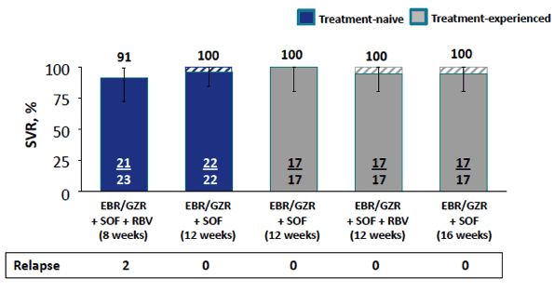
C-ISLE: SVR With EBR/GZR + SOF ± RBV for GT3 HCV in Pts With Compensated Cirrhosis
mFAS*
Prevalence of NS5A RASs
100
98
100
98
80
80
60
60
SVR (%)
RASs
51%
(n = 49)
No RASs
49%
(n = 47)
40
40
*Modified full analysis set excludes discontinuations not related to study drugs. 3 pts discontinued for administrative reasons.
20
20
n/N =
48/
49
n/N =
46/
47
High SVR rates in treatment-experienced, cirrhotic pts with GT3, but no NS5A-experienced pts included
0
0
NS5A RASs Present
NS5A RASs Absent
Foster GR, et al. AALSD 2016. Abstract 74.
Notes:
EBR, elbasvir; GT, genotype; GZR, grazoprevir; mFAS, modified full analysis set; pegIFN, peginterferon; RAS, resistance-associated substitutions; RBV, ribavirin; SOF, sofosbuvir; SVR, sustained virologic response.
And they did very well if they had baseline resistance substitutions, but again, these were not NS5A inhibitor–experienced patients so really doesn’t specifically address the case patient we have been considering.
In summary, it is important to know that resistance is not the only determinant in how you’re going to retreat a patient; you have to look at all other factors. And I think the place where we really are still very limited is in decompensated cirrhotic patients who have experienced failure of DAA regimens because they’re not going to be helped out by these coming approvals because you really should not be using a protease inhibitor in decompensated patients. Otherwise, I think waiting for new regimens expected soon when you can safely do so is a reasonable approach for patients who have experienced DAA failure.

Slide 27
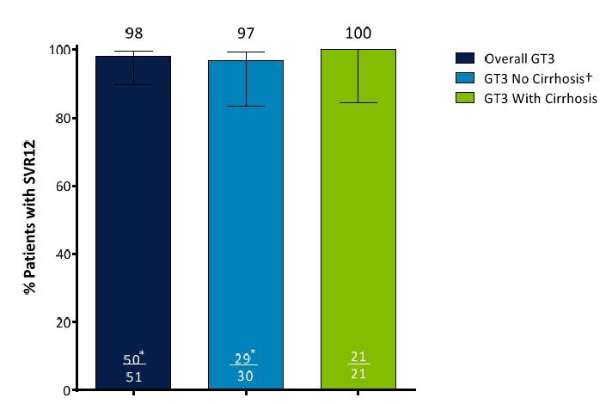
QUARTZ II-III: SVR With OBT/PTV/r + SOF ± RBV for 12 weeks in GT3 HCV pts
High SVR rates in treatment-experienced, cirrhotic/non cirrhotic pts with GT3, but no NS5A-experienced pts included
Shafran S. et al., J Hepatology 2017
Notes:
EBR, elbasvir; GT, genotype; GZR, grazoprevir; mFAS, modified full analysis set; pegIFN, peginterferon; RAS, resistance-associated substitutions; RBV, ribavirin; SOF, sofosbuvir; SVR, sustained virologic response.
And they did very well if they had baseline resistance substitutions, but again, these were not NS5A inhibitor–experienced patients so really doesn’t specifically address the case patient we have been considering.
In summary, it is important to know that resistance is not the only determinant in how you’re going to retreat a patient; you have to look at all other factors. And I think the place where we really are still very limited is in decompensated cirrhotic patients who have experienced failure of DAA regimens because they’re not going to be helped out by these coming approvals because you really should not be using a protease inhibitor in decompensated patients. Otherwise, I think waiting for new regimens expected soon when you can safely do so is a reasonable approach for patients who have experienced DAA failure.

Slide 28
Retreatment framework for GT3 DAA failures
GT3
DAA failure
Consider waiting, even if cirrhotic
Genotypic resistance testing
New therapies Q2 2017:
GLE/PIB
SOF/VEL/VOX
24 wk failure?
NO
YES
SOF-based triple regimens
Or
wait for
GLE/PIB or
SOF/VEL/VOX
No NS5A RASs
NS5A RASs
SOF/VEL + RBV (24)
SOF/VEL + RBV (24)
(esp if no Y93H)
SOF triple
For 2-drug regimens:
1. Increase duration
2. Add RBV

Slide 29

New pan-genotypic regimens are on their way to the market
Regimen | NS5B Polymerase Nucleotide Inhibitor (. . . buvir) | NS3/4A Protease Inhibitor (. . . previr) | NS5A Inhibitor (. . . asvir)
Sofosbuvir/velpatasvir/voxilaprevir | SOF | VOX | VEL
Glecaprevir/pibrentasvir | -- | GLE | PIB
Grazoprevir/ruzasvir/uprifosbuvir | UPR | GZR | RZR
AL-335 + odalasvir + simeprevir | AL-335 | SMV | ODV

Slide 30
HCV Resistance Issue After Failure: is it going to change with new DAAs?
Type of RASs
Number of RASs
Y93H
GT-3
Combinations of RASs

Slide 31
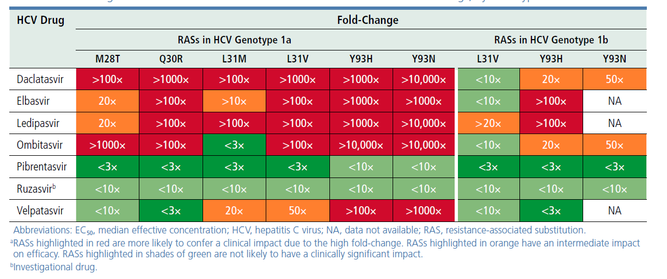
Not all NS5A RASs are created equal
Type of RASs
Wyles DL et al., HCV Drug Resistance, 2017

Slide 32
73/198 (36.9%) of NS5A-failing patients presented >2 NS5A-RASs
Number of RASs
2 or more NS5A RASs
1 NS5A RAS
No NS5A RASs
100%
1.4
10.9
4.1
80%
31.5
31.6
66.7
60%
60.9
RASs prevalence at failure
81.6
100
100
100
40%
52.6
67.1
20%
28.3
33.3
14.3
15.8
0%
HCV-1a
HCV-1b
HCV-2c
HCV-3a
HCV-3h
HCV-4a
HCV-4d
HCV-4v
(N=46)
(N=73)
(N=6)
(N=49)
(N=1)
(N=3)
(N=19)
(N=1)
Di Maio VC et al., EASL 2017

Slide 33
Efficacy of NS5A-retreatment is reduced by baseline presence of NS5A-RASs
(natural or derived by NS5Ai-exp)
P=0.015
100
90
85.5
80
70
66.7
SVR₁₂ (%)
60
50
42.9
40
30
20
10
47/55
6/9
3/7
0
No NS5A RASs
Only 1
NS5A RAS
More than 1
NS5A RASs
P-value was calculated by Fisher exact test.
Cento V et al., update from EASL 2017
Notes:
Eventualmente splittare in gt1a, 1b e 3

Slide 34
Sofosbuvir/Velpatasvir/Voxilaprevir for GT1 HCV Pts Who Failed on DAA Therapy
Wk 12
SVR12
Randomized, open-label phase II trial
Baseline characteristics
  Noncirrhotic, 49%;
  Compensated cirrhosis, 51%
  NS5A-experienced, 41%
Pts with GT1 HCV (HCV RNA ≥ 10,000 IU/mL), who have received previous HCV DAA treatment for a duration of >6 weeks, with compensated cirrhosis (platelet cutoff of 75,000 µL, no Child-Pugh B and C) or without cirrhosis
(N = 49)
SOF/VEL/VOX QD
(n = 24)
100% (24/24)
SOF/VEL/VOX + RBV QD
(n = 25)
96% (24/25)
Fixed-dose combination of sofosbuvir-velpatasvir-voxilaprevir (400, 100, and 100 mg) once daily with or without weight-adjusted RBV (1,000 or 1,200 mg/day) administered twice-daily.
100
97
98
100
100
80
SVR12 (%)
60
40
20
n/N =
144/
148
89/
91
33/
33
16/
16
0
1
2
3
4
Sarrazin, et al. EASL 2017. Abstract THU-248.
Lawitz E. et al., Hepatology 2017
Number of RASs

Slide 35
26.6% DAA-failing patients showed double-class NS3+NS5A RASs
Combinations of RASs
No RASs
100
RASs in 1 DAA target
100
RASs in 2 DAA targets
RASs in 3 DAA targets
RASs in 4 DAA targets
80
79.4
60
RASs prevalence (%)
50.0
42.9
41.8
42.5
40
39.3
29.8
33.0
21.4
21.3
23.4
20
8.6
8.6
8.8
10.9
8.5
7.1
3.6
5.9
5.5
4.3
0
1.7
1.7
SOF+RBV
(N=28)
SMV+
SOF ± RBV
(N=84)
DCV+
SOF ± RBV
(N=58)
LDV+
SOF ± RBV
(N=91)
3D ± RBV
(N=47)
2D ± RBV
(N=2)
Di Maio VC et al., EASL 2017

Slide 36
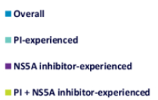
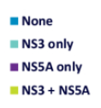
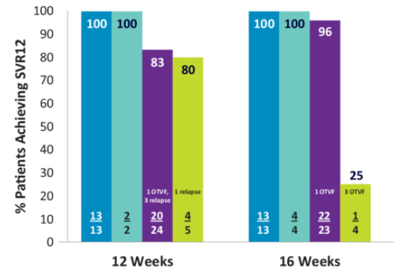
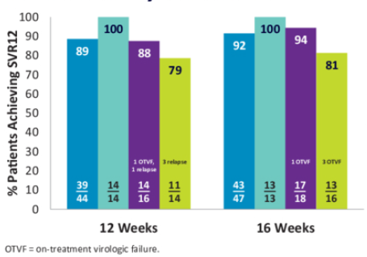
MAGELLAN-I: efficacy of glecaprevir/pibrentasvir in DAA-experienced patients can be reduced by double-class RASs
SVR₁₂ rate by prior DAA-experience
SVR₁₂ rate by baseline RASs
Pilot-Matias T. et al., EASL 2017 poster #SAT-204

Slide 37
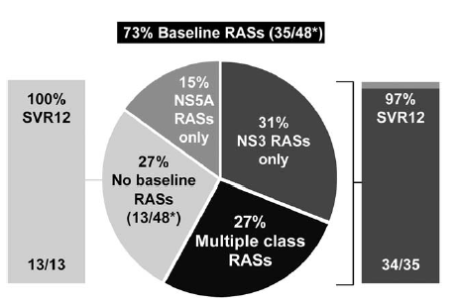
Sofosbuvir/Velpatasvir/Voxilaprevir for GT1 HCV Pts Who Failed on DAA Therapy
Randomized, open-label phase II trial
Baseline characteristics
  Noncirrhotic, 49%; compensated cirrhosis, 51%
  NS5A-experienced, 41%
  NS5A RASs only, 15%; NS3 RASs only, 31%; Multiple class RASs, 27%
Wk 12
SVR12
Pts with GT1 HCV (HCV RNA ≥ 10,000 IU/mL), who have received previous HCV DAA treatment for a duration of >6 weeks, with compensated cirrhosis (platelet cutoff of 75,000 µL, no Child-Pugh B and C) or without cirrhosis
(N = 49)
SOF/VEL/VOX QD
(n = 24)
100% (24/24)
SOF/VEL/VOX + RBV QD
(n = 25)
96% (24/25)
Fixed-dose combination of sofosbuvir-velpatasvir-voxilaprevir (400, 100, and 100 mg) once daily with or without weight-adjusted RBV (1,000 or 1,200 mg/day) administered twice-daily.
Lawitz E. et al., Hepatology 2017

Slide 38
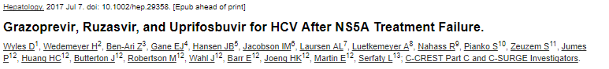
C-SURGE
GT1 patients who failed treatment with LDV/SOF or GZR/EBR. Overall, 43% were cirrhotic, 86% had GT1a infection. At baseline, NS5A RASs were present in 31/43 (72%) and 46/49 (94%) participants in the 16- and 24-weeks arms, respectively; 38% had 2 NS5A RASs, 4% had ≥3 NS5A RASs, and 55% had NS5A and NS3 RASs. Y93 polymorphisms were present in 17/43 (40%) participants in the 16-week arm and 28/49 (57%) participants in the 24-week arm.
C-CREST
24 patients underwent retreatment: 23 were F0-F2, 2 had GT1 infection, 14 had GT2 infection, and 8 had GT3 infection. At baseline, 19 (83%) had NS5A RASs, and 20 (87%) had RASs in ≥2 regions, including 19 (83%) participants with RASs in both NS3 and NS5A regions. 5/8 GT3 patients had Y93H.
NS5A
NS3
NS5A
NS3
Wyles D. et al., Hepatology, 2017

Slide 39
POLARIS-1 and -4: Impact of Baseline RASs on 12-Wk SOF/VEL/VOX in DAA-Experienced Pts
Y93H
GT-3
Integrated analysis of data from SOF/VEL/VOX arms of 2 phase III trials of DAA-experienced pts with (n = 263) and without (n = 182) previous NS5A inhibitors
Baseline RASs:
None
Any
NS3 only
NS5A only
NS3 + NS5A
100
98
99
100
100
97
100
100
100
100
100
99
100
100
97
97
94
94
80
60
SVR12 (%)
40
20
n/N =
41/42
173/
175
45/45
59/59
69/71
8/
8
23/23
3/
3
23/23
3/
3
69/70
50/53
47/50
2/
2
9/
9
36/37
31/32
0
1
2
3
4-6
Genotype
Sarrazin, et al. EASL 2017. Abstract THU-248.

Slide 40

SURVEYOR-II, Part 3: SVR12 Rates With GLE/PIB for Pts With GT3 HCV ± Cirrhosis
100
91
96
98
96
80
60
High SVR rates in treatment-experienced, cirrhotic pts with GT3, but no NS5A-experienced pts included
SVR12 (%)
40
20
n/N =
20/22
21/22
39/40
45/47
0
Tx Wks
Cirrhosis
Tx Experienced
Breakthrough
Relapse
LTFU
12
-
+
0
2
0
16
-
+
0
1
0
12
+
-
0
0
1
16
+
+
1
1
0
Wyles DL, et al. AASLD 2016. Abstract 113.
Slide credit: clinicaloptions.com
Notes:
GLE, glecaprevir; GT, genotype; HCV, hepatitis C virus; LTFU, lost to follow-up; PIB, pibrentasvir; SVR, sustained virologic response; Tx, treatment.
But, again, not NS5A inhibitor experienced, so it really doesn’t apply to our case patient.

Slide 41
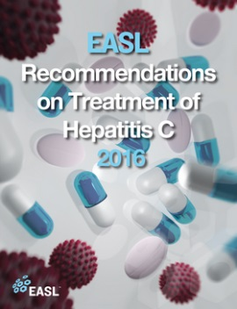
Contraindications to therapy:
Treatment regimens comprising an NS3-4A protease inhibitor, such as simeprevir, ritonavir-boosted paritaprevir or grazoprevir, should not be used in patients with Child-Pugh B decompensated cirrhosis or with compensated cirrhosis but with previous episodes of decompensation and are contraindicated in patients with Child-Pugh C decompensated cirrhosis, because of the substantially higher protease inhibitor concentrations in these patients.
EASL GUIDELINES 2016
Notes:
Se un child-A diventa un child-B, non lo tratto perché rischio, o lo tratto perché lo potrei riportare a Child-A?

Slide 42



Which Role for a Virologist in DAAs (Failures) Era?
HCV-genotype and subtype.
Natural resistance: drug-specific RASs, 15% cut-off. Baseline NS5A RASs affect response:
  LDV/SOF – GT1a, all TE and TN with cirrhosis
  GZR/EBR – all GT1a
  SOF/VEL & SOF/DAC – GT3 cirrhosis
  Future regimens: Y93H in GT-3 will probably reduce SVR rate to (some) short regimens/TE patients.
  HCV-genotype and subtype. Re-testing HCV genotype after an “usual” failure may provide unexpected results …
  Resistance after DAA failure: resistance test should be performed in all 3 genes NS3 + NS5A + NS5B. Treatment decisions in patients with RASs.

Slide 43

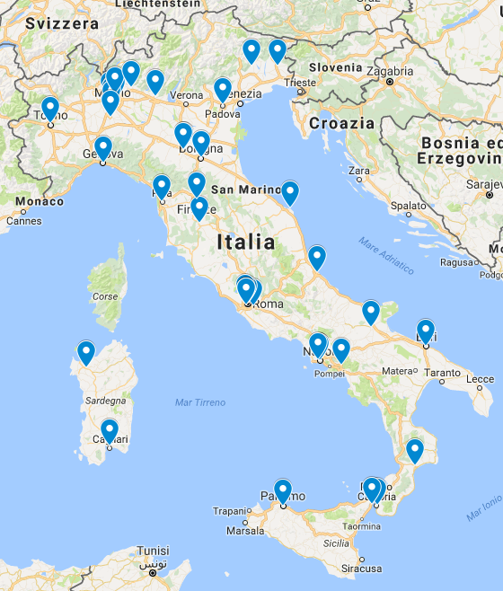
HCV Virology Italian Resistance Network Study Group: VIRONET-C
VIRONET-C BOARD: F Ceccherini-Silberstein (President), A Craxì (President), M Andreoni, CF Perno, M Puoti, M Zazzi.
STEERING COMMITTEE: S Bonora, M Brunetto, A Callegaro, MR Capobianchi, V Cento, G Gaeta, G Raimondo, T Santantonio.
PARTICIPATING VIROLOGISTS and PHYSICIANS: A Aghemo (Milano); A Alberti (Padova); A Ammassari (Roma); P Andreone (Bologna); M Andreoni (Roma); G Angarano (Bari); M Angelico (Roma); G Antonelli (Roma); S Babudieri (Sassari); P Bagnarelli (Ancona); F Baldanti (Pavia); G Barbarini (Pavia); B Bartolini (Roma); ML Biondi (Milano); E Boeri (Milano); S Bonora (Torino); V Borghi (Modena); M Brunetto (Pisa); R Bruno (Pavia); S Bruno (Milano); B Bruzzone (Genova); F Caccuri (Brescia); AP Callegaro (Bergamo); V Calvaruso (Palermo) MR Capobianchi (Roma); N Caporaso (Napoli); G Cariti (Torino); A Caruso (Brescia); F Ceccherini-Silberstein (Roma); V Cento (Roma); A Ciaccio (Monza); A Ciancio (Torino); A Cingolani (Roma); M Clementi (Milano); N Coppola (Napoli); A Craxì (Palermo); N Cuomo (Napoli); A D’Arminio Monforte (Milano); E Degasperi (Milano); A de Luca (Siena); M Di Stefano (Foggia); G D’Offizi (Roma); C Ferrari (Parma); A Focà (Catanzaro); G Foti (Reggio Calabria); S Galli (Bologna); GB Gaeta (Napoli); E Galmozzi (Milano); AR Garbuglia (Roma); W Gennari (Modena); V Ghisetti (Torino); A Giacometti (Ancona); A Giorgini (Milano); A Gori (Monza); A Grieco (Roma); A Lai (Milano); P Lampertico (Milano); M Levrero (Roma); R Lionetti (Roma); F Maggiolo (Bergamo); S Malandrin (Monza); N Marascio (Catanzaro); S Marenco (Genova); C Mastroianni (Latina), S Menzo (Ancona); V Micheli (Milano); L Monno (Bari); F Morisco (Napoli); G Morsica (Milano); C Mussini (Modena); LA Nicolini (Genova); S Paolucci (Pavia); S Parisi (Padova); G Parruti (Pescara); C Pasquazzi (Roma); A Pellicelli (Roma); MO Pensi (Terni-Foligno); CF Perno (Roma); M Persico (Salerno); S Petta (Palermo); E Polilli (Pescara); T Pollicino (Messina); ML Ponti (Cagliari); G Portella (Napoli); M Puoti (Milano); G Raimondo (Messina); MC Re (Bologna); M Rendina (Bari); G Rizzardini (Milano); D Romagnoli (Baggiovara); T Ruggiero (Torino); MG Rumi (Milano); FP Russo (Padova); M Sanguinetti (Roma); R Santangelo (Roma); T Santantonio (Foggia); V Sangiovanni (Napoli); M Siciliano (Roma); A Soria (Monza); L Sticchi (Genova); M Strazzabosco (Monza); G Taliani (Roma); G Tarantino (Ancona); P Toniutto (Udine); C Torti (Catanzaro); ML Vatteroni (Pisa); M Viganò (Milano); V Vullo (Roma); S Zanussi (Aviano, Pordenone); M Zazzi (Siena); AL Zignego (Firenze); M Zuin (Milano).

Slide 44
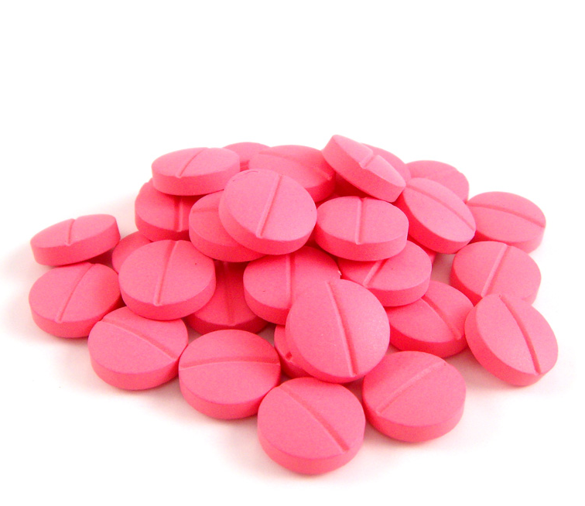
“Viral”, “patient” and “treatment” parameters have to be taken into account for possible DAA failure
Liver status
HCV Genotype and Subtype
RBV use
Clinical evaluation
HCV-RNA
DAAs
Treatment duration
Comorbidities
Resistance
Adherence

Slide 45
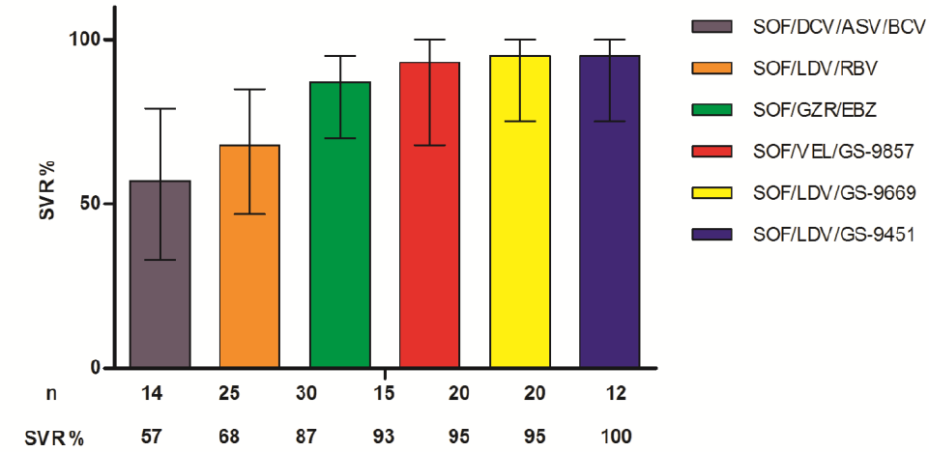
No one-size-fits-all: 6 weeks DAA therapies in GT1
Several small studies have demonstrated the feasibility of 6 weeks of SOF therapy in combination with an NS5A inhibitor and a protease inhibitor for HCV GT 1 … but with variable efficacy.
El Sherif O et al., J Viral Hepat. 2017

Slide 46
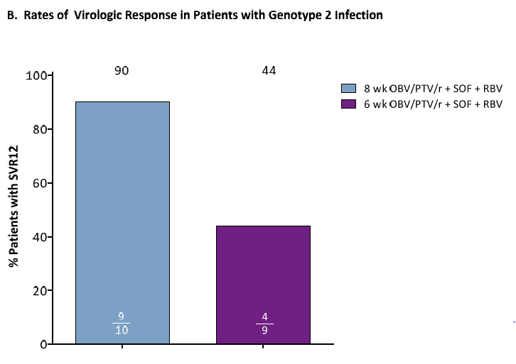
In GT2 patients without cirrhosis, 6 week treatment with OBV/PTV/r + SOF with RBV resulted in an SVR12 rate of 44%
Shafran S. D. et al., J Viral Hepat. 2017

Slide 47
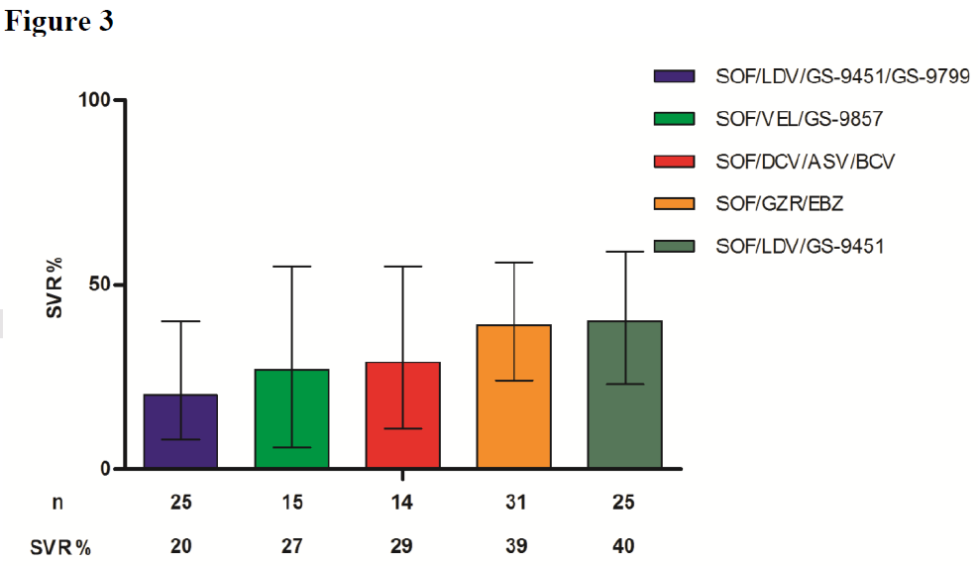
4 weeks of therapy with various combinations of the currently available DAAs appears to be sub-optimal in phase 2 trials in GT1
El Sherif O et al., J Viral Hepat. 2017

Slide 48
How «short» can we go?
10⁶
RELAPSE!!!
10⁵
10⁴
Baseline parameters that may affect HCV response to DAA treatment:
Cirrhosis
HCV-RNA
Resistance
IL28B
10³
HCV genotype
Treatment experience
10²
Comorbidities
HCV viral load
10¹
10
TND
Undetectability threshold
Off therapy
CURE
Week 01
Week 02
Week 03
Week 04
Week 05
Week 06
Week 07
Week 09
Week 10
Week 11
Week 08
Week 12
Week +1
Week +2
Week +3
Week +4
Week +5
Week 24
Week +6
Notes:
24 settimane sono meglio di 12. Le cinetiche di decadimento non le vedo più nel momento in cui scendo sotto la soglia di rilevabilità. La cinetica di secondo e 3 ordine a noi è sconosciuta. I pazienti sono indistinguibili una volta che la viremia è scesa sotto la soglia di rilevabilità. I pazienti sono nel limbo al momento dell’interruzione del trattamento. Se io non lo so, e non ho scelto bene il paziente …
Riflessione su come scegliere il paziente che va ad 8, 12 o 24 rimane ad appannaggio di persone competenti.

Slide 49
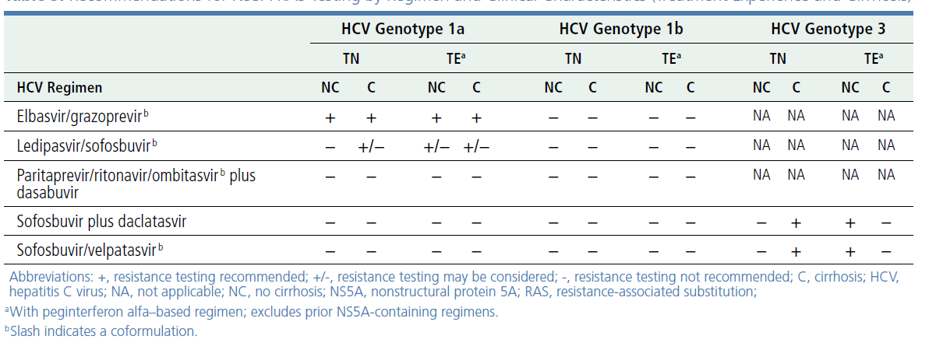
Recomendations for baseline NS5A RAS testing in NS5A-naive patients
Wyles DL et al., HCV Drug Resistance, 2017

