Slide 1
Epatopatia
Alcolica
Mariano Quartini
S.C. Epatologia e Gastroenterologia
A.O. «S.Maria» - Terni

Slide 3
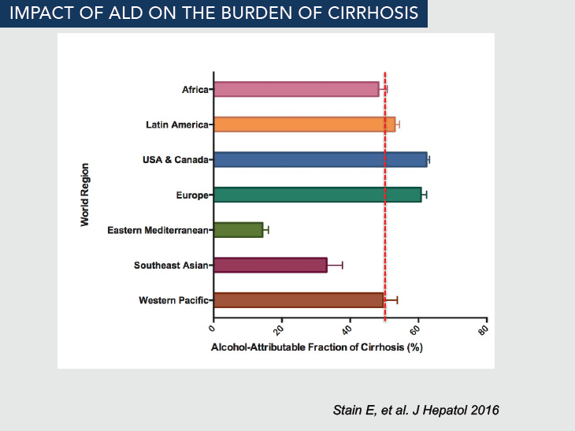

Slide 7
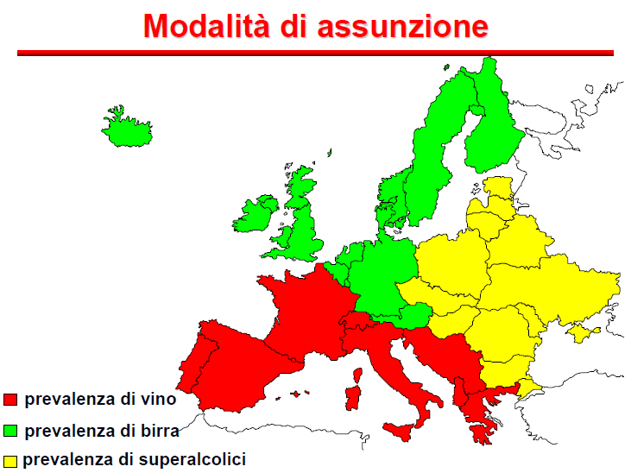

Slide 10
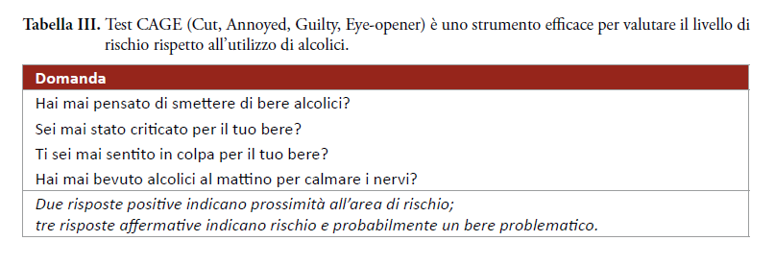
AISF-SIMG, 2017

Slide 11
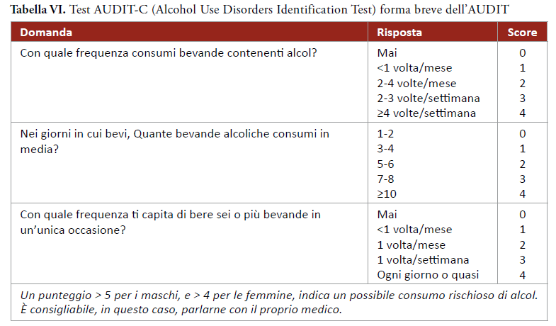
AISF-SIMG, 2017

Slide 12
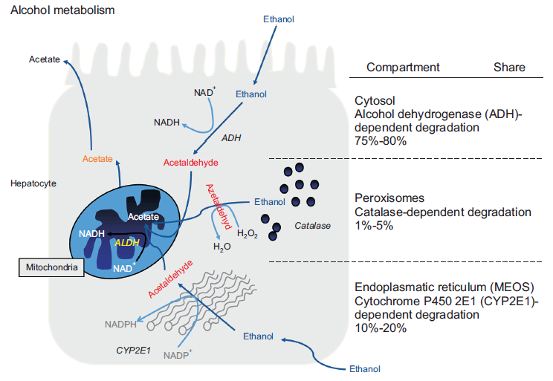

Slide 14
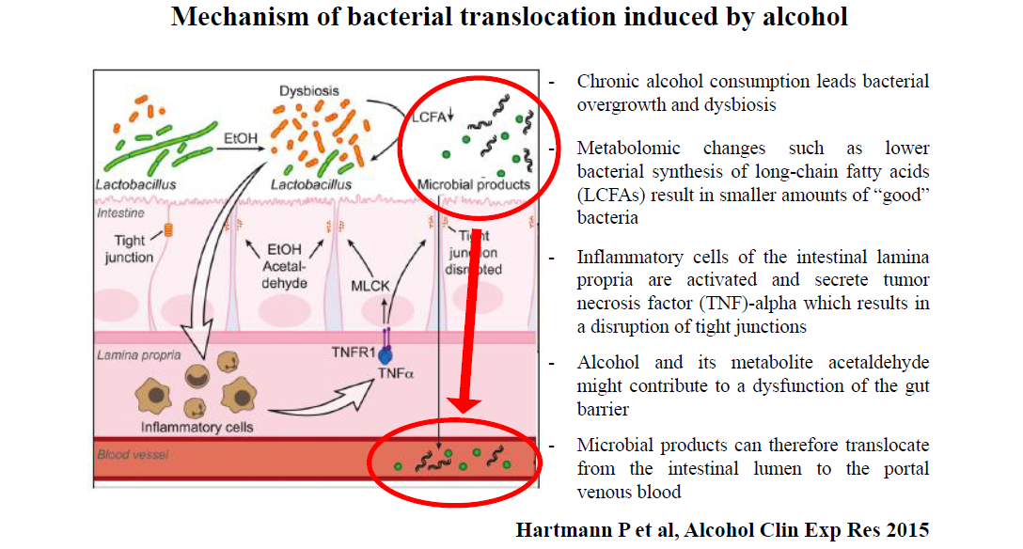

Slide 16
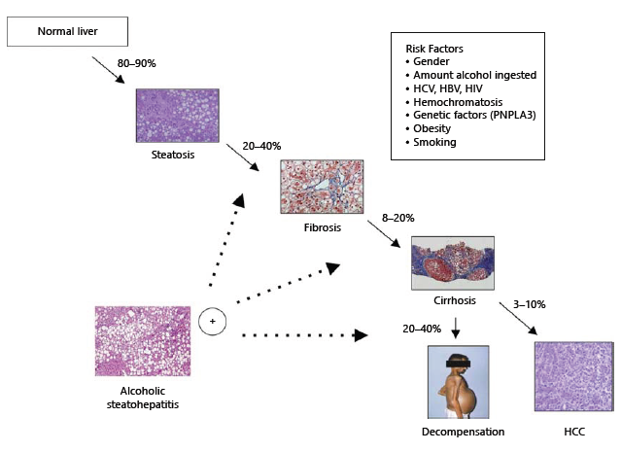
EASL, 2012

Slide 17
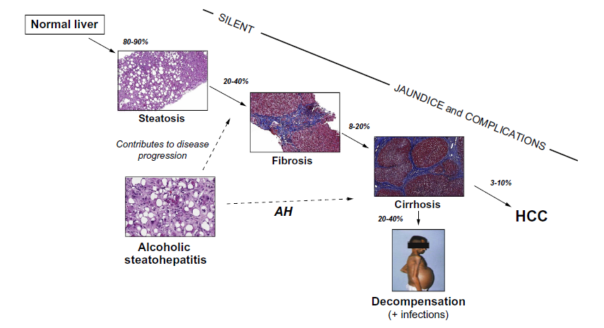
Mathurin P., Bataller R., J Hepat 2015

Slide 18
Liver Biopsy in pts with: aggressive forms of ALD
cofactors
Modificata, Mueller et al, WJG 2014

Slide 19
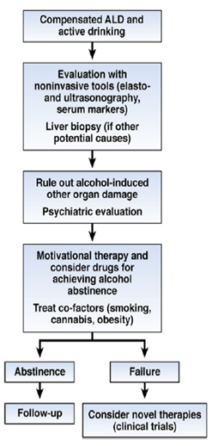
Mathurin P., Bataller R., J Hepat 2015

Slide 22
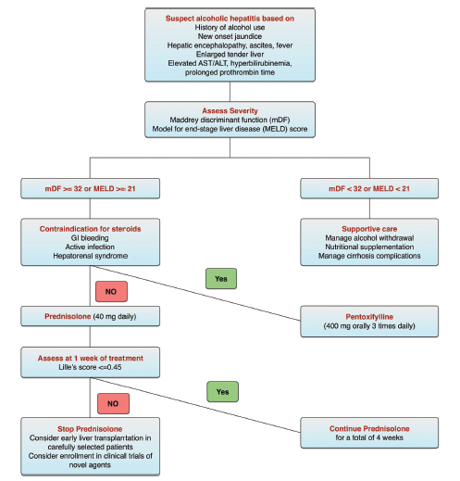

Slide 23
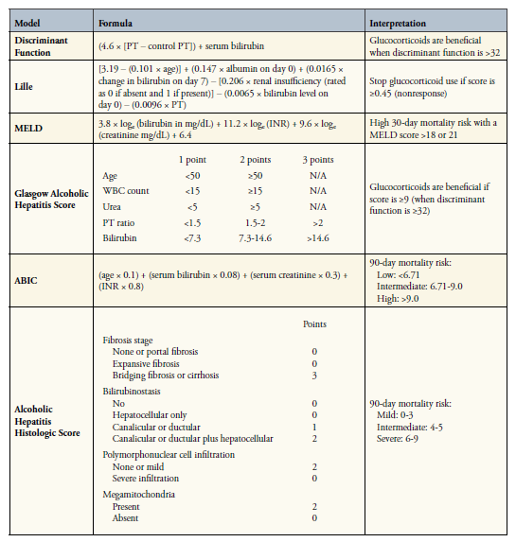

Slide 24
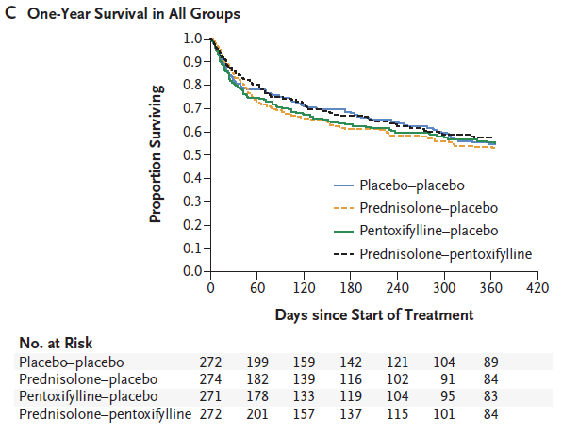
STOPAH Trial
NEJM, 2015

Slide 25
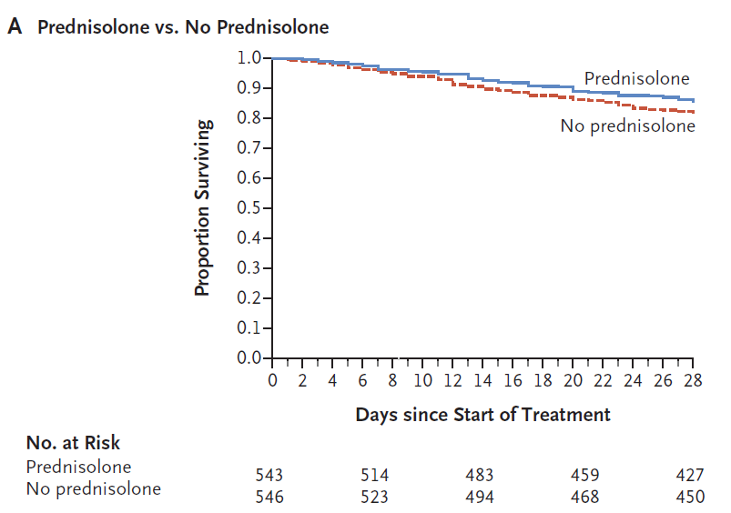

Slide 31
Bataller R., 2016

Slide 33
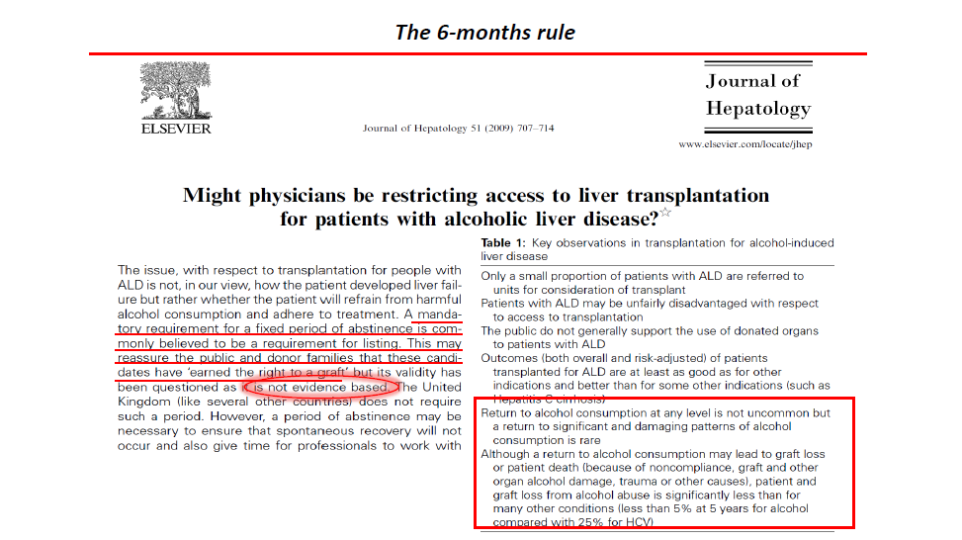

Slide 35
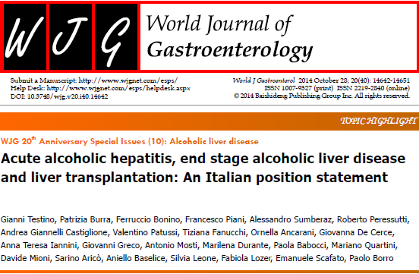
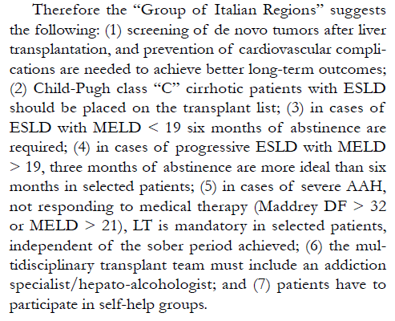

Slide 37
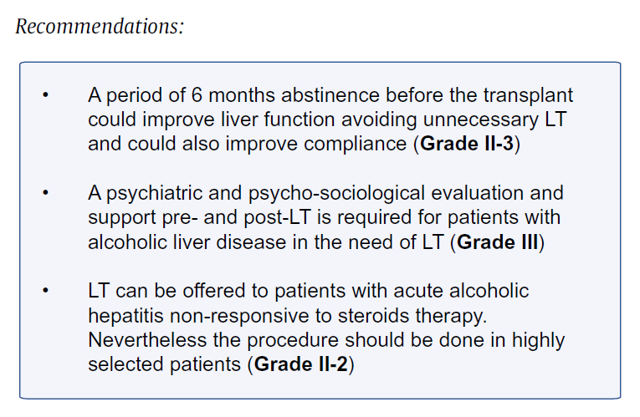
EASL, 2016

Slide 41
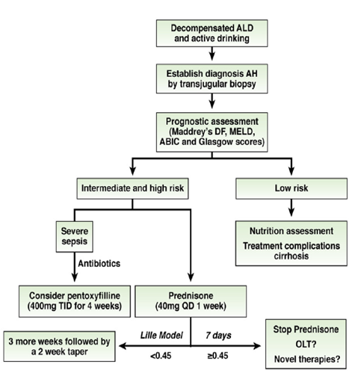
Mathurin P., Bataller R., J Hepat 2015

Slide 42
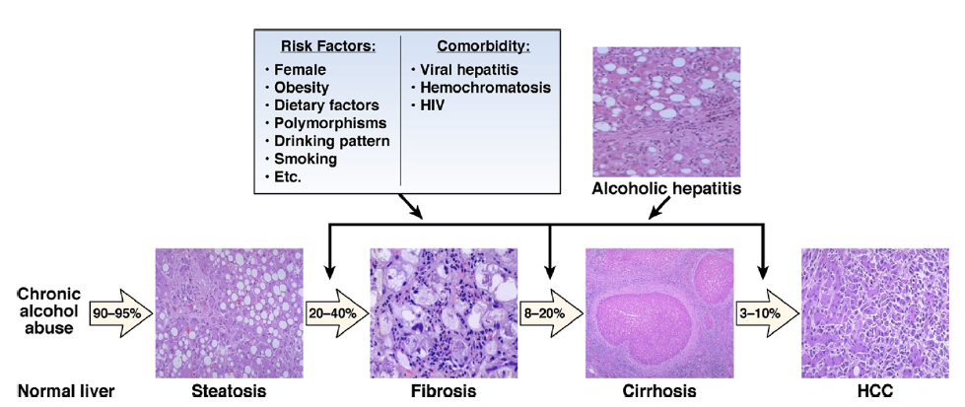
Spectrum of ALD, risk factors, and comorbidity
Gao B., Bataller R, Gastroent 2011

Slide 43
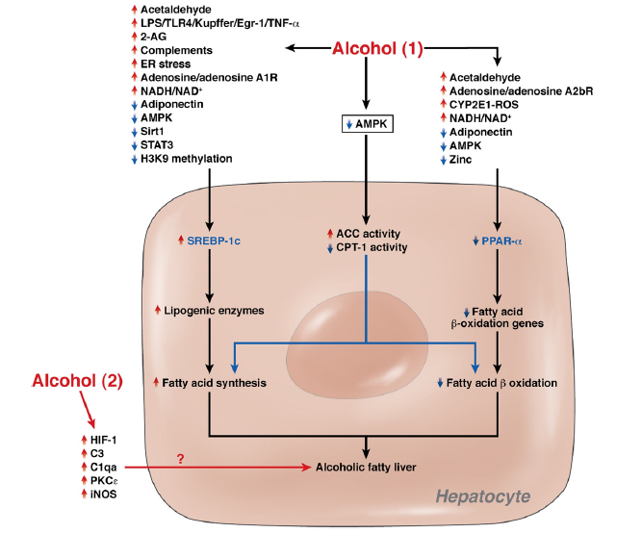
Mechanisms of alcoholic fatty liver
Gao B., Bataller R, Gastroent 2011

Slide 44
P value 0.06

Slide 45
NEW ENGLAND JOURNAL OF MEDICINE, APRIL, 2015
STeroids Or Pentoxifylline for Alcoholic Hepatitis
to determine whether prednisolone or pentoxifylline administered for a 28-day period reduced short-term and medium-term mortality among patients admitted with severe alcoholic hepatitis

Slide 46
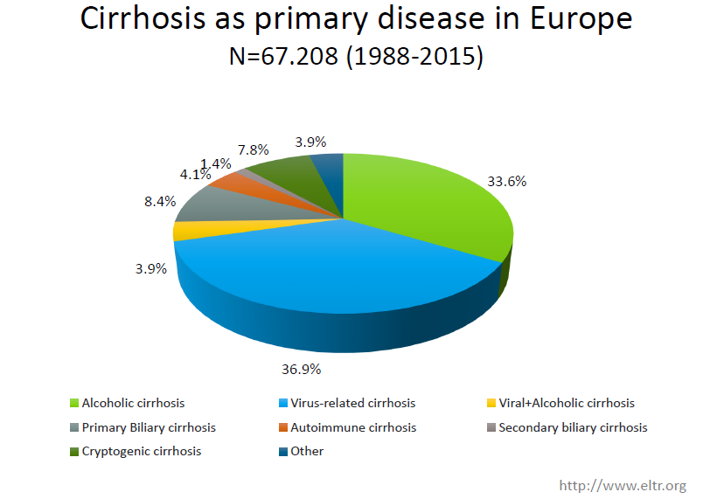

Slide 48
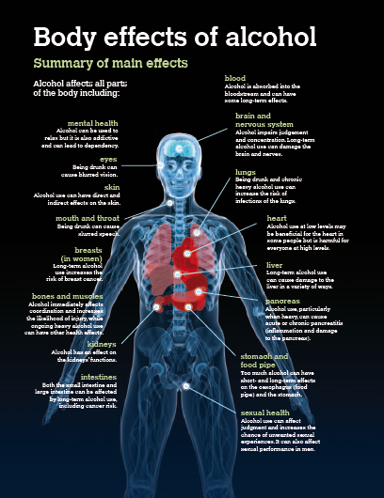

Slide 49
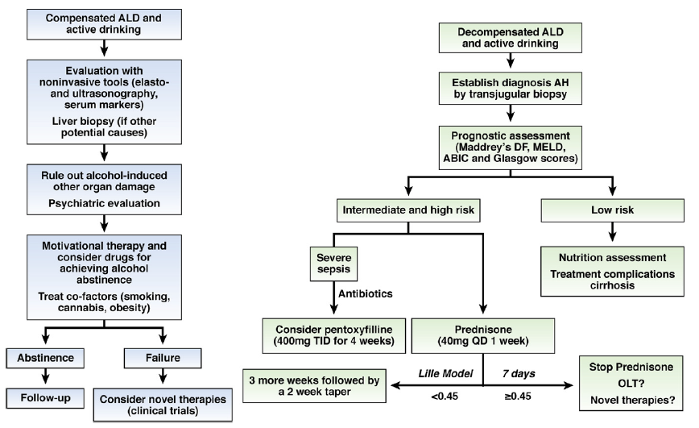
Mathurin P., Bataller R., J Hepat 2015

