Slide 1
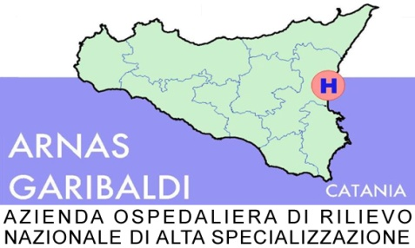
UOD Epatologia
HCC. Le terapie loco-regionali
29 settembre 2017
maurizio russello

Slide 2
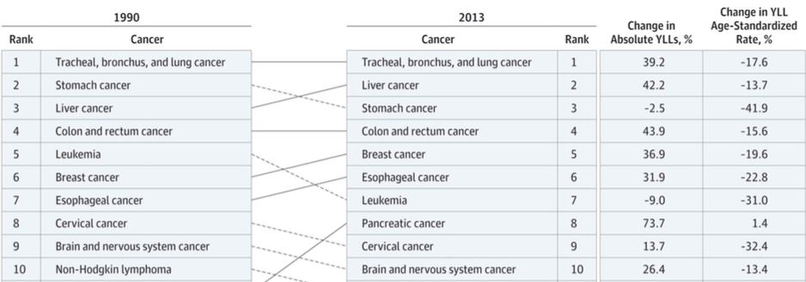
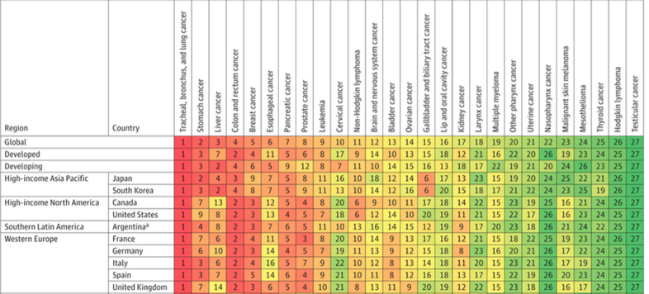
The global Burden of Cancer 2013
The top ten
JAMA Oncol 2015

Slide 3
Mortalità per principali tumori in Italia
ISTAT, 2013

Slide 4
Sopravvivenza (%) relativa standardizzata
a 5 anni dei principali tumori, per area geografica

Slide 5
The evolutionary scenario of HCC in Italy: an update
Database ITA.LI.CA
Bucci L, Liver Int 2016

Slide 6
The evolutionary scenario of HCC in Italy: an update
Database ITA.LI.CA
Bucci L, Liver Int 2016

Slide 7
Stage-adapted therapy for Pts With HCC (BCLC)
Stage of Disease | Treatment Option | Survival, %
Very early (0) Early (A) | Surgery/ transplantation PEI/RFA | ~ 50-75 at 5 yrs ~ 40-50 at 5 yrs
Intermediate (B) | TACE | ~ 40-60 at 2 yrs
Advanced (C) | Sorafenib/Regorafenib clinical trials | < 30 at 1 yr
Very early (0) single, <2.1cm, C-P A
Early (A) single or 3 nodules <3.1cm, C-P A/B
Intermediate (B) multinodular, C-P A/B
Advanced (C) portal invasion, extrahepatic spread C-P A/B
Notes:
HCC, hepatocellular carcinoma; PEI, percutaneous ethanol injection; RFA, radiofrequency ablation; TACE, transarterial chemoembolization.

Slide 8
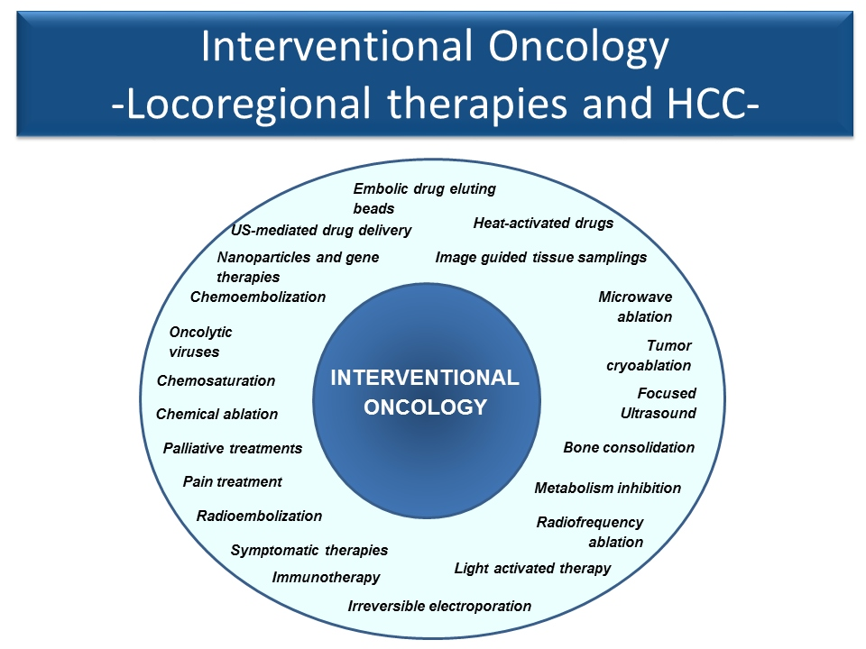

Slide 9
  Locoregional therapies
  Percutaneous ablation
CHEMICAL ACTION
PERCUTANEOUS ETHANOL INJECTION (PEI)
ELECTROMAGNETIC ACTION
RADIOFREQUENCY CURRENTS (RF)
MICROWAVE RADIATIONS (MW)
LASER
IRREVERSIBLE ELECTROPORATION
MECHANICAL ACTION
HIGH INTENSITY FOCUSED ULTRASOUND (HIFU)
THERMAL ACTION
CRYOABLATION
Transarterial
Embolization
Chemoembolization
Radioembolization

Slide 10

Inter- and Intratumoral Heterogeneity
Subclone 1
Intertumor heterogeneity
Intratumor heterogeneity
Intercellular genetic
and nongenetic heterogeneity
Subclone 2
Subclone 3
Clonal heterogeneity
Bedard PL, et al. Nature. 2013;501:355-364. Burrell RA, et al. Nature. 2013;501:338-345.
Slide credit: clinicaloptions.com

Slide 11
ITA.LI.CA Database
Bucci L, Liver Int 2016 Jul 18. doi:10.1111/liv.13204

Slide 12
ITA.LI.CA Database
Bucci L, Liver Int 2016 Jul 18. doi:10.1111/liv.13204

Slide 13
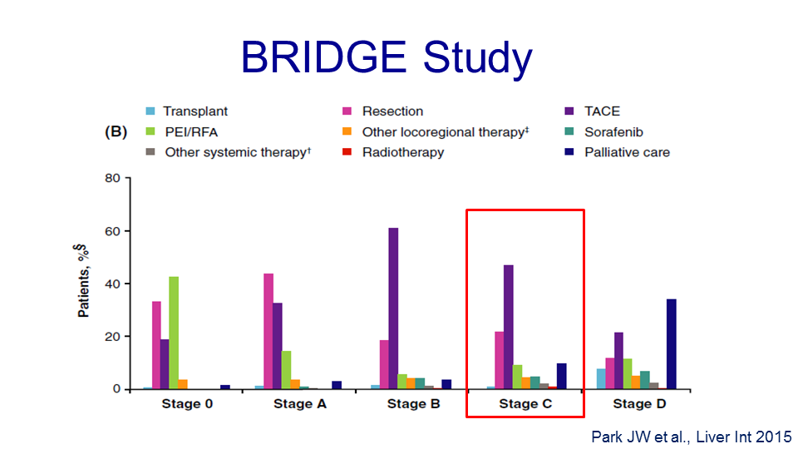
18,031 pts
(67% from Asia, 20% from Europe and 13% from North America)

Slide 14
Curative Treatments:
☛ 30% of pts
Resection
Noncirrhotics
  Choice of therapy
Cirrhotics
  Reserve for CTP A
  Avoid R hepatectomy
Best for solitary HCC
Only 5% to 15% eligible
Survival
  1 yr: 95%
  3 yrs: 85%
  5 yrs: 50%
Recurrence
  5 yrs: 70%
Ablation
Effective when
≤ 3 cm
Multiple modalities
  Thermal
  Chemical
Minimally invasive
Survival
  1 yr: 90%
  3 yrs: 75%
  5 yrs: 60% to 70%
Recurrence
  5 yrs: 70%
Transplant
Cures both cirrhosis and HCC
MELD exception
  Milan criteria
  Downsizing
Demand > supply
Survival
  1 yr: 91%
  2 yrs: 75%
  5 yrs: > 70%
Recurrence
  5 yrs: < 15%
National Comprehensive Cancer Network Guidelines. Hepatobiliary Cancers. Version 2.2016.
Notes:
CTP, Child-Turcotte-Pugh; HCC, hepatocellular carcinoma; MELD, Model for End Stage Liver Disease.

Slide 15
156 pts.

Slide 16
Three-year mortality
Five-year mortality
Clinical decompensation
Berzigotti A, Hepatology 2015

Slide 17
A new prognostic scoring system for resectable HCC
3.5% perioperative mortality (at 3 mo)
Sposito C, WJG 2016

Slide 18
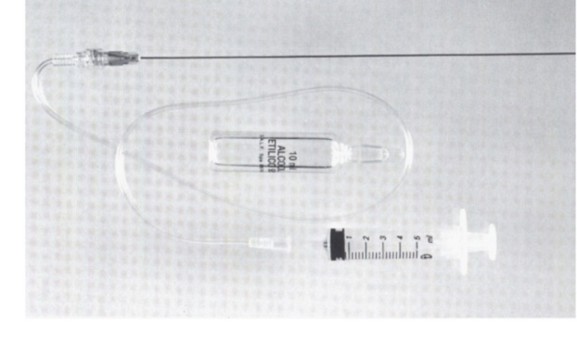
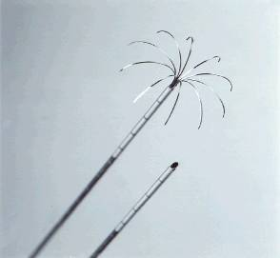
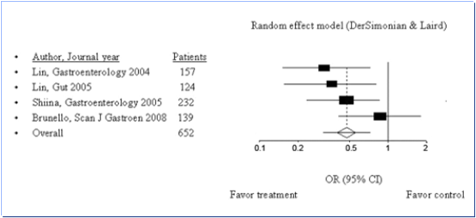
RF vs. PEI
(meta-analisi di RCT)
RF
PEI
LIMITI della PEI:
- Estensione della necrosi limitata al nodulo
- Presenza di setti che limitano la diffusione
dell’alcol
Cho et al., Hepatology 2009

Slide 19
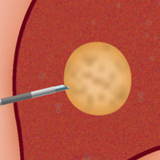
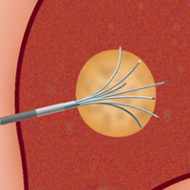
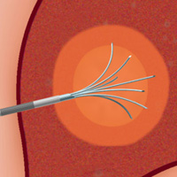
Radiofrequency Ablation
High-frequency (460 kHz) alternating current flows from electrical probe through tissue to ground
3 cm
Probe insertion
Extension of prongs
RF current application

Slide 20
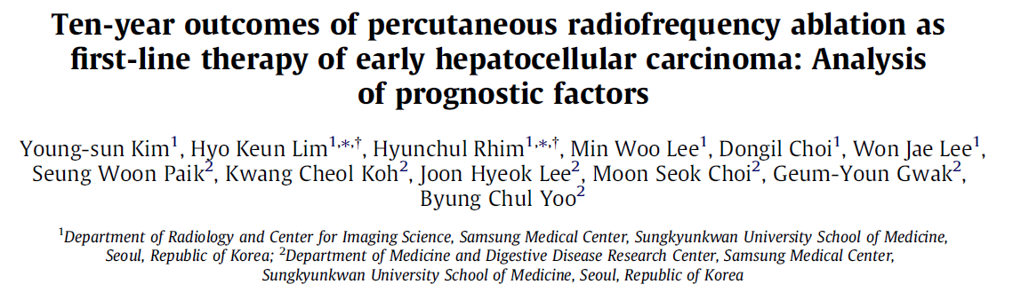
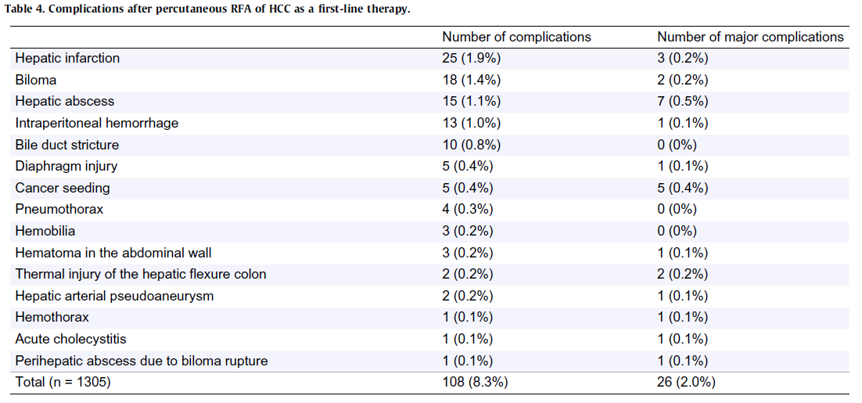
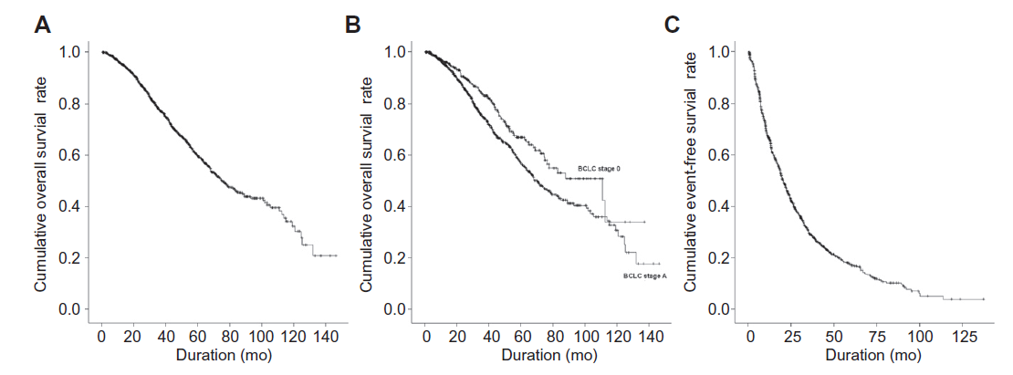
1305 pts
59.7%
32.3%
Overall Survival influenced by:
Child-Pugh class
Age
Antiviral therapy
Extrahepatic recurrence
J Hepatol 2013,58,89-97

Slide 21
HCC size and microsatellites
0.5 cm
≤2 cm
2-3 cm
≤3 cm
 satellites
1.5 cm ≅ 0
1.6 - 2 cm 3%
Sasaki et al., Cancer 2005; 103:299-306
Livraghi, J Hepatol Pancreat Surg 2010
Notes:
21

Slide 22
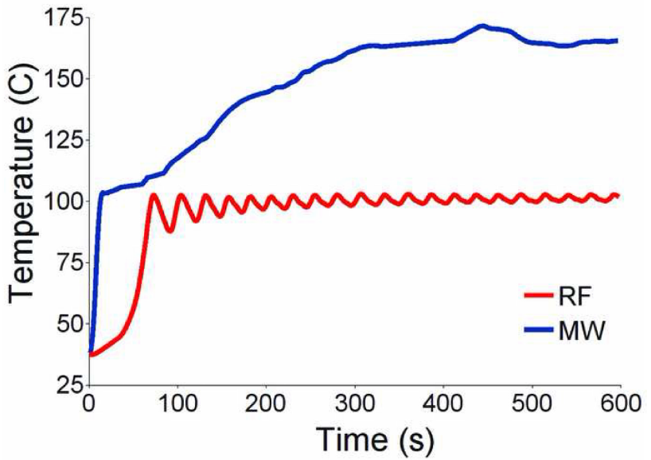
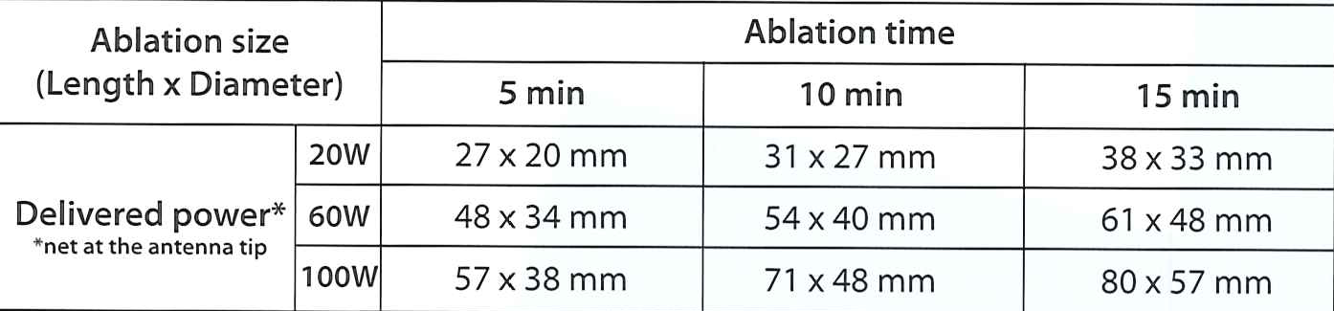
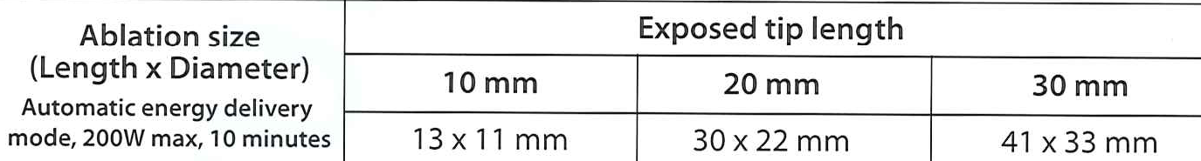
Microwave vs RF temperature in
in vivo porcine liver
MW AMICA PROBE
RF AMICA PROBE

Slide 23
MWA – Vantaggi (rispetto RFA)
Riscaldamento più veloce (5-10 min)
riduzione dei tempi di sedazione
possibilità di trattare più noduli nella stessa seduta
Maggiore ampiezza della necrosi ( > 4 cm), in rapporto alla
potenza (sino a 100W) e alla durata dell’esposizione
Possibilità di “controllare” le dimensioni della necrosi
Neutralizzazione dell’effetto “heat sinking”
Omogeneità e riproducibilità della necrosi
Confinamento del raggio d’azione delle microonde e
scomparsa delle piastre di riflessione
Comparison of the therapeutic effects of microwave
and radiofrequency ablation
No significant difference in:
- local ablative effect (83.7% vs 86.7%)
one-year and two-year survival rate (90% e 81.6% vs 91.8% e 81%)
complication rate.
Zhang XG, Acta Chir Belg 2014

Slide 24
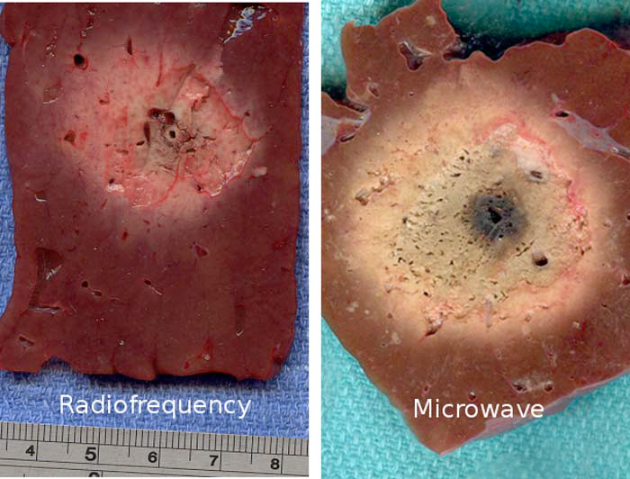
>3 cm
3 cm

Slide 25
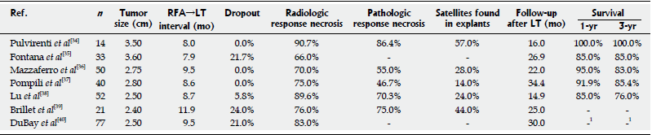
RFA come “ponte” al trapianto
Rallentamento tempo di progressione del tumore
Estensione dei tempi d’attesa in lista
Valutazione della biologia del tumore e della effettiva trapiantabilità
(test of time)

Slide 26
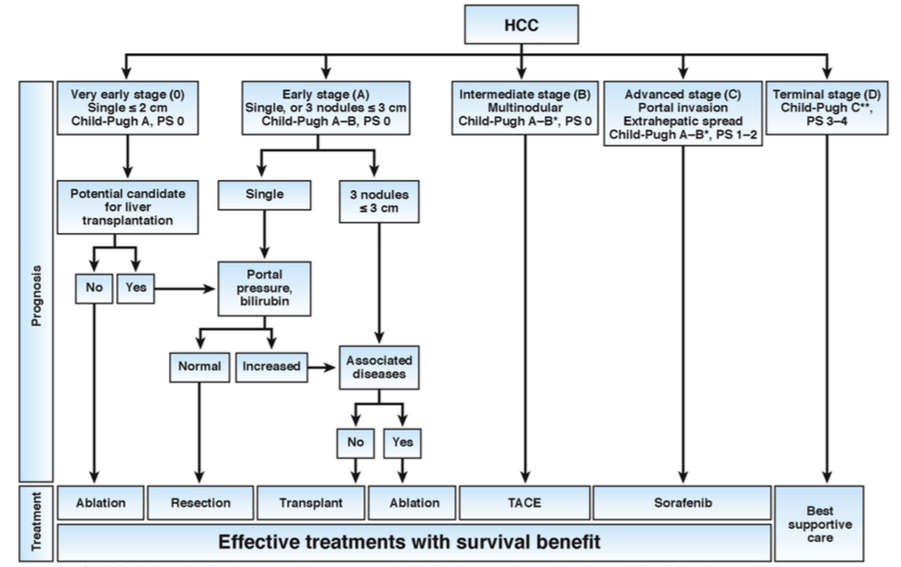
Updated BCLC staging system and treatment strategy
100% ?
Curative treatments (30%)
5-year survival (40–70%)
Target: 20%
OS: 20 mo (45-14)
Target: 40%
OS: 11 mo (6-14)
Target: 10%
OS: <3 mo
Bruix J, Gastroenterology 2016

Slide 27
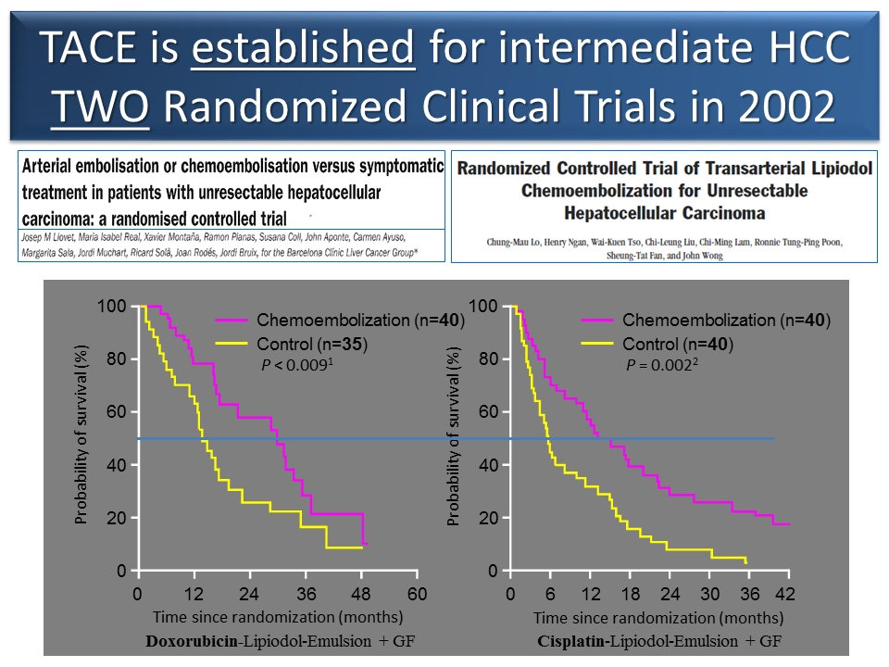

Slide 28
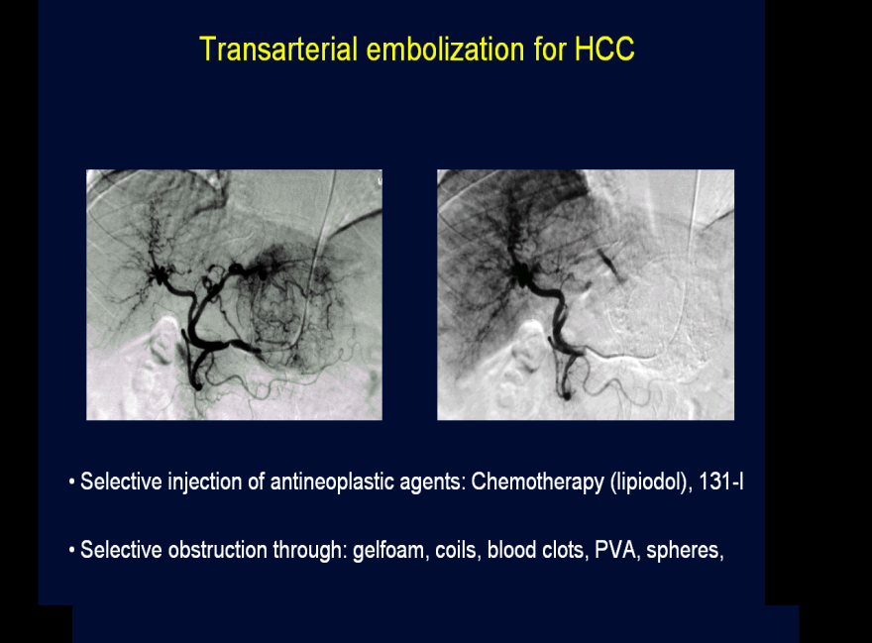
Intermediate stage (B): TACE
No firm evidence to support or refute TACE/TAE for unresectable HCC
(Oliveri RS, Cochrane Database Syst Rev 2011)
Lack of homogeneity in treatment modalities
- TAE vs TACE
- sTACE vs DEB-TACE
- interval between courses
- number of TACE
Toxicity (systemic/hepatic, immediate/delayed)
Radiological assessment (CT/MR, EASL/mRECIST)

Slide 29
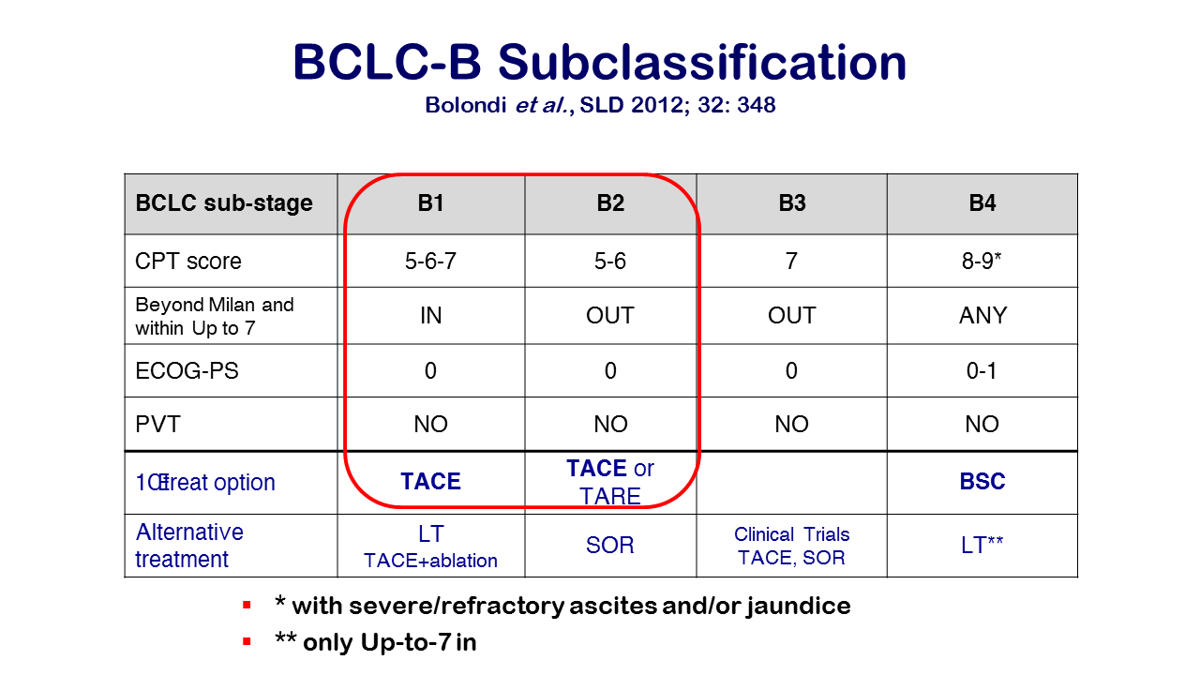

Slide 30
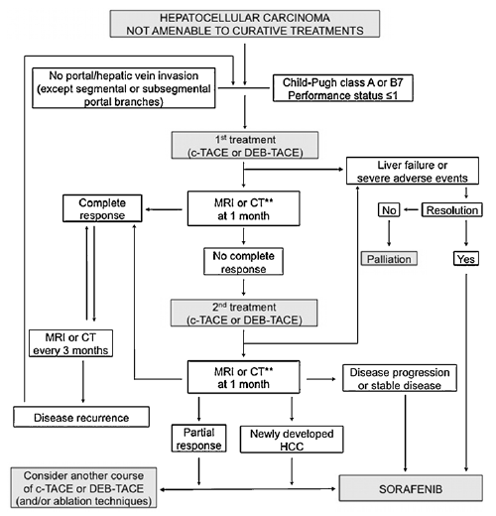
Treatment algorithm for TACE
AISF Position Paper, DLD 2013

Slide 31
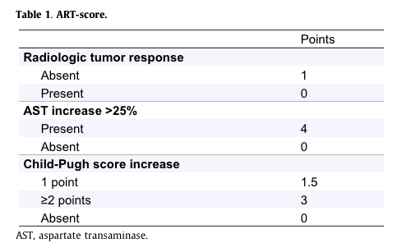
Identifying TACE Failure and Evaluating for Other Treatment Options
The ART-Strategy
median OS (months)
ART score ≥ 2.5 6.6
ART score 0-1.5 23.7
Sieghart W, Hepatology 2013

Slide 32
Comparison of mOS between
TACE and SORAFENIB-REGORAFENIB sequential therapy
Kudo M, Liver Cancer 2017

Slide 33
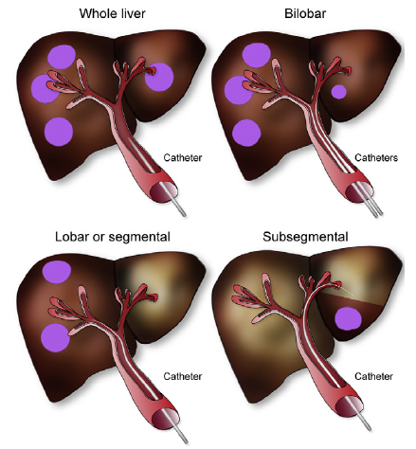
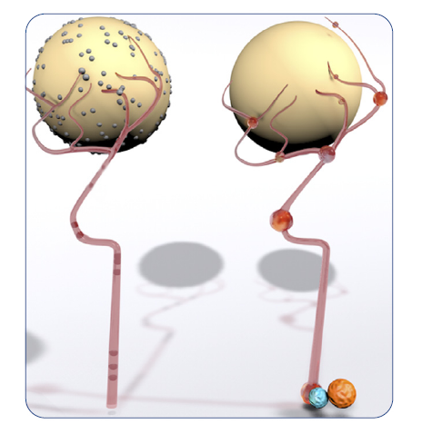
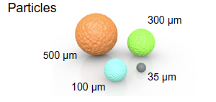
Radioembolization for HCC
Sangro B, J Hepatol 2012

Slide 34
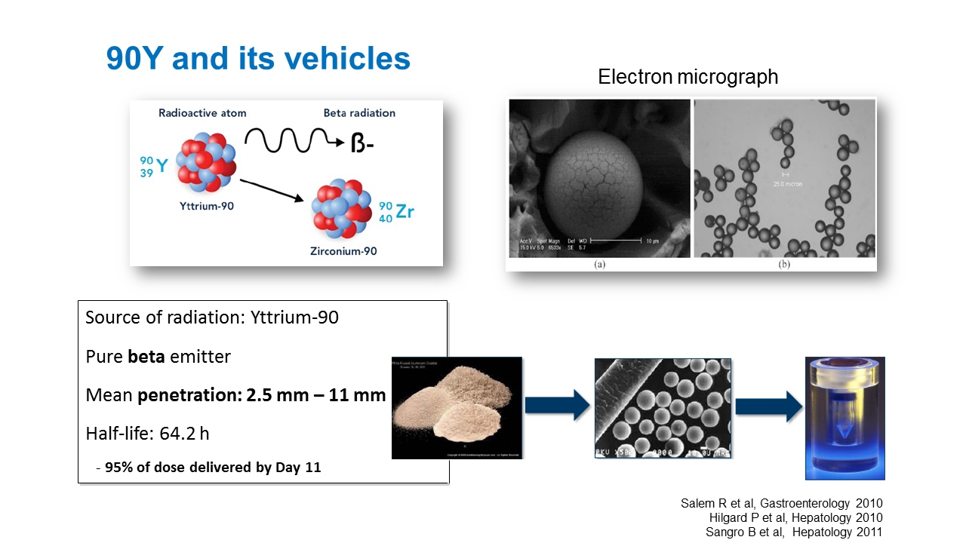

Slide 35
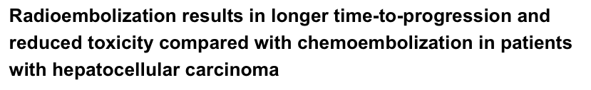
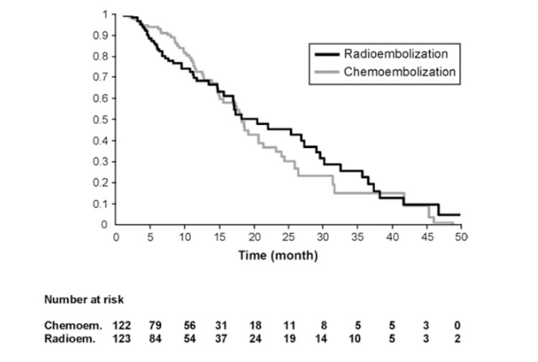
Salem R, Gastroenterology 2011

Slide 36
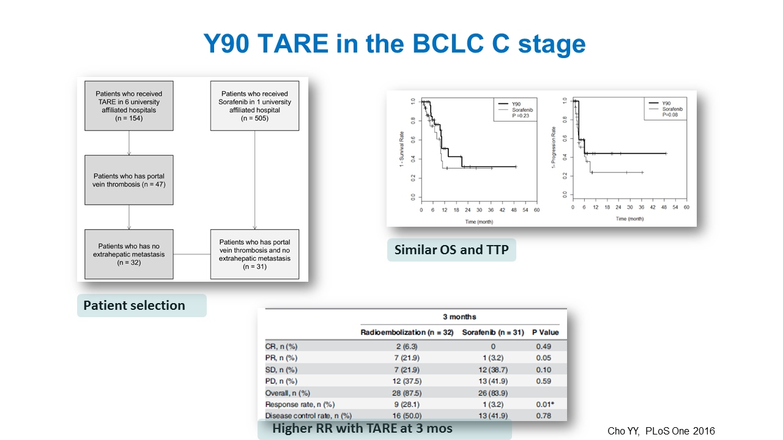

Slide 37
Phase III SARAH: SIRT vs Sorafenib in Locally Advanced, Inoperable HCC After 2 Rounds of TACE
ITT Population
(N = 459)
Per Protocol Population
(n = 380)
1.0
1.0
Median
8.0 mos
9.9 mos
Median
9.9 mos
9.9 mos
SIRT
Sorafenib
SIRT
Sorafenib
0.8
0.8
0.6
HR: 1.15 (95% CI: 0.94-1.41;
log-rank P = .18)
0.6
HR: 0.99 (95% CI: 0.79-1.24;
log-rank P = .92)
Probability of Survival
Probability of Survival
0.4
0.4
0.2
0.2
0
0
0
6
12
18
24
30
36
42
48
0
6
12
18
24
30
36
42
48
Pts at Risk, n
SIRT
Sorafenib
Mos Since Randomization
Pts at Risk, n
SIRT
Sorafenib
Mos Since Randomization
237
222
143
153
90
92
49
57
30
28
11
14
2
3
0
1
0
174
206
123
143
75
86
41
54
26
26
10
12
1
2
0
1
0
Vilgrain V, et al. EASL 2017. Abstract GS-02
Notes:
HCC, hepatocellular carcinoma; SIRT, selective internal radiation therapy; TACE, transarterial chemoembolization.

Slide 38
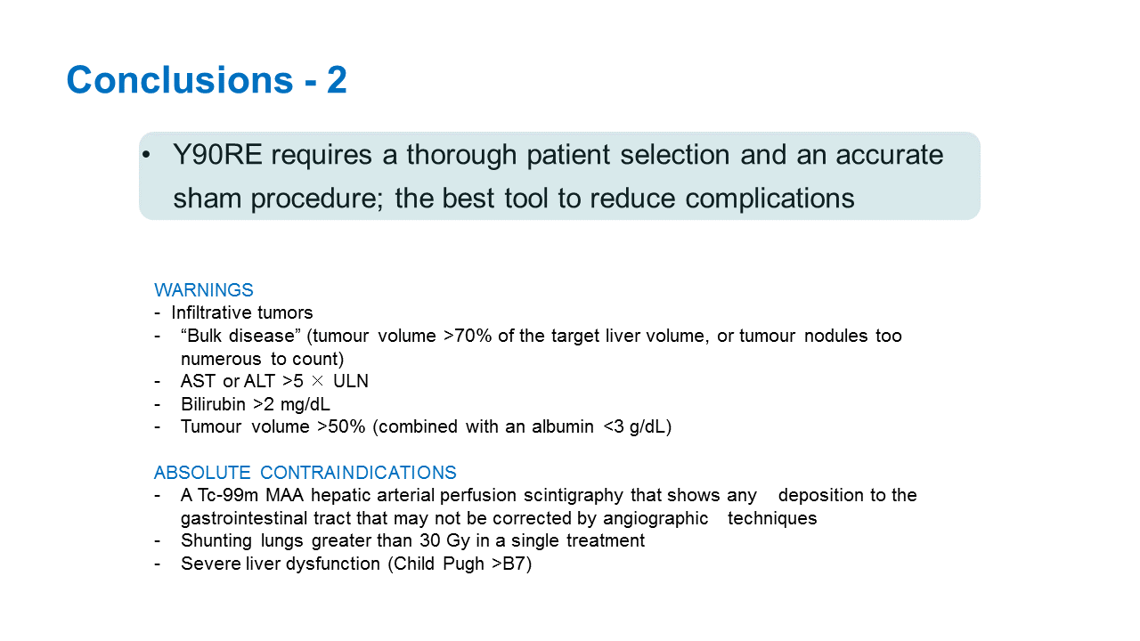
TARE: (potenziali) Indicazioni
Pazienti con controindicazioni alla TACE (trombosi portale);
Pazienti già trattati con TACE, senza risposta completa;
Pazienti con tumori di grandi dimensioni, con pattern infiltrante, tumori ipovascolari;
Pazienti intolleranti al sorafenib;
Down-staging (pre-OLT) e terapia “ponte” per il trapianto

Slide 39
Trattamenti combinati
RF + Resezione
HCC multifocale
ricorrenza post-resezione
epatectomia RFA-assistita
RF/MW/PEI + TACE
Effetto sinergico:
embolizzazione a.epatica ⇒ minor dispersione del calore (heat sink effect)
ipertermia ⇒ maggior distribuzione del chemioterapico
RF/MW → dopo TACE (<24h) PEI → dopo TACE (2-6 settimane)
    HCC > 3-5 cm
    controindicazione alla chirurgia
    HCC multifocale

Slide 40
TACE + Nivolumab
Nivolumab 240 mg IV Q2W
-4
-2
0
2
4
12
24
52 wks
Cohort 1
(N = 3-6)
Tumor biopsy
research bloods
DEB-TACE
Nivolumab 240 mg IV Q2W
Cohort 2
(N = 3-6)
-4
-2
0
2
4
12
24
52 wks
Tumor biopsy
research bloods
DEB-TACE
Nivolumab 240 mg IV Q2W
Cohort 3
(N = 3-6)
-4
-2
0
2
4
12
24
52 wks
Tumor biopsy
research bloods
DEB-TACE
ClinicalTrials.gov. NCT03143270.
Slide credit: clinicaloptions.com
Notes:
DEB, drug-eluting beads; TACE, transarterial chemoembolization.

Slide 41

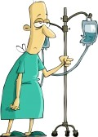
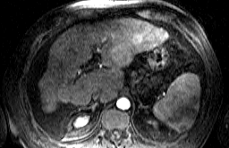
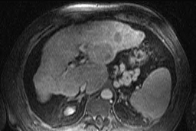
2017: personalizzazione delle cure
Stadio della cirrosi
Co-morbilità
Dimensioni
Numero
Sede

Slide 42
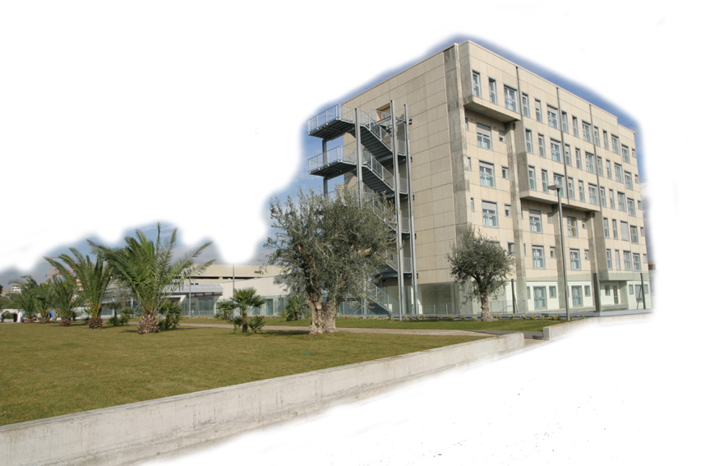
Grazie per l’attenzione !
UOD di EPATOLOGIA
R.Benigno
R.Faulisi
C.Cocuzza
C.Trovato
A.Bellia
M.Cannavò

