Slide 1
HBV e Oncogenesi
Rodolfo Sacco
U. O. Gastroenterologia e Malattie del Ricambio A.O.U.P - Pisa

Slide 2
Virione di HBV

Slide 3
Epidemiology

Slide 4
Prevalenza globale di HBsAg

Slide 5
Incidenza Globale annua di epatocarcinoma
(numero di casi per 100.000)

Slide 6
Incidence of liver cancer worldwide: Age Standardized Incidence
China
Middle Africa
Japan
Eastern Africa
Southeastern Africa
Melanesia
Western Africa
Southern Europe
Micro/Polynesia
Caribbean
Southern Africa
Western Europe
Eastern Europe
Northern America
Central America
Western Asia
Northern Africa
Australia/New Zealand
South America
Northern Europe
50
40
30
20
10
0
10
20
30
40
50
Age Standardized Incidence per 100,000
Parkin D et al. CA Cancer J Clin.

Slide 7
Hepatocellular carcinoma: More than cancer
Up to 80% of patients with HCC have two serious diseases − cancer and cirrhosis
Establishing prognosis is difficult and uncertain:
Progression of both cancer and underlying cirrhosis is difficult to forecast
Each disease might be influenced to different degrees by treatments that affect the overall prognosis
1. Llovet JM. J Gastroenterol 2005;40:225–35; 2. Vass, A. BMJ 2001;323:1388.

Slide 8
Risk Factors of Hepatocellular Carcinoma: Estimates
of the Attributable Fractions (%)
Risk factors
Europe / US
Japan
Africa / Asia
Hepatitis B virus
Hepatitis C virus
Alcohol
Tobacco
Aflatoxin
Other
22 (4-58)
60 (12-72)
45 (8-57)
12 (0-14)
limited
< 5
20 (18-44)
63 (48-94)
20 (15-33)
40 (9-51)
limited
?
60 (40-90)
20 (9-56)
? (11-41)
22
high exposure
< 5
Bosch & Ribes, Viruses and Liver Cancer

Slide 9
Viral infection B/C
HCC
Incidence
1980
1990
2000
2010
2020

Slide 10
Metabolic Disease
HCC
Incidence
1980
1990
2000
2010
2020
2030

Slide 11
Evidence for hepatitis B virus (HBV) as a cause of HCC
Carriers of inactive HBV at increased risk of HCC¹
20,069 patients – mean follow-up of 13.1 years
annual incidence rate of HCC in inactive HBV group (serum levels of HBV DNA < 10,000 copies/ml) vs control 0.06% vs 0.02% respectively HR 4.6 (95% CI 2.5–8.3)
Prospective cohort study of HBV-infected patients²
3,653 patients
164 incident cases HCC and 346 deaths during mean follow-up of 11.4 years
conclusion: elevated serum HBV DNA level (≥ 10,0000 copies/ml) strong risk predictor of HCC
Reduction of HCC incidence in young HBV vaccinees³
1,958 patients in 20-year follow-up study
HCC incidence statistically significantly lower in vaccinated vs unvaccinated birth cohorts
Reduced risk of HCC in interferon-treated patients who cleared serum HBsAg⁴
long term outcomes in 233 IFN-treated patients vs 233 untreated controls
cumulative incidence of HCC at the end of 15 years follow-up
2.7% IFN treated vs 12.5% untreated controls (p = 0.011)
Animal studies of HBV-induced hepatocarcinogenesis⁵
HBV virus large surface antigen (LHBS) mutant with deletion at the pre-S2 accumulates in endoplasmic reticulum
important prognostic marker for chronic HBV infection and HBV-related HCC
1. Chen JD, et al. Gastroenterology. 2010;138:1747-54. 2. Chen CJ, et al. JAMA. 2006;295:65-73
3. Chang M, et al. JNCI. 2009;101:348-55. 4. Lin SM, et al. J Hepatol. 2007;46:45-52.
5. Hsieh Y, et al. Mol Cancer Res. 2007;5:1063-72.
IFN = interferon.

Slide 12
Risk of HCC across a biological gradient of serum HBV DNA level
Entire cohort (N = 3,653)
14
Baseline HBV DNA level, copies/mL
≥ 1 Million
12
100,000–999,999
10,000–99,999
10
300–9,999
< 300
8
Cumulative incidence of HCC, %
6
4
2
0
0
1
2
3
4
5
6
7
8
9
10
11
12
13
Year of follow-up
Chen CJ, et al. JAMA. 2006;295:65-73.
Notes:
12

Slide 13
HCC may also develop in non-cirrhotic
patients with chronic viral hepatitis
164 incident HCCs diagnosed during 11.4 year of follow-up
41,779 person-years of follow-up
33 (20%) in patients without cirrhosis
HBV, REVEAL¹
Chen JD, et al. Gastroenterology

Slide 14
Viral pathogenesis of HCC

Slide 15
SVILUPPO DI HCC: PROCESSO MULTISTEP

Slide 16
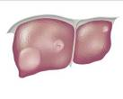
HCC: a Complex Pathogenesis
Chronologic sequence of cellular lesions culminating in the development of HCC in humans
HBV HCV other etiological factors
Chronic hepatitis
Phenotypically altered hepatocytes
Dysplastic hepatocytes
Hepatocellular Carcinoma
Cirrhosis
Preneoplasia (10 to 30 years)
Neoplasia (<5 years)
Dysplasia (3 to 5 years)
Large Liver Cell Dysplasia in 71-85% HCV Cirrhosis and 100% HBV Cirrhosis explanted livers
Thorgheirsson SS, Grisham JW. Nature Gen 2002; 31: 339-346; Park YN, Roncalli M. J Hepatol 2006; 45: 734-743

Slide 17
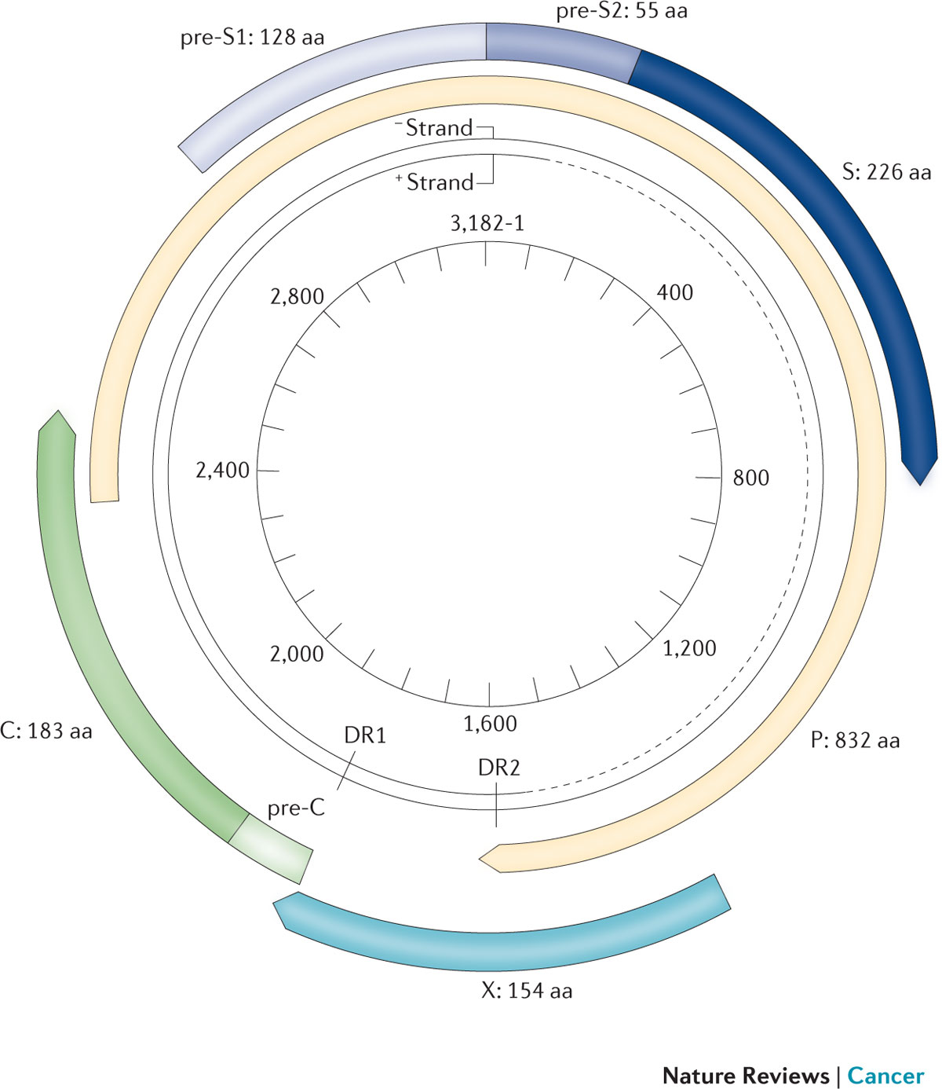
The HBV genome and encoded genes

Slide 18
Meccanismi alla base della carcinogenesi
Indotta dall’infezione HBV

Slide 19
Meccanismi indiretti: HBV agente infiammatorio

Slide 20
Viral Infection and HCC
HBV: direct mechanism
Integration of HBV-DNA into chromosomes
Inducer of cellular proto oncogenes
main role of HBx and Pre S mutations
Inhibitor of anti oncogenes

Slide 21
Meccanismi diretti: proteina X

Slide 22
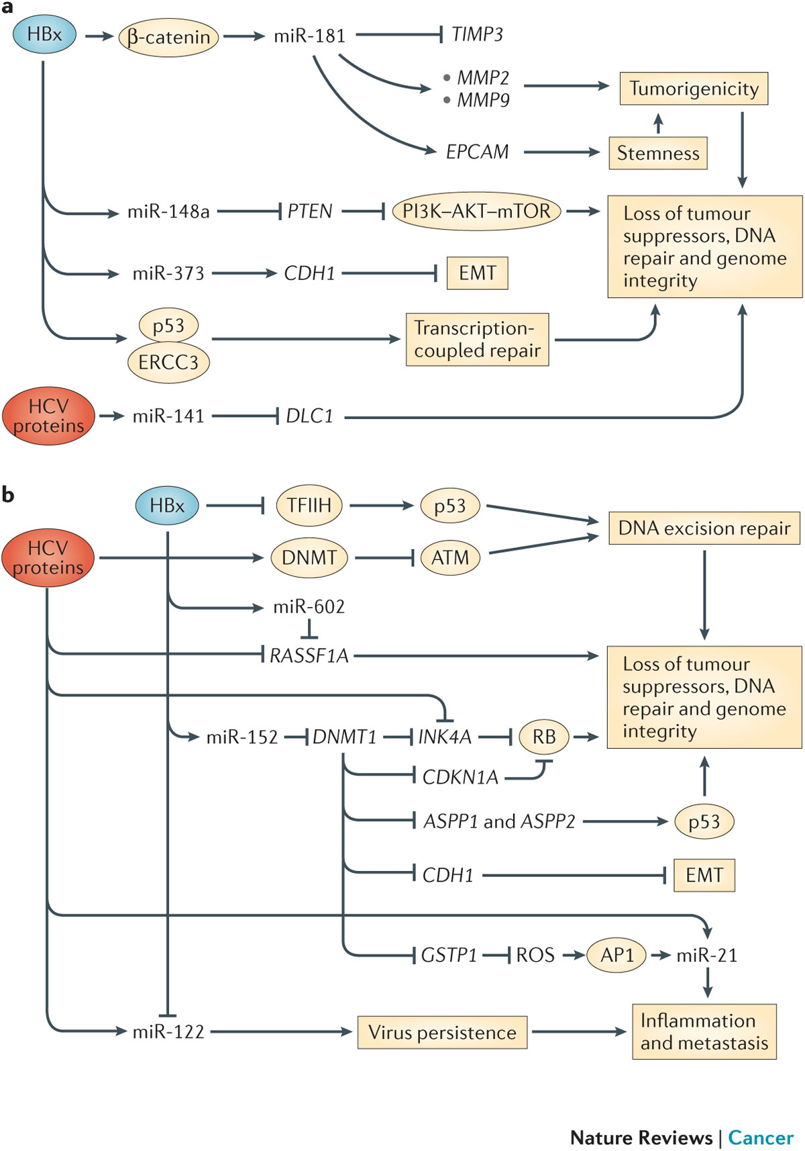
Examples of epigenetic alterations in host gene expression that are relevant to the pathogenesis of HBV and HCV-associated HCC

Slide 23
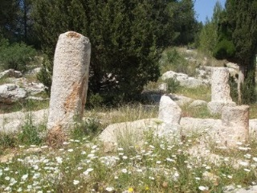
The Milestones
The Pathological Assessment
Regenerative nodules
Multi-step
development
Dysplastic nodule
(Early HCC)
De-novo development
Overt
HCC
(HBV)
International Working Party. Terminology of nodular lesions of the liver: recommendations of the World Congress of Gastroenterology Working Group. Hepatology 1995
International Pathology Consensus Group for HCC (ICGHN); Hepatology 2009

Slide 24
Stepwise Hepatocarcinogenesis and
Changes of Intranodular Blood Supply
Portal venous supply
Hepatic arterial supply
Abnormal arterial supply
Arterial supply
Portal supply
RN Low DN High DN Early HCC Well HCC Overt HCC
Matsui O, et al, Radiology 1991
Ueda K, Matsui O, et al, Human Pathology 1992
Hayashi M, Matsui O, et al, AJR 1999
Notes:
The in vivo demonstration has been a conquest of diagnostic imaging
Correlations between cancerogenesis and type of vascularization

Slide 25
Liver injury cascade
viral/toxic noxae
inflammation/oxidative stress
Functional changes
Structural changes
direct injury
Sinusoidal remodelling
Fibrogenesis
Hepatocellular injury
indirect injury
Hemodynamic alterations

Slide 26
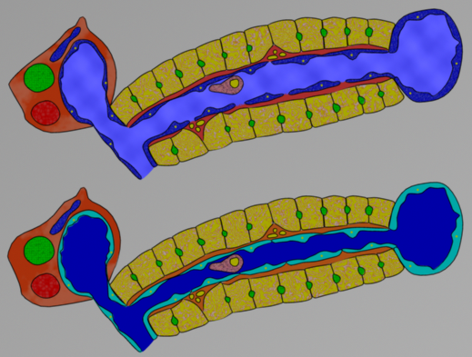
Functional changes
kupffer
Cells activation
endothelial
stellate
Endothelial
dysfunction
Vasoconstriction, Prothrombotic/Proliferative activities
Notes:
Functional changes caused by the activation of .. leads to endothelial dysfunction

Slide 27
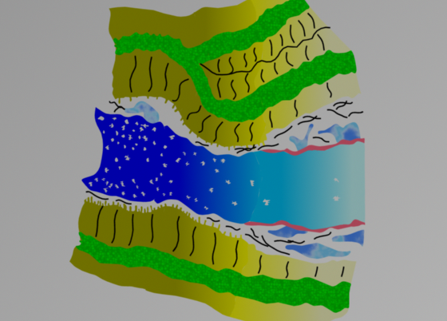
Sinusoidal remodelling
normal
abnormal
Normal Liver
Quiescent stellate cells
Sparse reticular collagen
Fenestrated endothelium
Microvilli on hepatocyte surface
Cirrhotic Liver
Proliferation of myofibroblasts
Deposition of matrix
Loss of endothelial fenestration
Loss of microvilli on hepatocyte surface
Twinning of hepatocytes
capillarization
Notes:
Sinusoidal remodelling represents the structural response to the functional changes
Moving from normal condition to cirrhosis

Slide 28
From the sinusoids to the portal tract
70%
30%
Notes:
Lets’ consider the portal tract
Blood supply to the sinusoids comes from….
Arterial supply not directly but via ….

Slide 29
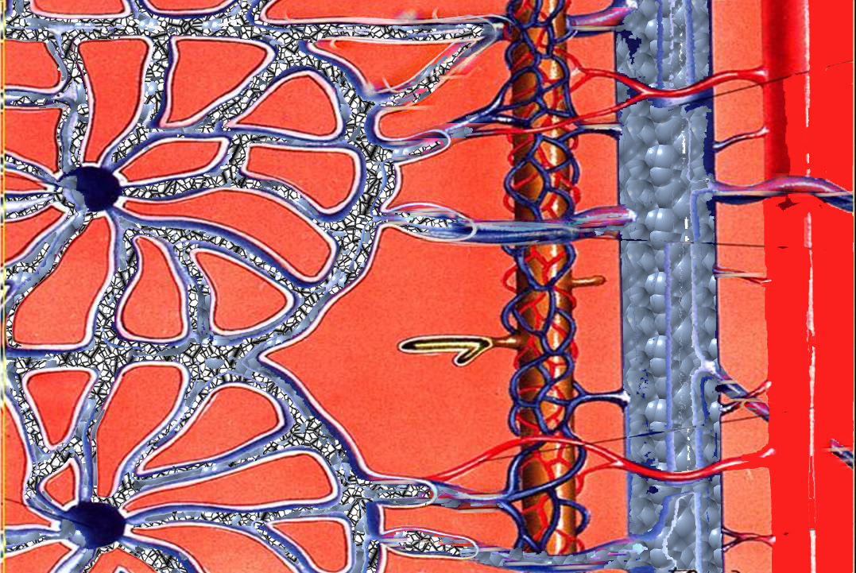
Vascular remodelling
Portal flow decrease
(sinusoidal fibrosis, thrombosis, capillarization)
Arterial flow increase (via peribiliary arterial plexus and AV shunt) -arterial buffer response-
30%
70%

Slide 30
Role of anti-HBV antiviral therapy on HCC

Slide 31
HCC development in patients with HBeAg-positive chronic HBV infection treated with IFN
1.0
Responder, no cirrhosis
0.9
Non-responder, no cirrhosis
0.8
Responder, cirrhosis
0.7
0.6
Non-responder, cirrhosis
Proportion of patients without HCC
0.5
0.4
0.3
0.2
0.1
0.0
0
1
2
3
4
5
6
7
8
9
10
11
12
13
14
15
16
17
Time (years)
Predictors of HCC: age, albumin, cirrhosis, and IFN response
Responders to IFN therapy appear to have a prolonged clinical remission and improved liver histology
Response to IFN therapy increased survival and reduced the risk of HCC
Van Zonnenveld M, et al. Hepatology. 2004;39:804-10.
Notes:
Damascus 14-16 April 2009 - An Update on HCC
9/28/17
31

Slide 32
Meta-analysis of 12 controlled trials of IFN therapy in patients with HBV cirrhosis: risk of HCC
Study, year | Interferon n/N | Placebo/no treatment n/N | RR (fixed) 95% CI | RR (fixed) 95% CI | Years of follow-up
Fattovich, 1997 | 4/40 | 6/50 |  | 0.83 (0.25, 2.75) | 7.2
Benvegnu, 1998 | 1/13 | 7/24 |  | 0.26 (0.04, 1.92) | 6.0
Brunetto, 1998 | 8/49 | 18/97 |  | 0.88 (0.41, 1.88) | 5.8
Ikeda, 1998 | 10/94 | 51/219 |  | 0.46 (0.24, 0.86) | 7.0
Krogsgaard, 1998 | 2/210 | 1/98 |  | 0.93 (0.09, 10.17) | 4.7
DiMarco, 1999 | 2/109 | 6/193 |  | 0.59 (0.12, 2.87) | 7.8
Mazzella, 1999 | 1/33 | 2/31 |  | 0.47 (0.04, 4.92) | 7.2
Papatheodoridis, 2001 | 17/209 | 15/195 |  | 1.06 (0.54, 2.06) | 6.0
Tangkijvanich, 2001 | 2/67 | 9/72 |  | 0.24 (0.05, 1.07) | 5.0
Yuen, 2001 | 6/208 | 0/203 |  | 12.69 (0.72, 223.79) | 8.9
Truong, 2005 | 1/27 | 0/35 |  | 3.86 (0.16, 91.12) | 6.5
Lin, 2007 | 5/233 | 16/233 |  | 0.31 (0.12, 0.84) | 6.5
Total (95% CI) | 1292 | 1450 |  | 0.66 (0.48, 0.89)
Total events: 59 (Interferon), 131 (placebo/no treatment) Test for heterogeneity: χ² = 14.16, df = 11 (p = 0.22), I² = 22.3% Test for overall effect: Z = 2.75 (p = 0.006)
0.001
0.01
0.1
1
10
100
1000
Favors interferon
Favors placebo/no treatment
IFN therapy reduced the risk of HCC by 34%
Benefit was more significant among patients with early cirrhosis than those without
Sung JJY, et al. Alim Pharmacol Ther. 2008;28:1067-77.
Notes:
Taormina 5-6 Ottobre 2009 - Advancing the border of treatment challenges in hepatitis C
9/28/17
32
Barcelona 7 February 2009 - Major achievements in the management of HCC during the past decade
9/28/17
32

Slide 33
Incidence of HCC in chronic HBV patients receiving nucleos(t)ide therapy: a systematic review
No cirrhosis
Virological remission
Cirrhosis
p < 0.001
20
No virological remission
20
17.6
16
16
p < 0.001
12
p < 0.001
p = NS
12
10.8
Patients with HCC (%)
8.8
Patients with HCC (%)
8
7.5
8
5.6
4
4
0.5
0
2.3
0
0
Patient
n
NUC naïve
2233/1054
With LAM resistance
241/170
Patient
n
NUC naïve
982/852
With LAM resistance
320/91
Nucleos(t)ide therapy led to a significantly lower incidence of HCC, but did not completely eliminate risk
Cirrhosis, HBeAg negative-status at baseline, and failure to remain in virological remission were associated with an increased risk of HCC
LAM = lamivudine; NUC = nucleos(t)ide.
Papatheodoridis GV, et al. J Hepatology. 2010;53:348-56.
Notes:
Damascus 14-16 April 2009 - An Update on HCC
9/28/17
33

Slide 34
Cumulative risk for development of HCC in patients with HBsAg seroclearance aged < 50 and ≥ 50 years^{1,2}
HBsAg seroclearance in patients aged < 50 years was associated with a significant reduction in the risk of HCC development (p = 0.004)
HBV persisted at low replicative and transcriptional levels after HBsAg seroclearance
20
15
HBsAg seroclearance at age ≥ 50
Cumulative risk of HCC (%)
10
5
HBsAg seroclearance at age < 50
0
0
12
24
36
48
60
72
84
96
108
120
Age of HBsAg
seroclearance
Follow-up time (months)
No. of patients
at risk
< 50
151
124
102
87
71
56
47
37
21
15
10
≥ 50
147
120
86
63
51
46
38
31
24
18
12
1. Yuen MF, et al. Hepatology. 2004;39:1694-701. 2. Yuen MF, et al. Gastroenterology. 2008;135:1192-9.
Notes:
Damascus 14-16 April 2009 - An Update on HCC
9/28/17
34

Slide 35
Prevention of HCC by antiviral therapy: the recommendation of the international liver societies
AASLD PG (HCC)¹ | HBV: continue to offer surveillance even after therapy-induced remission of inflammation or seroconversion
JSH (HCC)² | JSH does not cover surveillance (surveillance routine in Japan)
EASL CPG (HBV)⁴ | Needs to be established
AASLD PG = American Association for the Study of Liver Disease practice guidelines; EASL CPG = European Association for the Study of the Liver clinical practice guidelines;
JSH = Japan Society of Hepatology.
1. Bruix J, Sherman M. Hepatology. 2011;53:1020-2
2. Makuuchi M, et al. Hepatol Res. 2008;38:37-51.
3. Ghany MG, et al. Hepatology. 2009;49:1335-74.
4. EASL. J Hepatol. 2009;50:227-42.
Notes:
Damascus 14-16 April 2009 - An Update on HCC
9/28/17
35

Slide 36
Conclusions

Slide 37
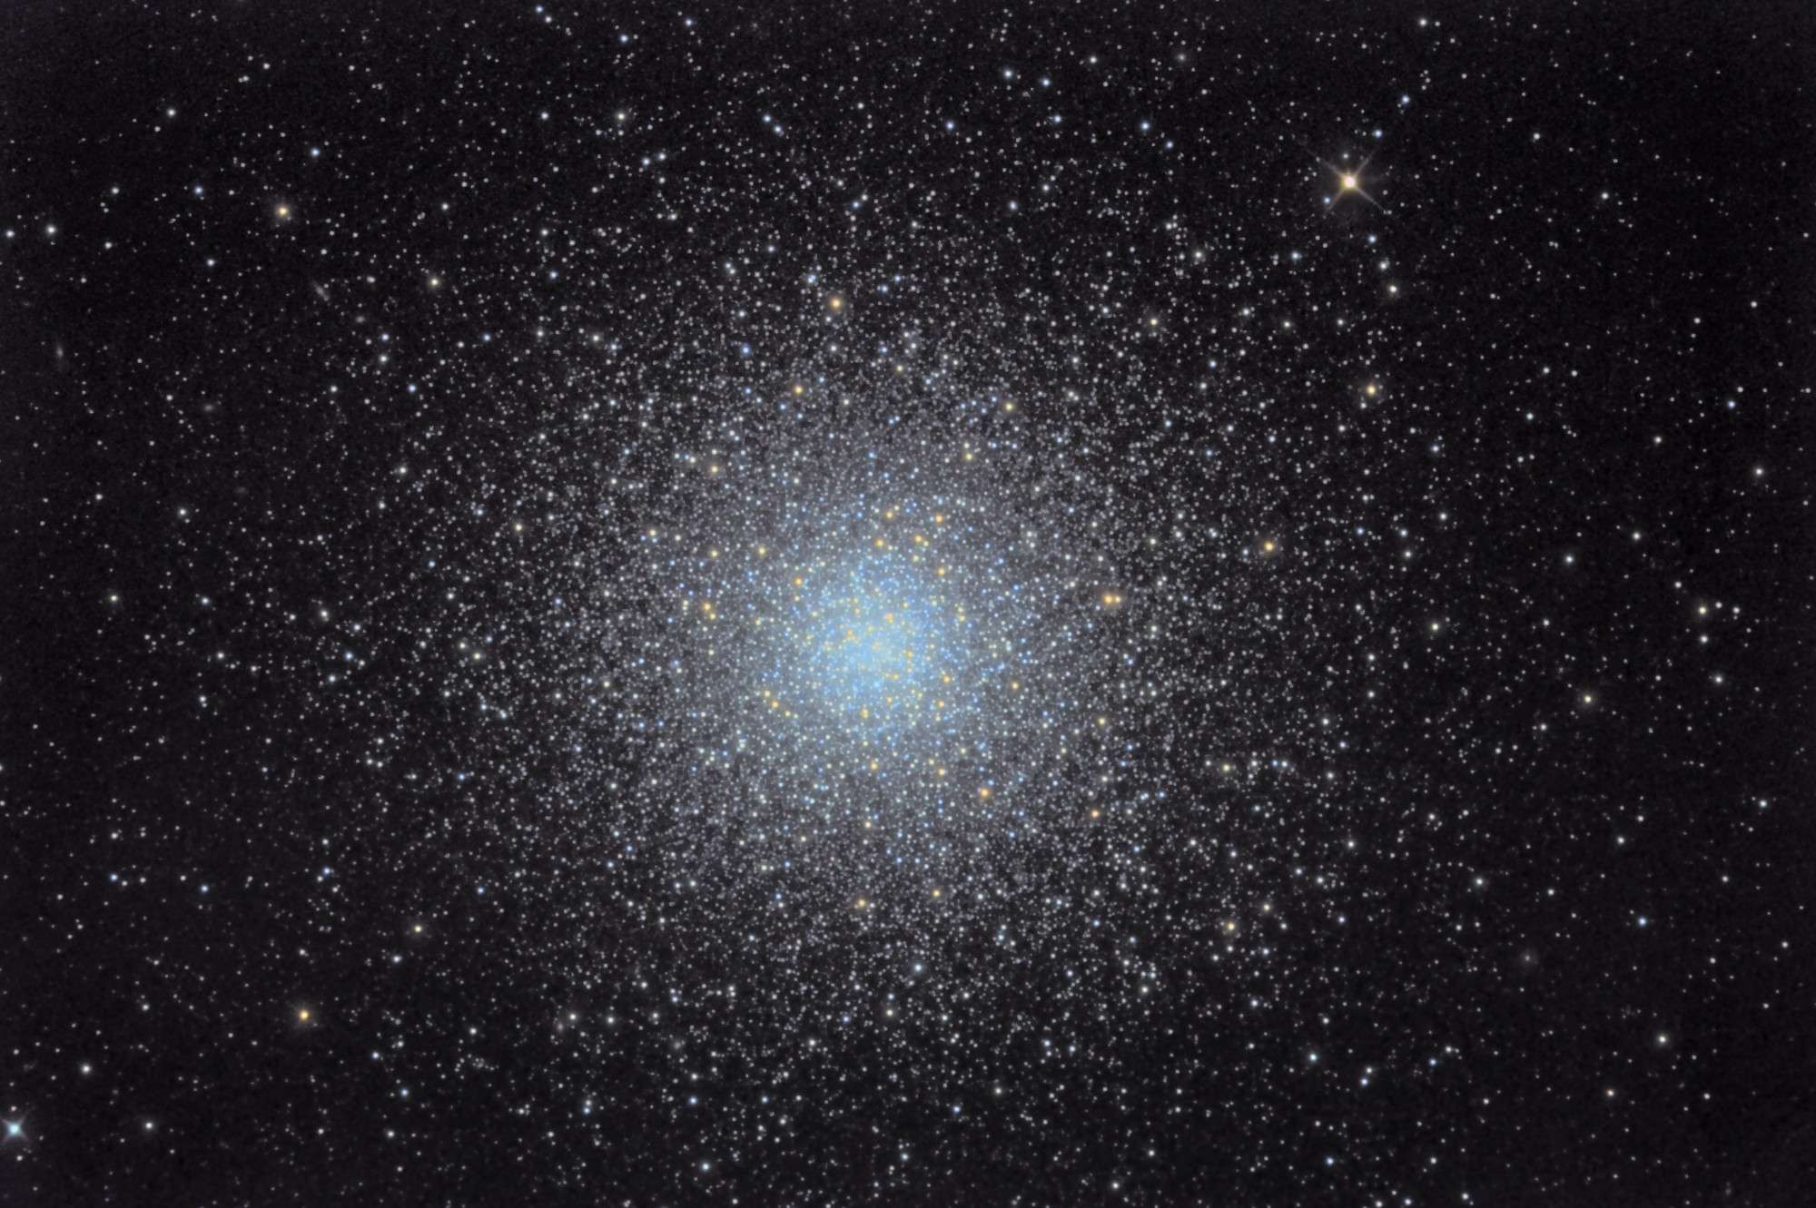
HCC is a Complex System
A complex system is composed of interconnected parts that as a whole exhibit some properties not obvious from the properties of the individual parts .

Slide 38
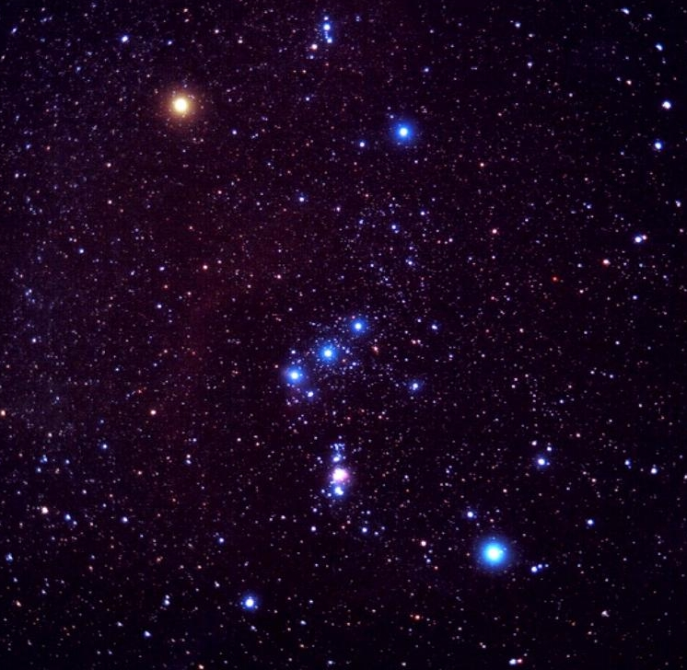
Cirrhosis
HCV
Age
Child-Pugh
NASH
MR
CT
PST
MELD
HBV
(CE)US
Fibrosis
Alcohol
Co-morbidities
Dysplastic nodules
Gene mutations
AFP
Biopsy
Obesity
HCC
HAIC
TAE
Anti-viral therapies
PEI
MWA
TARE
LTx
TACE
Resection
Supportive care
Sorafenib
…Trials
RFA

