Slide 1
DANNO EPATICO DA FARMACI ( DILI )
Gaetano Scifo
U.O.C. Malattie Infettive P.O. Umberto I ASP Siracusa

Slide 2
DILI
DILI ( Drug induced liver injury ) is a rare but potentially severe adverse drug reaction that should be considered in patients who develop laboratory criteria secondary to administration of a potentially hepatotoxic drug or non-infectious toxic agent and it is associated with different level of organ dysfunction

Slide 3
DILI is rare
- 10 – 20 per 100,000 pt / years
( 3,6 % ADR in Italy )
- 1 per 10000 – 1.000.000 prescriptions
- > 1000 drugs and HDS causing jaundice
- a better definition of DILI epidemiology has
been obtained with international registries in
USA and in Europe
DILI is also a leading cause of attrition of compounds in drug development and one of two most frequent causes for drug withdrawals restrictions and project termination

Slide 4
Of 76 drugs withdrawn from the market between 1969 and 2002 12 were attributable to liver damage

Slide 5
Major problem in drug development
Frequency of adverse hepatic reactions induced by the newer molecular targeted agents in oncology
Hepatotoxicity occurs in one third of patients treated with protein kinase inhibitors ( fatal outcome reported for pazopanib, sunitinib , regorafenib )
10% of patients treated with immune inhibitors (ipilimumab ) develop liver injury
The EGFR TKI ( gefitinib ) is associated with a 18,5% frequency of hepatotoxicity
The oncology population treated with MTAs is more likely to have multiple comorbidities and comedications (risk for hepatotoxicity)
Intensive post marketing surveillance of MTA-associated liver injury is required

Slide 6
Farmaci oncologici

Slide 7
Idiopatic vs Idiosincrasic DILI
Patients who consume acetaminophen at a single dose exceeding 7,5 gt , experience acute liver toxicity , 4 or 8 hours after ingestion ; acetaminophen intake at licensed dose of 4 gr/day over two weeks results in ALT elevations above 3 x ULN in one third of patients
Damage entity is proportional to administered dose
This form of dose-dependent acetaminophen toxicity is termed intrinsic DILI ( predictable , reproducible, known as concerns the underlyng mechanisms and develops with short latency after the consumption of drug )

Slide 8
Idiopatic vs Idiosincrasic DILI
Idiosincrasic DILI is non predictable , characterised bay a variable latency ( two weeks to months ) and a lack of a clear dose dependency
Drug-protein adducts, formed by drugs or their metabolites that interacts with host protein , are presented as neoantigens by HLA II triggering an immunoallergic injury
Individuals with underlyng hepatic injury ( viral hepatitis or inflammatory conditions ) may be more suscettible to immunoallergic injury

Slide 9
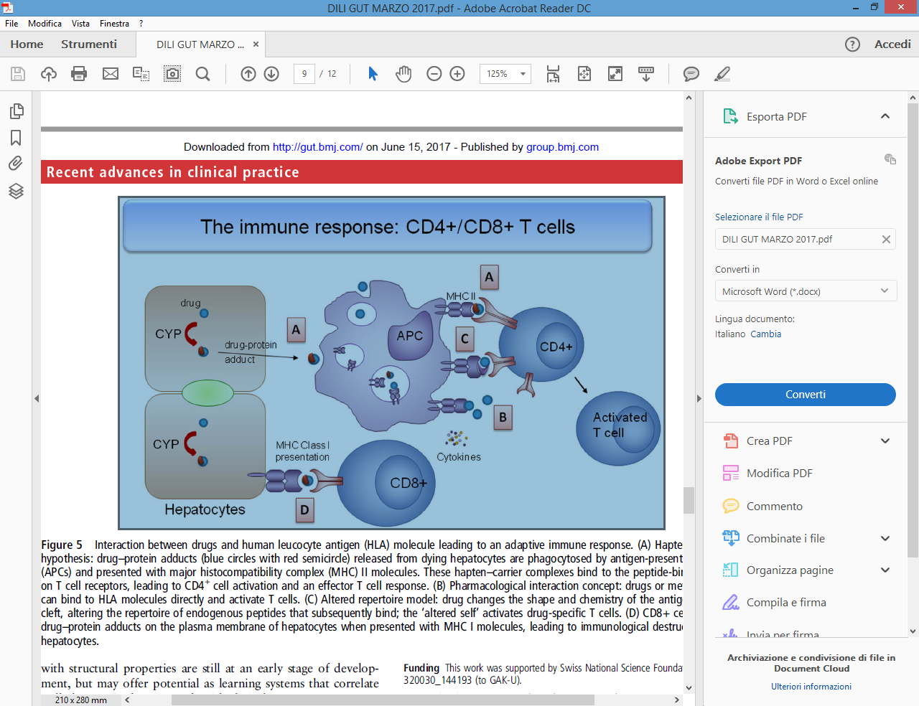

Slide 10
Idiopatic vs Idiosincrasic DILI
Following the initial insult , additional mechanisms can further amplify the injury :
Inhibition of transporters
Mitochondrial injury
Endoplasmic reticulum and oxidative stress
Proinflammatory cytokines

Slide 11
DILI Diagnosis
DILI is a clinical diagnosis
- clinical presentation variable
- exclude competing causes ( < 1% of acute liver injury )
- evaluation of biochemical pattern
- variable latency ,histology ,severity (poli-pharmacy common )
- difficult & delayed diagnosis
- time of exposure and course of liver damage are critical
points
- probability score and analysis of literature reports are
useful tools
- main cause of ALF and ALF related liver transplantation
in USA

Slide 15
Current diagnosis of DILI
Depends on expert opinion that is based on patient data and the tipical “ signatures “ associated with certaines drugs
Causality score ( RUCAM ) are intended to confirm or exclude the suspicion of DILI

Slide 16
RUCAM ( Roussel-Udaf Causality Assessment Method ) diagnostic score
RUCAM is applicable only for acute injury not for preexisting chronic liver disease

Slide 17
DILI presentation
Acute viral hepatitis-like syndrome , without symptoms unless rash or other cutaneous manifestations
The clinical spectrum can mimic almost every other liver disorder
Concomitant eosinophilia is rare
Histopathological findings in DILI can resemble many other liver disorders , thereby limiting the value of liver biopsy in DILI diagnosis

Slide 18
Hy’s Law ( referred by R. Temple )
Observation made by Hyman Zimmerman in 70s
suggesting a 1 in 10 mortality risk of DILI if the
following three criteria are met :
Serum ALT or AST > 3 x N
Serum total bilirubin elevated to > 2 x N without initial findings of cholestasis ( elevated serum alkaline phosphatase )
No other reason can be found to explain the combination of increased ALT and bilirubin such as viral hepatitis A,B,C or other preexisting or acute liver disease
Currently used by FDA in the evaluation of potential drug related liver damage

Slide 19
DILIN (2009)

Slide 20
INTERNATIONAl WORKING GROUP ON DILI ( 2011 )
GP Aithal et al Clinical Pharmacol Ter 2011 89 : 806 - 15
ALT _> 5 x ULN
ALP _> 2 x ULN
ALT _> 3 x ULN & TB _> 2 xULN
Rise of ALT and ALP , reliable marker of tissue damage
Rise of BT , decrease of albumin and INR , are indicative of liver
dysfunction

Slide 21
Algoritmo diagnostico

Slide 22
The FDA’s Liver Toxicity Knowledge Database ( LTKB )
Contains 3 categories of drugs
Most DILI concern drugs ( boxes warning or withdrawn from
the market due to hepatotoxicity )
Less DILI concern drugs ( DILI mentioned in the label )
No-DILI concern drugs ( non DILI indicated in the label )
Analising data from 254 drugs , FDA group found that drugs
that are substrates of cytocrome P450 enzymes are a higher
likelihood od causing DILI irrespective of the administered
dose wereas mere inhibitors of P 450 enzymes were only
associatedwith a risk of DILI at higher dose
Other groups have applied inhibition of BSEP ( Bile Salt Export
Pump ) and mitocondrial toxicity as parameters to stratify
most- , less- or no- concern drugs

Slide 23
Algoritmo diagnostico

Slide 27
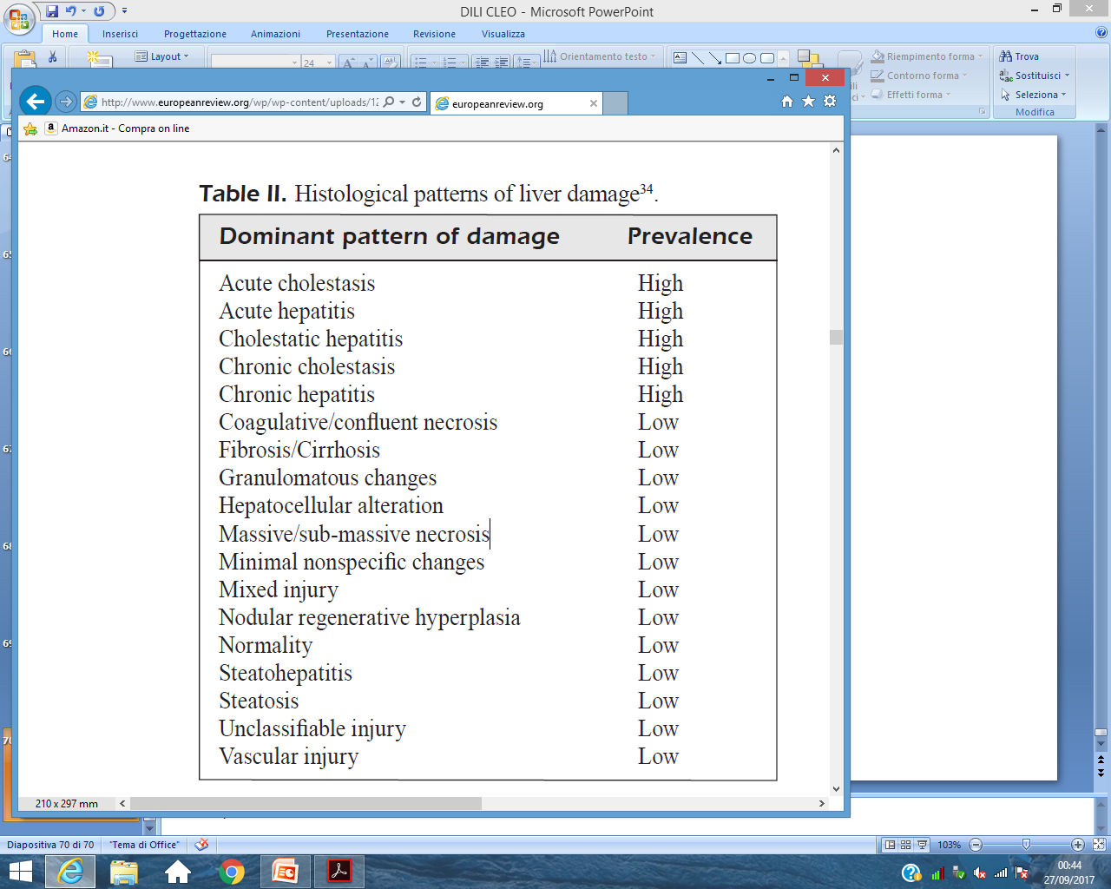

Slide 28
SIGNATURE
Istological signature
Drug signature ( severity , latency and biochemical
pattern

Slide 29
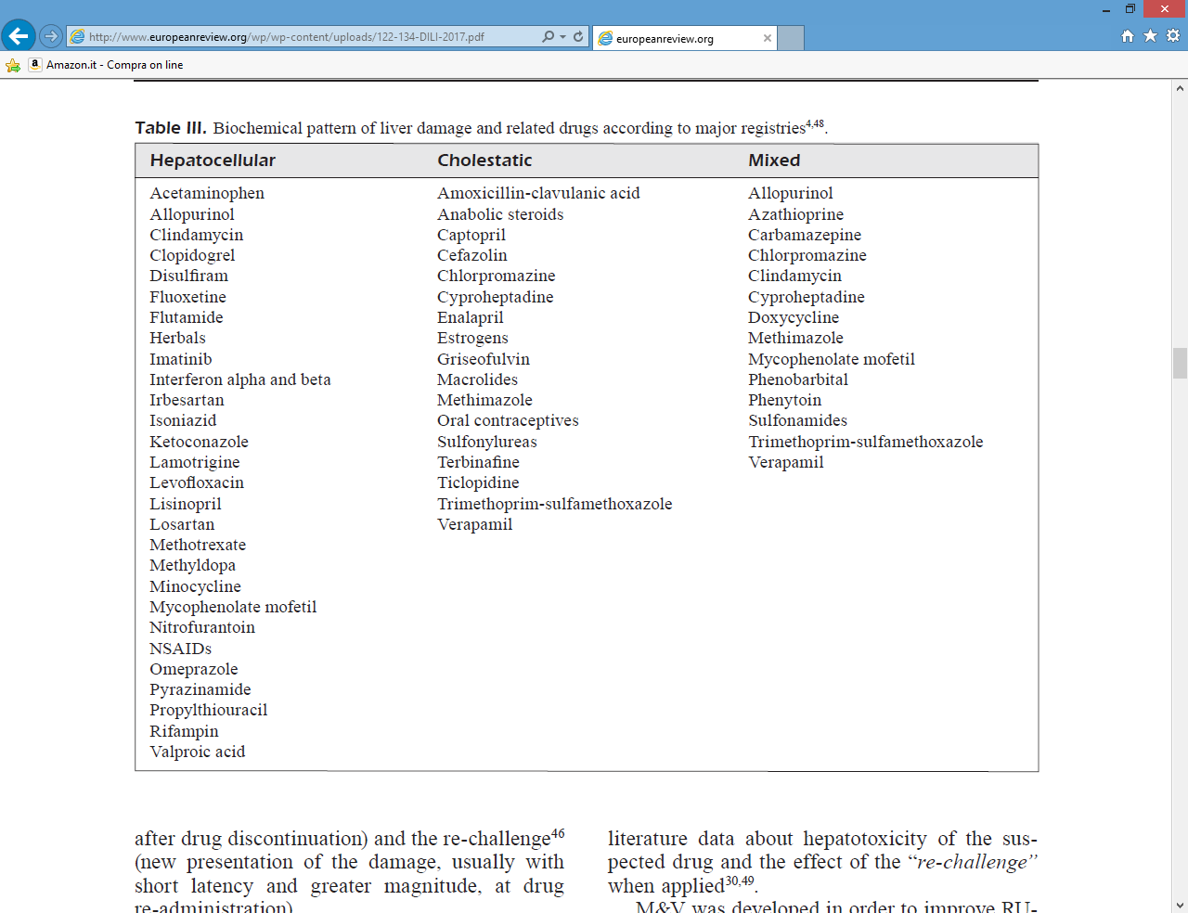

Slide 30
SIGNATURE
Istological signature
Drug signature ( severity , latency and biochemical
pattern )

Slide 31
Reexposure
Reexposure to a drug thought likely have caused hepatotoxicity is strongly discouraged , especially if the initial liver injury was associated with significant aminotranspherase elevation ( for example > 5 x N or Hi’s law or jaundice )
In individuals with suspected DILI , especially when liver biochemistries are rising rapidly or there is evidence of liver dysfuncyion , suspected agent(s) should be promptly stopped

Slide 32
Key question for the management
Key question is wether a patient in whom DILI has been diagnosed will progress to severe liver injury with potentially fatal outcome or recover spontaneous after cessation of causative agent
A diagnostic algorithm that allows identification of risk factor and prediction of the subsequent clinical course

Slide 33
Prognostic evaluation
Prominent cholestatic component defined by elevation of ALP is associated with less risk of progression
Recent analysis from Spanish DILI Registry showed that raised ALP > 2 x ULN not decrease the risk of ALF in cases that fulfilling HY’s Law
Marked raise of AST and an AST/ALT ratio > 1,5 at DILI recognition predict a worse prognosis
Persistently elevated TB and Alp ( 30 – 60 days ) can predict chronic outcome
Robles Diaz M. Gastroenterology 2014

Slide 34
Associated determinants with a more severe course
Female sex
Older age
Preexisting liver disease
Alcool abuse
Hepatocellular biochemical pattern
Some genetic determinants
Robles Diaz M. Gastroenterology 2014

Slide 35
DILI & autoimmune features
ANA , ASMA , elevated IgG level and histological features of AIH may cause diagnostic confusion in DILI
Screening for autoimmune disease is mandatory and pathological features of AIH may also be drug induced
DILI with autoimmune features should distinguished from idiopathic disease and tipically resolves after stopping the causative drug
A lack of recurrence after stopping corticosteroids supports a diagnosis of drug-induced AIH rather idiopathic AIH
No diagnostic test to differentiate idiopathic from drug related AIH
Liver histology ( low count of mature B cell and NK in portal tracts of DILI , high count of B cell and plasma cells in AIH )

Slide 43
Chronic liver disease after acute hepatocellular DILI

Slide 45
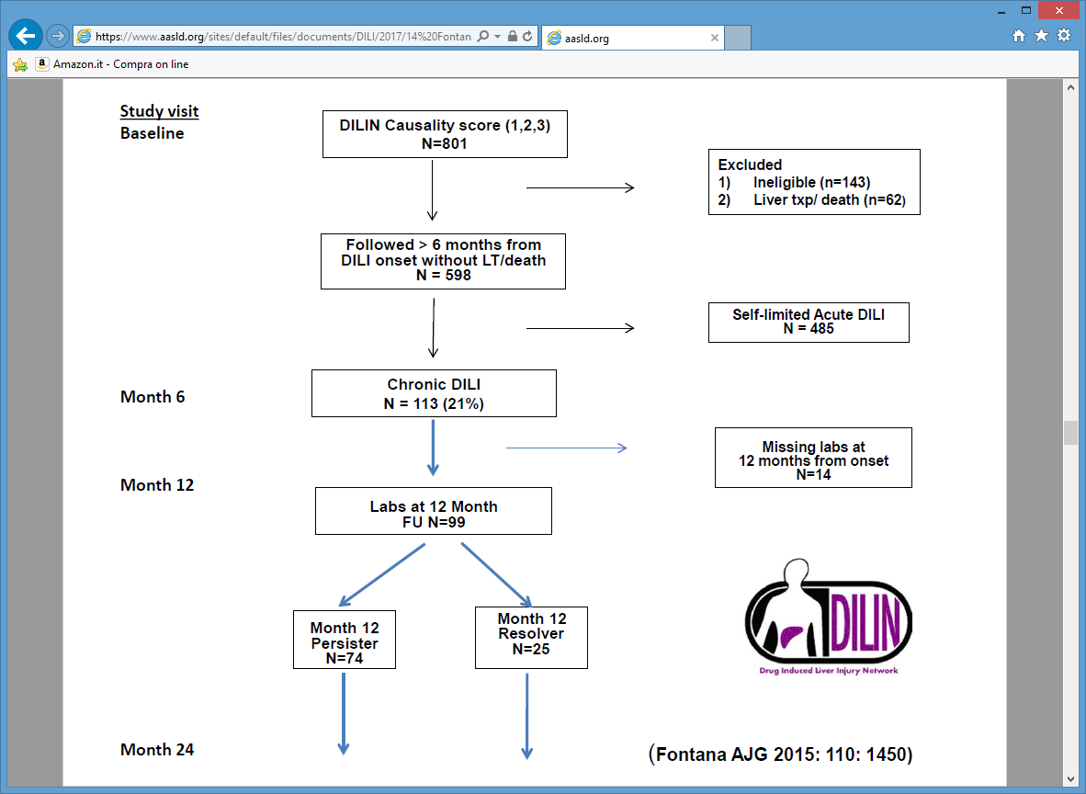

Slide 47
DILI in NAFLD and others diseases

Slide 59
IN VITRO AND IN SILICO TOOLS FOR THE ASSESSMENT AND PREDICTION OF DILI
Cell-based assays ( human hepatocytes , immortalised
hepatocytes , hepatoma cells lines , pluripotent stem cells cell
derived hepatocytes )
Animal models ( heterozigous SOD2 +/- mouse )
Chimeric mice with humanised livers
These models have proven useful to elucidate mechanisms
The prediction of DILI in a susceptible individual has not been
possible by any of these in vitro systems

Slide 60
Assessing causality in patients with polipharmacy
A test system called MetaHeps allows identification of the DILI
causing drug
This test use monocyte-derived hepatocyte-like cells from the
affected patient
MH cells from patients with DILI are more susceptible to
toxicity by the causative drug than MH cells derived from
patients non DILI
The identification of true positive among patients with
multiple comedications could help to develop more specific
biomarkers tht identify patients at risk of progressing more
severe DILI

Slide 61
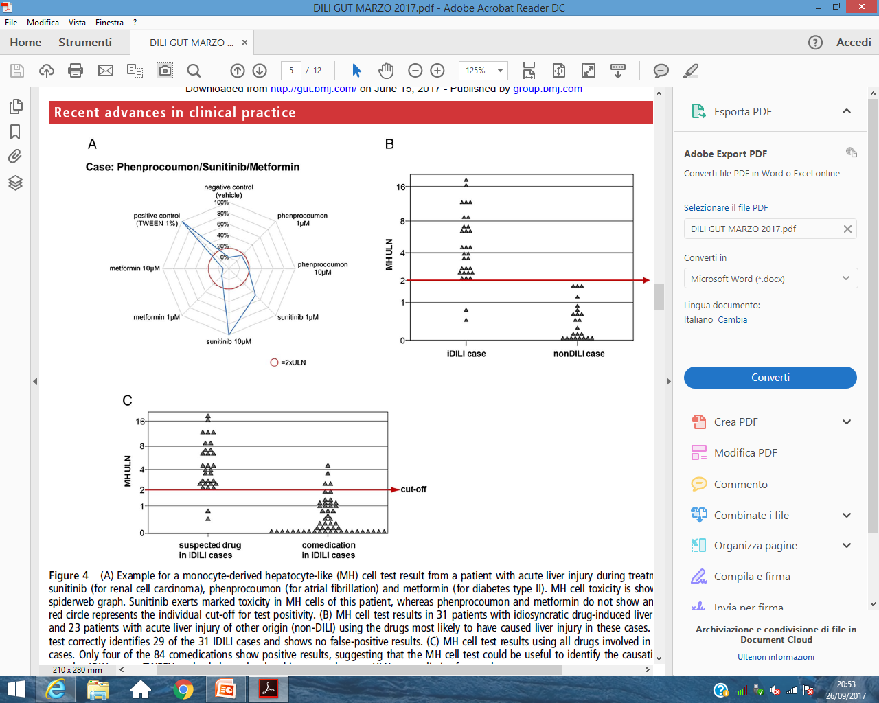

Slide 62
New liver biomarkers
MicroRNA -122 ( mir-122 ) hepatospecific
HGMB1 is a chromatin-binding ptotein released by necrotic
cells , subsequently targets TLR and RAGE , thus acting as
DAMPM ( Damage Associated Molecular Pattern Molecule )
MCSFR1 Macrophage Colony Stimulating Factor Receptor 1 ,
marker of immune activation
Glycodeoxicolic acid have prognostic value

Slide 65
New liver biomarkers
MicroRNA -122 ( mir-122 ) hepatospecific
HGMB1 is a chromatin-binding protein released by necrotic
cells , subsequently targets TLR and RAGE , thus acting as
DAMPM ( Damage Associated Molecular Pattern Molecule )
MCSFR1 Macrophage Colony Stimulating Factor Receptor 1 ,
marker of immune activation
Glycodeoxicolic acid have prognostic value

Slide 66
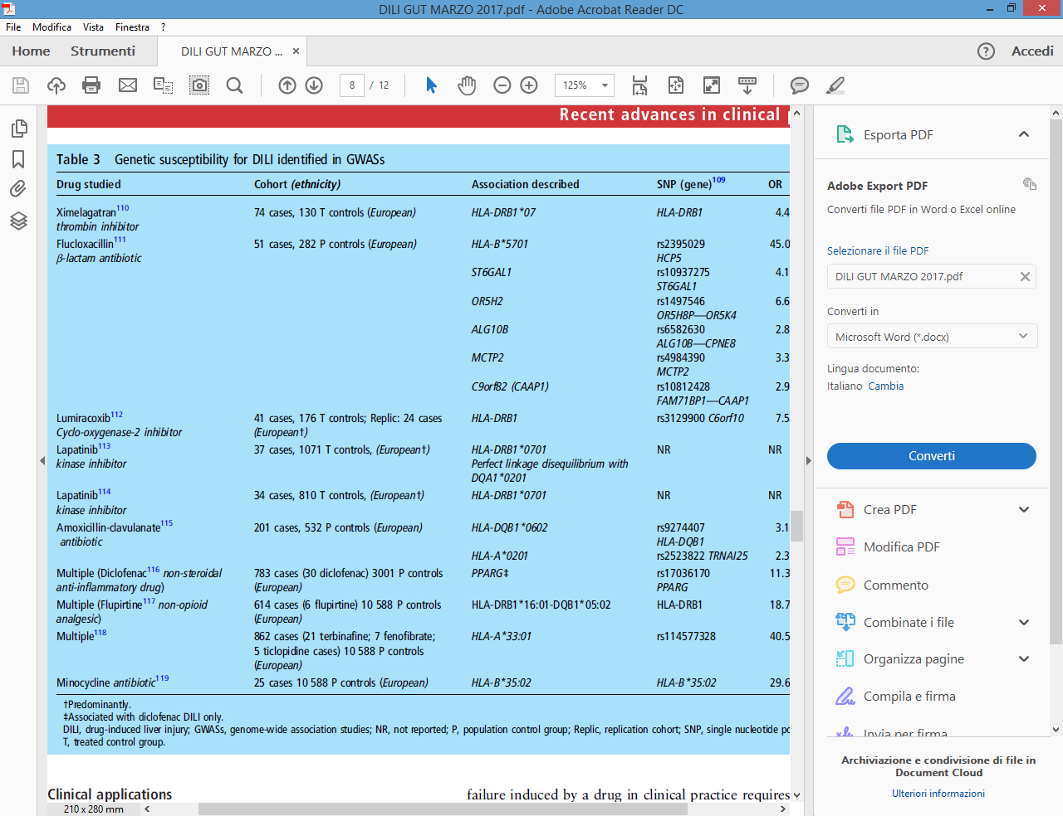

Slide 70
Specific Treatment for DILI are scarce
Corticosteroids can be used in DILI with clinical and laboratory
manifestations of hypersesitivity and in DILI-induced
autoimmune hepatitis
Antihistamines eventually associated with cholestyramine can
be useful as a symptomatic treatment for itching in cholestatic DILI
Cholestiramine can have specific indication for leflunomide
induced liver injury
L-carnitine is recommended in the treatment of valproate –
induced direct hepatotoxicity
Folic acid is used to reduce methotrexate toxicity
UDCA is vastly used in cholestatic DILI but its efficacy is uncertain

Slide 71
TAKE HOME MESSAGES
DILI sinonimo di danno epatico idiosincrasico raro ma negli USA la
piu’ frequente causa di ALF e di trapianto per ALF
Diagnosi clinica e di esclusione
Per la diagnosi occorre ricorrere ai probability score ( RUCAM ) e a
Banche dati che analizzano i report della letteratura scientifica
Diversi profili di danno biochimico hanno diverso significato
prognostico ( ipertransaminasemia > ALF , Fosfatasi alcalina e BT
danno cronico ad impronta colestatica )
I farmaci hanno diverse « signature « istologiche , di severità , di
latenza e di alterazioni bioumorali
La prognosi condizionata anche da : sesso , età , alcol ,malattie
epatiche preesistenti , danno epatocellulare , fattori genetici
La storia naturale è abbastanza ben studiata ( DILIN )
Nuovi biomarkers sono in valutazione
La terapia rimane condizionata dalla scarsa disponibilità di farmaci

