Slide 1

NASH e HCC
G. Svegliati-Baroni
Clinica di Gastroenterologia
SOS Epatopatie Croniche-Trapianto di Fegato
Università Politecnica delle Marche, Ancona

Slide 2
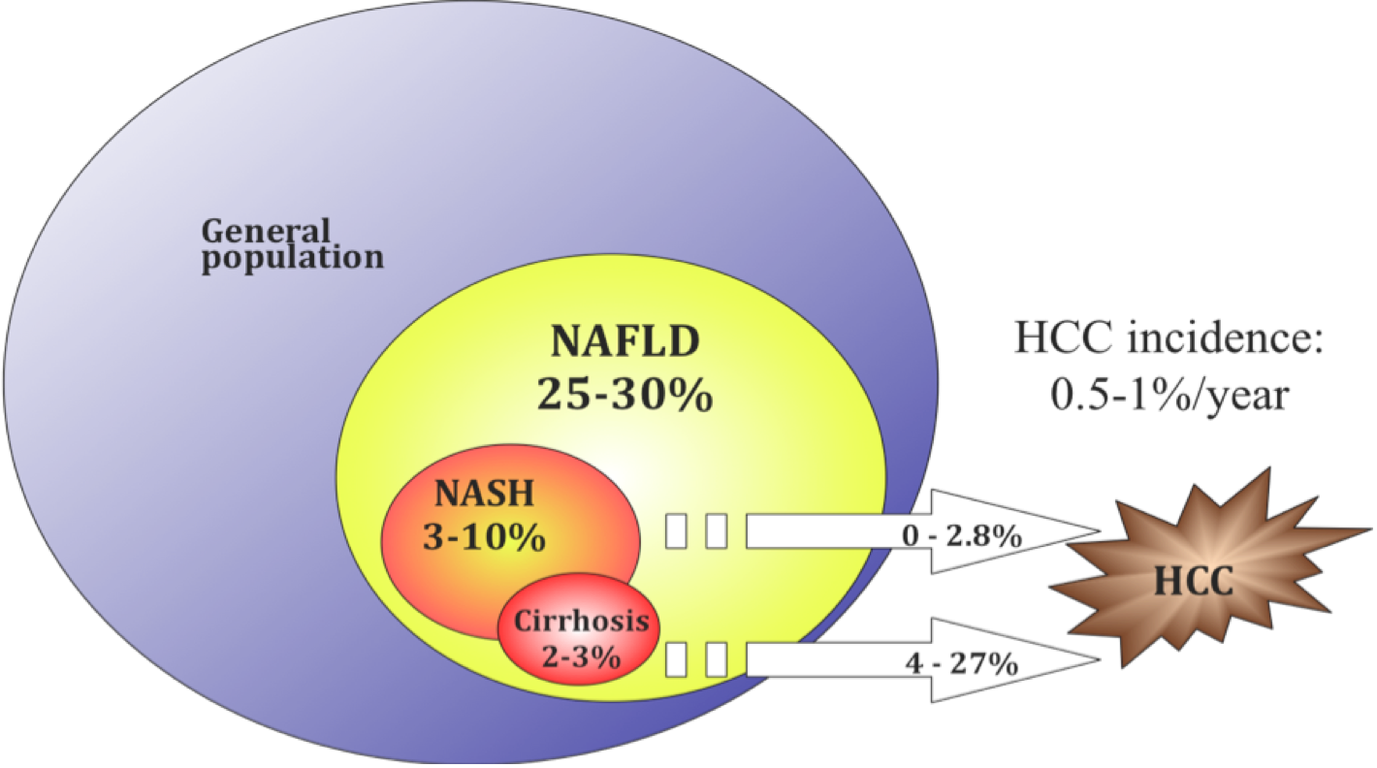
THE BURDEN OF NAFLD/NASH
Notes:
Nessuno conosce la storia naturale di NAFLD/NASH, nè la reale incidenza di HCC in queste patologie....

Slide 3
Worldwide estimated new PLC cases and mortality
(2012)
Incidence
782,000 new PLCs worldwide
5th most common cancer in men (554,000 cases, 7.5% of total) and 9th in women (228,000 cases, 3.4%)
Mortality
2nd most common cause of death from cancer worldwide, responsible for nearly 746,000 deaths
HCC is the main cause of mortality in compensated cirrhosis
Globocan, IARC 2012

Slide 4
Geographical distribution of risk factors
>80% HCC associated with HBV or HCV

Slide 5






Risk factors of HCC
>80% associated with HBV o HCV (“viral” cancer)
Pisani et al., Cancer Epidemiol Biomarkers Prev 1997
Western society
HCC is becoming an “addiction-environmental” cancer:
Drugs
Alcohol
Food
Tobacco smoking
Environmental contaminants
Notes:
Sappiamo con certezza che, nelle aree non colpite da una iperendemia da HBV, almeno l’80%.
Se poi consideriamo le cause più comune di CLD e HCC nel mondo occidentale (C ed alcool), raggiungiamo prevalenze prossime al 100%.

Slide 6
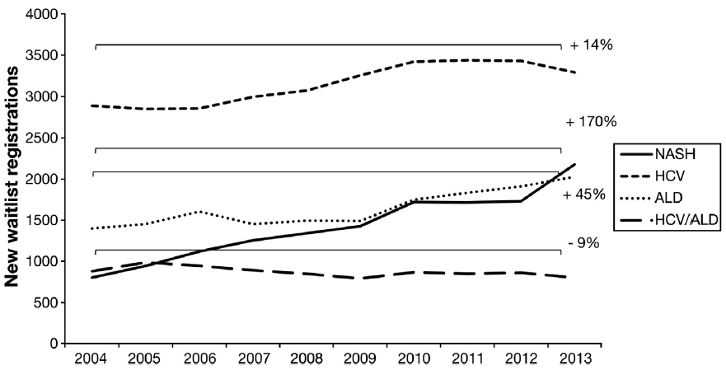
Nonalcoholic Steatohepatitis Is the Second Leading Etiology of Liver Disease Among Adults Awaiting Liver Transplantation in the United States
Wong et al., Gastroenterology 2015
Notes:
From 2004 to 2013, NASH demonstrated the greatest increase as a cause of chronic liver disease among new liver transplant waitlist registrations, increasing 170% and becoming the second
leading etiology of chronic liver disease among new waitlist registrants in 2013 (Figure 1). During this same period, new waitlist registrants with ALD increased 45% and HCV
increased 14%, and patients with HCV/ALD decreased by 9% (Figure 1).

Slide 7
What is
Non-Alcoholic Fatty Liver Disease (NAFLD)?
NAFLD is a chronic liver condition characterized by hepatic fat accumulation in the absence of ethanol abuse (<20g/day) & other identifiable causes
NAFLD is associated to insulin resistance
NAFLD is considered the hepatic manifestation of Metabolic Syndrome
NAFLD
Insulin
resistance
T2DM
Hypertension
BMI & WC
Dyslipidemia

Slide 8
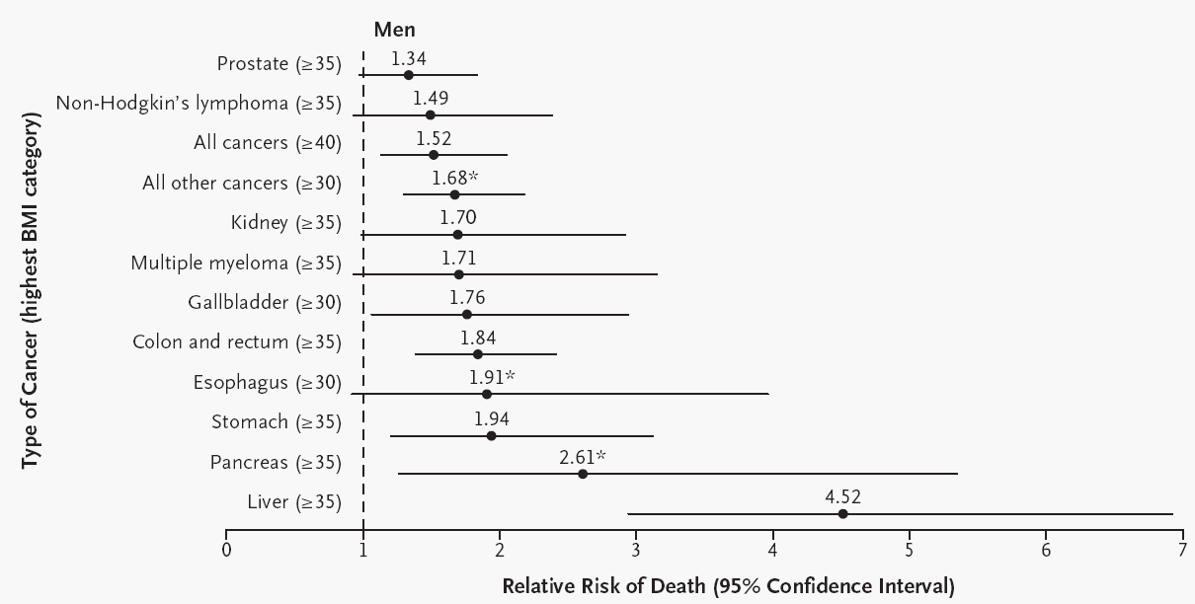
Overweight, Obesity, and Mortality from Cancer in a Prospectively Studied Cohort of U.S. Adults.
Calle et al., NEJM 2003
Notes:
…e nella categoria dei soggetti maschi con il BMI più elevato, raggiunge il rischio più elevato tra tutte le neoplasie.

Slide 9
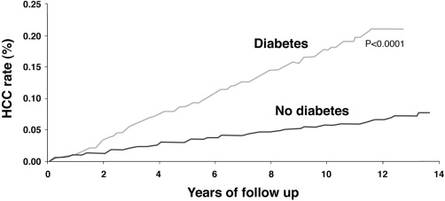
Emerging risk factors for HCC: diabetes
Case–control study: 173,463 patients with diabetes vs 650,620 without diabetes.
No patient had acute or chronic liver disease recorded before, during or
within 1 year of the index hospitalization
824,263 hospitalized USA veterans (1985–1990):
HCC during follow-up: 317 diabetes (2.39 x 10⁵ person-years)
515 controls (0.87 x 10⁵ person-years)
El-Serag HB, et al. Gastroenterology 2004;26:460–8.

Slide 10
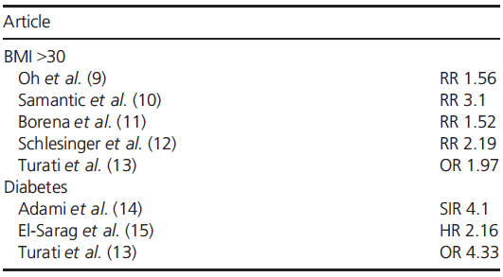
Risk of developing HCC in obese and diabetic patients.
Margini & Dufour, Liv Intern 2016
Notes:
Successivamente una serie di studi epidemiologici hanno dimostrato la relazione tra obesità e HCC da una parte e tra diabete e HCC dall’ altra, indipendentemente dal consumo di alcol o dalla presenza di infezioni virali.

Slide 11
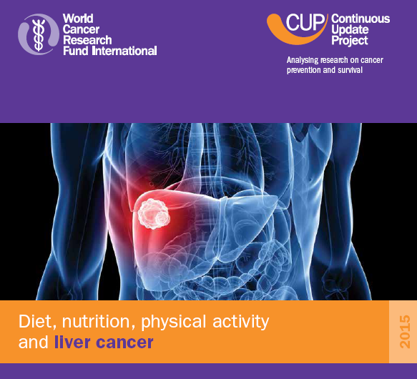

8.200.000 adulti
24.500 HCC

Slide 12
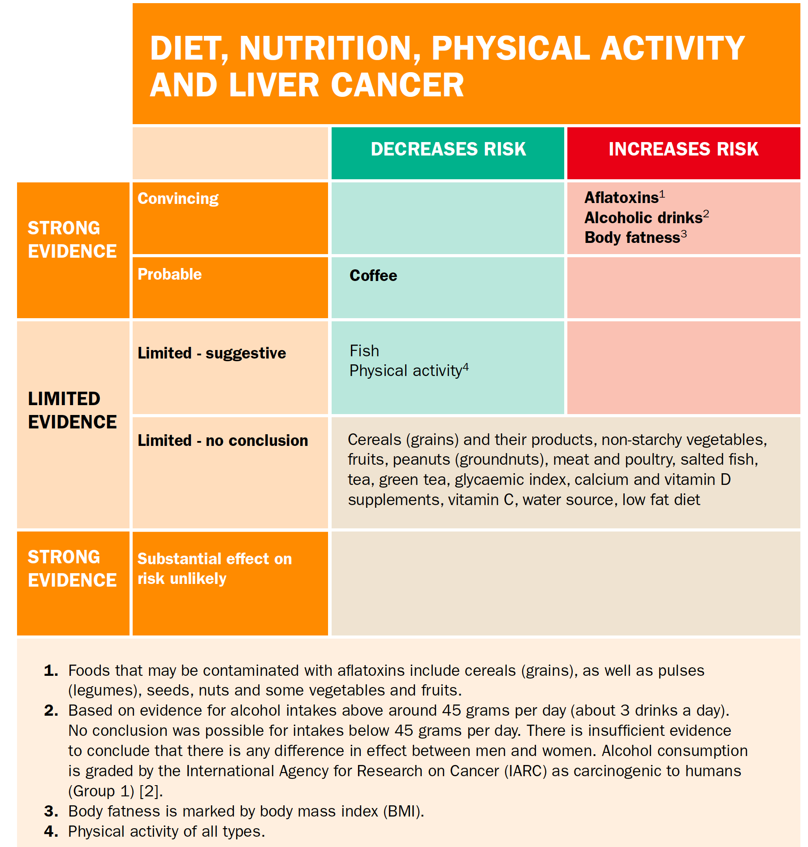

Slide 13


ITAlian.LIver.CAncer network 2015
(since 1998): 6597 pts.
Benvegnù L. (PD)
Borzio F. (MI)
Cammà C. (PA)
Caturelli E. (VT)
Ciccarese F. (Treviglio)
Colecchia A (BO)
Di Marco M. (Seriate)
Farinati F. (PD)
Giannini E. (GE)
Masotto A. (Negrar)
Nardone G (NA)
Felder M. (BZ)
Foschi G.F. (Faenza)
Gasbarrini A. (Roma)
Missale G. (PR)
Morisco F. (NA)
Piscaglia F. (BO)
Rapaccini G.L. (Roma)
Sacco R. (PI)
Svegliati-Baroni G. (AN)
Trevisani F. (BO)
Virdone R. (PA)
Zoli M. (BO)
BZ
MI
Seriate
Negrar
Treviglio
PD 1,2
PR
BO 1,2,3,4
Faenza
GE
PI
AN
FI
VT
Roma 1,2
NA 1,2
PA 1,2
Database ITA.LI.CA 2015

Slide 14
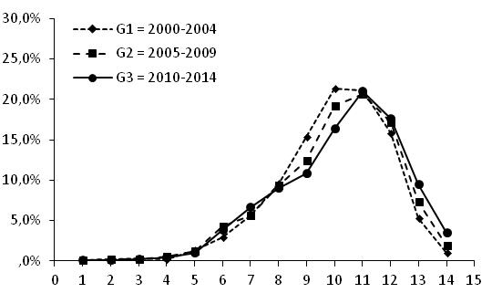
The changing scenario of hepatocellular carcinoma in the new century in Italy
 | Total n. 5192 | 2000-2004 n. 1147 | 2005-2009 n. 1624 | 2010-2014 n. 2421 | P
Mean age (±SD) years |  | 66.8 ± 9.5 | 67.4 ± 10.2 | 68.3 ± 10.6 | <0.001
30
25
HCC
Cirrhosis
Ageing
20
Patients (%)
15
10
5
0
<24
30-34
25-29
35-39
40-44
45-49
50-54
55-59
60-64
65-69
70-74
75-79
80-84
85+
Age (years)
Bucci L et al., Liv Intern 2017
Database ITA.LI.CA 2015
Notes:
L’ età alla diagnosi aumenta significativamente nel tempo, e questo si mantiene sia per le forme virali che per quelle non virali…probabilmente questo effetto è dovuto all’ effetto dei farmaci antivirali, sia HBV che HCV, che rallentano, ma non prevengono, i processi di epatocarcinogenesi

Slide 15
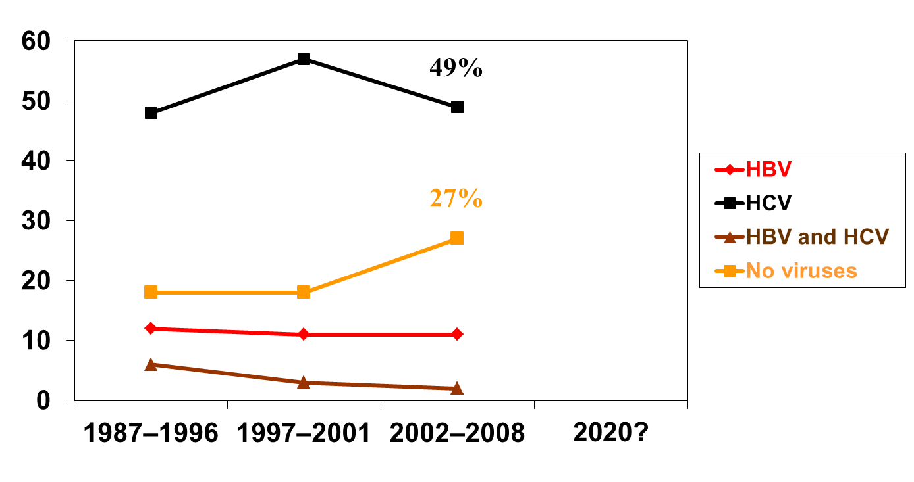
Etiology of HCC in Italy:
observed and expected temporal trends
11 centers, 3027 patients, recruitment period 1987–2008
Percentage
Santi V. et al., for ITA.LI.CA, J Hepatol 2012;56:397-405

Slide 16
The changing scenario of hepatocellular carcinoma in the new century in Italy
p < 0.001
Bucci L et al., Liv Intern 2017
Database ITA.LI.CA 2015
Notes:
In realtà questo appaiamento sembra essere ancora lontano…
multi-etiology, if there was a combination of: a) alcohol abuse or non-alcoholic NAFLD +
viral infection(s) (multi-etiologic-viral subgroup); b) alcohol abuse + other non-viral disease (multietiologic-
non-viral subgroup);

Slide 17
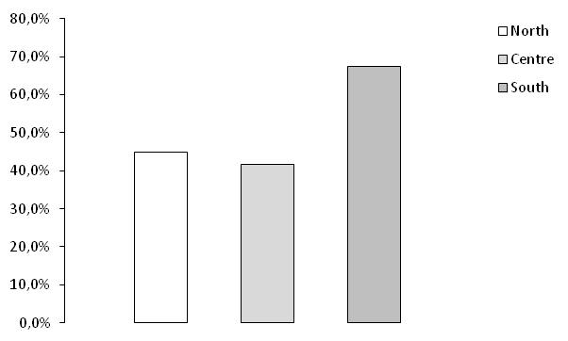
Etiology of HCC:
observed regional differences in Italy
HCV prevalence (2010-2014)
p<0.001
80
p<0.001
60
p=0.191
40
Percentage
20
0
North
Center
South
Bucci L et al., Liv Intern 2017
Database ITA.LI.CA 2015
Notes:
Per l’ alta prevalenza di HCV nei centri del Sud Italia, entrati in Italica nell’ ultimo quinquennio…la differenza tra Nord e Centro è verosimilmente legata al maggior consumo di alcol al Nord…

Slide 18
Etiology of HCC:
observed regional differences in Italy
HBV
Percentage
HCV
Multietiology
No viruses
North
Centre
South
Bucci L et al., in revision
Database ITA.LI.CA 2015

Slide 19
The changing scenario of hepatocellular carcinoma in the new
century in Italy
55%
49%
49%
HBV
HCV
31%
Multietiology
Percentage
28%
22%
No viruses
2000-2004
2005-2009
2010-2015
Bucci L et al., in revision
Database ITA.LI.CA 2015
Notes:
In realtà questo appaiamento sembra essere ancora lontano…
multi-etiology, if there was a combination of: a) alcohol abuse or non-alcoholic NAFLD + viral infection(s) (multi-etiologic-viral subgroup); b) alcohol abuse + other non-viral disease (multietiologic-
non-viral subgroup) (quello ceh è rpesentato qui, è la multietiology virale)

Slide 20
The changing scenario of hepatocellular carcinoma in the new
century in Italy
55%
49%
49%
HBV
HCV
31%
Multietiology
Percentage
28%
22%
No viruses
2000-2004
2005-2009
2010-2015
Bucci L et al., in revision
Database ITA.LI.CA 2015
Notes:
In realtà, escludendo il contributo dei 5 centri locati nel sud Italia, il trend di HCC legato ad HCV sarebbe continuato a scendere…

Slide 21
Virus-free HCC in ITA.LI.CA:
temporal trends in the new century
Percentage
Bucci L et al., Liv Intern 2017
Database ITA.LI.CA 2015

Slide 22
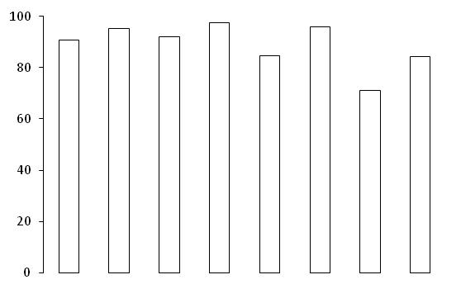
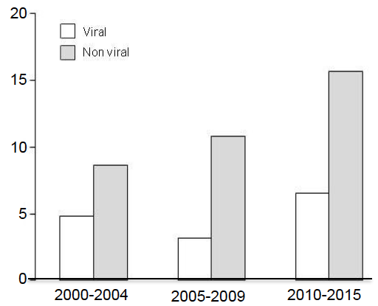
The changing scenario of hepatocellular carcinoma in the new
century in Italy
 | Total n. 5038 | 2000-2004 n. 1105 | 2005-2009 n. 1567 | 2010-2014 n. 2366 | P
Cirrhosis |  | 94.3% | 94.6% | 90.4% | <0.001
Prevalence of cirrhosis by aetiology
Proportion of HCC patients with a non cirrhotic liver
Viral
p < 0.001
Non viral
100
80
60
Percentage (%)
40
20
0
HCV
Other
HBV (± HDV)
Multiviral
Multiaetiology
Alcohol
Multiaetiology
NASH/Criptogenic
Bucci L et al., Liv Intern 2017
Database ITA.LI.CA 2015
Notes:
L’ HCC insorge su cirrosi nel 90% dei casi, anche se questa osservazione è significativamente meno frequente nelle cause non virali, portando all’ osservazione che l’ incremento delle cause non virali si associa ad un incremento delle diagnosi di HCC su fegato non cirrotico.

Slide 23
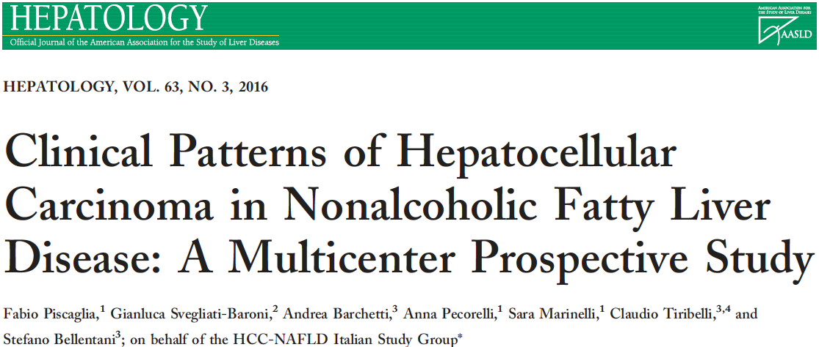
145 NAFLD-HCC vs 611 HCV-HCC from January 2010 to December 2012
Cirrhosis was detected in 78 of 145 NAFLD patients (53.8%)

Slide 24
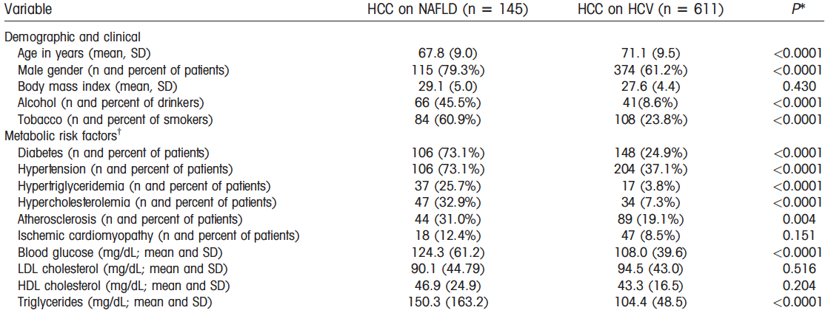
Notes:
I pazienti con HCC su NAFLD erano più giovani, di sesso maschile, fumatori e bevitori sociali di alcol, questo dovuto verosimilmente al fatto che non erano a conoscenza di una epatopatia cronica. I pazienti con HCC-NAFLD ovviamente avevano in misura maggiore i fattori della sindrome metabolica, guardate in particolare il diabete…

Slide 25
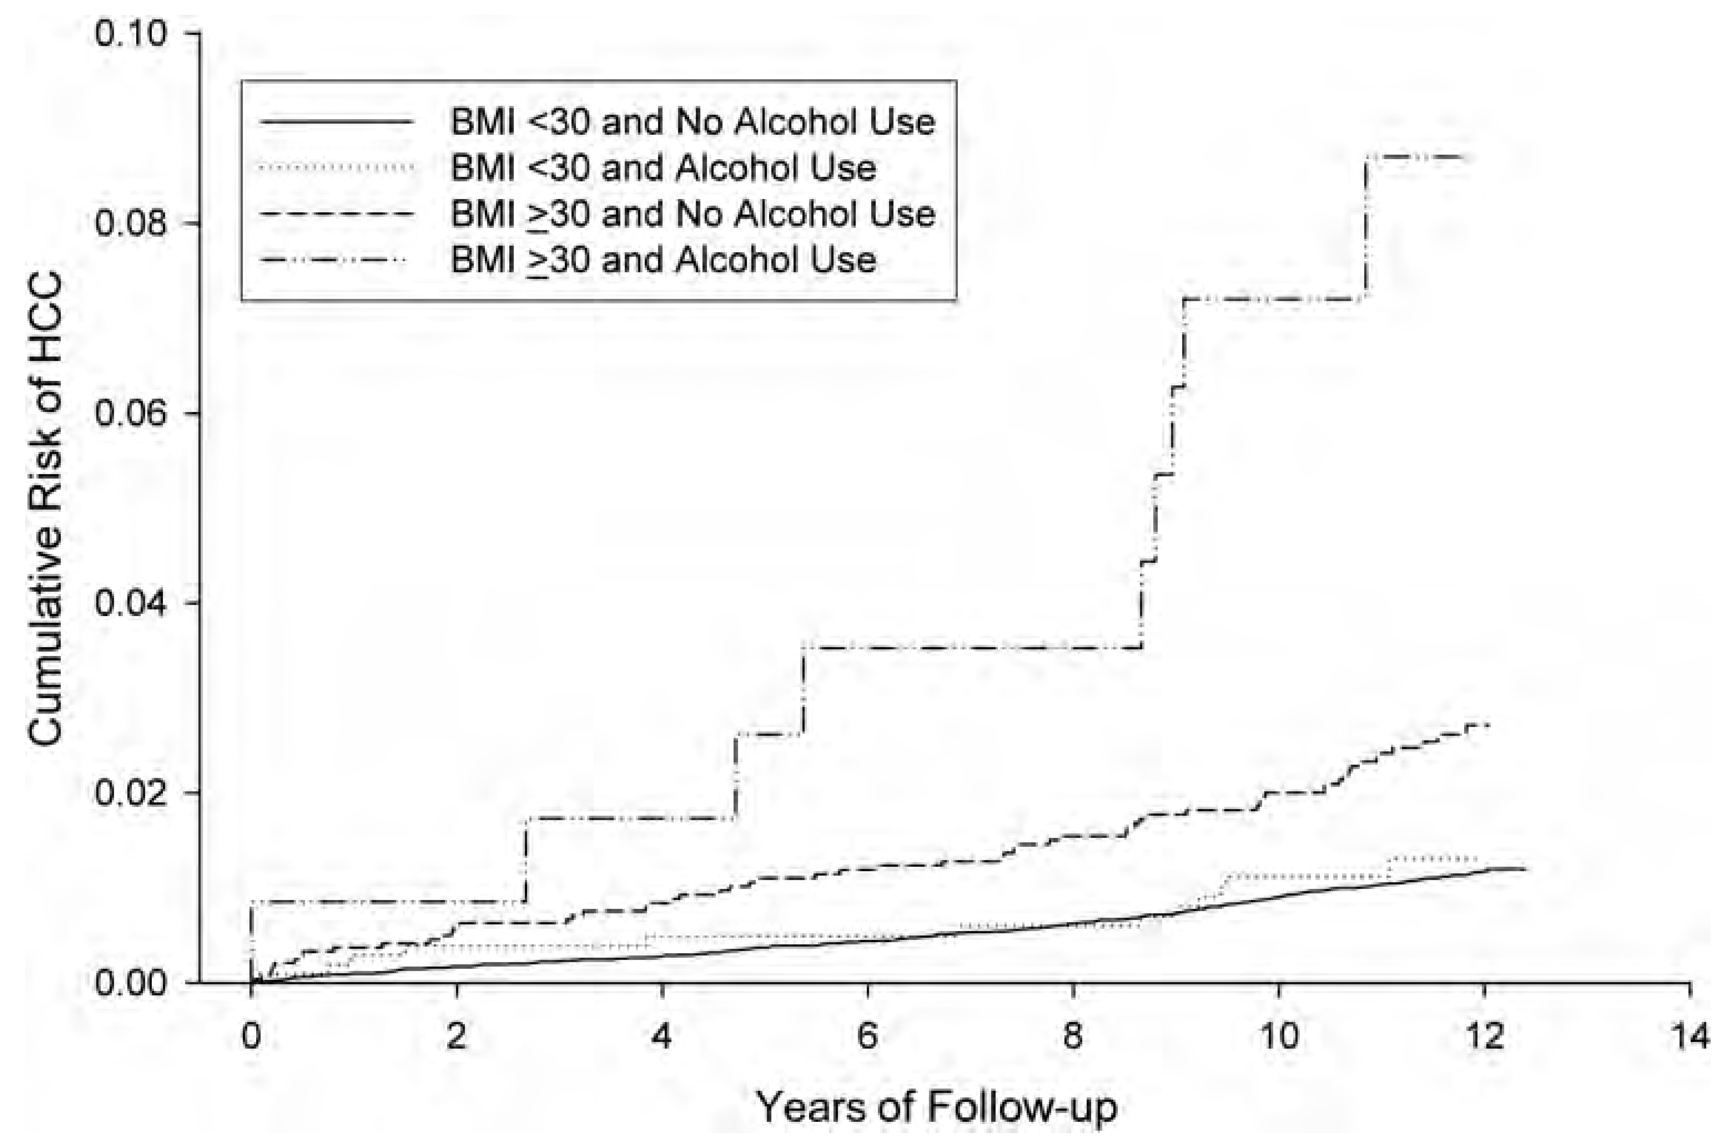
Synergism between obesity and alcohol in increasing the risk of hepatocellular
carcinoma: a prospective cohort study
Prospective cohort study of 27312 Taiwanese subjects, f-up 12 yrs
Drinkers
Non drinkers
8.7%
p < 0.001
p < 0.0001
Relative risk of HCC
2.7%
1.3%
Loomba et al., Am J Epidemiol 2013
Notes:
Dalla review di Sookolan Gastro 2016
Finally, the putative protection of MAC against NAFLD in obese individuals could be justifiably questioned because of the lack of studies exploring the long-term cumulative effect of MAC on liver fibrosis and cancer development. Alcohol use and obesity showed a synergistic association with the risk of incident HCC in a large study from Taiwan. Among alcohol drinkers, the cumulative risk of HCC in nonobese subjects was 2.7% vs 8.7% in obese participants.
Dal testo del paper
We found that risk of incident HCC was highest among obese alcohol users (P < 0.0001), followed by nonobese alcohol users. The risk of HCC was significantly lower in participants who did not consume
alcohol. In the Kaplan-Meier, the cumulative risk is shown. The graph shows the signifcant and synergistic effect of alcohol and BMI, confirmed at the multivariate analysis.
Limitations: no definition of the amount of alcohol.

Slide 26
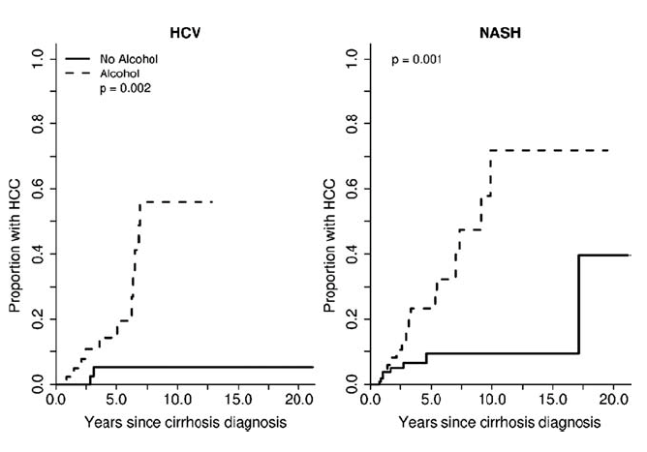
Risk of HCC development in cirrhosis
Social alcohol intake compared with no alcohol intake
Ascha et al., Hepatology 2010

Slide 27
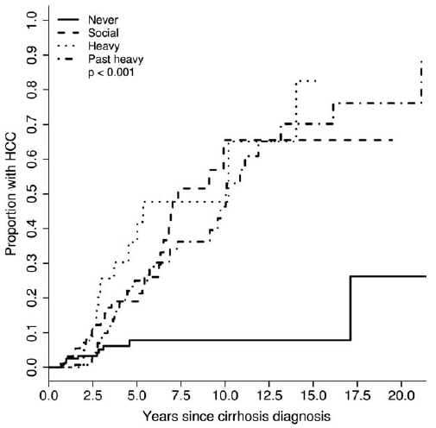
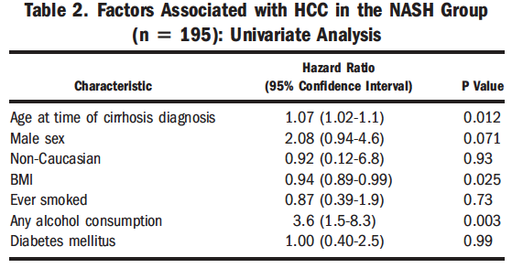
The incidence and risk factors of hepatocellular carcinoma
in patients with nonalcoholic steatohepatitis.
195 NASH-cirrhosis and 315 HCV-cirrhosis
3.2 yrs f-up, 12.8% NASH-cirrhosis and 20.6% HCV-cirrhosis developed HCC, p = 0.03
Ascha et al., Hepatology 2010
Notes:
Dal paper
Patients who reported never drinking alcohol were significantly less likely to develop HCC compared with those who reported any level of drinking (P < 0.001) in both the HCV and NASH groups. In multivariate analysis, adjusting for factors of interest based on univariate analysis, only older age at the time of cirrhosis diagnosis (hazard ratio, 1.08 [confidence interval 1.02-1.1]; P 1/4 0.006) and any alcohol consumption (hazard ratio, 3.8 [confidence interval 1.6-8.9]; P 1/4 0.002) remained independently associated with the development of HCC in the population with NASH-cirrhosis.
Prendere il discorso dalla review di Ajmera

Slide 28
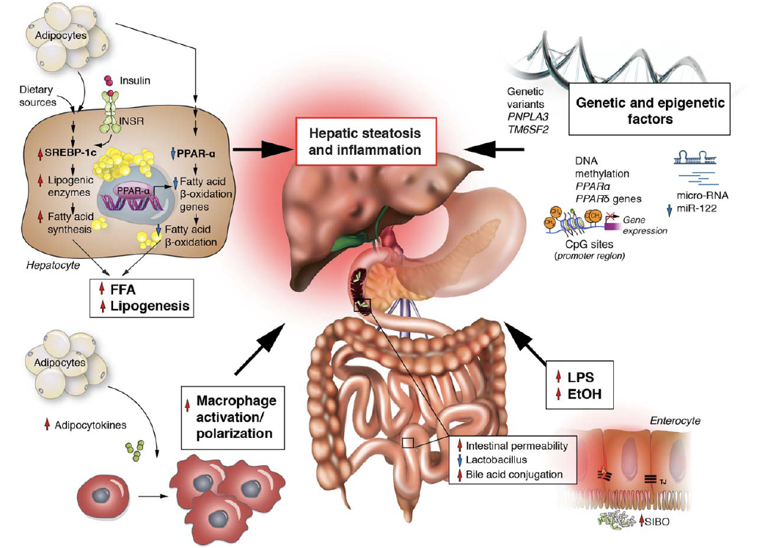
OVERLAP IN THE PATHOGENESIS OF AFLD AND NAFLD
Ajmera et al., Hepatology 2017
Notes:
Significant methodological limitations were present, including incomplete adjustment for confounding factors and failure to measure lifetime use or the pattern of alcohol intake. Thus, a strong recommendation of benefit of moderate alcohol use in NAFLD cannot be made due also to the overlap in the pathogenesis between AFLD and NAFLD.
Infatti AFLD e NAFLD hanno meccanismi patogenetici simili a cominciare dalla lesione base rappresentata dalla steatosi, causata da un eccesso di arrivo di acidi grassi liberi nella NAFLD e da una aumentata attività di SREBP-1c indotta da etanolo. Né nella NAFLD né nella AFLD sappiamo perché un paziente sviluppa solo steatosi ed un altro progredisce fino alla cirrosi ed all’ HCC.
In entrambi le situazioni, NAFLD e eccessivo consumo di etanolo, abbiamo insulino-resistenza e infiltrazione di marofagi attivati a livello del tessuto adiposo.
Inoltre i soggetti a rischio di progressione del danno epatico sono gli stessi sia per qaunto riguarda AFLD che NAFLD, in quanto vi è assoluta sovrapposizione tra i fattori genetici che contribuiscono alla progressione di queste due condizioni (PNPLA3 e TM6SF2).
Anche il ruolo delle modificazioni della microbiota sono sostanzialmente sovrapponibili: 1) in entrambi le situazioni esiste disbiosi ed aumento della permeabilità intestinale; 2) una caratteristica distintiva tra NAFLD e NASH è la capacità del microbiota intestinale di produrre elevate quantità di alcol; 3) i batteri intestinali in corso di NAFLD e AFLD sono in grado di produrre acidi biliari secondari che sono potenti attivatori dei meccanismi proinfiammatori (mettere e adattare il cartoon nostro).

Slide 29
How Safe Is Moderate Alcohol Consumption in Overweight and Obese Individuals?
…..obese patients with NASH and advanced fibrosis should be regarded as a high-risk population for progressing to end-stage liver disease; hence, alcohol drinking should be avoided.
Sookolan & Pirola, Gastro 2016
Notes:
Considerazioni sugli studi che hanno valutato il consumo di alcol nei pazienti NAFLD (dalla review di Ajmera Hepatology 2017):
No prospective, randomized trials on moderate alcohol use in NAFLD exist;
Second, alcohol use is obtained by history taking and thus subject to recall bias;
Finally, race and sex may influence the likelihood of abstaining from alcohol and the severity of NAFLD, leading to confounding of the results.
In addition, thresholds for moderate alcohol use in women are lower than in men, and use of a single cutoff can lead to misclassification.
No evaluation of binge drinking or drinking habit during the week can be provided.

Slide 30
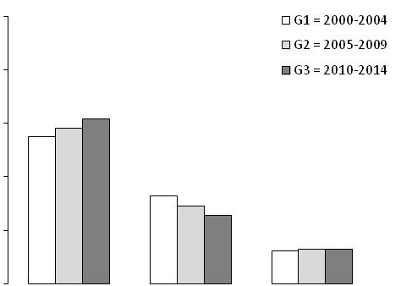
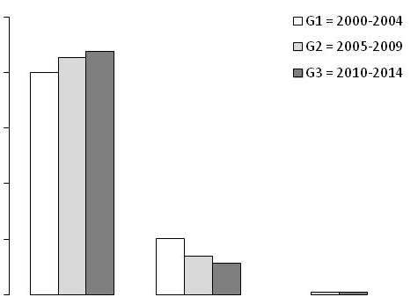
The changing scenario of hepatocellular carcinoma in the new century in Italy
Type of diagnosis
100
80
p = 0.030
Surveillance interval
p <0.001
B
60
100
p <0.001
Percentage
p <0.001
p = 0.017
40
p = 0.049
80
p = 0.013
20
60
Percentage
0
40
Surveillance
Incidental
Symptoms
p <0.001
Modality of HCC diagnosis
20
p =0.006
0
3-7
8-13
>13
Interval (months)
Bucci L et al., Liver Intern 2017
Database ITA.LI.CA 2015
Notes:
L’ HCC viene diagnosticato in pazienti sottoposti a sorveglianza in più del 60% dei casi, con una riduzione dei casi diagnosticati in modo incidentale. Per qaunto riguarda la modalità della sorveglianza, si è assistito ad un progressivo incremento della sorveglianza su base semestrale.

Slide 31
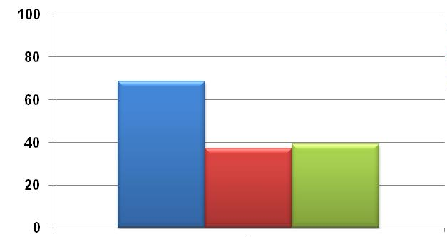
Surveillance for HCC by aetiology in ITA.LI.CA
Percentage of cases diagnosed during regular surveillance
68%
% patients
37%
39%
HCV
n. 2342
Alcohol
n. 864
NASH/ Crypt.
n. 271
Bucci L et al., in revision
Database ITA.LI.CA 2015
Notes:
Questo indica che l’ eziologia della malattia influenza la decisione sulla sorveglianza

Slide 32
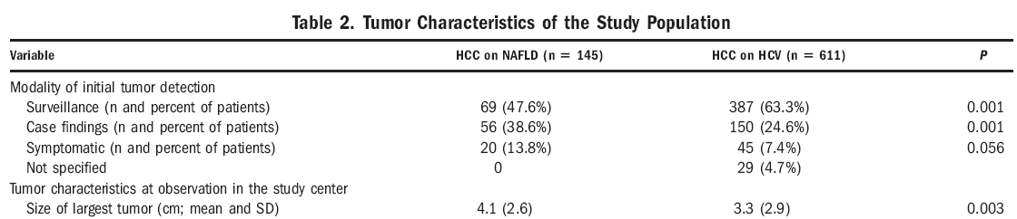

Slide 33
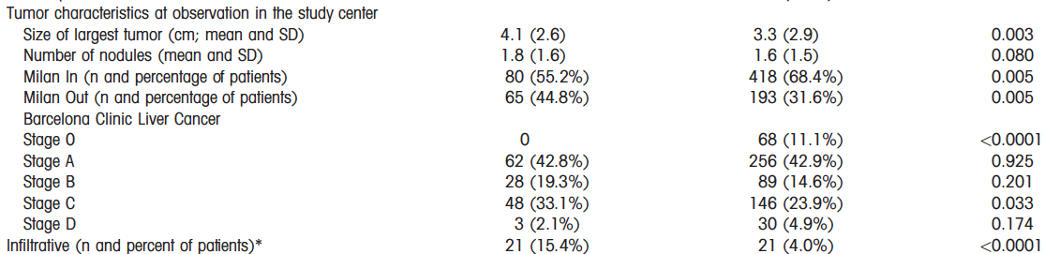
Notes:
However, the overall rate of patients submitted to curative treatments (surgical resection, transplantation, or percutaneous ablation) was similar in the two populations (45.5% versus 49.1% in HCV-HCC, P 5 nonsignificant).
Probabilmente perchè i pz con NAFLD-HCC avevavo tumori più grandi, ma migliore funzione epatica.

Slide 34
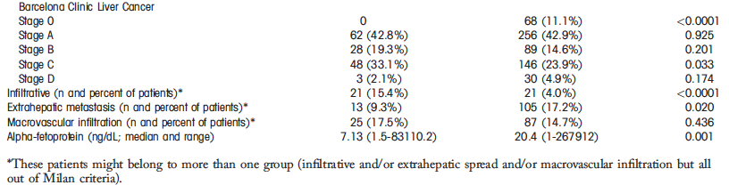
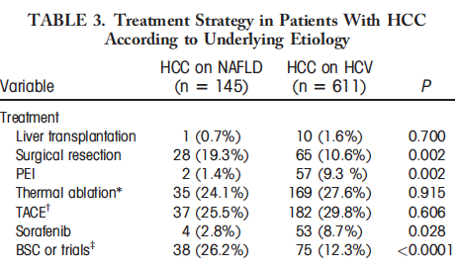
HCC Tumor Characterists: NAFLD vs HCV
HCC on NAFLD
n=145
HCC on HCV
n=611
Crude mean overall survival
NAFLD = 27.2 months
HCV = 34.4 months (P = 0.015).
Survival rates at 1 year and 3 years
NAFLD = 76.4% and 48.7%
HCV = 84.2% and 61.1%
Piscaglia et al., Hepatology 2016

Slide 35
HCC Tumor Characterists: NAFLD vs HCV
HCC on NAFLD
n=145
HCC on HCV
n=611
Mean overall survival lead time adjusted
NAFLD = 25.5 months
HCV = 33.7 months (P = 0.015).
Survival rates at 1 year and 3 years
NAFLD = 76.4% and 48.7%
HCV = 84.2% and 61.1%
Piscaglia et al., Hepatology 2016
Notes:
Lead-time bias is the bias caused by the amount of time by which the diagnosis is advanced because of the surveillance program.

Slide 36
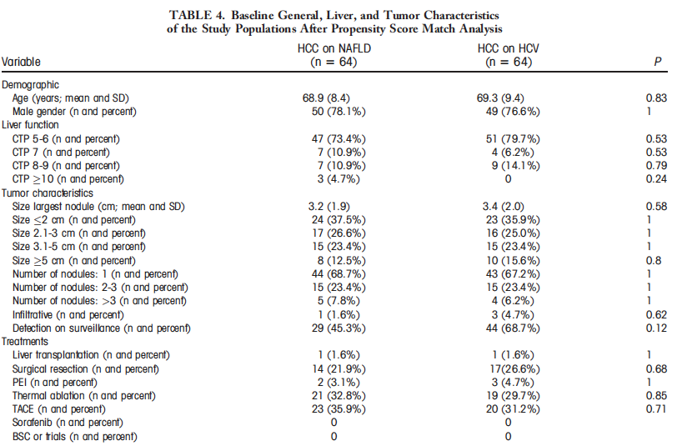
HCC in NAFLD vs HCV after propensity score matching
Mean overall survival
NAFLD = 30.2 months
HCV = 36.9 months (P = 0.33).
Survival rates at 1 year and 3 years
NAFLD = 87.4% and 72.6%
HCV = 91.9% and 63.3%
Mean overall survival of HCC on NAFLD
NAFLD with cirrhosis = 28.5 m NAFLD without cirrhosis = 34.9 m
(P = ns).
No significant impact of cirrhosis
Piscaglia et al., Hepatology 2016
Notes:
Quindi quando anlizzaimo I dati con il propensity score quindi eliminando fattori confondenti come il tumor burden o la funzione epatica, non vi è differenza nella sopravvivenza. Questo indica che la ridotta sopravvivenza è dovuta allo stadio più tardivo di diagnosi piuttosto che ad una maggiore aggressività intrinseca.

Slide 37
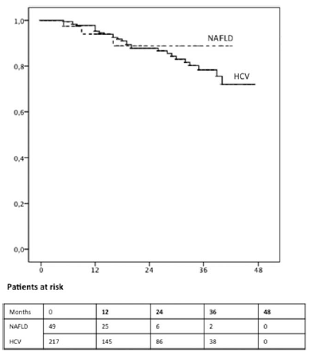
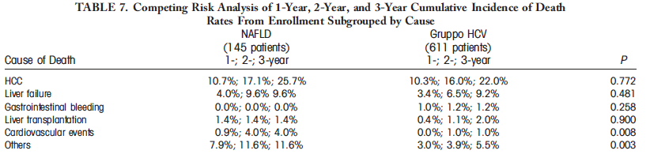
HCC in NAFLD vs HCV: only Milan-in submitted to curative therapies
Mean overall survival
NAFLD = 38.6 months
HCV = 41.0 months (P = ns).
NAFLD HCC patients die more of non liver related causes than HCV HCC patients
Piscaglia et al., Hepatology 2016

Slide 38
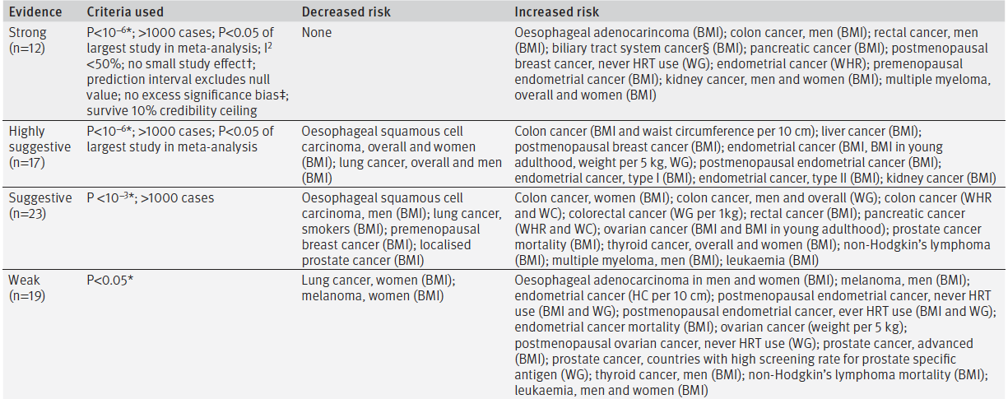
Adiposity and cancer at major anatomical sites: umbrella review
of the literature
Kyrgiou et al., BMJ 2017

Slide 39
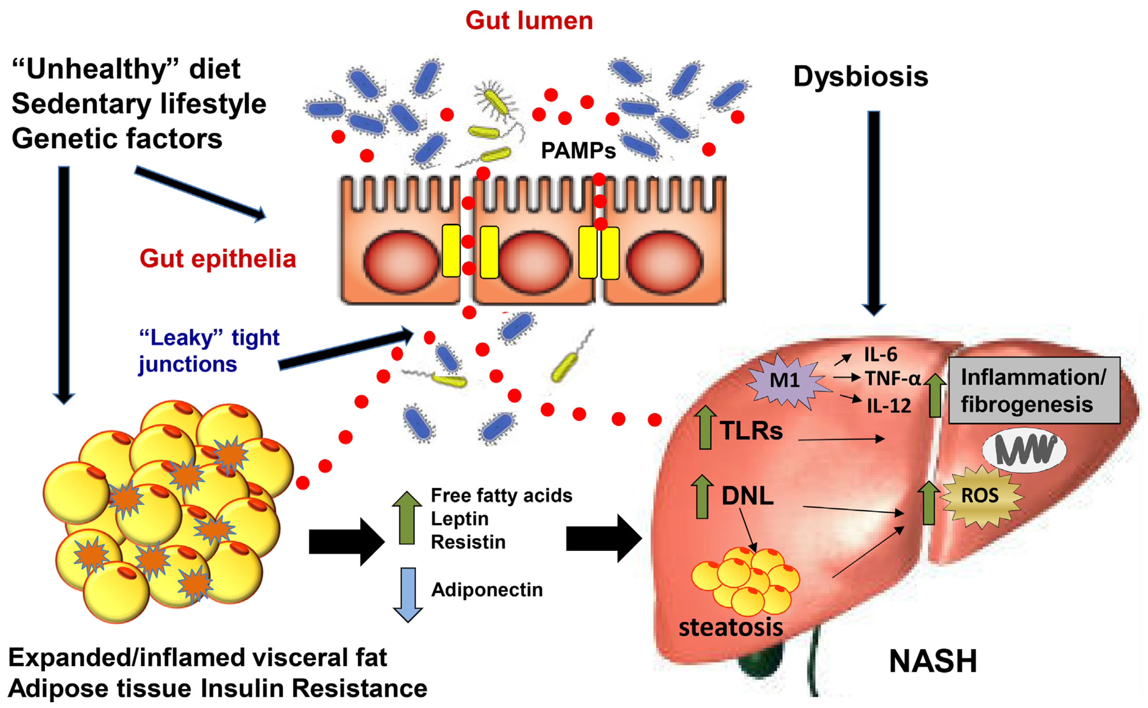
Pathogenesis of NAFLD/NASH
Pierantonelli et al., Nature Scientific Rep 2017
Notes:
All these mechanisms can play a role in hepatocarcinogenesis related to NASH. All these mechanisms are, at least partially, independent from fibrosis and this might explain the epidemiology of HCC in NASH where non-cirrhotic HCC is more than a sporadic event. Dufuour
Liver International 2016

Slide 40
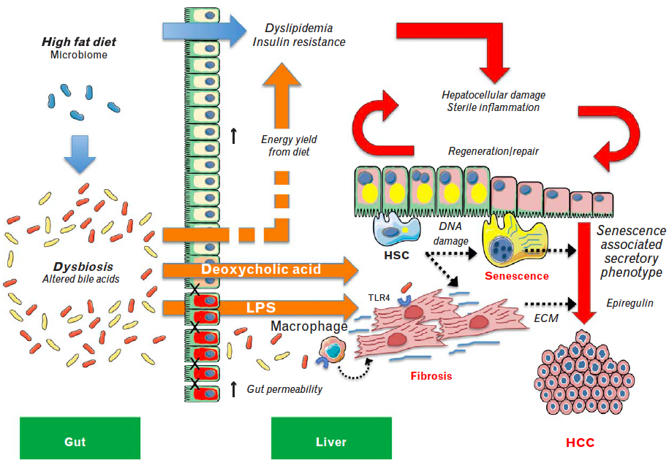
The role of diet and the gut–liver axis in promoting inflammation and hepatocarcinogenesis in NASH.
Lade et al., Curr Opin Oncol 2014
Notes:
All these mechanisms are, at least partially, independent from fibrosis and this might explain the epidemiology of HCC in NASH where non-cirrhotic HCC is more than a sporadic event. Dufuour
Liver International 2016
The role of diet and the gut–liver axis in promoting inflammation and hepatocarcinogenesis in nonalcoholic steatohepatitis (NASH). The effects of a high-fat diet (HFD) (blue arrows) drive metabolic and endocrine dysregulation by promoting the uptake and accumulation of lipids in metabolically sensitive organs, especially liver, adipose tissue, and the vasculature, leading to systemic dyslipidaemia and insulin resistance (red arrows indicate downstream pathogenic processes). HFD simultaneously promotes dysbiosis and changes to the bile acid pool in the gut, contributing to hepatic inflammation and promoting hepatocarcinogenesis in NASH (orange arrows) by: enhancing energy yield from the diet, which exacerbates the effects of increased caloric intake that drive chronic hepatocellular damage; sterile inflammation; liver regeneration/repair; production of toxic bile acids, especially deoxycholic acid (DCA); and inflammasome-mediated changes in gut permeability leading to the influx of TLR agonists including lipopolysaccharide (LPS). Hepatic stellate cells (HSCs) are emerging as key
players in the gut–liver axis and new evidence implicates the cells in NASH-associated hepatocellular carcinoma (HCC) (black dotted arrows) by: DCA-mediated DNA damage in HSCs that promotes a ‘senescence-associated secretory phenotype’; endotoxin (LPS)-mediated TLR4 activation in both activated HSCs and macrophages, which enhance fibrosis through the
secretion of extracellular matrix (ECM) and mitogenic factors (e.g., epiregulin), which stimulate tumor growth.

Slide 41
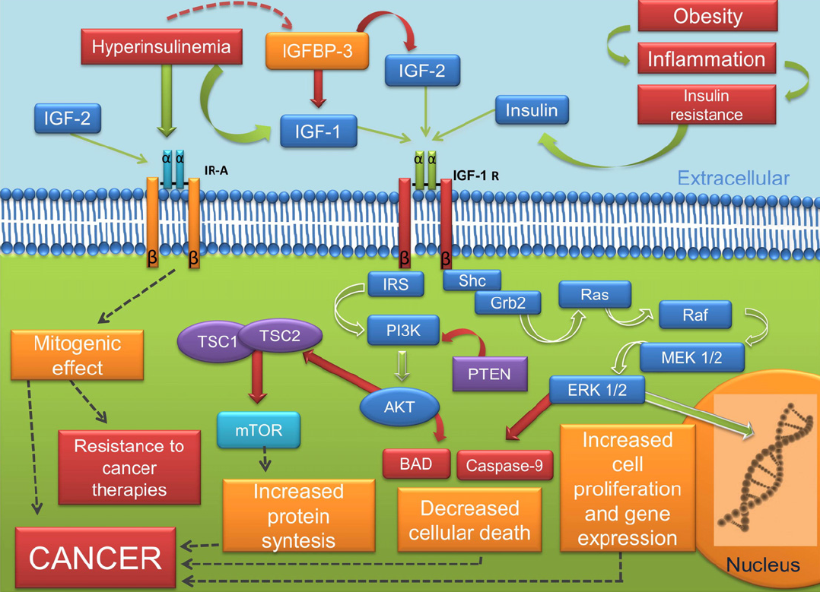
Metabolic syndrome and risk of cancer: Which link?
Mendonca et al., Metabolism 2015
Notes:
The adipose tissue in MS patients is characterized by deregulation of cytokine production, which can unleash a chronic inflammatory state. This inflammation and its mediators may be involved in tumor development.

Slide 42
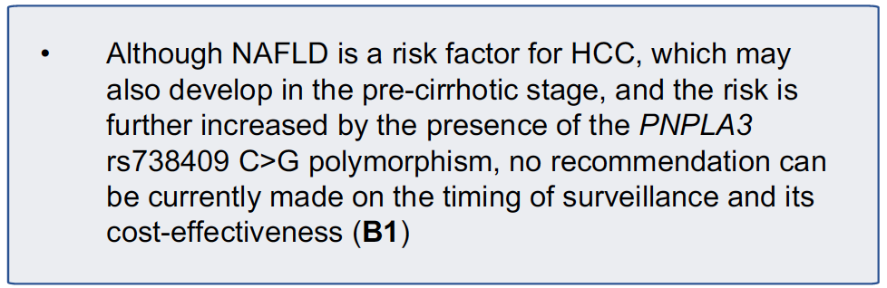
Screening for HCC-NAFLD
EASL CPG 2016

Slide 43
Screening for HCC-NAFLD
Apart from advanced fibrosis/cirrhosis, data only point to male sex, older age, alcohol abuse and MetS components as established clinical risk factors for HCC development in NAFLD.
For these reasons, except for patients with NASH-cirrhosis, specific surveillance/screening strategies cannot be currently recommended in NAFLD patients.
AISF position paper on NAFLD, Dig Liv Dis 2017

Slide 44
Nonalcoholic Steatohepatitis Is the Second Leading Etiology of Liver Disease Among Adults Awaiting Liver Transplantation in the United States
Wong et al., Gastroenterology 2015
Notes:
From 2004 to 2013, NASH demonstrated the greatest increase as a cause of chronic liver disease among new liver transplant waitlist registrations, increasing 170% and becoming the second
leading etiology of chronic liver disease among new waitlist registrants in 2013 (Figure 1). During this same period, new waitlist registrants with ALD increased 45% and HCV
increased 14%, and patients with HCV/ALD decreased by 9% (Figure 1).

Slide 45
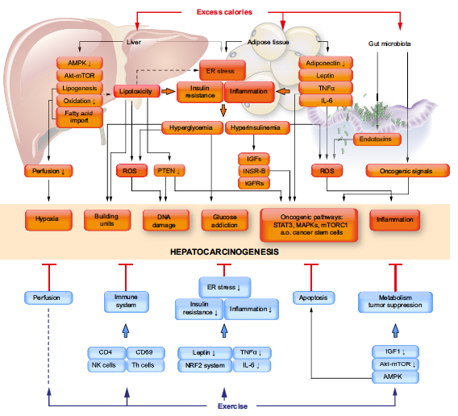
Exercise and risk of HCC
Saran et al., J Hepatol 2016

Slide 46
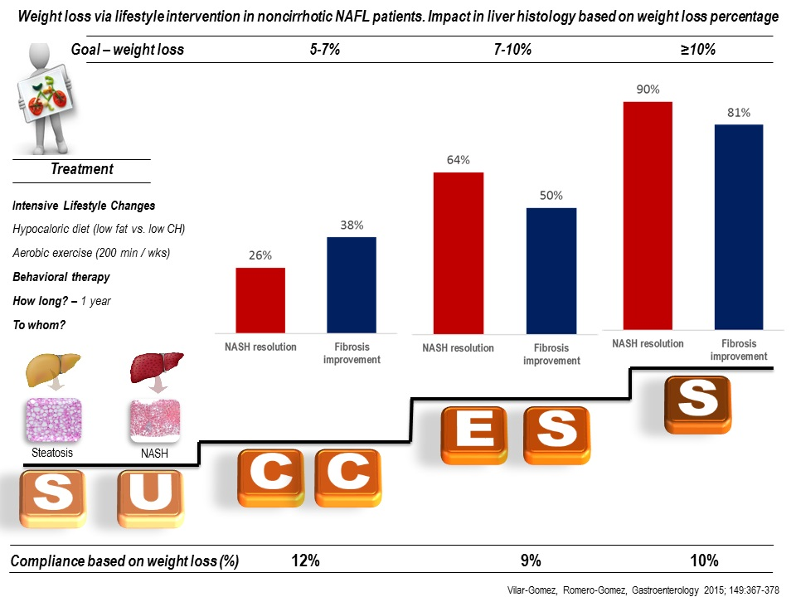

Slide 47
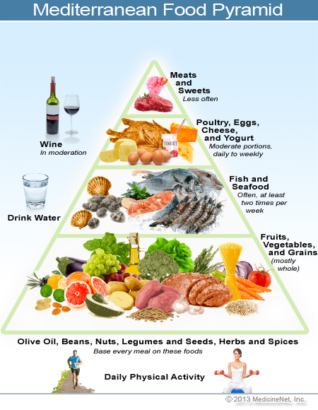
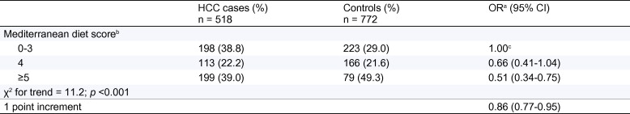
Emerging protective factors for HCC: mediterranean diet
Case-control study:
518 HCC vs 772 controls
Report 2015
0= lowest adherence to MD
9= highest adherence to MD
Model adjusted for: center, age, sex, education, body mass index, smoking, diabetes, non-alcohol energy intake, and HBsAg and/or anti-HCV positivity.
Turati F et al., J Hepatol 2015;60:606-11
Notes:
Therefore, at present, an efficient primary prevention of HCC in developed countries, beside the prevention/cure of infections by hepatitis viruses, should be the implementation nationwide of educational campaigns aimed at fighting the risky use of alcohol and food and at promoting physical activity.

Slide 48
Pharmacological treatment of T2DM: useful for liver damage in NASH?
Glitazones
  Pioglitazone ↓ histological diagnosis of NASH
Metformin
  ↓ Risk of HCC in diabetic patients
  Ineffective ↓ histological NASH
GLP-1 agonists
  Liraglutide ↓ histological diagnosis of NASH
DPP4 inhibitor
  Sitagliptin ineffective in ↓ liver fat and ALT

Slide 49
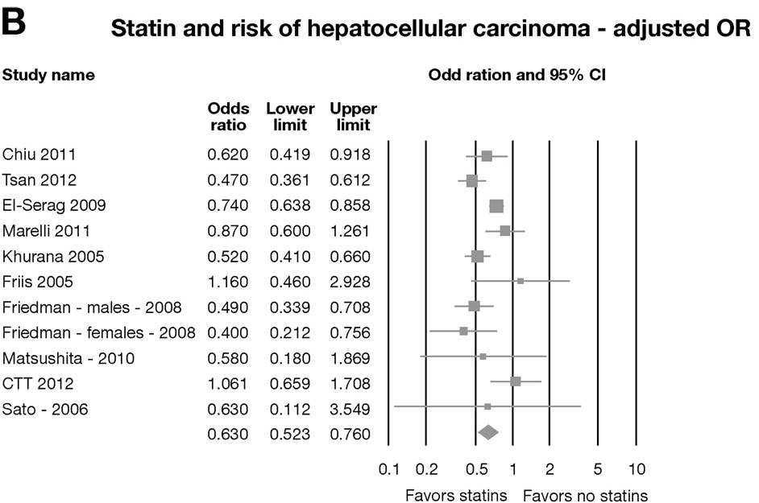
Statins Are Associated With a Reduced Risk of Hepatocellular Cancer: A Systematic Review and Meta-analysis
Singh et al., Gastro 2013
Notes:
Statin users were less likely to develop HCC than statin nonusers, although the results were heterogeneous. Based on meta-analysis, statin use is associated with a reduced risk of HCC, most strongly in Asian but also in Western populations. Randomized clinical trials in populations at high risk for HCC (especially in Asian populations with hepatitis B) are warranted.

Slide 50
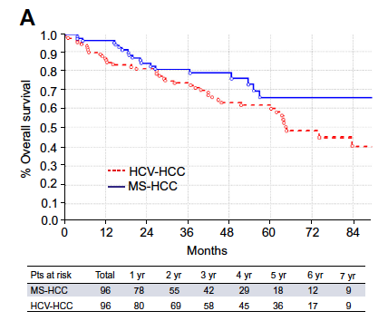
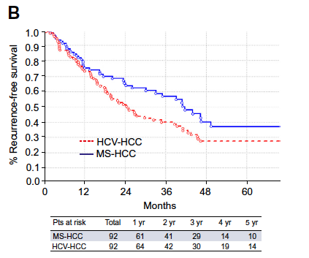
Resection for HCC in NAFLD and HCV
Multicenter study, 1563 patients, 6.1% with MS-HCC
p = 0.077
p = 0.031
Viganò et al., J Hepatol 2016

Slide 51
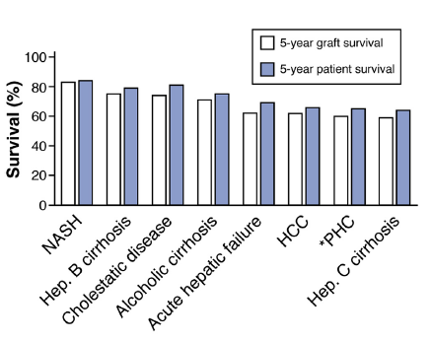
NAFLD and OLT
Dutkowskiet al., J Hepatol 2015

Slide 52
NAFLD and HCC in ITALY: take home messages
The incidence and mortality of HCC is decreasing, particularly in men.
The etiologic scenario is changing, with a reduction in HCV-related tumors and a progressive rise of non-viral tumor, particularly of “metabolic” HCCs.
Several series of patients highlight the need to focus future research on identifying those patients with NAFLD who require surveillance in order to establish earlier diagnosis and offer them treatment, which appeared to be as effective as that provided for patients with HCV at an early stage.

Slide 53


