Slide 1
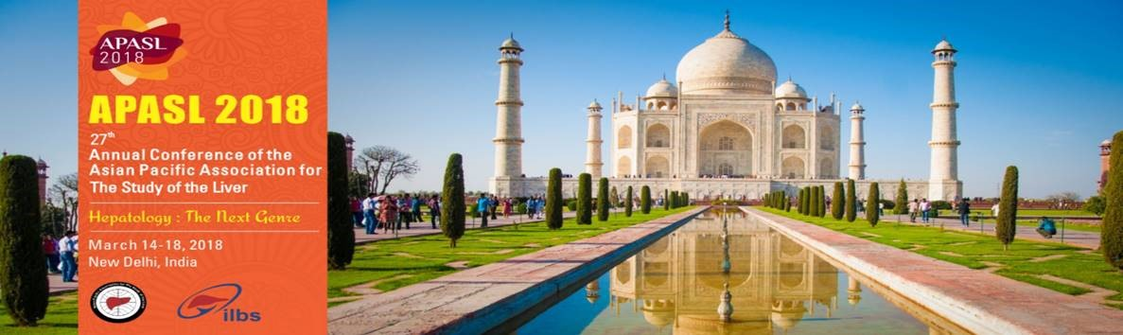
SUSTAINED VIROLOGICAL RESPONSE IN HCV PATIENTS TREATED WITH DACLATASVIR+SOFOSBUVIR, WITH OR WITHOUT RIBAVIRIN: A LARGE FIELD-PRACTICE EXPERIENCE
Rodolfo Sacco
Gastroenterology Unit - Pisa University Hospital
on behalf of Italian Hospital Hepatologists (CLEO)*
ITALY

Slide 2
Background

Slide 3
Select Competitive HCV Antivirals by Class
NS3
Viral RNA
NS2
NS4B
NS5A
NS5B
Cyp B
ER lumen
NS4A
NS3 protease
Simeprevir
Paritaprevir
(ABT-450)ª
Grazoprevir
Glecaprevir
(MK-5172)
Voxilaprevir
Telaprevir
Boceprevir
NS5A
Daclatasvir
Ledipasvir
Ombitasvir
(ABT-267)
Elbasvir
(MK-8742)
Velpatasvir
Pibrentasvir
NS5B polymerase
Non-nucleosides
Dasabuvir (ABT-333)
Nucleos(t)ide analogs
Sofosbuvir
ª Ritonavir boosting required.

Slide 4
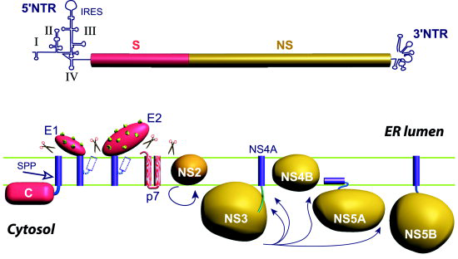
DCV: a highly selective HCV NS5A inhibitor^{1,2}
HCV Structural proteins
HCV Non-structural proteins
Daclatasvir^{1,2}
HCV Genome³
NS5A is a multifunctional protein that interacts with many host proteins and other viral proteins^{4,5}
Involvement of NS5A in different stages of the HCV lifecycle and modulation of host pathways makes it a key target for antiviral therapies^{2,5}
HCV Lifecycle Steps | Direct-Acting Antiviral
 | NS3 | NS5A | NS5B
Viral Entry
Translation
Processing
Replication complex
Replication
Assembly
Release
⁶
⁵
^{4,5}
^{4,5}
⁶
^{4,5}
1. Gao et al. Nature. 2010;465:96.; 2. Nettles et al. Hepatology. 2011;54:1956; 3. Chevaliez et al. In: Hepatitis C Viruses: Genomes and Molecular Biology, 2006; 4. He et al. In: Hepatitis C Viruses: Genomes and Molecular Biology, 2006; 5. Gao et al. Curr Opin Virol 2013;3:514; 6. Jazwinski et al. Gastroenterol Hepatol 2011; 7:154-162
Notes:
INIBITORI DI PROTEASI NS34A (EVIR) TEL BOC SIM PARITA.
INIBITORI NS5A (TASVIR) DAC OMBITA
INIBITORI DI NS5B RNA POLIMERASI (BUVIR) SOF DASA

Slide 5
DCV: a highly active replication complex inhibitor with pangenotypic coverage
In vitro studies demonstrate EC₅₀ values in the picomolar to low nanomolar range across all HCV genotypes^{1,2}
DCV displays a therapeutic index (CC₅₀/EC₅₀) of at least 100,000 in vitro¹
DCV exhibits additive to synergistic effects in combination studies with¹:
  NS3 protease
  NS5B polymerase inhibitors
  Interferon α2β & ribavirin (RBV)
Assay² | EC₅₀
HCV replicon genotype 1a, WT | 0.020 nM
HCV replicon genotype 1b, WT | 0.004 nM
HCV replicon genotype 2a, JFH | 0.071 nM
HCV replicon genotype 3a | 0.15 nM
HCV replicon genotype 4a | 0.012 nM
HCV replicon genotype 5a | 0.033 nM
HCV replicon genotype 6a | 0.054 nM
1. Gao M, et al. Nature 2010;465:96–100; 2. Gao et al. Curr Opin Virol. 2013;3:514;

Slide 6
European Real-World Experiences with DCV
German Cohort
Greek Cohort
French ATU/Hepather/HepaVIH
Eurocup

Slide 7
Aims
This multicenter, prospective field-practice study evaluates the DCV+SOF combination, with or without ribavirin (RBV), in HCV patients including those with advanced liver disease from 19 Italian referral centers

Slide 8
Methods
We included 620 consecutive patients fulfilling eligibility criteria of the Italian Drug Agency treated in 19 referral centers of Italy.
Fibrosis stage was evaluated by Transient Elastometry (METAVIR F3>10kPa, F4>13 kPa).
Clinical cirrhosis was defined by at least one of the followings: decompensation, oesophageal varices, platelets<100,000/mmc.
Patients received daily SOF+DAC for 12 (218) or 24 (392) weeks.
248 (48%) with RBV.
The primary efficacy endpoint was SVR12.

Slide 9
Results

Slide 10
Baseline characteristics
Parameter | Patients: 620
Age, median years | 60±9
Male, (%) | 63.2
BMI, kg/m² | 24.4±4
Prior treatment category, (%) | 40.5
HCV RNA >2x10⁶ IU/mL (%) | 39.6
Coinfection with HIV (%) | 11.2
Coinfection with HBV (%) | 1.1
Fibrosis stage F4, (%) | 71.5
Clinical cirrhosis, (%) | 50.4
ALT, U/L | 86±55
AST, U/L | 101±73

Slide 11
Cirrhosis and genotype distribution

Slide 12
SVR rates and virological failures
640
G1: 100%
GT2: 97.5%
GT3: 97.2%
GT4:100%
Virological failures (12/608):
8 pts gt2, previously treated with SOF+RBV;
4 pts gt3, naive (2 HIV coinfected)
All were F4
(6 pts clinical cirrhosis)
All were treated without RBV
560
480
400
320
240
160
80
0

Slide 13
Undetectable HCV-RNA
ALT and AST normalization
Most patients (52.5%) reached HCV RNA below LLOQ at 4 weeks
  27.3% reached this goal after 2 weeks
  18.8% at the end of treatment.
AST and ALT levels totally recovered at 12 weeks of follow-up (26±15
U/L and 27±17 U/L, respectively; p<0.001 vs baseline).

Slide 14
Adverse events
On-Treatment Safety Summary
At least one adverse events (AE), (%) | 46.0
Elevated bilirubin, (%) Elevated bilirubin grade 3 – 4, (%) | 30.6 4.9
Anemia (%) Pts treated with RBV (%) Pts not treated with RBV (%) | 27 18.3
On-Treatment Safety Summary

Slide 15
Conclusions
DCV + SOF ± RBV achieved a high SVR12 rate in a large real-world population of HCV-infected
patients with advanced liver disease
  High SVR12 rates regardless of HCV genotype, cirrhosis status, baseline disease characteristics
  Comparably high SVR12 rates were achieved with or without RBV
DCV + SOF ± RBV was generally safe and well tolerated
Clinical practice data from Italian network confirm the high efficacy and the pangenotypic action of this combination across a broad spectrum of patients and clinical settings

Slide 16

*Italian Hospital Hepatologists
( Authors of this work)
* ANTONIO IZZI, VINCENZO MESSINA, LUIGI ELIO ADINOLFI, ANTONIO ASCIONE, GIORGIO BARBARINI, ANGELO BARLATTANI,
GIUSEPPE CARITI, RAFFAELE COZZOLONGO, BASILIO FIMIANI, RUGGIERO FRANCAVILLA,
CATERINA FURLAN,GIOVANNI GARRUCCIU, VINCENZO IOVINELLA, LUCA RINALDI,
MASSIMO MARIGNANI, PAOLA BEGINI, VALERIA PACE PALITTI, ADRIANO M. PELLICELLI,
GAETANO SCIFO, UMBERTO VESPASIANI GENTILUCCI

