Slide 1


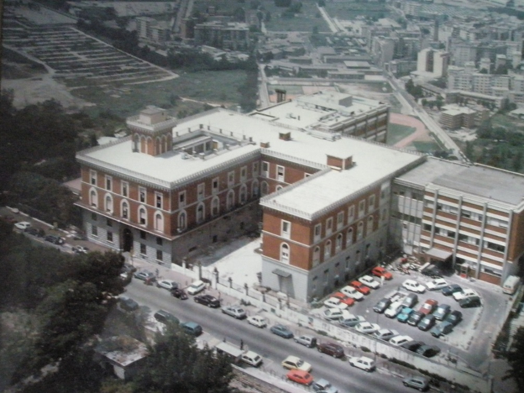

Encefalopatia portosistemica:
dalle linee guida alla pratica clinica
ANTONIO ASCIONE
CENTRO PER LE MALATTIE DEL FEGATO
OSPEDALE FATEBENEFRATELLI NAPOLI
antonio.ascione@paginemediche.it

Slide 2
DICHIRAZIONE
Non ho interessi finanziari che confliggono con la mia presentazione.
Non ho interessi finanziari con nessuna delle industrie che operano nel campo delIe malattie del fegato.
La mia presentazione non include discussioni sull’uso di farmaci off-label.

Slide 4
AGENDA
Definition
Epidemiology
Pathophysiology
Diagnosis
Therapy
Prevention

Slide 6
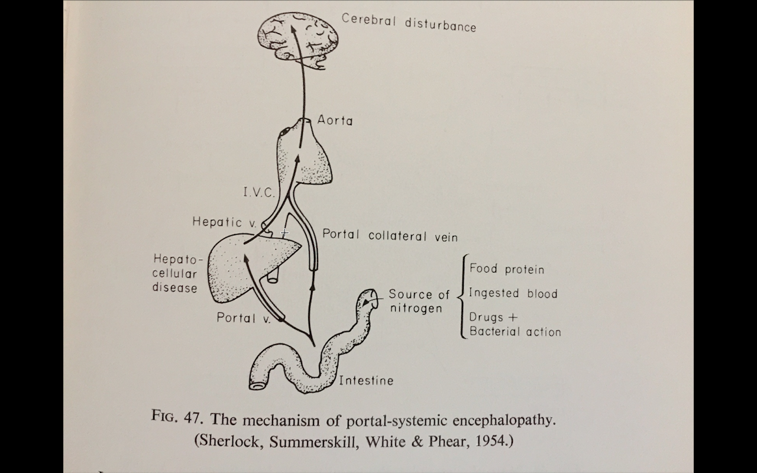
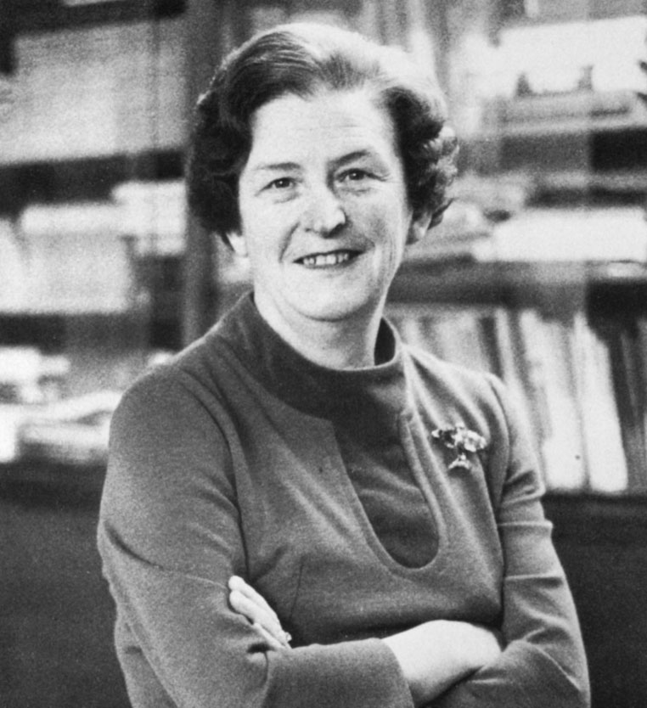

Slide 7
THE EVOLUTION OF THE DEFINITION OF HE
1998
2014
AASLD/EASL guidelines
Working Party at the 11 world Congress of Gastroenterology
HE reflects a spectrum of neuropsychiatric abnormalities seen in patients with liver dysfunction after exclusion of other known brain disease.
syndromic definition
not mentioning PS- shunting
excluding associated conditions
(why vascular dementia or other metabolic encephalopathies cannot be associated with HE?)
HE is brain dysfunction caused by liver insufficiency and/or portal-systemic shunting;
it manifests as a wide spectrum of neurological/psychiatric abnormalities ranging from subclinical alterations to coma.
etiopathological definition
the adjective ‘hepatic’ implies a causal connection to liver insufficiency and/or shunt
accepts the existence of associated encephalopathies in which ‘hepatic’ mechanisms interacts with other causes/mechanisms
Notes:
Verificare se ci sono linee guida più recenti e vedi quella dell’AISF

Slide 8
Complications of Cirrhosis Result from Portal Hypertension or Liver Insufficiency
Portal hypertension
Variceal hemorrhage
Ascites
Cirrhosis
Liver insufficiency
Encephalopathy
Jaundice
Notes:
COMPLICATIONS OF CIRRHOSIS
Cirrhosis leads to two clinical syndromes: portal hypertension and liver insufficiency. Development of variceal hemorrhage and ascites are the direct consequence of portal hypertension, while jaundice occurs as a result of a compromised liver function. Encephalopathy is the result of both portal hypertension (portosystemic shunting) and liver dysfunction (decreased ammonia metabolism). Ascites in turn can become complicated by infection (spontaneous bacterial peritonitis) and by the development of a functional renal failure (hepatorenal syndrome).

Slide 9
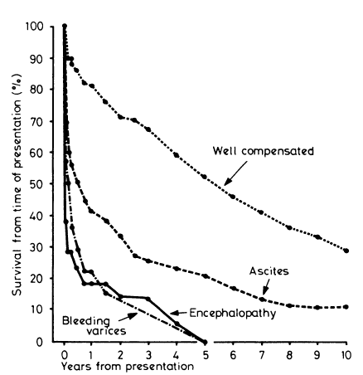
Notes:
VEDI PAPER

Slide 10
PREVALENZA DELLA ENCEFALOPATIA
NEI CIRROTICI
ALLA DIAGNOSI: 10-14%
a 5 anni: 5-25%
NELLO SCOMPENSO: 16-21%
PAZIENTI CON TIPS: 10-50%
MINIMA ENCEFALOPATIA: 20-80% dei cirrotici
O COVERT
DOPO EPISODIO RISCHIO RECIDIVA A 1 ANNO: 40%
PARKINSONISMO ASSOCIATO A CIRROSI: 4%
AASLD/EASL Guidelines, 2014

Slide 11
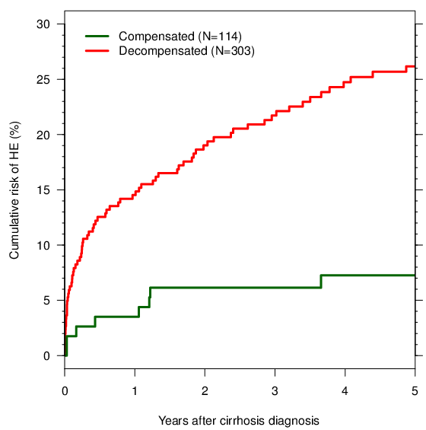
RISK OF OVERT HE IN CIRRHOSIS
Jepsen P, Ott P, Andersen PK, Sørensen HT, Vilstrup H. The clinical course of alcoholic liver cirrhosis: A Danish population-based cohort study. Hepatology 2010;51:1675-1682.
Notes:
This analysis of our own Danish data shows that patients with compensated cirrhosis are unlikely to develop HE as the first complication. This is consistent with the observations that HE is rarely the first complication of cirrhosis.
Patients who already have developed cirrhosis complications are much more likely to develop HE.
11

Slide 12
Prevalence of overt HE in Italy according to CTP score
B C
A
Studio Policentrico Italiano sulla Nutrizione nella Cirrosi, 1994
Notes:
Ci sono altri studi più recenti ?

Slide 14
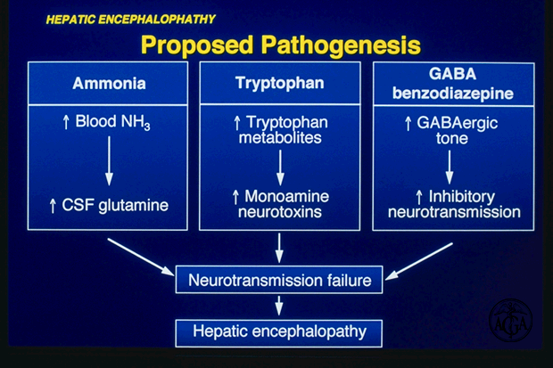

Slide 15
Pathophysiology of hepatic encephalopathy
Organism
Organ
ALA
GLN
microglia
X ?
citokines
NH4
hyponatremia
Brain
Muscle
NH4
BZ
astrocyte
NH4
ROS⁻
Blood
↓endogenous osmolites
Liver
ALA/GLN
Urea
Aa.
NH4
NH4
Kidney
↓↑ glicemia
UREA
Small intestine
Colon
glutaminasis
Dysfunction of neuron-astrocyte unit
UREA
NH4
Indols, mercaptans?
Inflammatory Ils?
Neuron
(Amodio, Hepatic Encephalopathy, in Cirrhosis, Lee and Moreau Ed, Wiley Publisher 2015)
Notes:
VEDI PAPER O CPT DA AMODIO

Slide 16
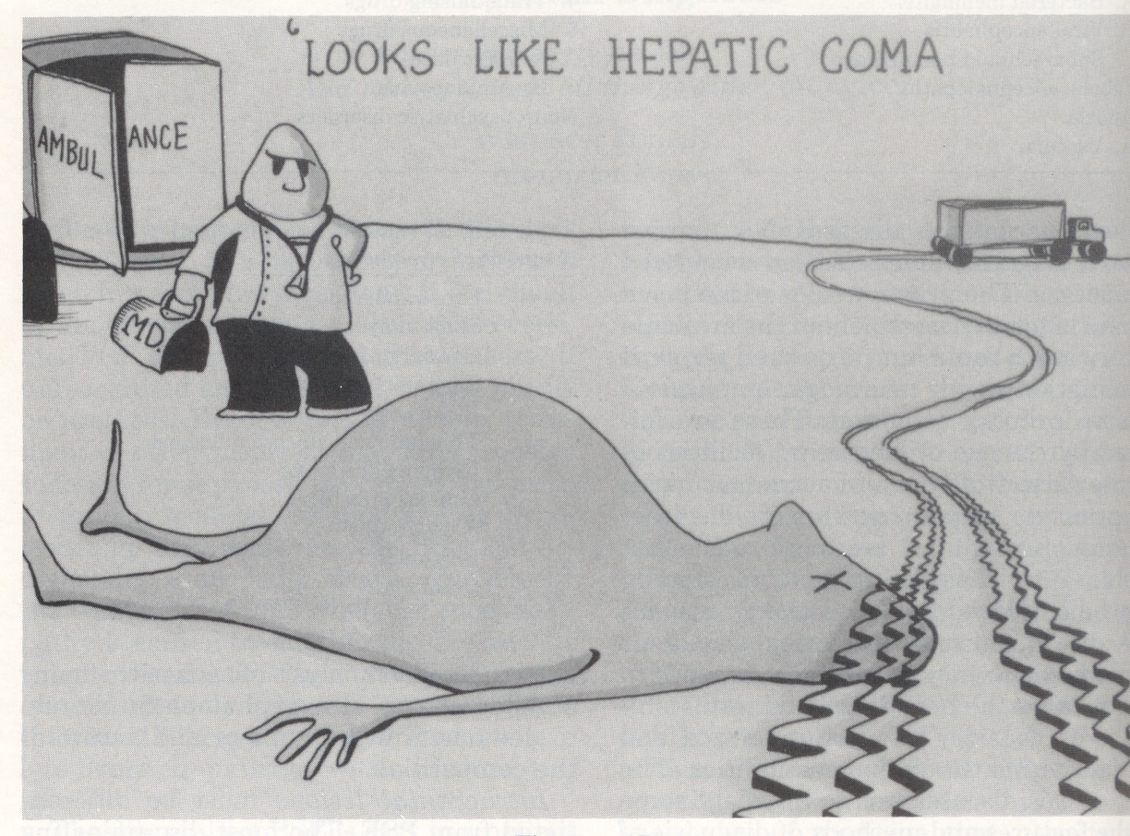
Courtesy of Harold Conn

Slide 17
THE DIAGNOSTIC TREE FOR HE
Clinical signs suggesting HE
Is there liver insufficiency and/or portal-systemic shunting?
no
yes
Look for other brain/metabolic disorders
Are there precipitating factors?
no
yes
Are there other plausible causes or con-causes of brain dysfunction?
yes
no
HE
Possible mixed encephalopathy
Consider ARD response
to confirm diagnosis
Treatment for precipitating
factors+ ARD

Slide 18
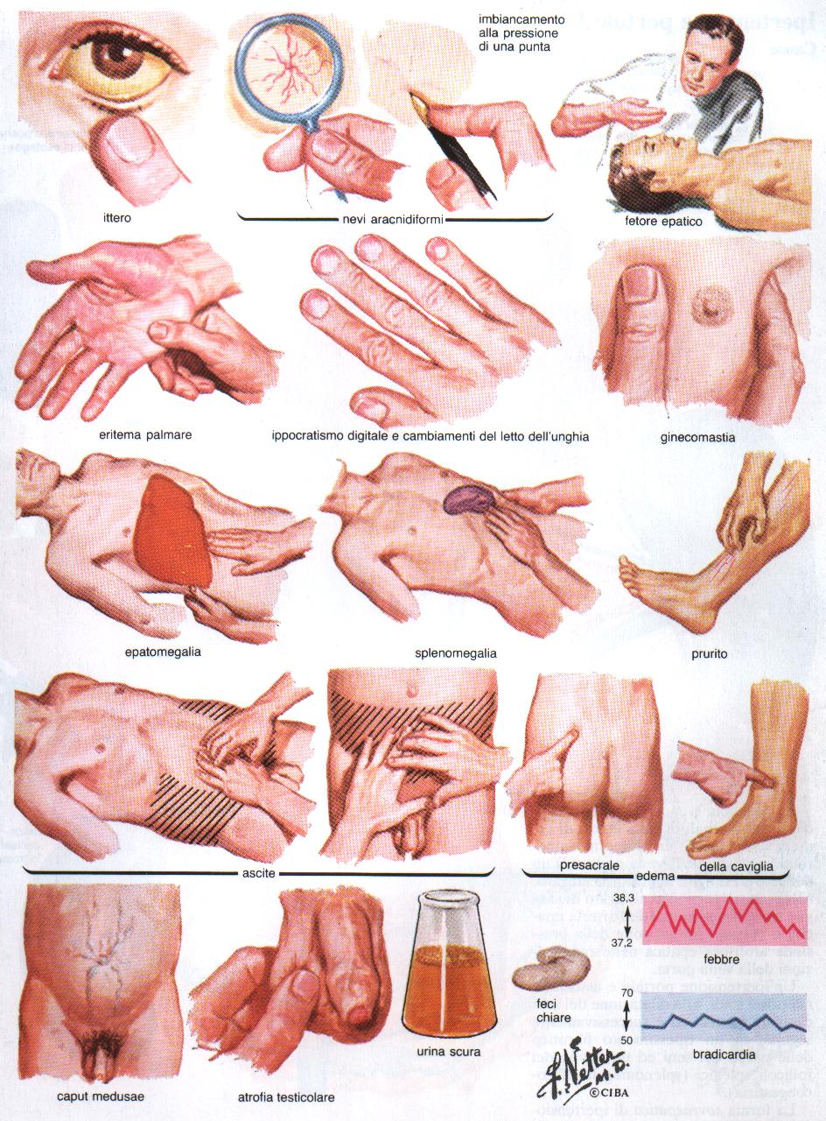
Jaundice
Spyder nevi
Foetor
Palmar Erythema
Gynecomastia
Hepatomegaly
Splenomegaly
Pruritus
Ascites
Oedema
Caput medusae
Testicular athrophy
Dark urine
Pale stools
Fever
Bradicardia

Slide 19
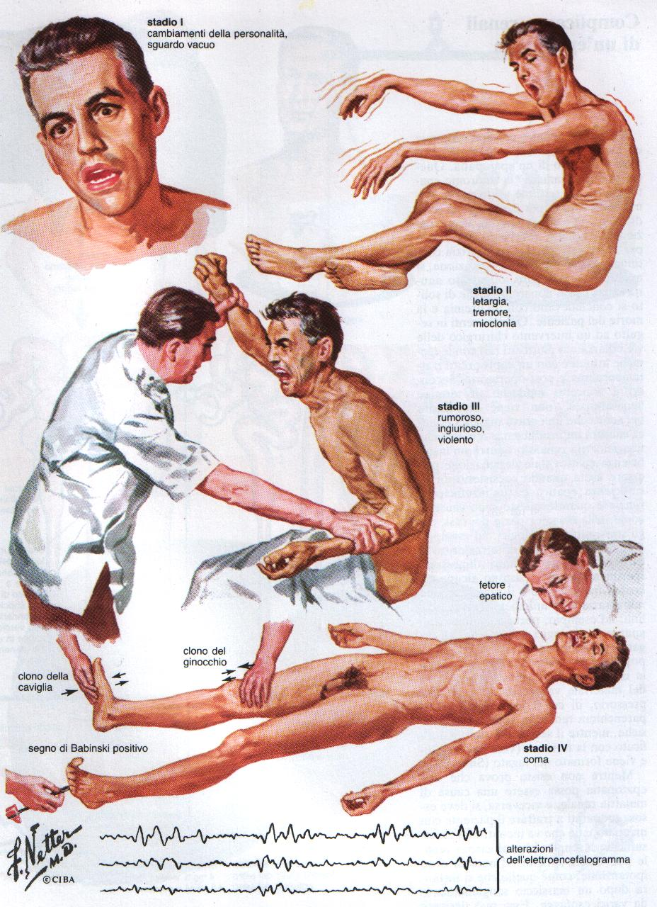
STAGE 1- Trivial lack of awareness
Euphoria or anxiety -
Shortened attention span
Impairment of addition or
subtraction
Altered sleep rhythm
STAGE 2 – Lethargy or apathy
Disorientation for time
Obvious personality change
Inappropriate behavior
Asterixis
STAGE 3 – Somnolence to semi-stupor
Responsive to stimuli
Confused
Gross disorientation
Bizarre behavior
STAGE 4 - Coma

Slide 20
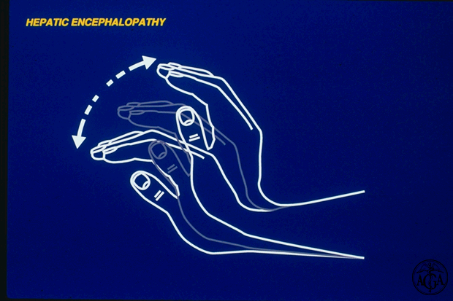
ASTERIXIS

Slide 21
EASL/AASLD GUIDELINES, 2014

Slide 22
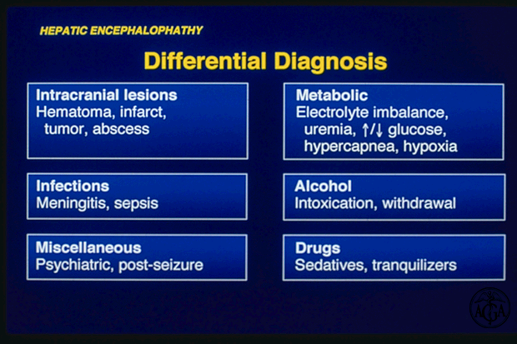

Slide 23
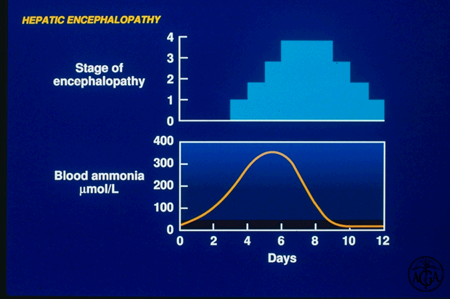
Increased blood ammonia alone does not add any diagnostic, staging or prognostic value for HE patients (AASLD/EASL guidelines)

