Slide 1
Recurrent HE

Slide 2
AALD/EASL guidelines, 2014

Slide 3
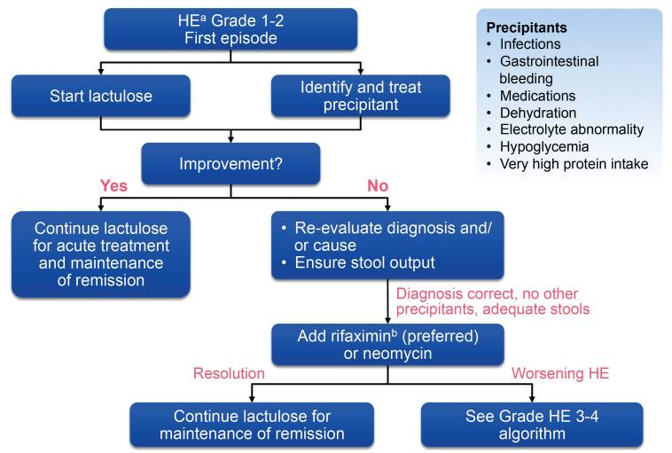
Click on image to magnify.

Slide 4
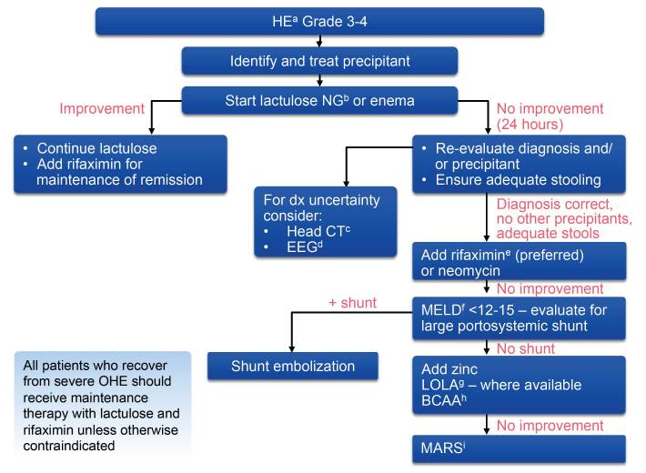
Click on image to magnify.

Slide 5
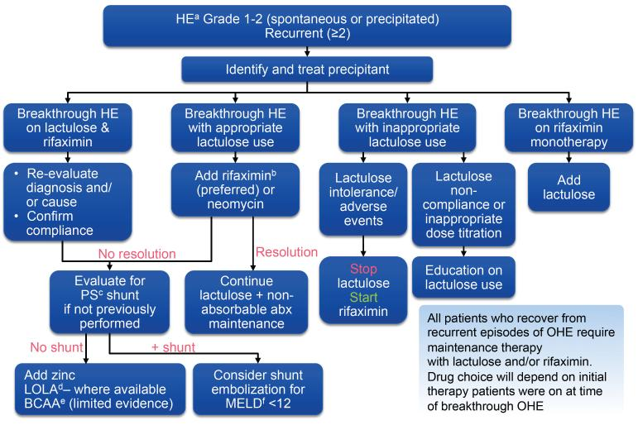
PMC full text: | Mayo Clin Proc. Author manuscript; available in PMC 2014 Aug 11.Published in final edited form as: Mayo Clin Proc. 2014 Feb; 89(2): 241–253. Published online 2014 Jan 8. doi: 10.1016/j.mayocp.2013.11.009 Copyright/License ►Request permission to reus | << PrevFigure 2Next >>

Slide 6
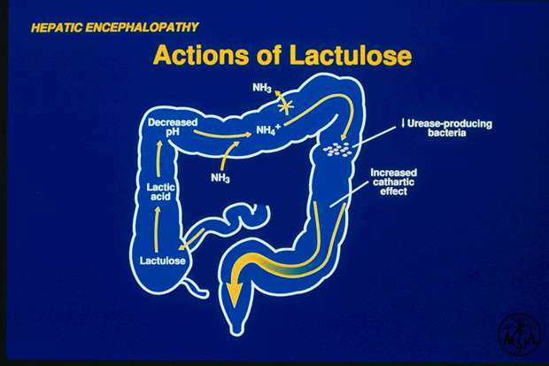

Slide 7
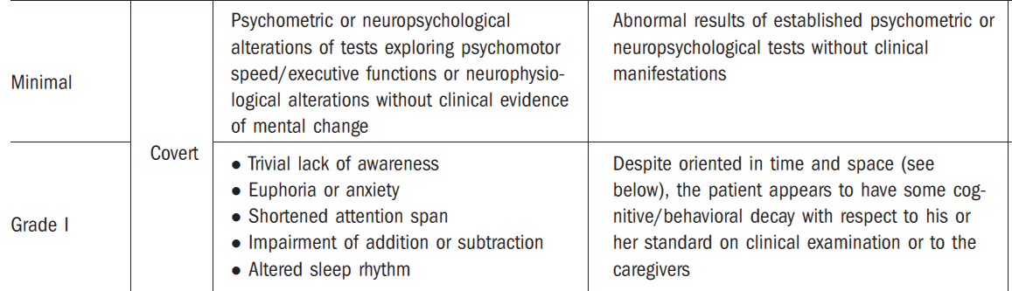
COVERT HE
AASLD/EASL guidelines, 2014

Slide 8
FIRST OPTION FOR THE PATIENT WITH COVERT HE
Unchanged diet habits
+
disaccharides in amount sufficient to produce two bowel movements of soft stools per day
Modify the diet so that it has:
fiber (especially soluble fermentable) up
to 35-40 g/day)
probiotic foods (e.g. yogurt)
a bedtime snack of complex
carbohydrates
vegetable proteins (e.g., from pulses) and dairy proteins > than meat proteins
Monitor psychometrical/uantitative EEG/CFF manifestations
SECOND OPTION FOR THE PATIENT
(oral supplementations)
  BCAA
  Probiotics/prebiotics/rifaximine
  L-ornitin – L-aspartate. (LOLA)
  Carnitine/acetilcarnitine
(Amodio, Hepatic Encephalopathy, in Cirrhosis, Lee and Moreau Ed, Wiley Publisher 2015)

Slide 9
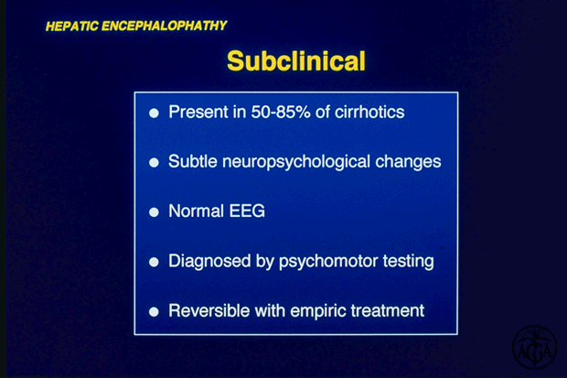

Slide 10
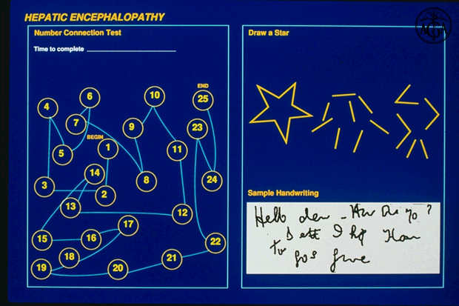

Slide 11
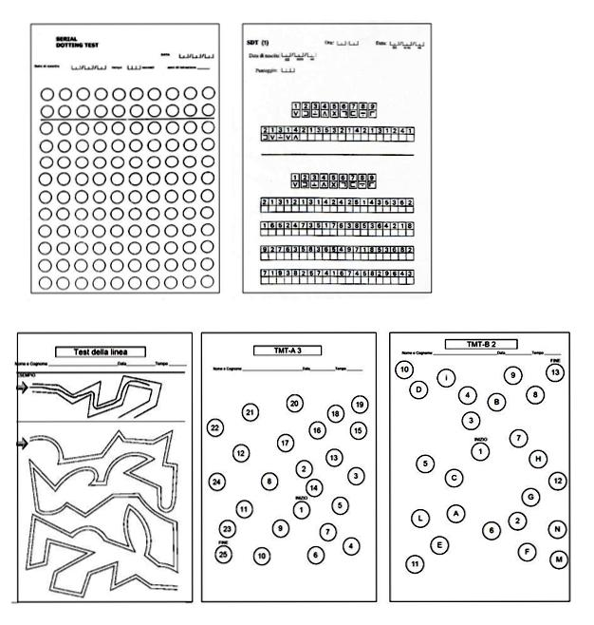
The Porto Systemic Encephalopathy test battery
(PSE test)
producing the Psychometric Hepatic Encephalopathy Score
(PHES)
Forms of the Italian standardization
Amodio et al, J Hepatol, 2008

Slide 12
Driving History Characteristics of Cirrhotics and Controls
Cirrhoticsª (n=109)
TV and/or MVAs within 1 yr
TV within 1 yr
MVA within 1 yr
TV and/or MVAs within 5 yr
TV within 5 yr
MVA within 5 yr
Controls (n=98)
% of Patients
TV, traffic violations; MVA, motor vehicle accidents.
Bajaj JS et al. Am J Gastroenterol. 2007;102(9):1903-1909.

Slide 13

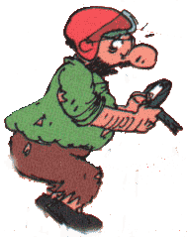

MHE and driving ability
…Is Minimal HE implicated in this outcome?
Courtesy of Piero Amodio

Slide 14
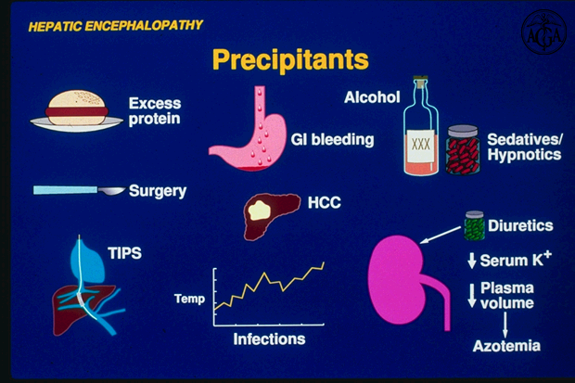

Slide 15
DIET – AASLD/EASL RECOMMENDATIONS

Slide 16
Key points:
Hepatic encephalopathy (HE) is not synonym of delirium/coma in a subject with end-stage liver disease; rather it is a specific condition with its own pathophysiology.
Once diagnosed, it requires a multiaxial assessment and classification.
HE has a major impact on patients and caregivers well- being and is a marker and/or risk factor for poor survival.
Both treatment of HE and prophylaxis of future HE are required.
Covert HE (ie, HE without frank disorientation) is now easily detectable and can be treated.
Amodio P. Liver International 2018

Slide 17

Corricella Port, Island of Procida (Napoli-ITALY)
By Andrea Ascione, August 2018
شكرا

Slide 18
scarto

Slide 20
AASLD/EASL guidelines, 2014

Slide 22
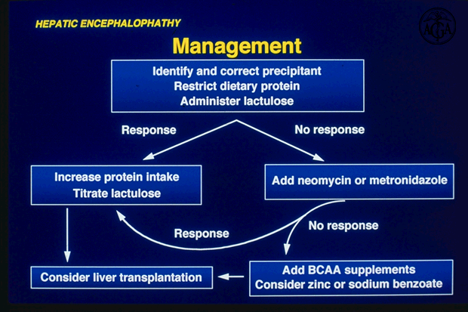
RIFAXIMIN

