Slide 1

HBsAg quantitativo e
nuovi marcatori di HBV:
ruolo attuale e futuro nella pratica clinica
Gaetano Bertino
Hepatology Unit
Department of Clinical and Experimental Medicine
University of Catania - Italy
gaetanobertinounict@gmail.com
CATANIA
30 SETTEMBRE - 1 OTTOBRE 2018

Slide 2
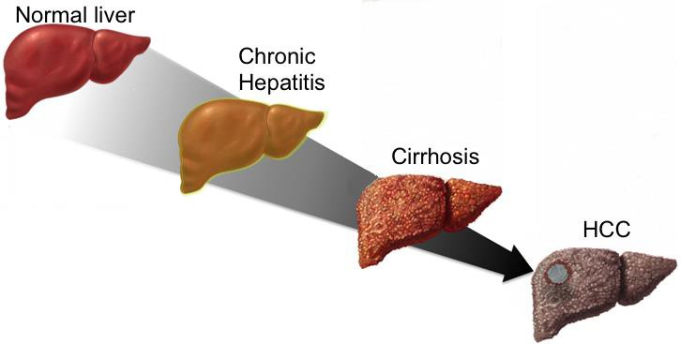
Virus suppression and
sustained disease control
Virus suppression
Liaw YF et al, N Engl J Med. 2004; Chang KC et al, Hepatology 2010; Marcellin P et al, Lancet 2013; Hosaka T et al, Hepatology 2013; Kim et al, Cancer 2015; Papatheodoridis GV al, J Hepatol 2015
Xinxin ZHANG

Slide 3
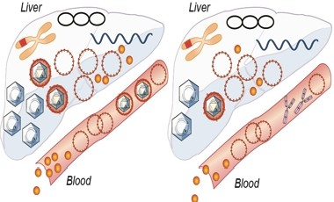
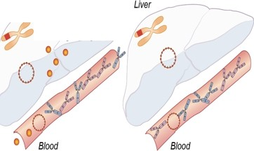

Definition of Cure
Liver
Liver
Liver
Liver
Blood
Blood
Blood
Blood
No treatment
Nucleos(t)ide analogue
induced virus suppression
(HBe seroconversion = 20%)
Decreased viral RNA and
protein synthesis
HBsAg loss and seroconversion
Elimination of cccDNA but persistence
of integrated viral DNA
Virus suppression
Functional cure
Complete cure
Infectious
particles
Integrated DNA
HBeAg
HBsAg
viral RNA
Y
Anti-HBe
1. Durant el & Zoulim, J Hepatol 2016
2. Zeisei, Lucifora et al, Gut 2015
3. ReviIl et al, Nature Reviews Gastroenterol Hepatol 2016
Mature
nucleocapsid
Y
cccDNA
Anti-HBs
Xinxin ZHANG

Slide 4
Biomarkers in evaluation to assist drug development
«Classic»
«Novel»
«Classic»
«Novel»
Dane particles
cir HBV-RNAs
HBsAg
HBcrAg
EXTRACELLULAR/SERUM
plasma
membrane
0.7 kb
2.4 kb
2.1 kb
3.5 kb
CYTOPLASM
Subgenomic RNAs
pgRNAs
nuclear membrane
NUCLEUS
rcDNA
cccDNA
Integrate sequences
exosome
HBeAg
Sphere
Filament
Nucleocapsid
Testoni B et al. Semin Liver Dis 2017

Slide 5

Classic biomarkers
HBsAg
HBeAg
HBV-DNA
Journal of Hepatology 2017 vol. 67 I 370-398

Slide 6
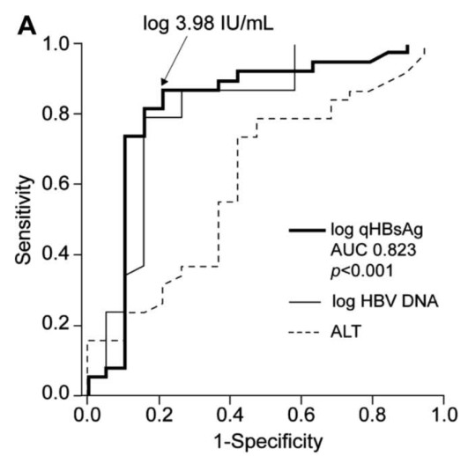
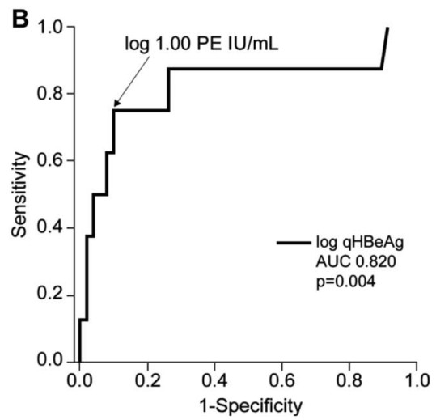
The baseline level of qHBsAg and the on-treatment decline of qHBeAg in
HBeAg positive patients were highly useful in predicting VR and SR
ROC curves of baseline characteristics used to predict VR
on-treatment qHBeAg used to predict SR
• Baseline HBsAg: cutoff level of 3.98 IU/mL, yielded the highest predictive value for VR
• HBeAg decline: 1.00 PE IU/mL, yielded the highest predictive value for SR
LEE et al. Hepatology 2011

Slide 7
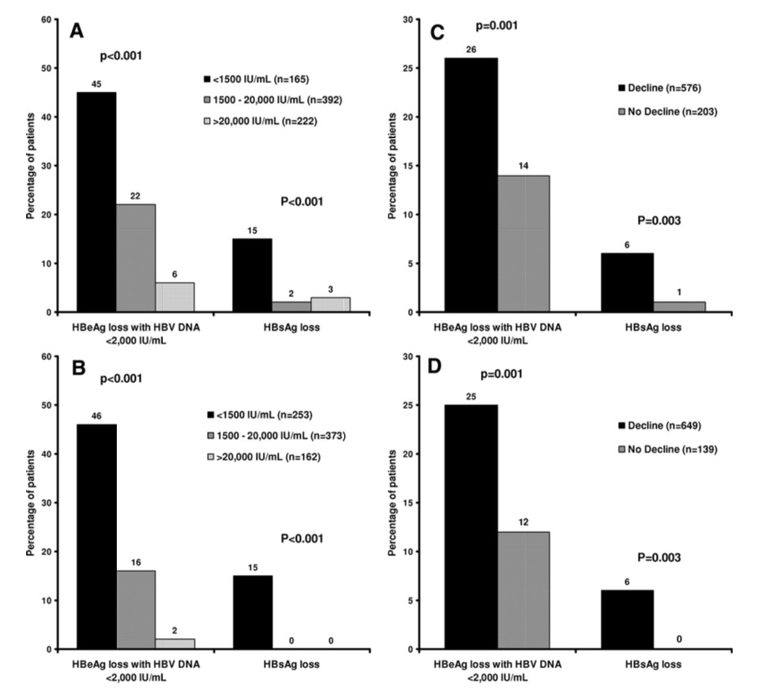
HBsAg levels can be used to guide therapy decisions in HBeAg-positive patients treated with PEG- IFN
Application of the prediction rules based on HBsAg levels at week 12 (A) and 24 (B) and HBsAg declines at weeks 12 (C) and 24 (D)
Response rates were low:
• in patients with genotypes A or D if there was no decline of HBsAg by week 12 (NPV: 97%-100%)
• in patients with genotypes B or C if HBsAg at
week 12 was >20,000 IU/mL (NPV: 92%-98%).
At week 24, nearly all patients with HBsAg
>20,000 IU/mL failed to achieve a response (NPV: response and HBsAg loss: 99% and 100%).
Sonneveld MJ et al. Hepatology 2013

Slide 8
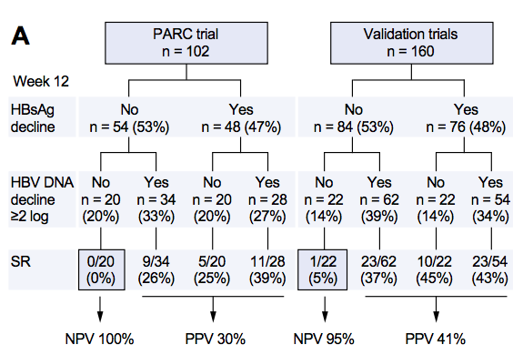
HBsAg decline at week 12 is an effective predictor of response rate in CHB patients treated with Peg-IFN
Flowchart showing chances of sustained response (SR)
Combination of HBsAg and HBV DNA levels at week 12 identifies HBeAg-negative patients with a very low chance of SR
Rijckborst V et al. J Hepatol 2012

Slide 9
Clinical Practice Guidelines
EASL 2017 Clinical Practice Guidelines on the management
of hepatitis B virus infection
European Association for the Study of the Liver
Monitoring of patients treated with PegIFNa
Recommendations
All CHB patients treated with PegIFNa should be followed with periodical assessments of at least full blood count, ALT, TSH, serum HBV DNA and HBsAg levels (Evidence level I/II-2, grade of recommendation 1).
HBeAg-positive CHB patients treated with PegIFNa should be also followed with periodical assessments of HBeAg and anti-HBe (Evidence level I, grade of recommendation 1).
CHB patients with virological response after PegIFNa therapy should remain under long-term follow-up because of the risk of relapse (Evidence level II-2, grade of recommendation 1).
Journal of Hepatology 2017 vol. 67 I 370-398

Slide 10
Clinical Practice Guidelines
EASL 2017 Clinical Practice Guidelines on the management
of hepatitis B virus infection
European Association for the Study of the Liver
Predictors of PegIFNa response and stopping rules
Recommendations
In HBeAg-positive CHB patients, HBsAg levels >20,000 IU/ml for genotype B and C, or no decline of HBsAg levels for genotype A and D, at 12 weeks of PegIFNa therapy are associated with a very low probability of subsequent HBeAg seroconversion and can be used as PegIFNa stopping rules (Evidence level II-2, grade of recommendation 2).
In HBeAg-positive CHB patients with genotype A-D, HBsAg levels >20,000 IU/ml at 24 weeks of PegIFNa therapy are associated with a very low probability of subsequent HBeAg seroconversion and can be used as PegIFNa stopping rules (Evidence level II-2, grade of recommendation 2).
In HBeAg-negative CHB patients with genotype D, a combination of no decrease in HBsAg levels and <2 log10 IU/ml reduction in serum HBV DNA levels at 12 weeks of PegIFNa therapy predicts no response and should be used as PegIFNa stopping rules (Evidence level II-2, grade of recommendation 1).
Journal of Hepatology 2017 vol. 67 I 370-398

Slide 11
Clinical Practice Guidelines
EASL 2017 Clinical Practice Guidelines on the management
of hepatitis B virus infection
European Association for the Study of the Liver
Week 12 and 24 stopping rules for HBeAg-positive and -negative patients treated with PegIFNa. These rules are based upon viral genotype, HBsAg and HBV levels
Journal of Hepatology 2017 vol. 67 I 370-398

Slide 12
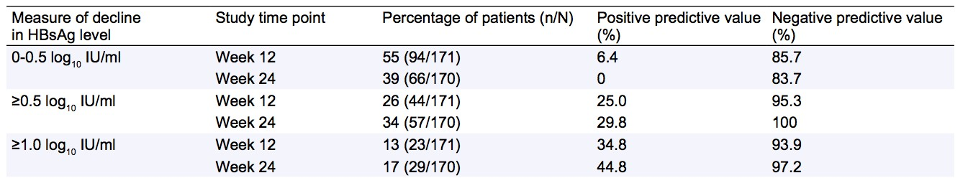
HBsAg decline in HBeAg positive CHB patients treated with TDF
suggests the possibility of HBsAg loss
Exploratory measures of HBsAg decline at weeks 12 and 24 for HBeAg-positive patients on TDF and corresponding positive and negative predictive values for ultimate HBsAg loss.
A reduction in HBsAg levels of ≥1 log₁₀ IU/ml at week 12 and 24 has a very high NPV (97%) and modest PPV (45%) for ultimate HBsAg loss
A lack of appreciable decline in HBsAg levels (≤0.5 log10) at week 12 or 24 had a very high negative predictive value (NPV >90%); in contrast,
a ≥1-log₁₀ decline in HBsAg level by week 12 or 24 had the highest positive predictive value (PPV), 34.8% and 44.8% respectively, for progressing to HBsAg loss
Marcellin P et al. Journal of Hepatology 2014

Slide 13
HEPATOLOGY, 2018
Papatheodoridis GV et al.
Probability of Retreatment in 130 Patients With HBeAg-Negative CHB Without Cirrhosis Who Discontinued Effective Long-Term NA Therapy in Relation to Their Main Characteristics
‡P = 0.108 if initial NA is added in the model.
The definition of relapse strongly affects the off-NAs rates of relapse and therefore can have a great impact on the probability of retreatment in HBeAg-negative CHB patients who discontinue an effective long-term NA therapy. The majority of patients would be retreated within 12-24 months if clinically significant relapse and indication for retreatment are considered to be HBV DNA >2000 IU/mL even combined with elevated ALT levels, whereas retreatment would not be initiated in the majority of patients if more stringent criteria for retreatment initiation are adopted.
Off-NAS relapses cannot be easily predicted by the patients’ main epidemiological and treatment characteristics; therefore, additional research is required in this field.
Notes:
In conclusion, the definition of relapse strongly affects the off-NAs rates of relapse and therefore can have a great impact on the probability of retreatment in HBeAg-negative CHB patients who discontinue an effective long-term NA therapy. The majority of patients would beretreated within 12-24 months if clinically significant relapse and indication for retreatment are considered to be HBV DNA >2000 IU/mL even combined with elevated ALT levels, whereas retreatment would not be initiated in the majority of patients if more stringent criteria for retreatment initiation are adopted. Regardless of definition, off-Nas relapses cannot be easily predicted by the patients’ main epidemiological and treatment characteristics; therefore, additional research is required in this field. Given that both Asian and European guidelines have
now included the option of treatment discontinuation in HBeAg-CHB patients without cirrhosis who will remain under close monitoring,(3,7) clinicians may start to withdraw oral antiviral agents in such patients who have remained in long-term (i.e., >2 years and preferentially
>3 years) virological remission. Close posttreatment follow-up with at least ALT and HBV DNA determinations is mandatory, and strict and predefined criteria for retreatment are necessary for avoiding potential life-long retreatment in large proportions of these patients.
In conclusione, la definizione di recidiva influenza fortemente i tassi di recidiva off-NAs e quindi può avere un grande impatto sulla probabilità di ritrattamento in pazienti CHB HBeAg-negativi che interrompono una terapia efficace a lungo termine con NA. La maggior parte dei pazienti verrebbe trattata entro 12-24 mesi se la recidiva clinicamente significativa e l'indicazione per il ritrattamento sono considerati HBV DNA> 2000 IU / mL combinati anche con elevati livelli di ALT, mentre il ritrattamento non sarebbe iniziato nella maggior parte dei pazienti se di più vengono adottati criteri rigorosi per l'avvio del ritrattamento. Indipendentemente dalla definizione, le ricadute off-Nas non possono essere facilmente predette dalle principali caratteristiche epidemiologiche e di trattamento dei pazienti; pertanto, sono necessarie ulteriori ricerche in questo campo. Dato che hanno entrambe le linee guida asiatiche ed europee ora include l'opzione di interruzione del trattamento in pazienti HBeAg-CHB senza cirrosi che rimarranno sotto stretto monitoraggio, (3,7) i medici possono iniziare a ritirare agenti antivirali orali in tali pazienti che sono rimasti a lungo termine (cioè,> 2 anni e preferenzialmente > 3 anni) remissione virologica. È obbligatorio un follow-up post-trattamento con almeno le determinazioni del DNA ALT e HBV, e sono necessari criteri rigorosi e predefiniti per il ritrattamento per evitare il potenziale ritrattamento per tutta la vita in grandi proporzioni di questi pazienti.

Slide 14
HEPATOLOGY, 2018
Papatheodoridis GV et al.
Given that both Asian and European guidelines have now included the option of treatment discontinuation in HBeAg- CHB patients without cirrhosis who will remain under close monitoring,(1,2) clinicians may start to withdraw oral antiviral agents in such patients who have remained in long-term (i.e., >2 years and preferentially >3 years) virological remission.
Close posttreatment follow-up with at least ALT and HBV DNA determinations is mandatory, and strict and predefined criteria for retreatment are necessary for avoiding potential life-long retreatment in large proportions of these patients.
EASL 2017 Clinical Practice Guidelines on the management of hepatitis B virus infection. J Hepatol 2017
Sarin SK et al. Asian-Pacific clinical practice guidelines on the management of hepatitis B: a 2015 update. Hepatol Int 2016
EDITORIAL I HEPATOLOGY, 2018
Lampertico P, Berg T
«However, HBsAg levels at baseline or at NA cessation, a parameter which has been shown to predict post-cessation outcomes in other studies, were not available in this study, limiting the conclusions regarding relapse and re-treatment
prediction.»
Notes:
Dato che sia le linee guida asiatiche che quelle europee hanno ora incluso l'opzione di interruzione del trattamento nei pazienti HBeAg-CHB senza cirrosi che rimarranno sotto stretta osservazione, (1,2) i medici possono iniziare a ritirare agenti antivirali orali in tali pazienti che sono rimasti a lungo -termine (cioè> 2 anni e preferenzialmente> 3 anni) remissione virologica.
È obbligatorio un follow-up post-trattamento con almeno le determinazioni del DNA ALT e HBV, e sono necessari criteri rigorosi e predefiniti per il ritrattamento per evitare il potenziale ritrattamento per tutta la vita in grandi proporzioni di questi pazienti.

Slide 15
HEPATOLOGY, 2017
Jen W.J. et al.
During a median follow-up period of 155 (2-614) weeks after cessation of Nuc therapy,
virologic relapse = 547 patients (79.2%)
clinical relapse = 419 patients (60.6%)
42 patients had confirmed HBsAg clearance, with a 6-year cumulative incidence of 13%,
9% in patients with cirrhosis
16% in patients without cirrhosis
On-treatment HBsAg kinetics (from baseline to EOT) in patient groups with different off-therapy events; patients with both clinical and virologic remission showed the greatest decline (P < 0.0001)
No clinical relapse + no virological relapse
Notes:
Of the original cohort of 1,075 HBeAg-negative
patients with chronic HBV infection who had discontinued
Nuc therapy, 5 (0.47%) showed HBsAg loss
during 156 (38.4-568) weeks of Nuc therapy. The 6-
year cumulative incidence and calculated annual incidence
of HBsAg seroclearance during Nuc therapy
were 3% and 0.15%, respectively.
Cinetica di HBsAg durante il trattamento (dalla linea di base a EOT) in gruppi di pazienti con diversi eventi di off-terapia; i pazienti con remissione sia clinica che virologica hanno mostrato il più grande declino

Slide 16
HEPATOLOGY, 2017
Jen W.J. et al.
Comparisons of the On-Treatment and Off-Treatment Features of the Patients With and Without HBsAg Seroclearance
End-of-treatment HBsAg levels strongly predicted HBsAg loss

Slide 17
HEPATOLOGY, 2017
Jen W.J. et al.
Cumulative HBsAg seroclearance rate in patients with EOT HBsAg <100, 100-499, and 500 IU/mL (log-rank test, P < 0.0001)
The 4-year probability of HBsAg loss was approximately 30% in patients with EOT HBsAg <100 IU/mL compared to none in patients with >100 IU/mL.
Notes:
The 4-year probability of HBsAg loss was approximately 30% in patients with EOT HBsAg
<100 IU/mL compared to none in patients with >100 IU/mL.

Slide 18
Research Article
Long-term response after stopping tenofovir
disoproxil fumarate in non-cirrhotic HBeAg-negative
patients – FINITE study
The potential to discontinue TDF therapy in HBeAg-negative patients was investigated
CHB patients
HBeAg-negative
> 4 years
TDF therapy
Primary endpoint:
HBsAg loss
by Week 144
Berg T, Simon KG, Mauss S, et al. J Hepatol. 2017;67:918‐924
Notes:
Unlike previous studies, the primary endpoint was not relapse in HBV DNA levels, but the rates of HBsAg loss and long-term immunological control defined as HBV DNA levels <2000 IU/ mL.

Slide 19
Research Article
Long-term response after stopping tenofovir
disoproxil fumarate in non-cirrhotic HBeAg-negative
patients – FINITE study
DNA >2,000, ALT ≤2xULN
DNA ≤2,000, ALT ≤2xULN
HBsAg loss
TDF-restart
4/21 (19%) cleared HBsAg
5/21 (23.8%) had HBV- DNA < 2000 IU/ml
13/21 (62%) remained off therapy
Berg T, Simon KG, Mauss S, et al. J Hepatol. 2017;67:918‐924

Slide 20
Research Article
Long-term response after stopping tenofovir
disoproxil fumarate in non-cirrhotic HBeAg-negative
patients – FINITE study
Highlights
The potential to discontinue tenofovir disoproxil fumarate (TDF) therapy in HBeAg-negative patients was investigated.
Of the patients who stopped TDF therapy, 62% remained off therapy to Week 144.
Of which 43% of patients had achieved either HBsAg loss or HBV DNA <2,000 IU/ml.
Four patients (19%) achieved HBsAg loss and three of them achieved HBsAg seroconversion.
Discontinuing TDF therapy was well-tolerated.
There is potential for HBsAg loss and/or sustained virological response in non-cirrhotic HBeAg-negative patients stopping long-term TDF therapy.
Arm A (TDF-stop)
Arm A (TDF-continue)
Patient profiles of HBsAg, HBV DNA, ALT and HBsAg levels at each clnical visit
Berg T, Simon KG, Mauss S, et al. J Hepatol. 2017;67:918‐924
Notes:
Although the number of patients included in our study was small,
there is a marked similarity between the response rates in this study
and those of Hadziyannis et al.10 One key finding in our study was
that, like in other studies, all patients experienced a relapse in HBV
DNA levels which was transient and most patients had a spontaneous
decrease in HBV DNA to below levels requiring treatment

Slide 21
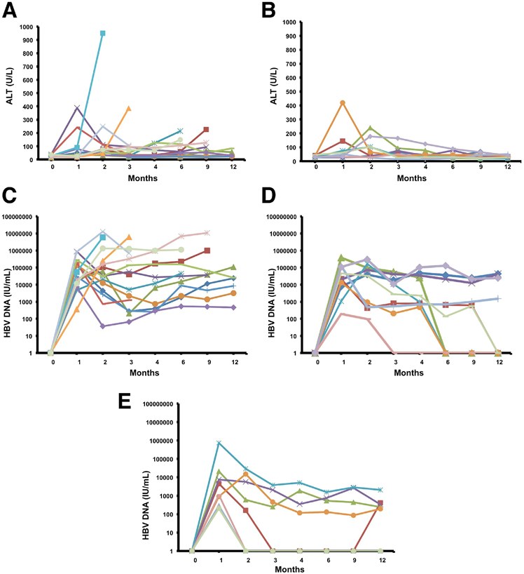

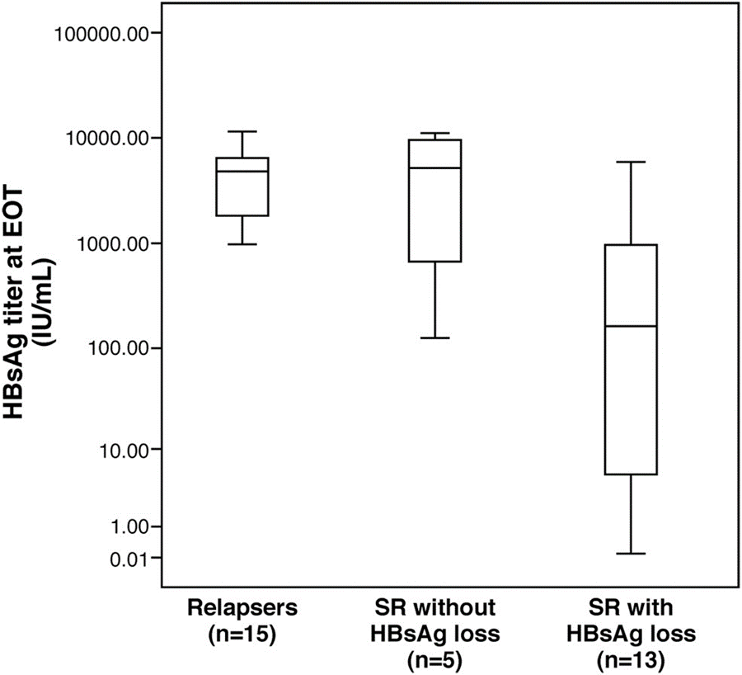
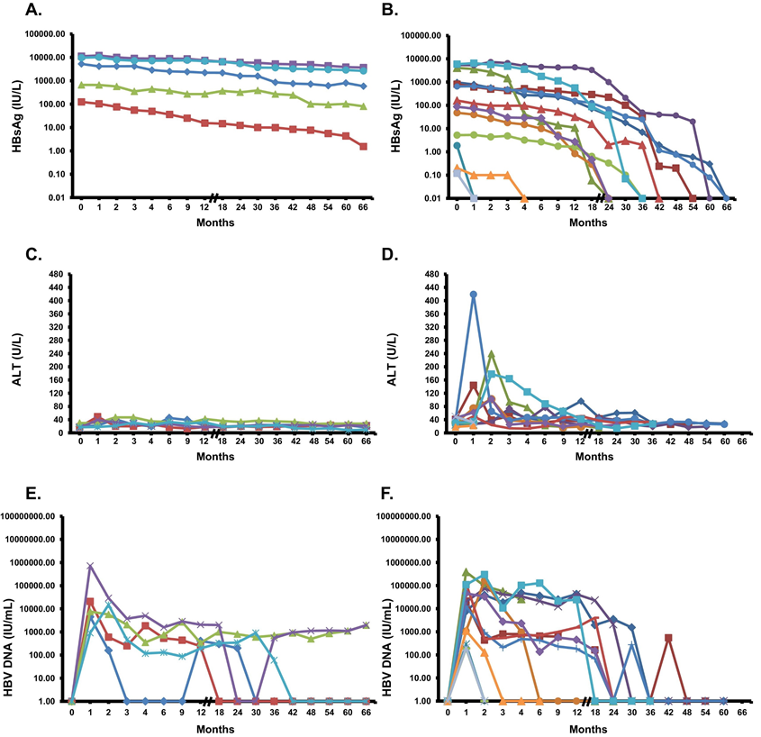
The course of (A and B) ALT and (C and D) HBV DNA levels during the first 12 months off treatment in patients with biochemical relapse (n 25) who either resumed antiviral therapy (n 15; A and C) or remained
without antiviral therapy (n 10; B and D). For patients who resumed
antiviral treatment during the first year (n 9), ALT and HBV DNA values are shown until the onset of therapy (A and C). In E, the course of HBV DNA in the 8 patients who did not receive antiviral therapy and did not show biochemical relapse is also shown. Undetectable HBV DNA
values are assigned a value of 1.
The number of patients who experienced a relapse and received antiviral therapy (relapsers) or lost HBsAg among the remaining patients during follow-up
The time course of serial HBsAg, ALT, and HBV DNA titers during the posttreatment follow-up period in the 18 patients with SR who did not resume antiviral therapy are shown (A, C, and E, patients without HBsAg loss [n 5]; B, D, and F, patients with HBsAg loss [n 13]). The time interval for testing was every 3 months for the first 12 months and every 6 months (//) after month 12.
EOT HBsAg levels in patients with SR and HBsAg loss (n 13) vs patients with virological and biochemical relapse (n 15; P .002) or patients with SR without HBsAg loss (n 5; P .07). SR indicates persistently not detectable HBV DNA or 2000 IU/mL combined with persistently normal ALT level following posttreatment month 6 sustained until the end of follow-up.
HADZIYANNIS ET AL GASTROENTEROLOGY 2012 Vol. 143, No. 3
Notes:
Sebbene il numero di pazienti inclusi nel nostro studio fosse piccolo, vi è una marcata somiglianza tra i tassi di risposta in questo studio e quelli di Hadziyannis et al. Uno dei risultati chiave del nostro studio è stato che, come in altri studi, tutti i pazienti hanno avuto una recidiva nei livelli di HBV DNA che era transitoria e la maggior parte dei pazienti ha avuto una diminuzione spontanea del DNA dell'HBV a livelli inferiori che richiedono un trattamento

Slide 22
PREDICTING OFF NA TREATMENT RESPONSE
The factors shown to be associated with a post-NA treatment response are:
younger age
low ALT and HBV DNA levels at baseline
the duration of consolidation treatment
Berg T et al. – FINITE study. J Hepatol. 2017
Although the level of HBsAg has also been found to be a marker for post-NA treatment response, results are contradictory
Certain studies have shown that HBsAg levels at the end of NA treatment could be predictive of responders to treatment withdrawal

Slide 23
Research Article
Long-term response after stopping tenofovir
disoproxil fumarate in non-cirrhotic HBeAg-negative
patients – FINITE study
Change in HBsAg level from baseline according to HBsAg level at the time of stopping therapy
Berg T et al. – FINITE study. J Hepatol. 2017
Notes:
Nello studio di Berg et al, i pazienti che hanno raggiunto una diminuzione dei livelli di HBsAg dopo l'interruzione del trattamento, avevano livelli di HBsAg al basale <25.000 IU / mL quando il trattamento con NA è stato interrotto.

Slide 24

Chen CH et al. found that HBsAg cut-off values of 120 and 200 IU/mL were predictive of a response to treatment
J Hepatol. 2014
Lee HA et al. identified serum HBsAg levels of <2 log₁₀ IU/mL to be a reliable predictor of a sustained off-treatment response
Clin Mol Hepatol. 2016

Slide 25
ORIGINAL ARTICLE
Treatment cessation of entecavir in Asian patients with hepatitis B e antigen negative chronic hepatitis B: a multicentre prospective study
Significance of this study
What is already known on this subject?
First-line nucleos(t)ide analogue therapy achieves high rates of virologic suppression inchronic hepatitis B (CHB).
Discrepancies exist in the possible treatment endpoints for hepatitis B e antigen (HBeAg) negative CHB.
The off-treatment durability of nucleos(t)ide analogue therapy in HBeAg negative CHB has not been well investigated.
The role of serum hepatitis B surface antigen (HBsAg) level monitoring after treatment cessation is undetermined.
What are the new findings?
Despite good virologic suppression beforetreatment discontinuation, HBeAg negative Asian CHB patients had high rates of virologic relapse (91.4% in 48 weeks).
25.8% of subjects had biochemical hepatitis during virologic relapse.
Mean serum HBsAg levels declined slowly and gradually after treatment cessation.
Baseline and subsequent serial HBsAg levels had no association with virologic relapse.
How might it impact on clinical practice in the foreseeable future?
With the high rates of virologic relapse noted, nucleos(t)ide analogue therapy should be continued indefinitely until the recognized treatment endpoint of HBsAg seroclearance.
Seto W-K, et al. Gut 2014;0:1–6

Slide 26
HBsAg levels predict HCC development in HBeAg (-) patients with low VL (Genotypes B and C)
HBsAg level (IU/ml)
<1000
≥1000
Logrank P <.001
Cumulatice incidence of HCC (%)
Years of follow-up
Cumulative incidence of HCC in 1068 HBeAg-negative patients with HBV DNA level <2000 IU/mL
Tseng TC et al. Gastroenterology 2012
Notes:
BACKGROUND & AIMS:
Patients with chronic hepatitis B virus (HBV) infection have a high risk for developing hepatocellular carcinoma (HCC). Patients with lower levels of hepatitis B surface antigen (HBsAg) have higher chances of losing HBsAg than those with high levels. However, little is known about whether higher levels of HBsAg increase risk for HCC.
METHODS:
We followed 2688 Taiwanese HBsAg-positive patients without evidence of cirrhosis for a mean time period of 14.7 years. In addition to the known risk factors of HCC, we investigated the association between levels of HBsAg and development of HCC.
RESULTS:
Of the patients followed, 191 developed HCC, with an average annual incidence rate of 0.5%. Baseline levels of HBsAg and HBV were associated with development of HCC, and risk increased with level. Compared to HBsAg level, by receiver operating characteristic curve analysis, HBV DNA level better predicted the development of HCC during 10-year and 15-year periods (both, P < .001). However, when we evaluated hepatitis B e antigen-negative patients with levels of HBV DNA <2000 IU/mL, factors that determined HCC risk included sex, age, and levels of alanine aminotransferase and HBsAg (≥1000 IU/mL), but not level of HBV DNA. Multivariate analysis showed that the adjusted hazard ratio for HCC in patients with levels of HBsAg ≥1000 IU/mL versus <1000 IU/mL was 13.7 (95% confidence interval: 4.8-39.3).
CONCLUSIONS:
Among patients infected with HBV genotype B or C, determinants of HCC risk include their sex, age, hepatitis B e antigen status, HBV genotype, and levels of alanine aminotransferase and HBV DNA, but not level of HBsAg. Among hepatitis B e antigen-negative patients with low viral loads, HCC risk is determined by levels of HBsAg and alanine aminotransferase and age, but not HBV DNA.

Slide 27
New biomarkers
HBcrAg
qAnti-HBc
HBV-RNA
cccDNA
Journal of Hepatology 2017 vol. 67 I 370-398

Slide 28
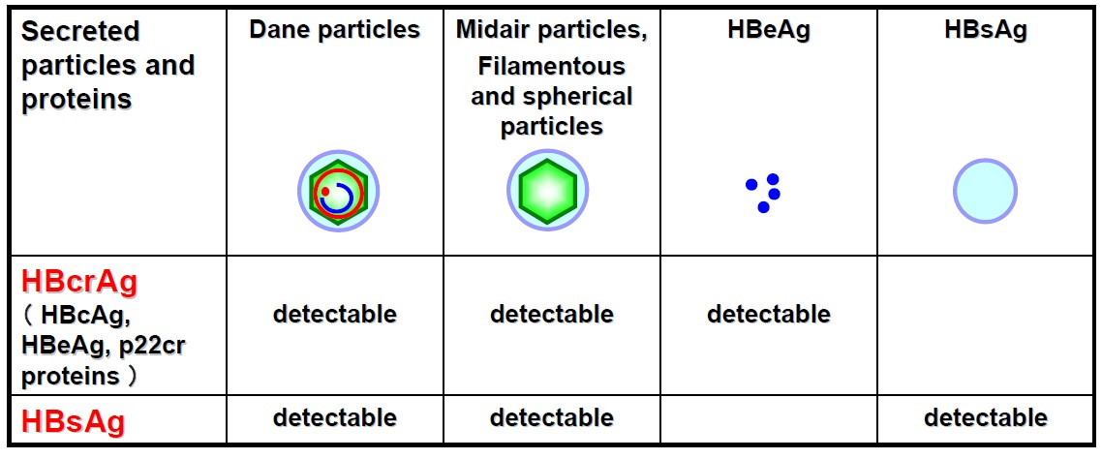
HBcrAg
HBcrAg quantification may provide additional information concerning the translational activity of the HBV infection beyond HBsAg quantification
EASL 2017 Clinical Practice Guidelines on the management of hepatitis B virus infection

Slide 29
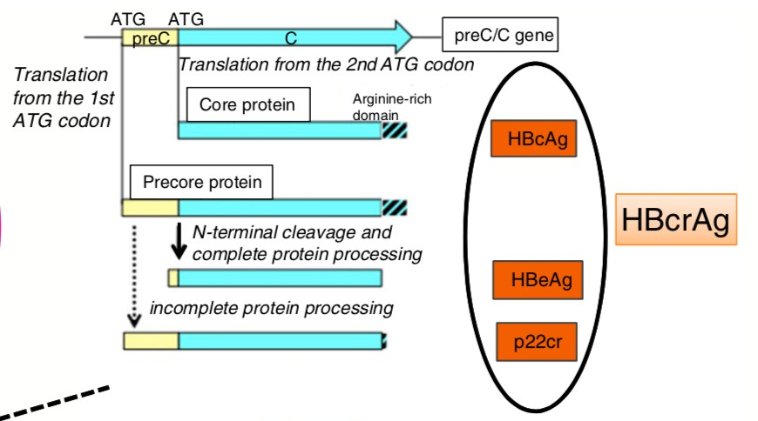



HBcrAg
3 proteins from the precore/core gene
HBcrAg = HBcAg, HBeAg, and prec22 precursor protein
CLEIA® HBcrAg assay kit with a fully automated analyzer system
(Lumipulse System, Fujirebio, Inc.)
HBcrAg is a potential surrogate marker of cccDNA
It may soon become a useful marker for disease monitoring, predicting treatment response and disease outcome of chronic hepatitis B
L-Y Mak et al. Aliment Pharmacol Ther. 2017

Slide 30
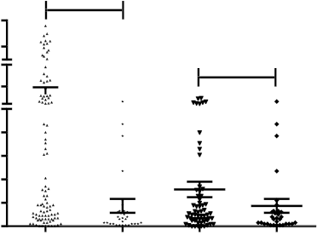
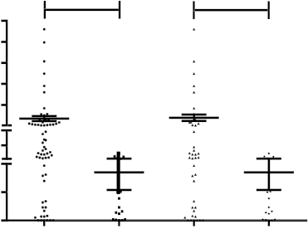
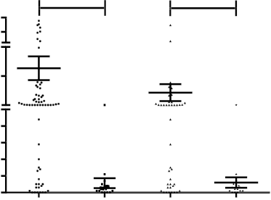
HBcrAg+ patients show higher cccDNA amount and activity
cccDNA
cccDNA transcriptional activity
pgRNA
p < 0 . 0 0 0 1
p < 0 . 0 0 0 1
p = 0 . 0 1 3
p < 0 . 0 0 0 1
p = 0 . 0 0 1
p = 0 . 0 7 7
cccDNA/cell
pgRNA/cccDNA
pgRNA relative quantity
HBcrAg
pos
neg
pos
neg
HBcrAg
pos
neg
pos
neg
HBcrAg
pos
neg
pos
neg
All patients
HBeAg neg
All patients
HBeAg neg
All patients
HBeAg neg
Testoni et al. AASLD 2016

Slide 31
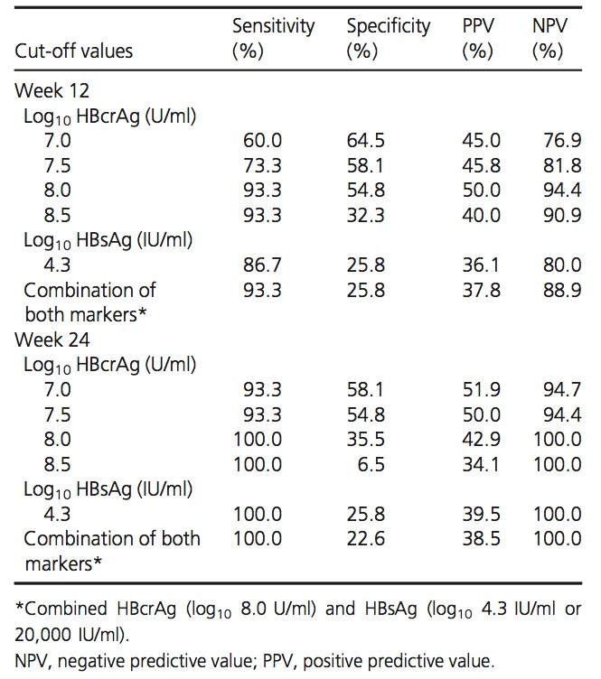
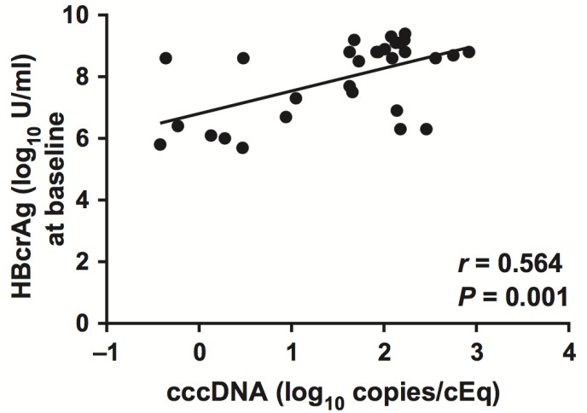
Monitoring HBcrAg levels during PEG-IFN therapy help identify patients with a very low probability of response
HBcrAg and HBsAg levels to predict virological response
at week 72
Correlations of HBcrAg and cccDNA at baseline
The quantitative HBcrAg represented a reliable
marker of intrahepatic cccDNA
Chuaypen et al. Liver International 2016

Slide 32
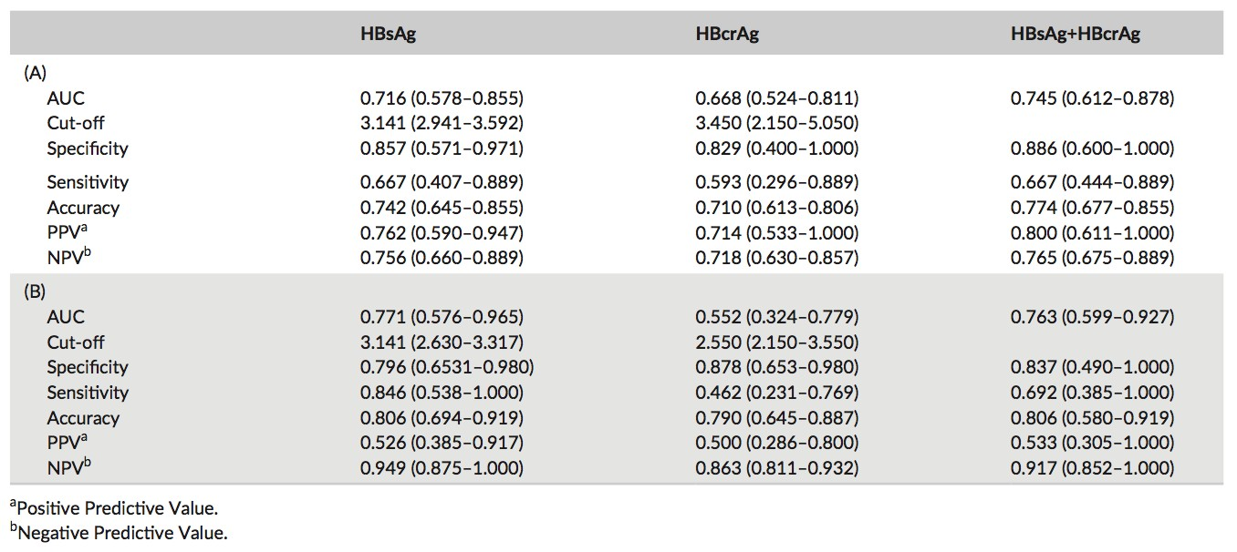
Baseline HBsAg and HBcrAg predict response/HBsAg loss in HBeAg negative CHB patients treated with Peg-IFN
Baseline levels of HBsAg and HBcrAg and the combination of the two markers identify patients with high probability of response (PPV: 80.0%) and low probability of response (NPV: 76.5%)
Martinot-Peignoux M et al. Journal of Viral Hepatitis 2016

Slide 33
PREDICTING OFF NA TREATMENT RESPONSE
Novel serum markers of HBV replication have also been assessed
for use in predicting a post-treatment response
HBV core-related antigen (HBcrAg)
Results from studies in Asian populations, mainly with HBV genotypes B and C infection, suggest that HBcrAg could be a potential marker for predicting a favourable outcome following discontinuation of Nas therapy
Matsumoto A, et al. Hepatol Res. 2007
HBeAg-negative patients who respond to NA treatment for at least 2 years and with both
HBsAg levels <1.9 log10 IU/mL and
HBcrAg levels <3.0 log10 IU/mL
have a low chance of a HBV DNA relapse after treatment withdrawal (1,2)
1. JSH guidelines for the management of hepatitis B virus infection. Hepatol Res. 2014
2. Tanaka E, Matsumoto A. Guidelines for avoiding risks resulting from discontinuation
of nucleoside/nucleotide analogs in patients with chronic hepatitis B. Hepatol Res. 2014

Slide 34








Circulating viral particles
Classic
Newly described
HBsAg
filament
DNA free particles
Dane
particle
sphere
HBeAg
RNA containing
particles
1. Van Bommel et al. Hepatology 2015
2. Hu et al. J Viral Hepatitis 2015

Slide 35
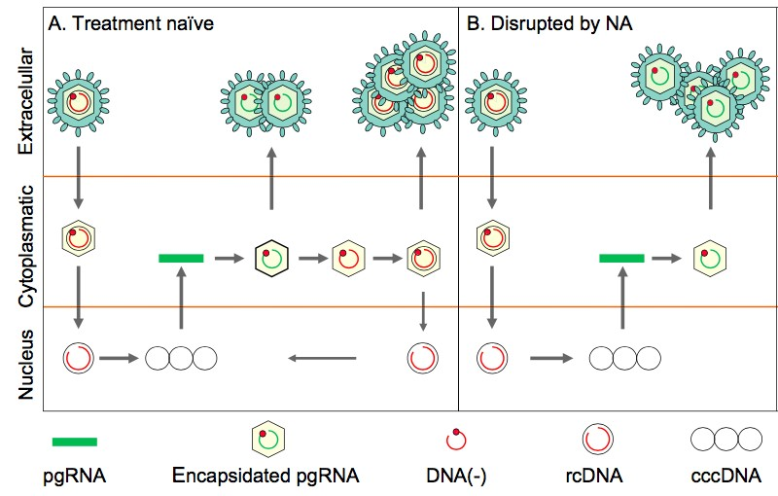

Predictive value of serum HBV RNA
during antiviral therapy
Independently predict virologic response
Predict HBV reactivation after discontinuation of NAs
Reflect antiviral potency of NAs
Predictor of early emergence of viral mutation during LAM therapy
1. Wang J. et al. Journal of Hepatology 2016
2. Huang Y.W. et al. Hepatobiliary Surg Nutr 2015

Slide 36
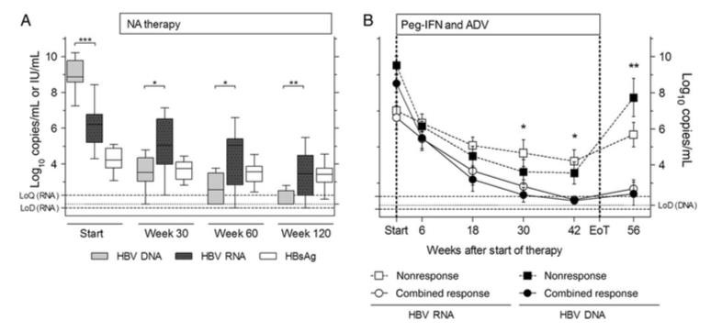
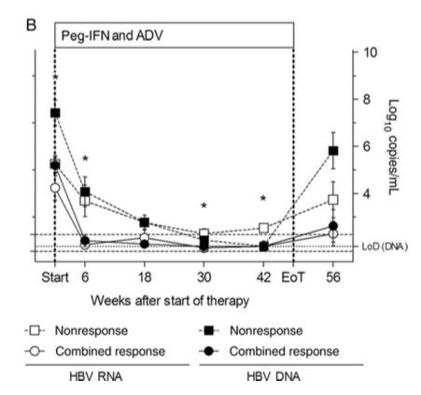
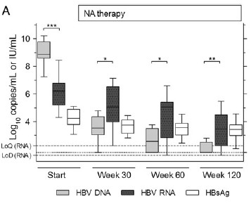
HBV RNA is associated with a response to Peg-IFN and NAs
HBV RNA levels during treatment in HBeAg positive patients
During long-term NA treatment of patients with CHB HBV RNA levels remained higher than HBV DNA levels
Peg-IFN–based treatment induced a stronger decrease in HBV RNA load than NA monotherapy
Responders showed a stronger and earlier decline in HBV RNA during Peg-IFN treatment
HBV RNA levels during treatment in HBeAg negative patients
Jansen et al. JID 2016

Slide 37
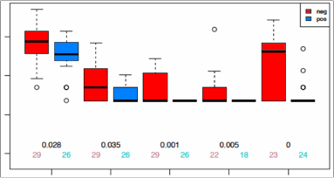
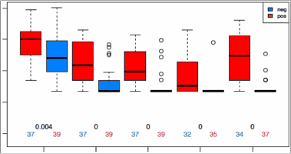
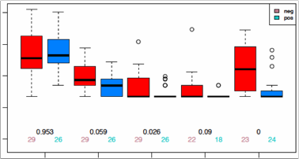
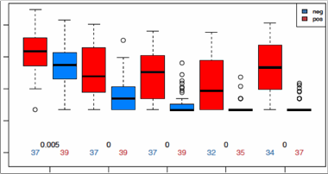
Serum HBV RNA is an early predictor of HBeAg seroconversion in patients with CHB treated with PegIFN ɑ-2a
PegIFN ɑ-2a+ LAM
PegIFN ɑ-2a
Non-responder
Responder
Non-responder
Responder
flRNA
(log10 cps/mL)
trRNA
(log10 cps/mL)
Week 0 12 24 48 72
Week 0 12 24 48 72
Baseline HBV RNA levels are lower in responders
During treatment, responders show markedly lower or undetectable ( ) HBV RNA levels
van Bömmel F, et al. AASLD 2015, San Francisco

Slide 38
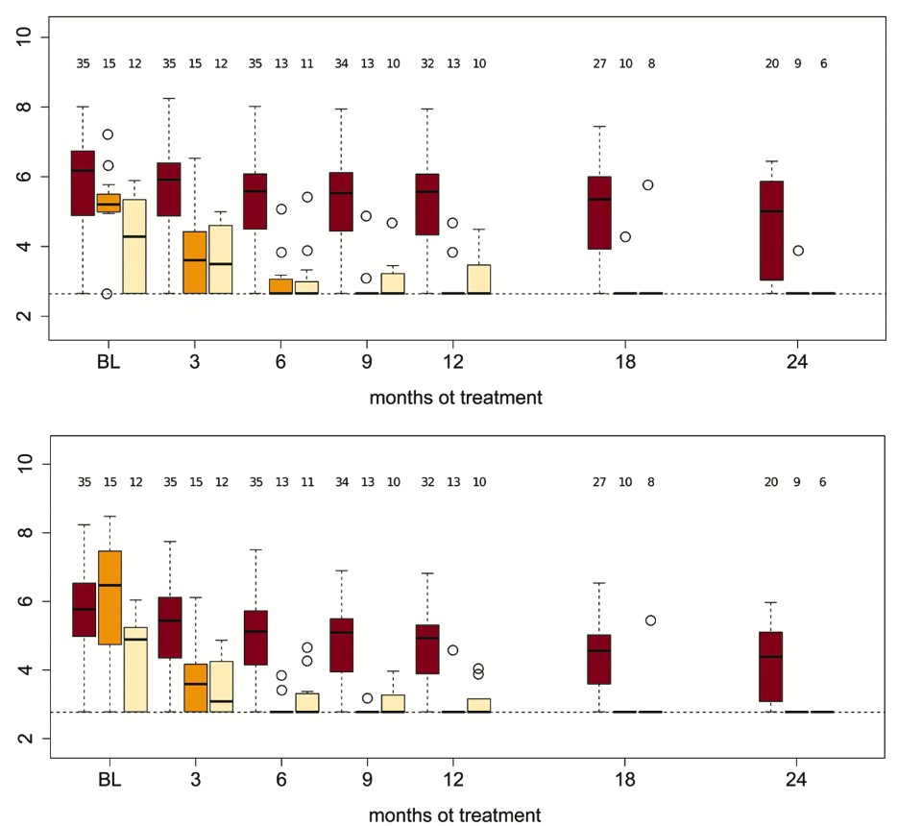
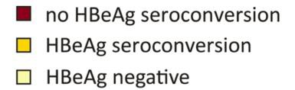
Serum HBV RNA is an early predictor of HBeAg seroconversion in patients with CHB treated with NAs
flRNA
(log10 cps/mL)
Those patients with subsequent HBeAg seroconversion showed a significantly stronger decline in HBV RNA levels during treatment
Patients with HBeAg negative chronic HBV infection have a marked decline in HBV RNA levels
trRNA
(log10 cps/mL)
van Bömmel F. et al. Hepatology 2015

Slide 39
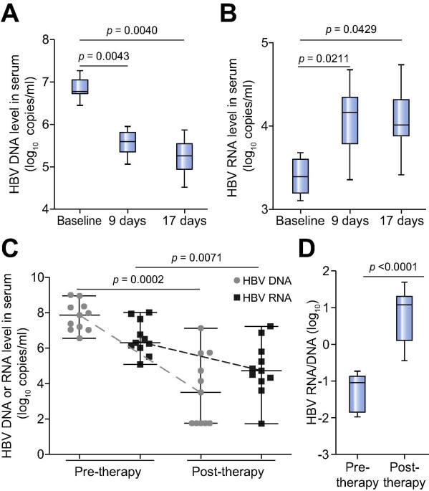
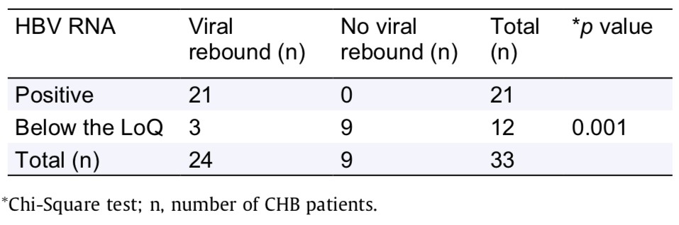
The association of HBV pgRNA virion levels and viral rebound after the discontinuation of NAs-therapy
Viral rebound occurred in 21 (100%) patients whose HBV RNA was positive at EoT, whereas, only in 3 (25%) of the 12 patients whose HBV RNA levels were below the LoD
*
*limit of detection
Wang et al. J Hepatol 2016

Slide 40
Serum HBV RNA below LOD may predict safe discontinuation of NAs therapy
P<0,001
33 CHB patients long-time NAs treated with HBV DNA levels < LoQ* at EoT (> 3y TT)
N=21
*limit of quantification
HBV RNA positive
HBV RNA below LoQ
N=9
N=3
Replase = reappearance of HBV DNA >LoQ,
6 months after cessation of NA
N=0
1. Wang J et al . J Hepatol 2016
2. Tsung J Gastroenterol 2013

Slide 41
PREDICTING OFF NA TREATMENT RESPONSE
Novel serum markers of HBV replication have also been assessed
for use in predicting a post-treatment response
HBV RNA
Serum HBV RNA levels during NA treatment as well as levels of intrahepatic HBV RNA have been suggested as another novel marker. Indeed, this marker provides information on cccDNA transcriptional activity even during suppression of HBV DNA during NA treatment. (1,2,3)
1. Wang J et al. J Hepatol. 2016
2. Yu Y et al. J Hepatol. 2017
3. Giersch K et al. J Hepatol. 2017
Low serum HBV RNA levels might there be a useful predictor for durably low HBV replication after stopping NA treatment.
However, the value of this marker has not yet been evaluated in a prospective
trial. Also, there is no existing validated assay for serum HBV RNA and the lower detection limit is undefined
van Bömmel F and Berg T. Liver Int. 2018

Slide 42
PREDICTING OFF NA TREATMENT RESPONSE
Novel serum markers of HBV replication have also been assessed
for use in predicting a post-treatment response
HBV RNA
Serum HBV RNA levels during NA treatment as well as levels of intrahepatic HBV RNA have been suggested as another novel marker. Indeed, this marker provides information on cccDNA transcriptional activity even during suppression of HBV DNA during NA treatment. (1,2,3)
1. Wang J et al. J Hepatol. 2016
2. Yu Y et al. J Hepatol. 2017
3. Giersch K et al. J Hepatol. 2017
«We agree with Yu and Wang et al. that it is important to study the role of intrahepatic and serum HBV RNA in predicting long-term outcome after NA cessation. However, we believe it would be difficult to include measurement of an intrahepatic marker in routine clinical practice and spatial intrahepatic distributions of replicative HBV forms may affect the results. Whether serum HBV RNA can be a surrogate for the intrahepatic forms requires further study in larger cohorts and we are planning to perform serum HBV RNA analyses from stored serum samples of patients included in the FINITE trial. In our experience of studying serum HBV RNA in NA-treated patients, this marker rapidly becomes undetectable in most HBeAg-negative patients, which is likely to limit the predictive power of this serum marker in this population.»
Thomas Berg and Jörg Petersen, Journal of Hepatology 2018 vol. 68, 595–629

Slide 43
New biomarkers
HBcrAg
qAnti-HBc
HBV-RNA
cccDNA
Journal of Hepatology 2017 vol. 67 I 370-398

Slide 44
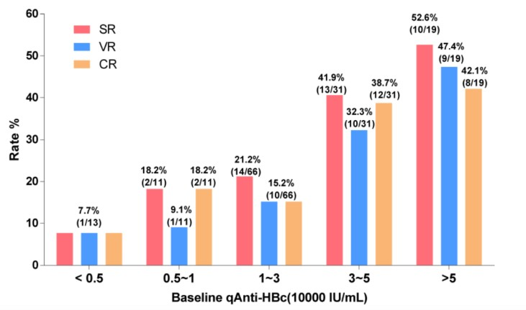
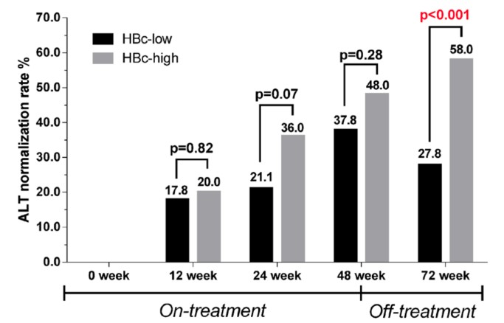
Baseline quantitative hepatitis B core antibody
Baseline anti-HBc titer may serve as a useful predictor of Peg-IFN and NA therapy efficacy in HBeAg-positive CHB patients, which could be used for optimizing the antiviral therapy of CHB
Asian-Pacific clinical practice guidelines on the management of hepatitis B: a 2015 update Hepatol Int. 2016
Patients who achieved response had a higher baseline qAnti-HBc level (>30,000IU/ml)
Treatment response rate according to baseline qAnti-HBc level status
ALT normalization rates in patients with different baseline qAnti-HBc levels
The response rate (SR, VR, CR) gradually rose
with increasing baseline qAnti-HBc levels
The HBc-high (>30,000IU/ml) patients had a higher
ALT normalization rate at the end of the follow-up
Hou JL et al. Theranostics 2015

Slide 45
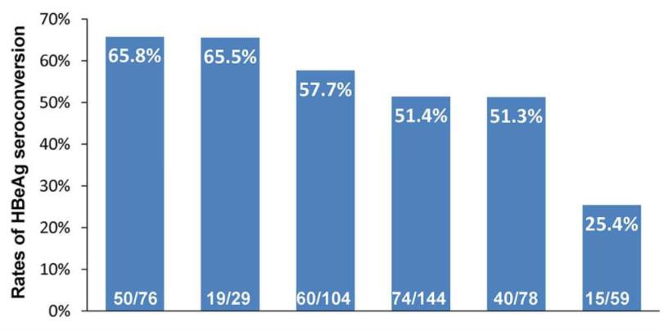
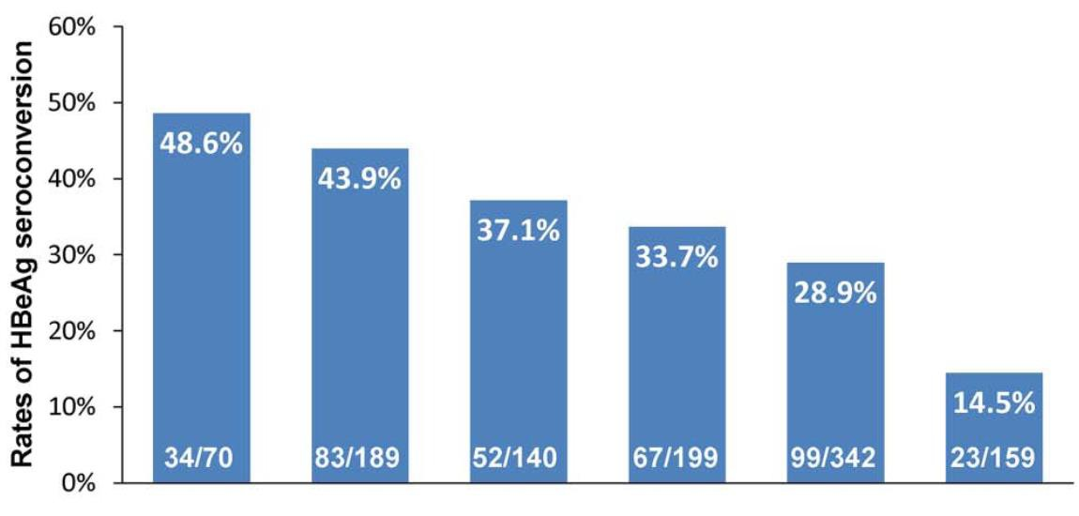


Baseline anti-HBc titre is a useful predictor of Peg-IFN and
NUC therapy efficacy in HBeAg positive CHB patients
(a)
(a)
(b)
(b)
Patients with baseline anti-HBc ≥4.4 log₁₀ IU/mL (a) and baseline HBV DNA <9 log₁₀ copies/mL (b) had 65.8% and 37.1% rates of HBeAg seroconversion in the Peg-IFN and NUC cohorts, respectively
Fan R. et al. Gut 2016

Slide 46
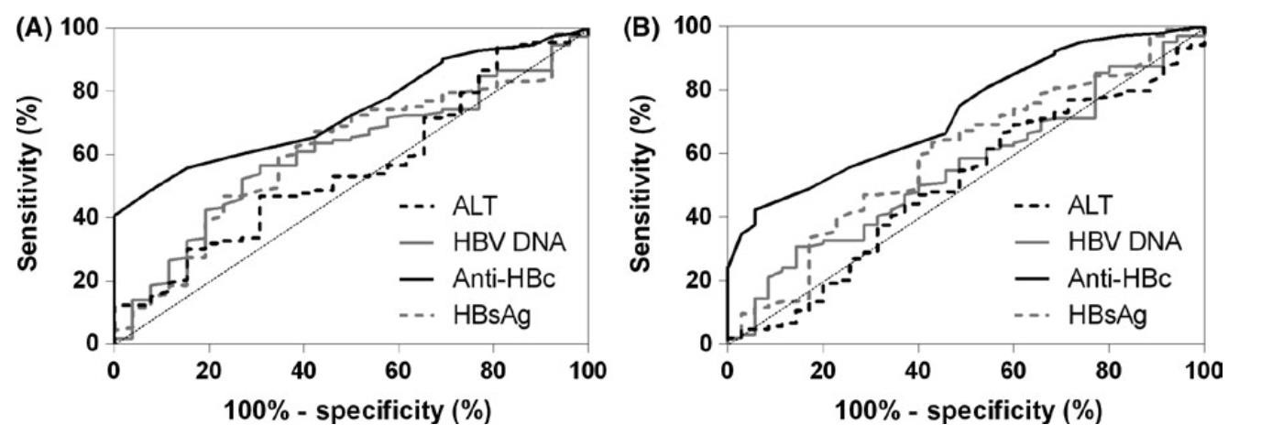
Baseline anti-HBc titre is a useful predictor of long-term entecavir therapy efficacy in HBeAg positive CHB patients
(A) AUROCs of baseline parameters in predicting HBeAg seroconversion at w144
(B) AUROCs of baseline parameters in
predicting HBeAg seroconversion at w240
Patients with baseline anti-HBc ≥4.65 log₁₀ IU/mL had 28.0% and 35.5% chance of seroconversion at weeks 144 and 240, respectively
Xu JH, et al. J Viral Hepat 2017

Slide 47
Research Article
Viral Hepatitis
JOURNAL
OF HEPATOLOGY
Quantitation of anti-core antibodies may help predict
HBV reactivation in patients with lymphoma and
resolved HBV infection
Hung-Chih Yang, Hsiao-Hui Tsou, Sung-Nan Pei, Cheng-Shyong Chang, Jia-Hong Chen, Ming Yao, Shyh-Jer Lin, Johnson Lin, Quan Yuan, Ningshao Xia, Tsang-Wu Liu,Pei-Jer Chen, Ann-Lii Cheng, Chiun Hsu, Taiwan Cooperative Oncology Group
High anti-HBc and low anti-HBs at baseline
predicted high risk of HBV reactivation
Increase in anti-HBc during HBV
reactivation was associated with
severe hepatitis flare
Highlights
The risk of HBV reactivation for patients with lymphoma and resolved HBV infection varied.
High anti-HBc and low anti-HBs at baseline predicted high risk of HBV reactivation.
Quantification of baseline anti-HBc/anti-HBs may optimize preventive strategies.
Journal of Hepatology 2018 vol. 69 I 286–292

Slide 48
New biomarkers
HBcrAg
qAnti-HBc
HBV-RNA
cccDNA
Journal of Hepatology 2017 vol. 67 I 370-398

Slide 49















Monitoring of the cccDNA pool and its transcriptional activity
Dane particles
cir HBV-RNAs
qHBsAg
HBcrAg
Extracellular / serum
filament
DNA free
particles
spher
Dane
particles
HBV RNA
particles
Cytoplasm
pgRNA
Subgenomic RNAs
Nucleus
Rc-DNA
cccDNA
pgRNA
Encapsidated
pgRNA
Subgenomic
RNAs
Exosomes
Testoni et al Sem Liver Dis, 2017

Slide 50
cccDNA
The main limitation is the requirement of liver biopsy
Persist in the liver of infected patients even after long-term NA therapy and even after HBsAg loss and seroconversion
Quantification of cccDNA levels and its transcriptional activity will be important in clinical trials evaluating novel treatment concepts to cure HBV infection
EASL 2017 Clinical Practice Guidelines on the management of hepatitis B virus infection

Slide 51
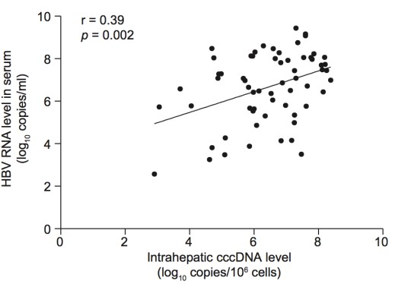
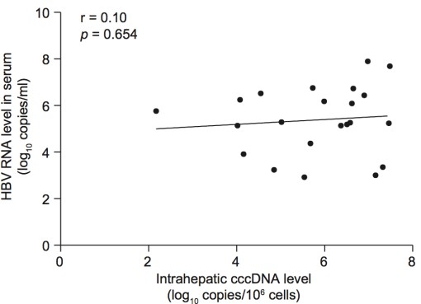
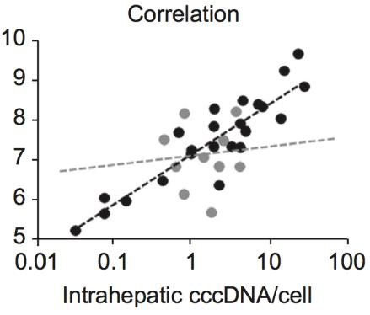

Correlation between cccDNA and HBV RNA
Correlation of serum pgRNA and intrahepatic cccDNA/cell in HBV-infected mice
B) Serum HBV RNA correlations with
intrahepatic cccDNA in HBeAg positive
patients
C) Serum HBV RNA correlations with
intrahepatic cccDNA in HBeAg negative
patients
Serum HBV RNA correlated well with intraphepatic cccDNA in HBeAg-positive patients(B), but not in HBeAg-negative patients(C)
1. Giersch K. et al. J Hepatol 2016
2. Wang J. et al. J Hepatol 2017

Slide 52
Research Article
Viral Hepatitis
JOURNAL
OF HEPATOLOGY
Quantitation of HBV cccDNA in anti-HBc-positive liver
donors by droplet digital PCR: A new tool to detect
occult infection
Gian Paolo Caviglia, Maria Lorena Abate, Francesco Tandoi, Alessia Ciancio, Antonio Amoroso, Mauro Salizzoni, Giorgio Maria Saracco, Mario Rizzetto, Renato Romagnoli, Antonina Smedile
Highlights
HBV covalently closed circular DNA (cccDNA) is responsible for viral persistence decades after liver disease resolution.
A latent occult HBV infection is identified by the presence of the antibody to the HB-core antigen (anti-HBc).
We developed a highly sensitive droplet digital PCR assay for intrahepatic HBV cccDNA quantitation.
HBV cccDNA is detectable and quantifiable in 27 out of 100 anti-HBc-positive liver donors.
Serum anti-HBc IgG levels are associated with the finding of intrahepatic HBV cccDNA.
Key message
The titer of anti-HBc IgG may be a useful surrogate to predict the risk of OBI reactivation in immunosuppressed patients.
Journal of Hepatology 2018 vol. 69 I 301–307

Slide 53

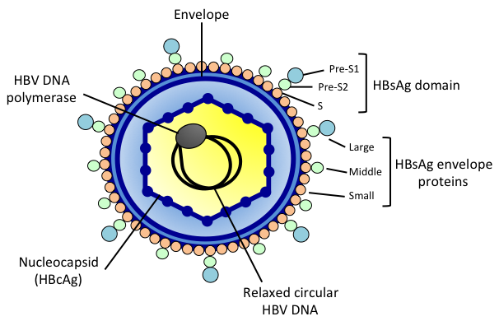

Other potential serum biomarkers
Hepatitis B virus large surface protein (LHBs)
QS by Next Generation Sequencing (NGS)
LHBs
Notes:
Clinical research. “Cohort studies, surveillance studies, and clinical trials of new therapeutic agents or strategies require serial measurements of HBV DNA. In research studies, tests for resistant variants should be sy stematically performed when antiviral therapy fails, to identify the resistant variant and characterize its nature and dynamics. Sensitive sequencing methods such as NGS are particularly useful for characterizing the dynamics of sensitive and resistant virus populations over time. Information about HBV genotype and core and core promoter mutations might be used in epidemiology and pathophysiology studies»
Ricerca clinica. Studi di coorte, studi di sorveglianza e studi clinici di nuovi agenti terapeutici o le strategie richiedono misurazioni seriali del DNA dell'HBV.
In studi di ricerca, prove per varianti resistenti dovrebbero essere
sistematicamente eseguita quando la terapia antivirale fallisce, a
identificare la variante resistente e caratterizzarne la natura
e dinamiche.
Metodi di sequenziamento sensibili come NGS sono particolarmente utili per caratterizzare le dinamiche di popolazioni virali sensibili e resistenti nel tempo. Informazione sul genotipo HBV e sul core e core promotter mutazioni potrebbero essere utilizzate in epidemiologia e patofisiologia

Slide 54
Journal of Clinical Virology 57 (2013) 318– 322
Early serum hepatitis B virus large surface protein level: A stronger predictor of virological response to peginterferon alfa-2a than that to entecavir in HBeAg-positive patients with chronic hepatitis B
Xuejuan Zhu, Qiming Gong, Demin Yu, Donghua Zhang, Leilei Gu, Yue Han, Jia Chen, Yan Zhang, Xinxin Zhang
Correlation of (A) LHBs and log HBV DNA, (B) LHBs and log HBsAg in patients before antiviral therapy
This study quantified dynamic changes in LHBs, HBsAg and HBV DNA levels in HBeAg-positive patients with CHB treated with peginterferon alfa-2a or entecavir. The serum LHBs level at week 4 proved to be more useful in prediction of VR to peginterferon alfa-2a therapy, and this lends support to the clinical utility of quantitative serological markers. In addition, these inexpensive and simple assays provide insight into the dynamic nature of the associations among LHBs, HBsAg and HBV DNA levels in patients receiving antiviral therapy. However, the study was based on a limited number of patients, and further research to identify and validate optimal cutoff levels of LHBs is needed.
Notes:
Grande livello di proteine superficiali del virus dell'epatite B nel siero: Un fattore predittivo più forte della risposta virologica al peginterferone alfa-2a rispetto a quello dell'entecavir nei pazienti HBeAg-positivi con epatite B cronica
In conclusione, questo studio ha quantificato i cambiamenti dinamici negli LHB,
Livelli di HBsAg e HBV DNA in pazienti HBeAg-positivi con CHB
trattato con peginterferone alfa-2a o entecavir. Gli LHB sierici
livello alla settimana 4 si è rivelato più utile nella previsione della VR a
la terapia con peginterferone alfa-2a, e ciò fornisce supporto alla clinica
utilità di marcatori sierologici quantitativi. Inoltre, questi sono economici
e semplici analisi forniscono informazioni sulla natura dinamica
delle associazioni tra LHB, HBsAg e HBV DNA in
pazienti che ricevono una terapia antivirale. Tuttavia, lo studio era basato
su un numero limitato di pazienti e ulteriori ricerche da identificare
e convalidare i livelli di taglio ottimali di LHB è necessario.

Slide 55

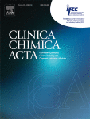
Clinica Chimica Acta
Volume 481, June 2018, Pages 12-19
Prediction value of serum HBV large surface protein in different phases of HBV infection and virological response of chronic hepatitis B patients
Can Liu, Wennan Wu, Hongyan Shang, Sheng Lin, Zhen Xun, Er Huang, Jinpiao Lin, Bin Yang, Qishui Ou

Slide 56
Clinica Chimica Acta
Volume 481, June 2018, Pages 12-19
Prediction value of serum HBV large surface protein in different phases of HBV infection and virological response of chronic hepatitis B patients
Can Liu, Wennan Wu, Hongyan Shang, Sheng Lin, Zhen Xun, Er Huang, Jinpiao Lin, Bin Yang, Qishui Ou
Highlights
Serum HBV-LP level was higher in patients with HBeAg(+) chronic hepatitis than those with other phases of HBV infection.
Serum HBV-LP was positive relevant to HBV DNA in HBV infection patients.
During antiviral therapy, baseline HBV-LP was lower in VR patients than that in PVR patients.
The cut-off points to predict VR by baseline HBV-LP were 32.4 and 28.6 S/CO for HBeAg(+) and HBeAg(-) patients, respectively.
“Baseline HBV-LP could predict the efficiency of virological
response. However, for more precise diagnosis, the quantitation of HBsAg and HBeAg should be considered.”

Slide 57
GASTROENTEROLOGY 2012;142:1303–1313
Clinical research. “Cohort studies, surveillance studies, and clinical trials of new therapeutic agents or strategies require serial measurements of HBV DNA. In research studies, tests for resistant variants should be sy stematically performed when antiviral therapy fails, to identify the resistant variant and characterize its nature and dynamics. Sensitive sequencing methods such as NGS are particularly useful for characterizing the dynamics of sensitive and resistant virus populations over time. Information about HBV genotype and core and core promoter mutations might be used in epidemiology and pathophysiology studies»

Slide 58
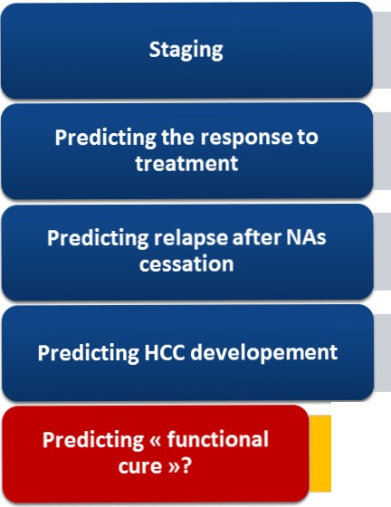
Key messages
Quantitative HBsAg
HBcrAg
HBV RNA level
Quantitative HBsAg
HBcrAg
HBV RNA level
Quantitative HBsAg
HBcrAg
HBV RNA level
Quantitative HBsAg?
HBcrAg
Which relevant/combined marker(s)?
Grazia Anna Niro - Congresso CLEO - Caserta 2018

Slide 59
What is the appropriate management strategy in
the consolidation phase ?
HBV DNA
increase
Monitor HBV DNA, ALT and
quantitative HBsAg +
new HBV markers like
HBV RNA and HBcrAg
-
Year on
treatment
before NA
discontinuation
Reactivation
phase
Consolidation
phase
Lag phase
Stop therapy
Close monitoring until
HBV DNA and ALT
stabilisation
Monitoring can be extended
to every 3 months
Follow-up every 4 weeks
until HBV-DNA increase
Berg T, PGC ILC 2018

Slide 60


Conclusion
The effectiveness of the classic biomarkers HBsAg, HBeAg, HBV DNA, mentioned in the guidelines in predicting response during antiviral therapy have been confirmed by many studies
The value of the new biomarkers HBcrAg, HBV RNA, qAnti-HBc and cccDNA, in predicting response still need more experiments to provide evidence
More other potential biomarkers are still needed to guide therapy, optimize CHB treatment strategies, and improve clinical outcomes in CHB patients

