Slide 1



Future hepatology beyond HCV:
Where are we now, where are we going?
Antonio Craxì
Di.Bi.M.I.S.
antonio.craxi@unipa.it

Slide 2
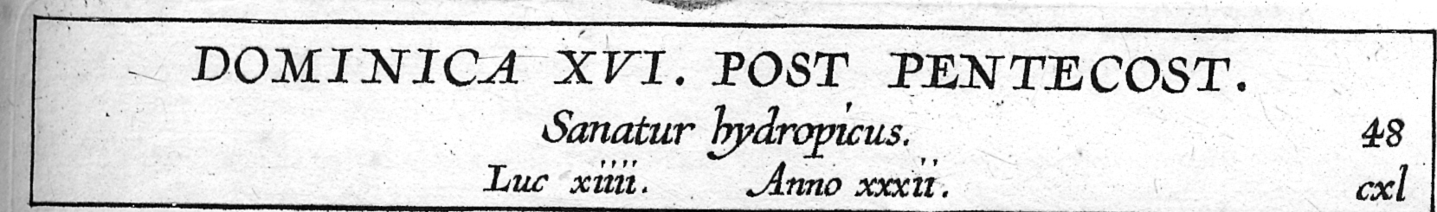
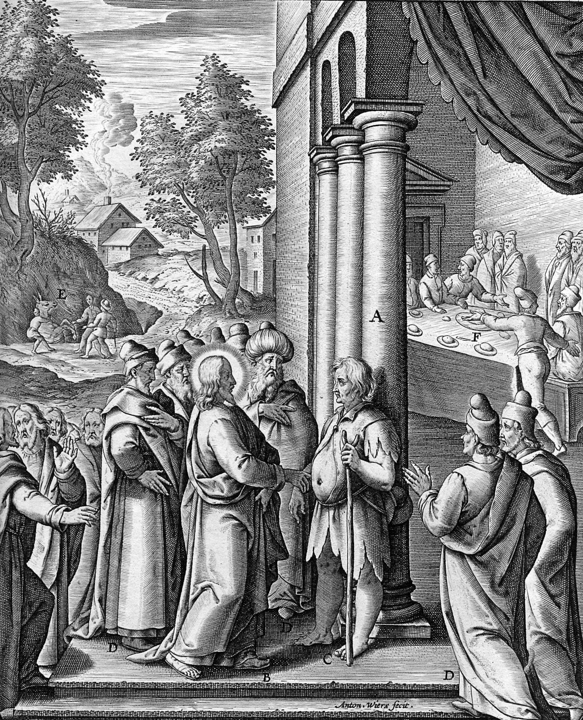

Hepatology:
a discipline with a past….

Slide 3
Future hepatology
Where are we now?
Where are we going?
Prevention | Screening | Therapy | Chronicity (cirrhosis, HCC)
Still needed | Needed | Reduced | +++
Vaccine | Needed | Eradication? | +++
None | Modest | Stable | +
Needed | Needed | Needed | ++
Needed | Needed | Needed | +++
Diseases whose etiology has been removed:
  HCV
Diseases whose etiology has been controlled:
  HBV
  Autoimmune & cholestatic (partially)
Diseases whose etiology is on the rise:
  NAFLD
  AFLD
»New» diseases: chronic HEV; aging OLTs;……

Slide 4
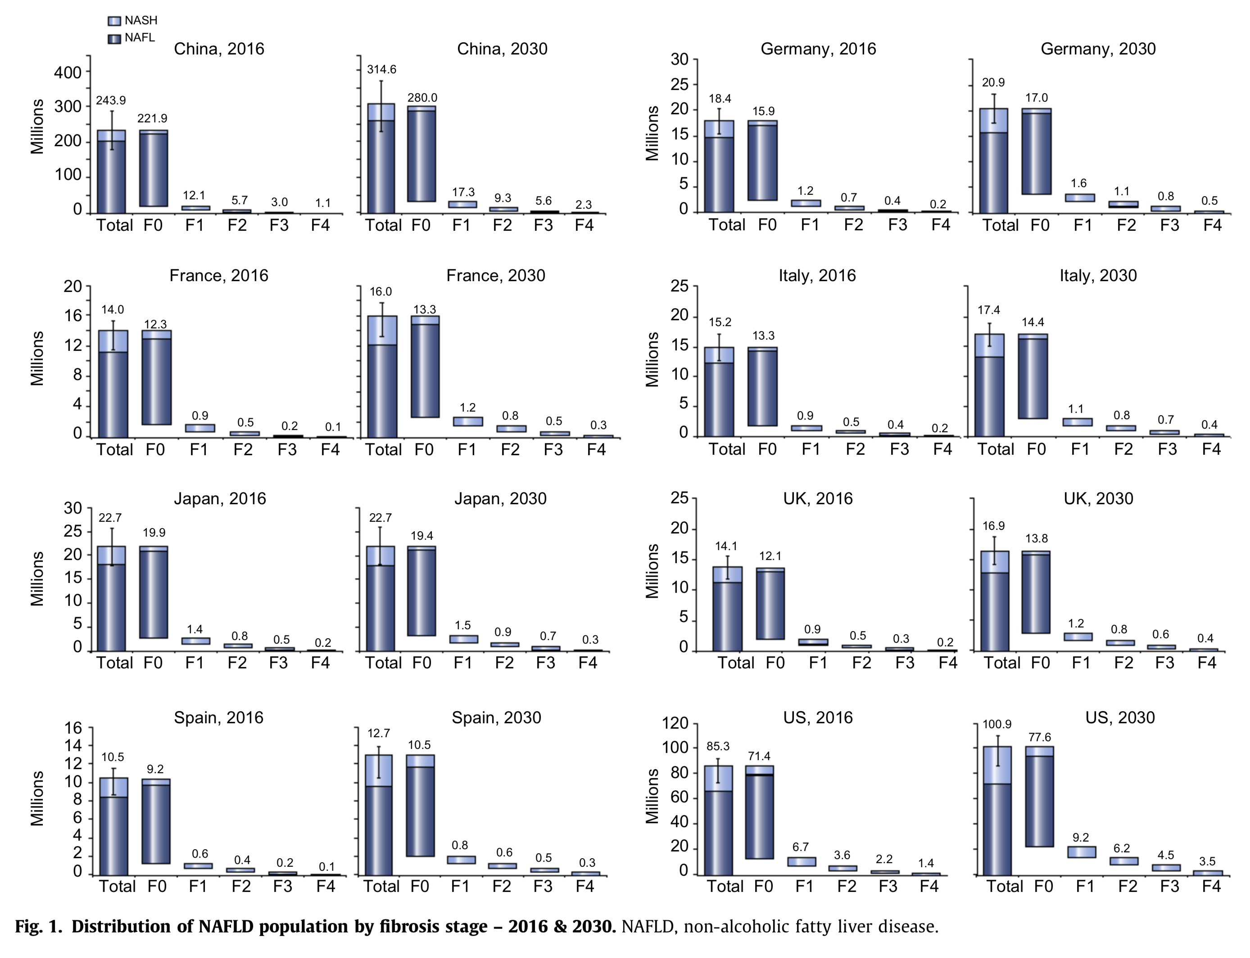
Modeling NAFLD disease burden in China, France, Germany, Italy, Japan, Spain, United Kingdom, and United States for the period 2016–2030
POLARIS Group, J Hepatol 2018 vol. 69; 896–904

Slide 5
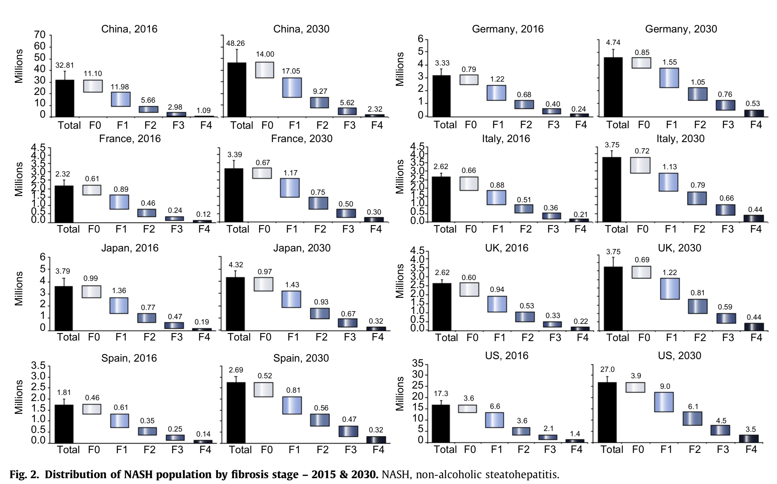
Modeling NAFLD disease burden in China, France, Germany, Italy, Japan, Spain, United Kingdom, and United States for the period 2016–2030
POLARIS Group, J Hepatol 2018 vol. 69; 896–904

Slide 6
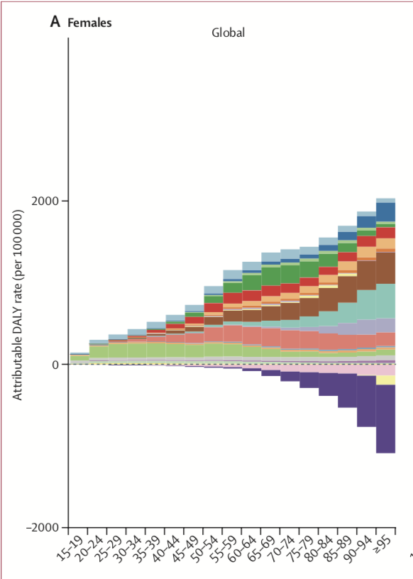
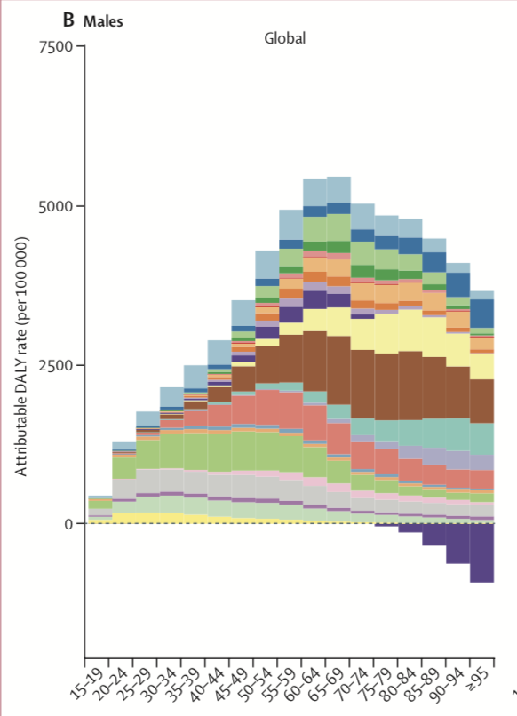
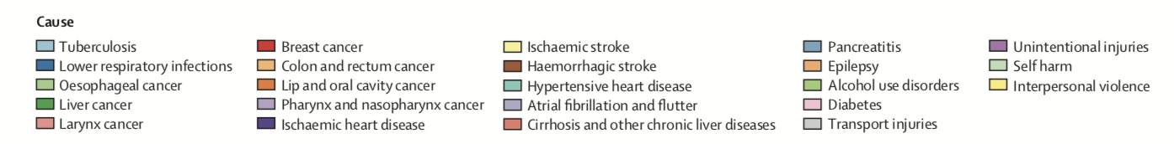
Alcohol use and burden for 195 countries and territories, 1990–2016: a systematic analysis for the Global Burden of Disease Study 2016
Liver cancer
Liver cancer
Cirrhosis
Cirrhosis
GBD 2016 Alcohol Coll., Lancet 2018; 392 : 1015-1035

Slide 7
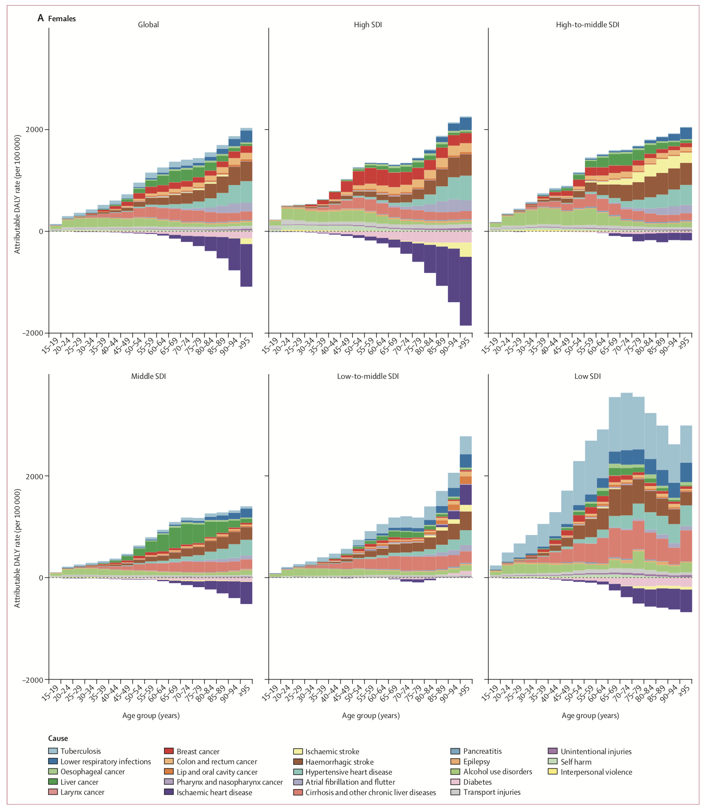
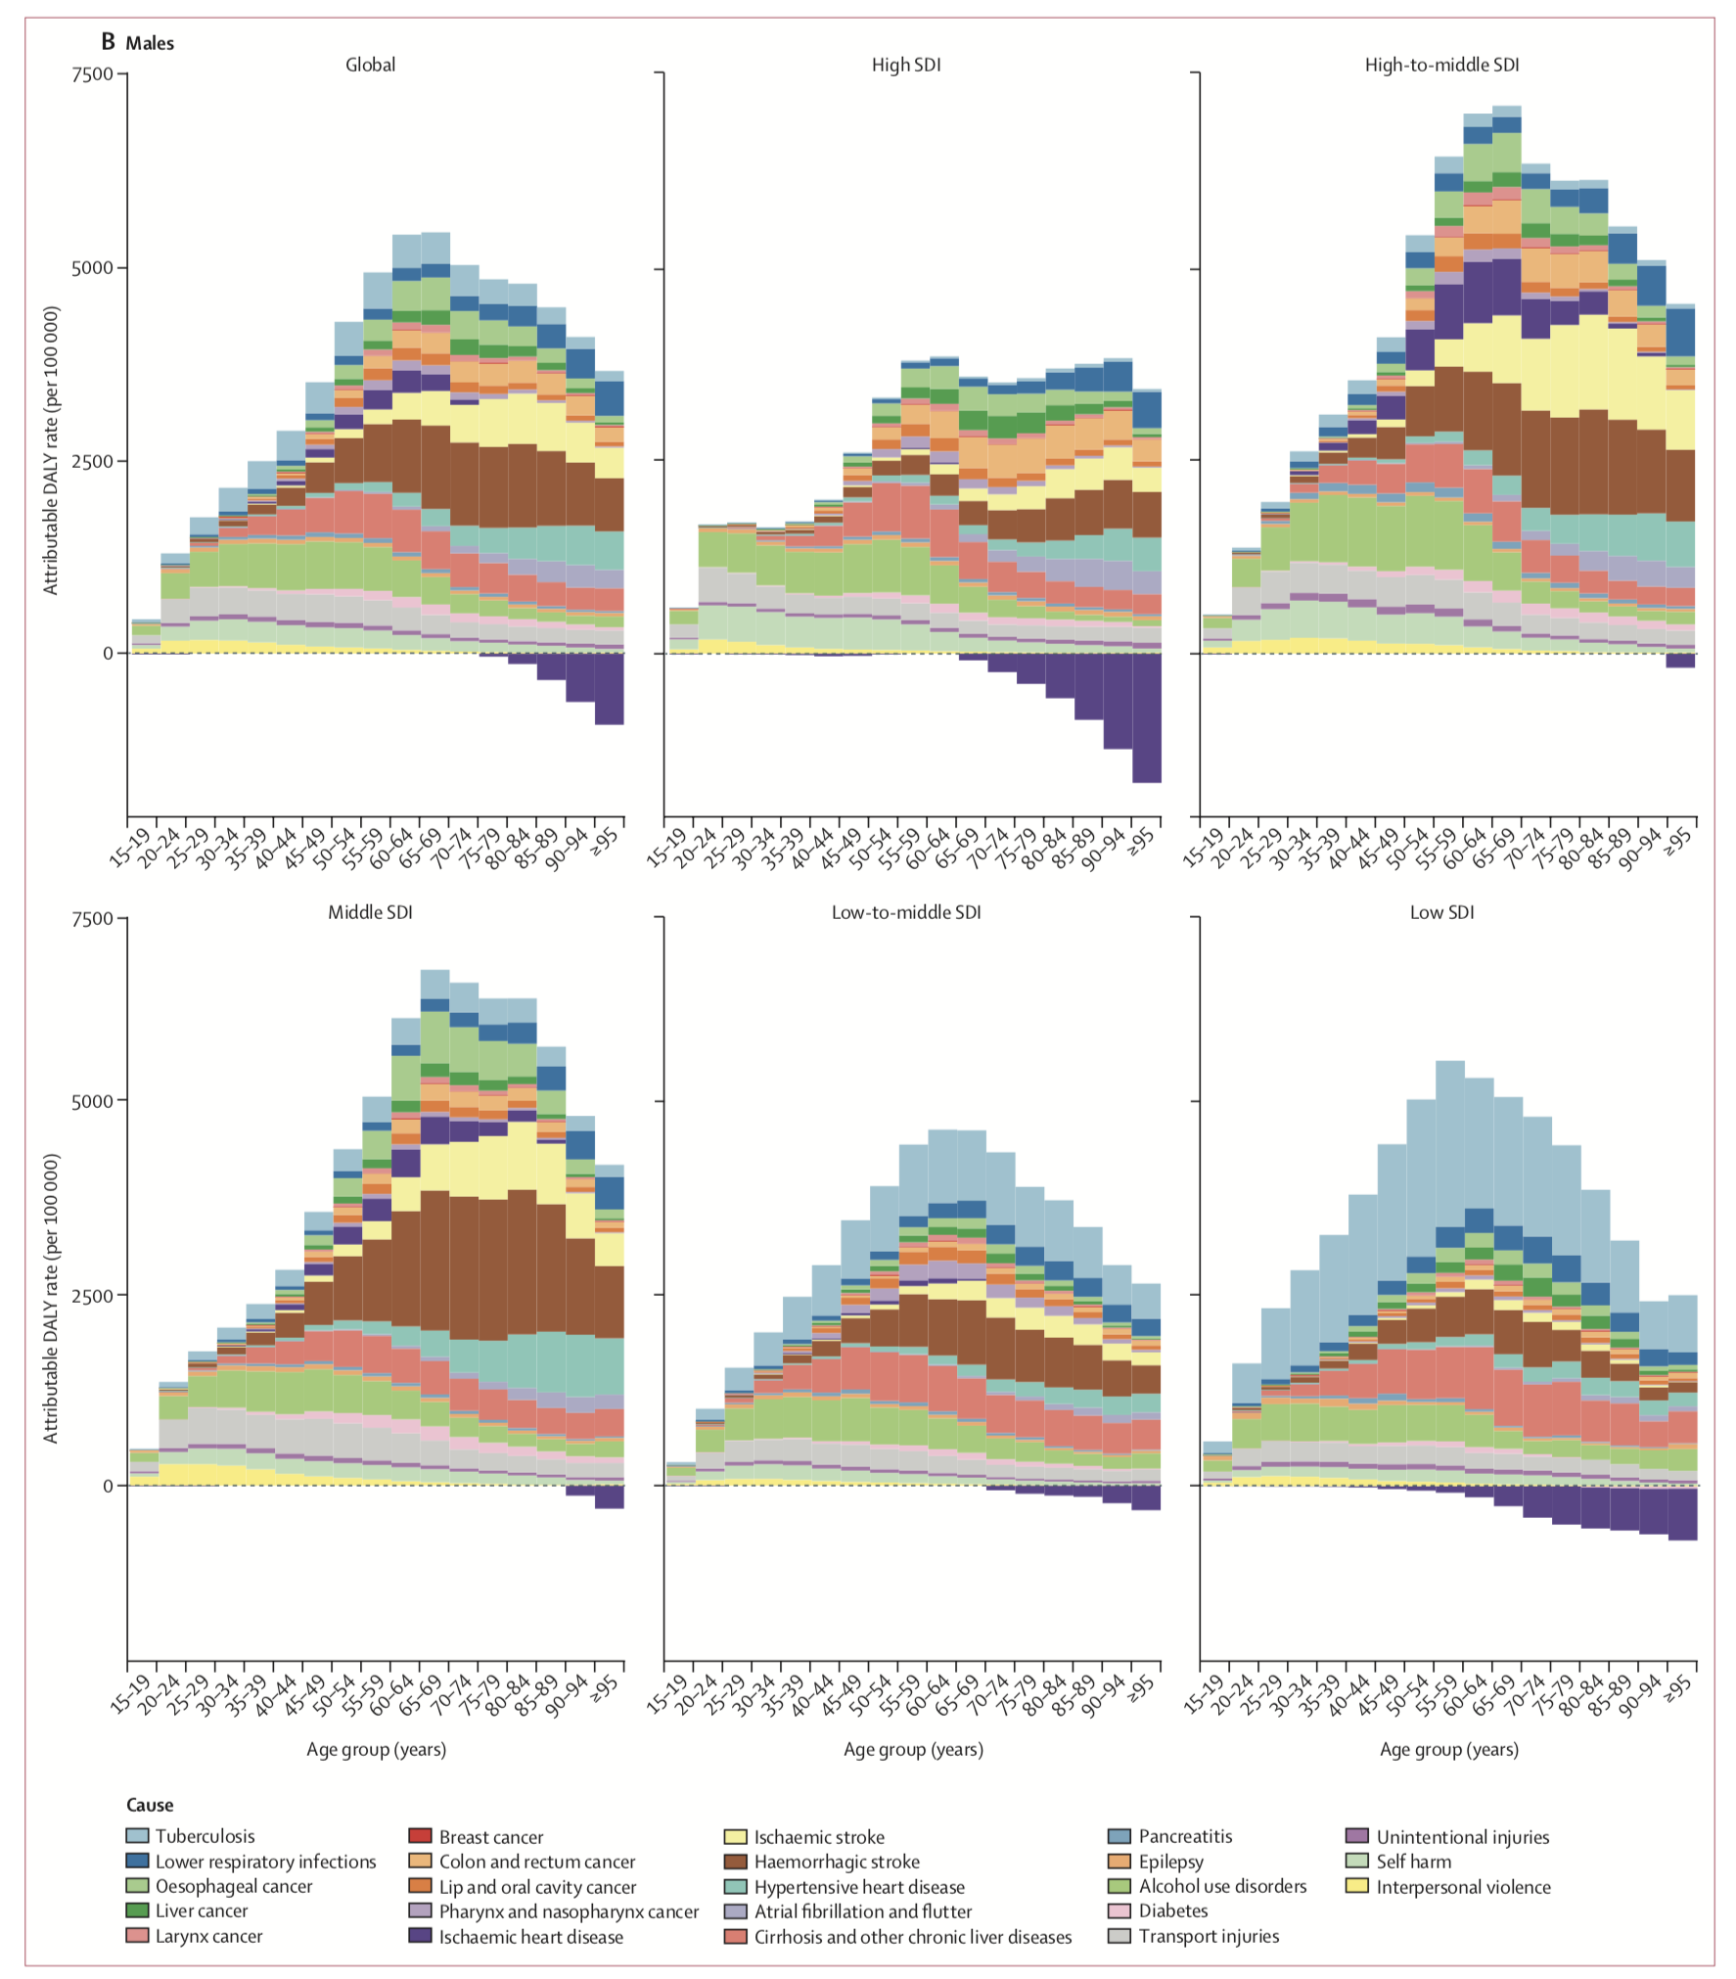
Alcohol use and burden for 195 countries and territories, 1990–2016: a systematic analysis for the Global Burden of Disease Study 2016
GBD 2016 Alcohol Coll., Lancet 2018; 392 : 1015-1035

Slide 8

Future hepatology: etiological therapies will influence outcomes according to disease stage
HVPG: < 5 mm Hg
HVPG: 5-12 mm Hg
“Decompensating Event”
HVPG > 12 mm Hg
Stage 3
Stage 1
Bleeding
F0 Fibrosis
No Varices
No Ascites
Stage 4
?
First non
bleeding
decompensation
Death or
OLT
SEPSIS
Renal
Failure
Etiological tx
Etiological tx
F3 Fibrosis
Varices
No Ascites
Stage 5
Second
decompensation
Stage 2
Etiological tx
Etiological tx
Hepatocellular carcinoma
Non-cirrhotic
Compensated Cirrhosis
Decompensated Cirrhosis
Modified from Arvaniti V. et al., Gastroenterology 2010; 139:1246-1256

Slide 9
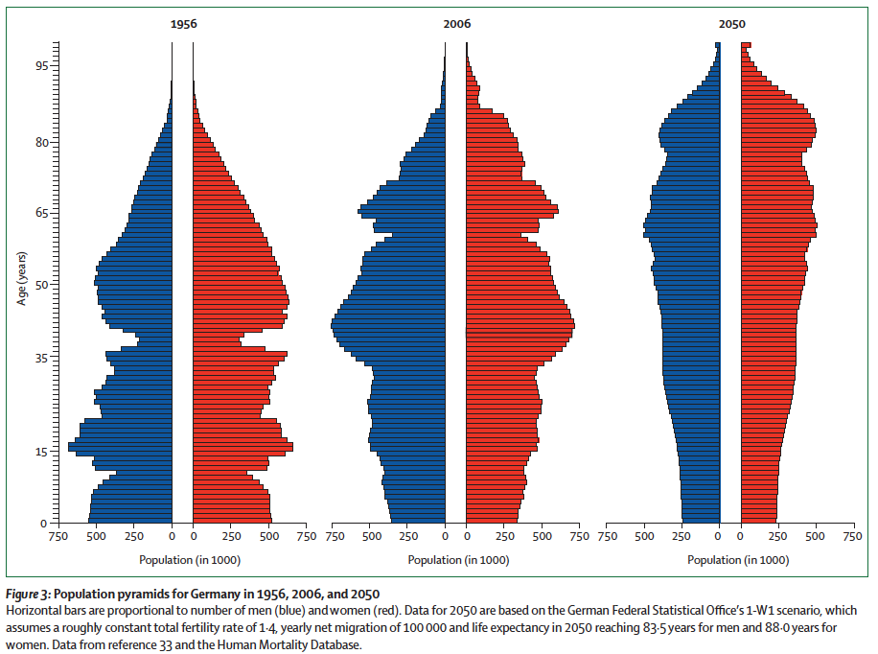
Christensen K et al. Lancet 2009;374:1196-1208

Slide 10
Christensen K et al. Lancet 2009;374:1196-1208

Slide 11
Christensen K et al. Lancet 2009;374:1196-1208

Slide 12
Future hepatology - Aging of the general population will induce:
Liver-related problems
Changes in the distribution of etiology (< STD; > NAFLD)
Evolution of alcohol-related liver disease
Ageing of etiologically cured fibrotic patients (HCV +++)
Emergence of long term problems in NA suppressed HBV patients (HCC; NA toxicity)
Age-related issues overlapping with liver disease
Cardiovascular morbidity/mortality (NAFLD +++; AFLD ++)
Polypharmacy
Frailty

Slide 13


Slide 14
Future hepatology – How shall we approach an aging population?
Non invasive diagnostic tests
Simplified (personalized) monitoring protocols
Multidisciplinary partnership with other specialists and HCPs

Slide 15
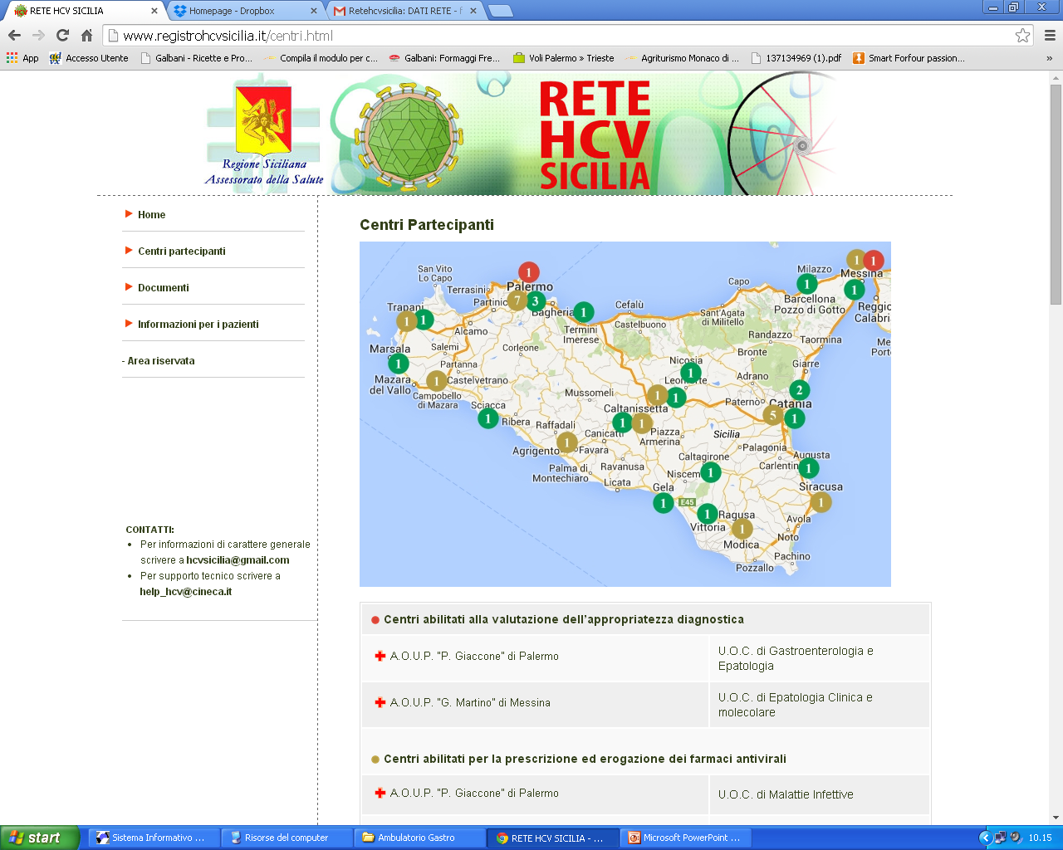
Baveno VI, Expanded Baveno VI criteria and RESIST HCV criteria for ruling out high-risk varices in 1055 patients of RESIST-HCV cohort
6 pts with LEV
4 pts with LEV
163 pts (15.5%)
374 pts (35.4%)
315 pts (30%)
Baveno VI
Expanded Baveno VI
RESIST HCV
Calvaruso V et al. submitted
Oral presentation at AISF 2017; Poster at EASL 2017
Notes:
15

Slide 16
Petta S et al, EASL 2018; Am J Gastroenterol, in press et al.
Clinical Features of NAFLD Patients
Liver cirrhosis was diagnosed by histology in 34.4% of patients.
EV were present in 31.5% of cases, and VNT in 11.5%.
 | NAFLD Cirrhosis Training Cohort N=314 | NAFLD Cirrhosis Validation Cohort M Probe N=338 | NAFLD Cirrhosis Validation Cohort XL Probe N=138 | P value° | P value^{ç}
Mean Age – years | 63 ± 11 | 62 ± 10 | 2 ± 11 | 0.593 | 0.406
Male Gender | 60 % | 55 % | 44 % | 0.239 | 0.001
Mean BMI – Kg/m² | 33.3 ± 6.7 | 30.3±5.0 | 37.5 ± 7.6 | <0.001 | <0.001
ALT – IU/L | 54 ± 41 | 59 ± 44 | 46 ± 36 | 0.104 | 0.070
PLT – 10³/mmc | 177 ± 80 | 178 ± 90 | 176 ± 82 | 0.785 | 0.980
Total Bilirubin – mg/dL | 1.0±0.4 | 1.0±0.5 | 1.0±0.6 | 0.981 | 0.942
INR | 1.0±0.4 | 1.0±0.2 | 1.0±0.2 | 0.954 | 0.896
Albumin – g/L | 4.1 ± 0.4 | 4.2 ± 0.5 | 3.9 ± 0.6 | 0.312 | <0.001
Blood Glucose – mg/dL | 133 ± 61 | 125 ± 48 | 127 ± 47 | 0.126 | 0.430
Type 2 Diabetes | 64.9% | 62.0 % | 59.8% | 0.480 | 0.352
Arterial Hypertension | 60.8 % | 63.2% | 56.7% | 0.558 | 0.480
LSM by M probe– Kpa* LSM by XL probe- KPa# | 24 ± 15 20 ± 14 | 26 ± 17 - | - 28 ± 17 | 0.264 - | - <0.001
Esophageal Varices Presence VNT | 26.4 % 10.2 % | 36.4 % 13.3 % | 29.7 % 10.1 % | 0.008 0.266 | 0.545 1.000
° comparison between Training Cohort and Validation Cohort M Probe; ^{ç} comparison between Training Cohort and Validation Cohort XL Probe.
Notes:
Southern, compared to nortehrn patients, had a lower prevalence of females, but a higher prevalence obesity and especially morbid .
The distribution of both MERTK and PNPLA3 genotypes was similar.
Instead, consdiering histology, Sicilian patient had a higher prevelance of severe liver damage in terms of steatosis, lobular inflammation and fibrosis

Slide 17
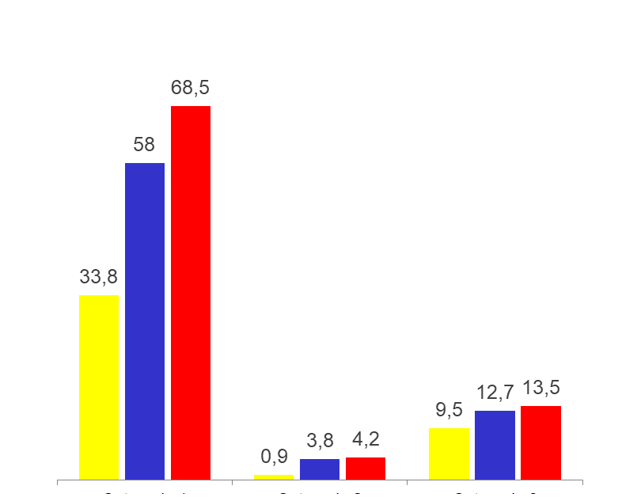
Noninvasive Assessment of VNT in NAFLD Cirrhosis
NAFLD cirrhosis criteria: PLT>110,000 and LSM<30 KPa for M probe
Baveno VI
Expanded Baveno VI
NAFLD Cirrhosis Criteria
Training Set
N=314
Validation Set
N=338
Spared EGD
Missed VNT
Missed
small EV
Spared EGD
Missed VNT
Missed
small EV
Similar Results in patients with LSM ≥13KPa and considering each center separately

Slide 18
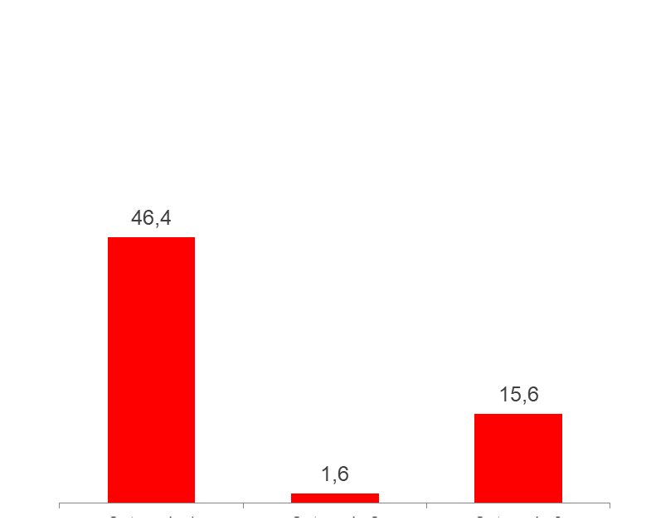
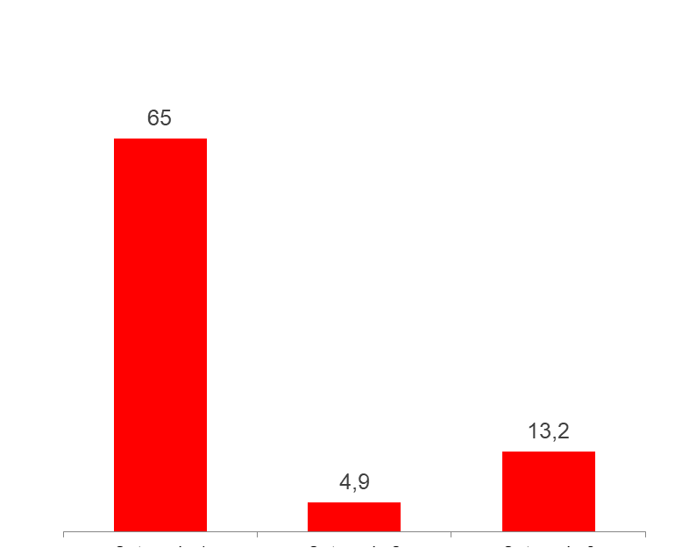
Noninvasive Assessment of VNT in NAFLD Cirrhosis
NAFLD cirrhosis criteria: PLT>110,000 and LSM<25 KPa for XL probe
NAFLD Cirrhosis Criteria
Training Set
N=314
Validation Set
N=138
Spared EGD
Missed VNT
Missed
small EV
Spared EGD
Missed VNT
Missed
small EV
Similar Results in patients with LSM ≥13KPa and considering each center separately

Slide 19
Future hepatology – How shall we approach an aging population?
Non invasive diagnostic tests
Simplified (personalized) monitoring protocols
Multidisciplinary partnership with other specialists and HCPs

Slide 20
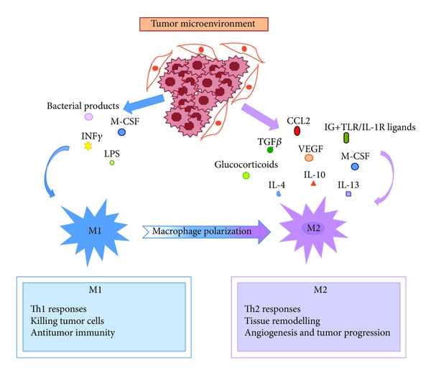
MerTK and M1-M2 homeostasis in oncogenesis

Slide 21
Flow-chart of the cohort
720 patients who started DAAs
between March 2015 and December 2016
204 patients excluded because of
44: previous HCC
145: chronic hepatitis
15: no SVR
patients with cirrhosis and SVR
evaluated

Slide 22
Risk factors for HCC
by Cox multivariate model
 | No HCC 488 pts (94.6%) | HCC 28 pts (5.4%) | p value | Adjusted HR (95%CI) p value
Age (years, mean, SD) | 66.8 ± 10.5 | 69.3 ± 8.8 | 0.22
Gender (% males) | 280 (57.4%) | 18 (64.3%) | 0.43
Platelets < 120x 10⁹/L | 222(45.5) | 24 (85.7) | 0.004 | 5.72 (1.97 – 16.63) 0.001
INR (mean,SD) | 1.1± 0.3 | 1.2 ± 0.3 | 0.08 | -
Bilirubin (mg/dL, mean,SD) | 1.0 ± 0.5 | 1.4 ± 0.8 | < 0.001 | -
Albumin (g/dL, mean, SD) | 3.9 ± 0.5 | 3.5 ± 0.5 | < 0.001 | -
Child Pugh score class B (%) | 45 (9.2) | 8 (28.6) | 0.001 | 3.09 (1.31 – 6.89) 0.009
De SNP MERTK polymorphism SNP CC/CA AA | 405 (83.0%) 83 (17.0%) | 18 (64.3%) 10 (35.7%) | 0.007 | 3.04 (1.40 – 6.62) 0.005

Slide 23
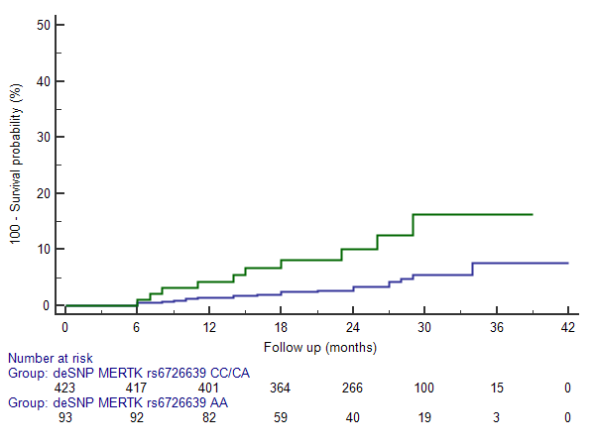
Probability of HCC according to de SNP MERTK rs6726639 in patients with HCV cirrhosis who obtained SVR by DAAs
Log rank p = 0.0032
de SNP rs6726639 AA
de SNP rs6726639 CC/CA

Slide 24
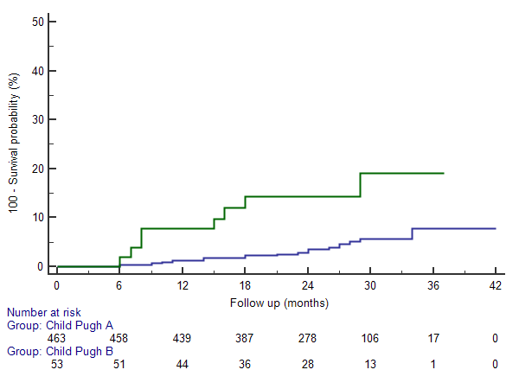
Probability of HCC according to Child Pugh score in patients with HCV cirrhosis who obtained SVR by DAAs
Log rank p < 0.001
Child Pugh B
Child Pugh A

Slide 25
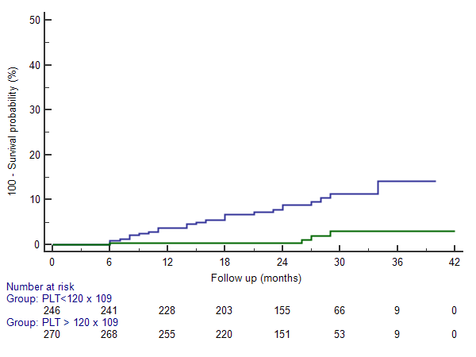
Probability of HCC according to PLT value in patients with HCV cirrhosis who obtained SVR by DAAs
Log rank p < 0.001
PLT < 120 x10⁹
PLT ≥ 120 x10⁹
PLT < 120 x10⁹
PLT ≥ 120 x10⁹

Slide 26
HCC occurrence according to risk factors in 516 patients SVR after DAAs
deSNP MERTK rs6726639 CC/CA : 423 patients (82%)
deSNP MERTK rs6726639 AA:
93 patients (18%)
Unfavorable factors:
deSNP MERTK rs6726639 AA
Class B Child-Pugh cirrhosis
PLT < 120 x 10³ /dL
Rate of HCC occurrence (%)
N.PTS (%) 201 (39) 195 (38) 28 (5) 51 (10) 32 (6.2) 9 (1.8)

Slide 27
Future hepatology – How shall we approach an aging population?
Non invasive diagnostic tests
Simplified (personalized) monitoring protocols
Multidisciplinary partnership with other specialists and HCPs

Slide 28
What is frailty?
Frailty: concept developed in gerontology (Fried et al. 2001)
Measure of „physiologic reserve“
Shrinking (self reported, >10 pounds weight reduction per year)
Weakness (grip strength - adjusted)
Exhaustion (self reported)
Slow walking speed (15 feet walking time – adjusted)
Low activity (kcal/week – adjusted)
Possible measurements/model:
Grip strength [kg] (nutrition)
Chair stands [sec.] (muscle)
Balance [sec.] (neuromotor fitness)

Slide 29
Elderly patient ≠ Frail patient
There are common features:
Reduced function of the immune system
Reduced muscle mass/sarcopenia/strength
Reduced kidney function (GFR reduction, proteinuria…)
Increase of comorbidities (diabetes, cancer, infections,…)
Alterations of hepatic and extrahepatic metabolism
Use of multiple therapeutic drugs
Frailty | Loss of functional, cognitive, and physiological reserve leading to a vulnerable state. Frailty may be considered a form of nutrition-related disorder
Sarcopenia | Reduction in muscle mass and function due to ageing (primary sarcopenia), acute or chronic illness (secondary sarcopenia), including chronic liver disease

Slide 30
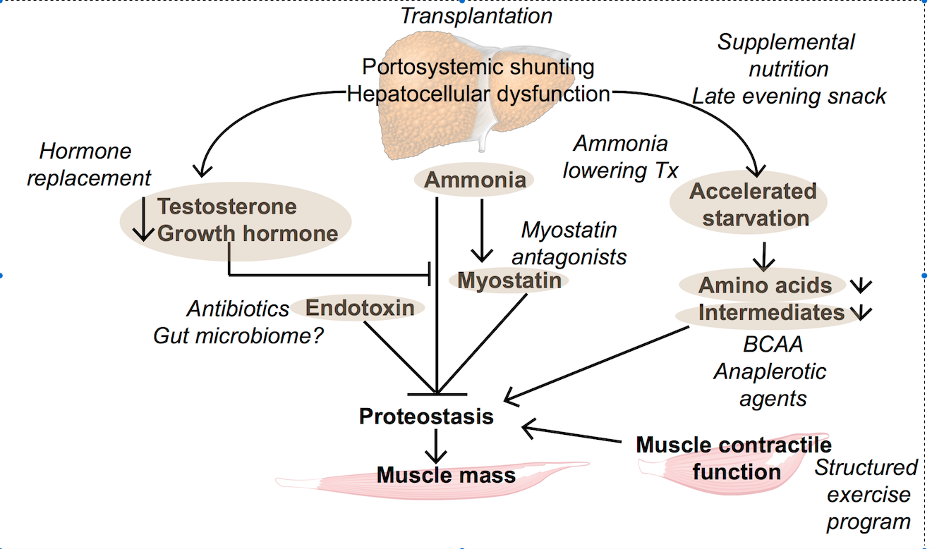
Mechanisms resulting in sarcopenia and failure to respond to standard supplementation
Anabolic resistance and dysregulated proteostasis result in failure to respond to standard supplementation
These mechanisms represent potential therapeutic targets
Notes:
BCAA, branched chain amino acid

Slide 31
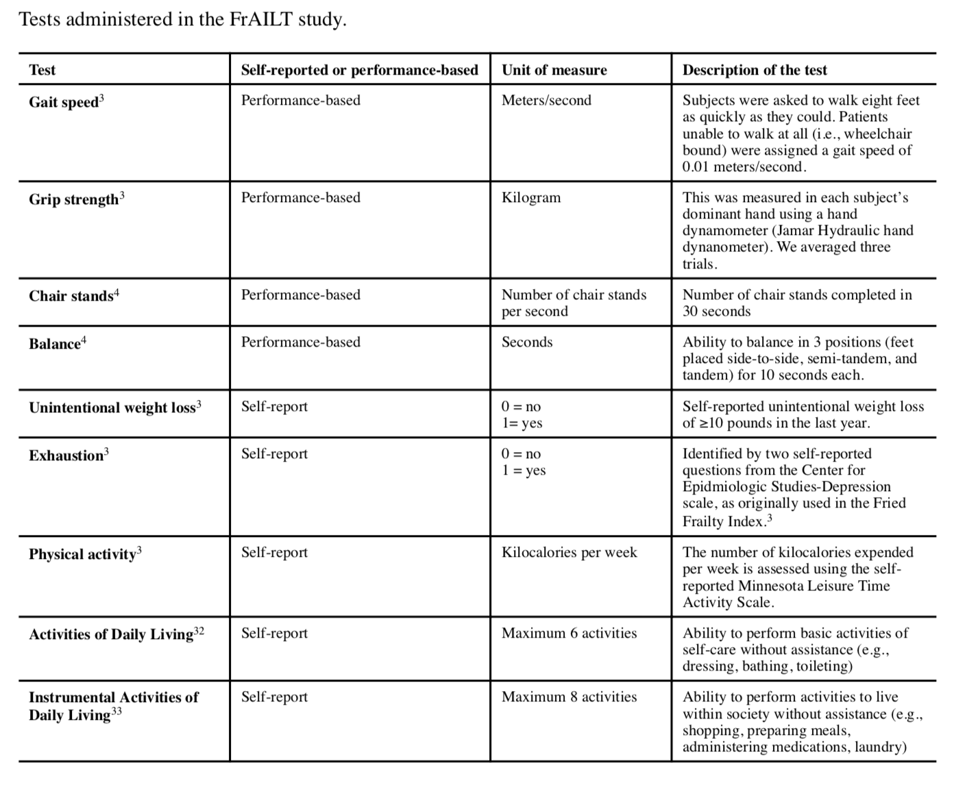
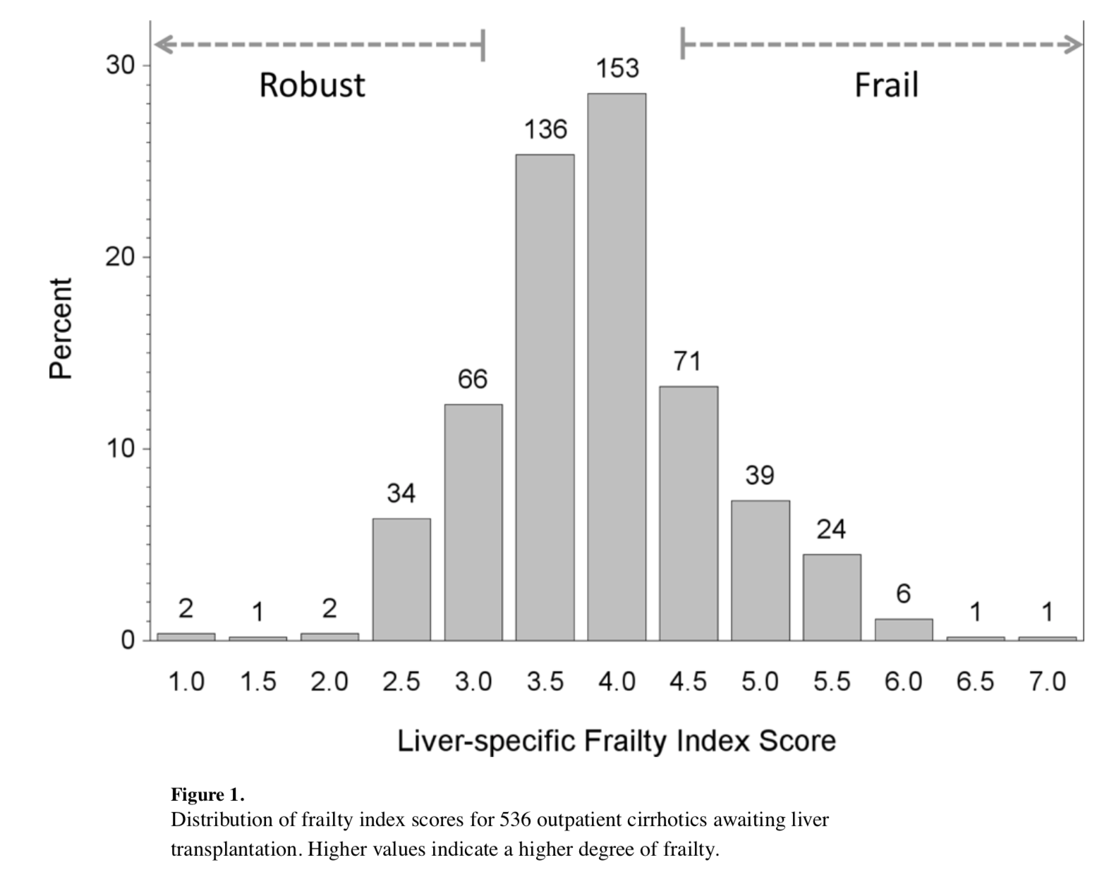
Development of a Novel Frailty Index to Predict Mortality in Patients with End-Stage Liver Disease
Lai, JC, et al. Hepatology. 2017; 66: 564–574.

Slide 32
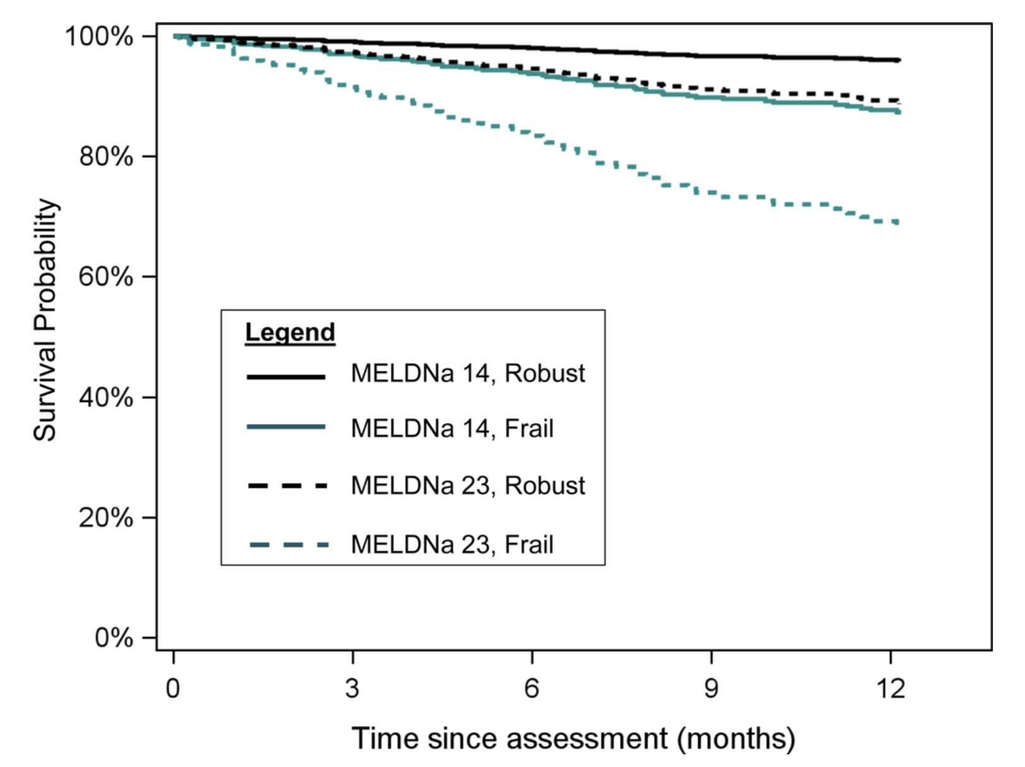
Development of a Novel Frailty Index to Predict Mortality in Patients with End-Stage Liver Disease
Lai, JC, et al. Hepatology. 2017; 66: 564–574.

Slide 33
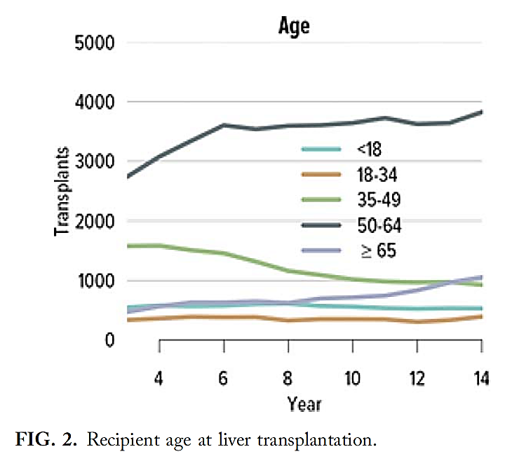
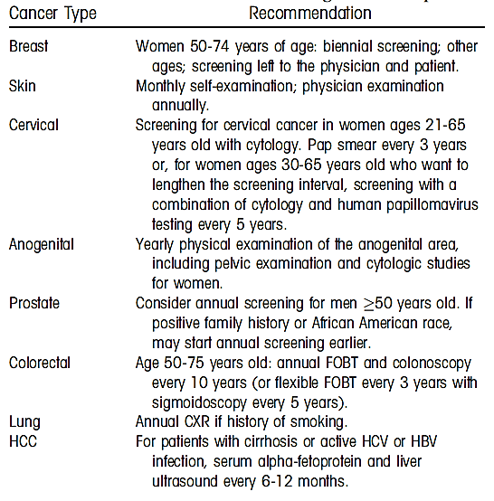
Liver transplantation 2017: trends
Recipient age increasing
IS side effects and comorbidities increasing
Charlton, L Transpl 2016
Approx. 50% of transplant candidates are >50 years old, 15% are ≥65 years old.
Elderly and frail patients are a reality in transplantation medicine today.

Slide 34
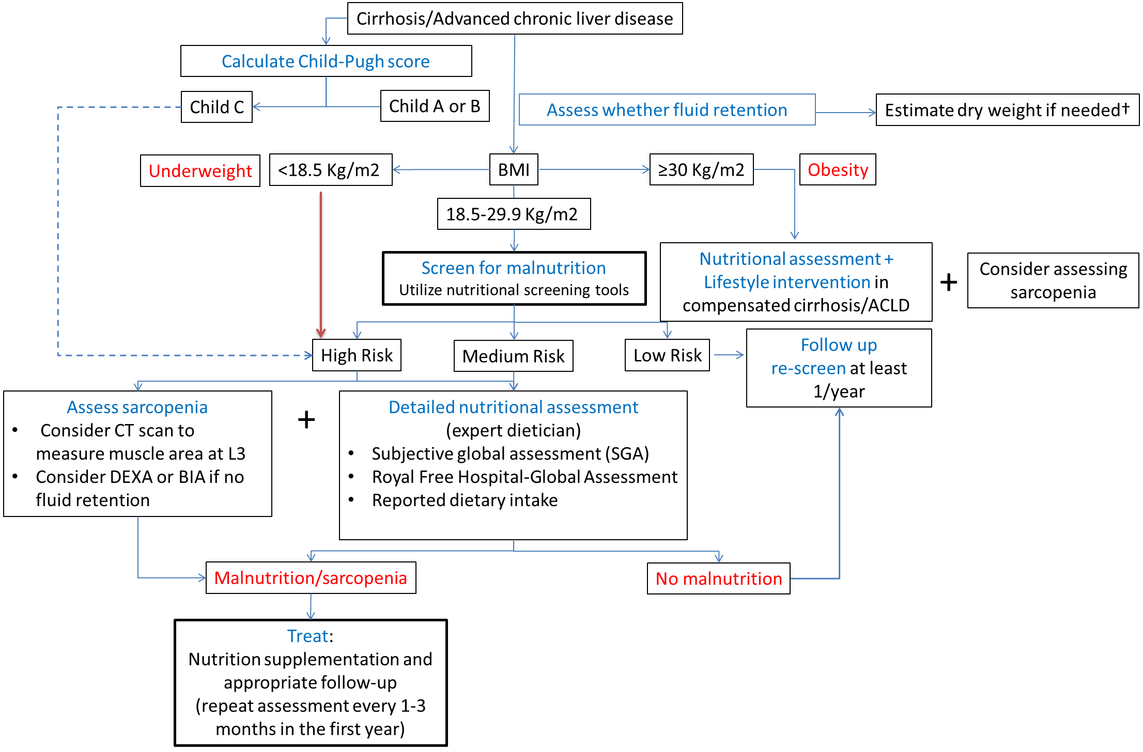

Nutritional screening and assessment in patients with cirrhosis
†In a case of fluid retention, body weight should be corrected by evaluating the patient’s dry weight by post-paracentesis body weight or weight recorded before fluid retention if available, or by subtracting a percentage of weight based upon severity of ascites (mild, 5%; moderate, 10%; severe, 15%), with an additional 5% subtracted if bilateral pedal oedema is present
Notes:
ACLD, advanced chronic liver disease; BIA, bioelectrical impedance analysis; BMI, body mass index; CT, computed tomography; DEXA, dual-energy X-ray absorptiometry

Slide 35

Hepatology beyond 2018: are we really at a border?

