Slide 1


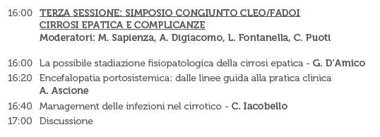
MANAGEMENT DELLE INFEZIONI NEL CIRROTICO
CARMELO IACOBELLO
UOC MALATTIE INFETTIVE
AOE CANNIZZARO
CATANIA

Slide 2
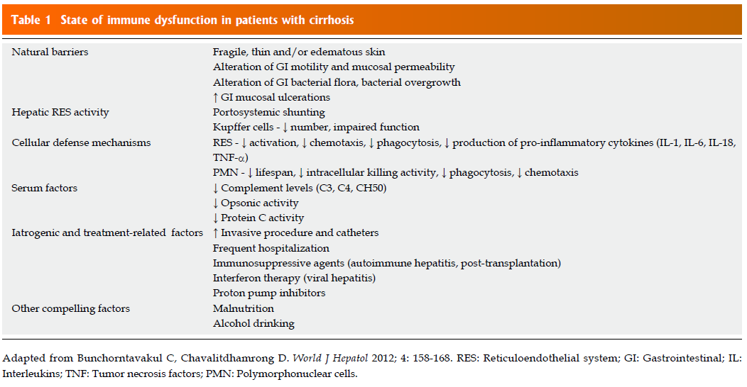

Slide 3
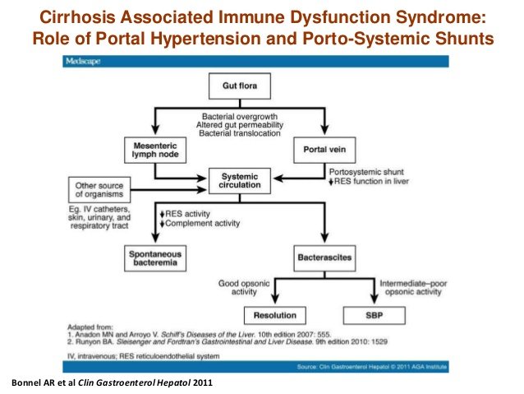

Slide 4
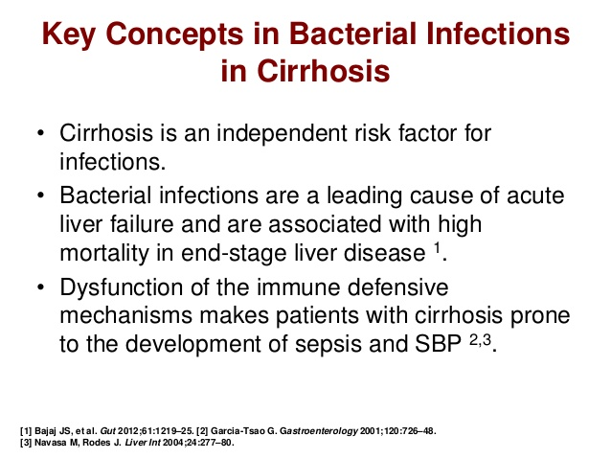

Slide 5
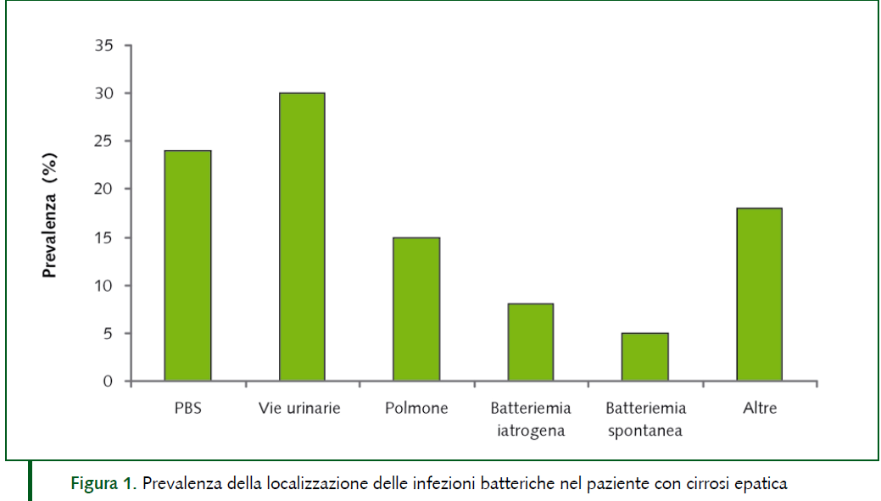

ABSSSI

Slide 6
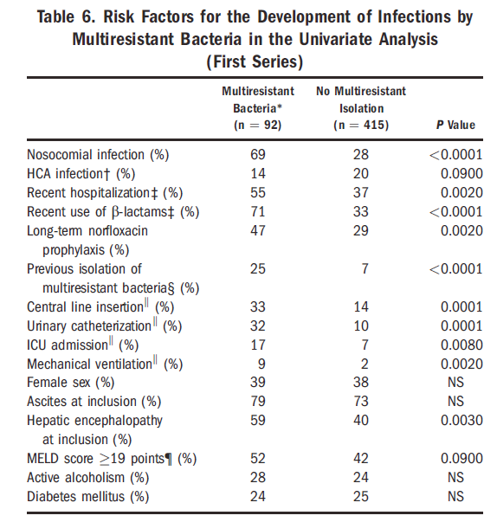
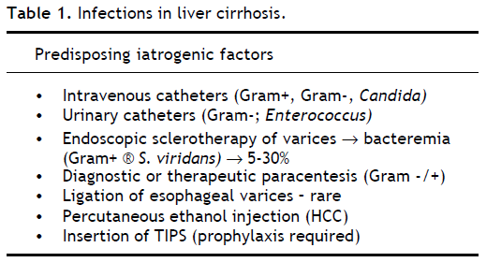

Strauss E.: Annals of Hepatology. 2014, 7-19

Slide 7
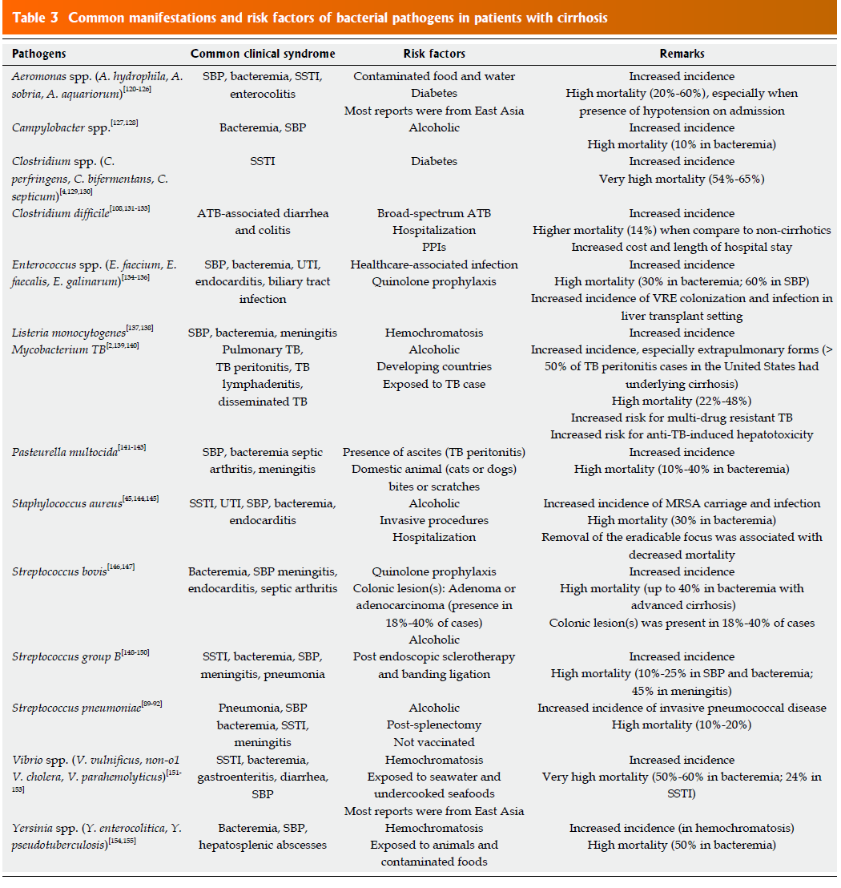

Slide 8
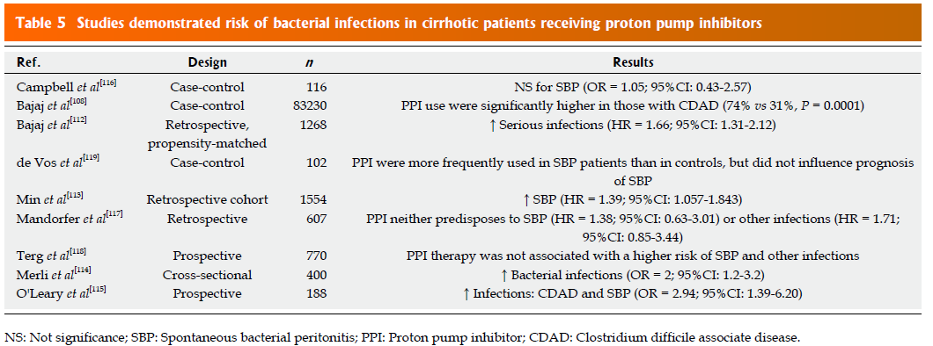

Slide 9
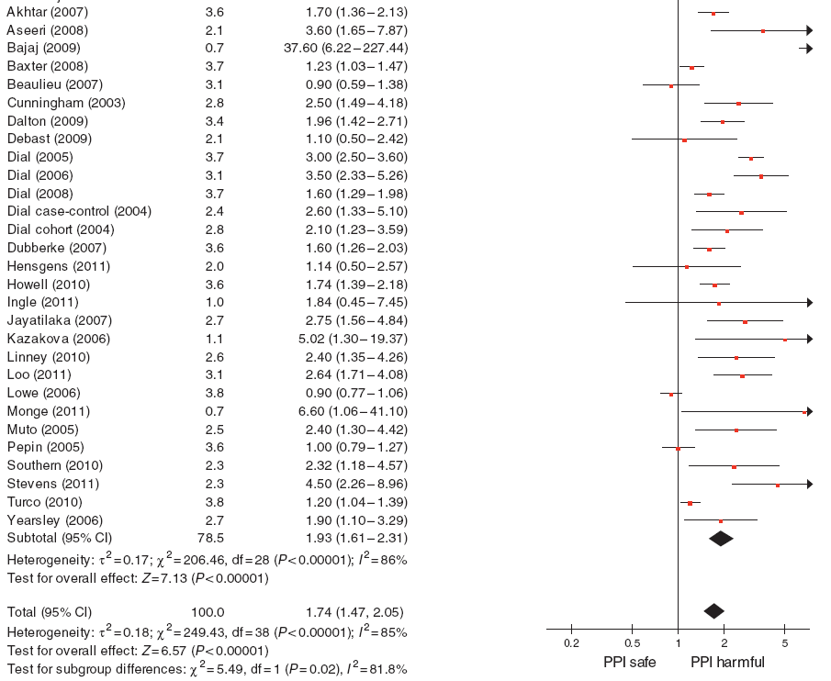
!
PPI e rischio di infezione da C difficile: metanalisi di 42 studi
Concurrent use of antibiotics with a PPI was also associated with an increased risk of CDI (OR 1.96, 95% CI 1.03-3.70) when compared to PPI alone.
Infezioni – Clostridium difficile
Kwok CS et al, Am J Gastroenterol 2012, 107:1011-19

Slide 10
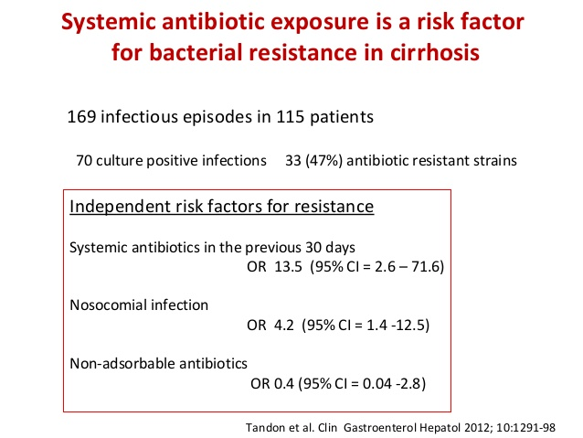

Slide 11
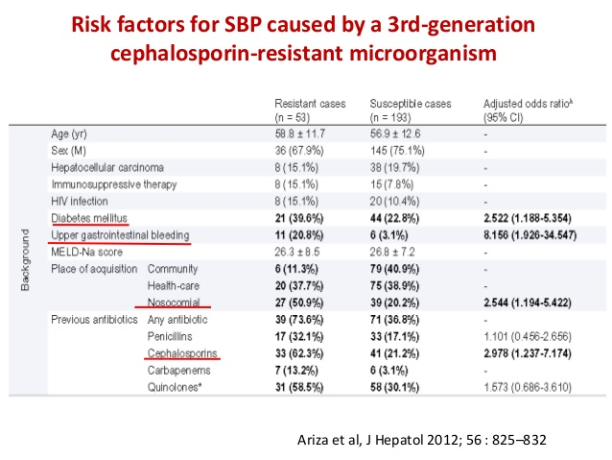

Slide 12
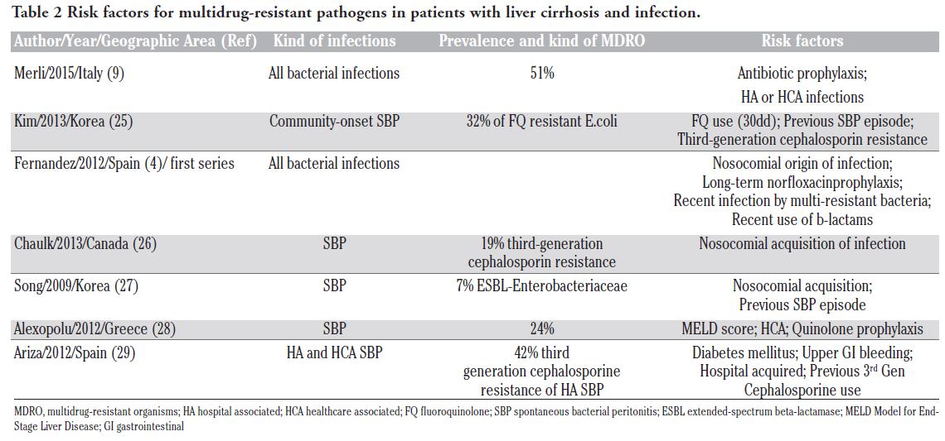
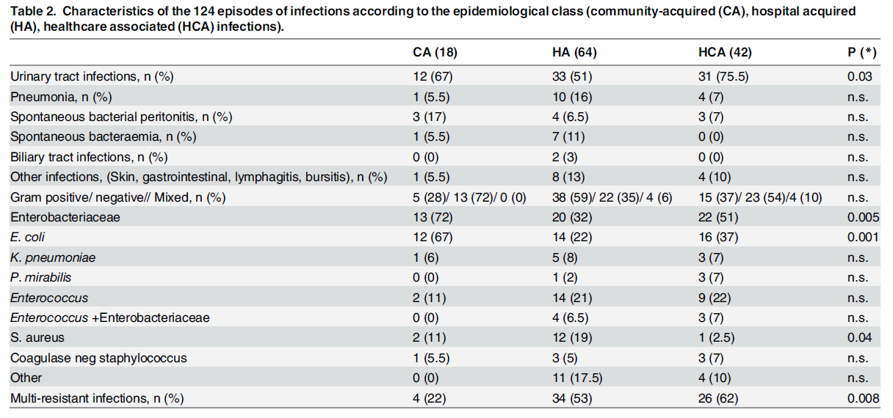
M. Bartoletti et al.: Infectious Diseases Report. 2018. 10:7621

Slide 13
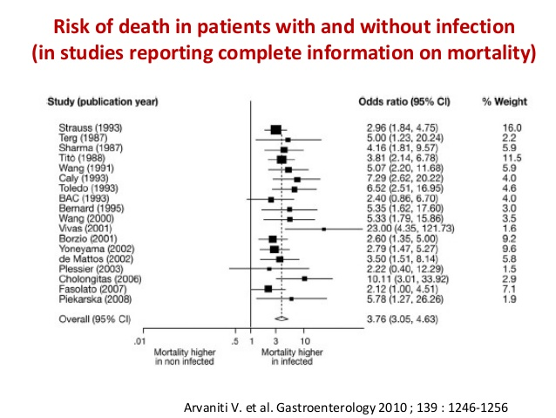

Slide 14
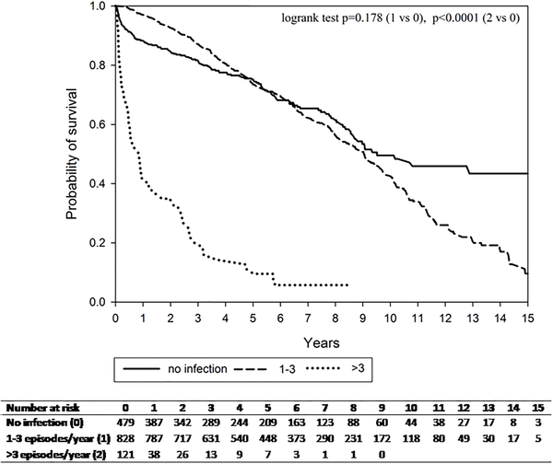

Fig 1. All-cause mortality among cirrhotic patients by frequency of infection episodes.
Yuan LT, Chuah SK, Yang SC, Liang CM, Wu CK, et al. (2018). PLOS ONE 13(5): e0197127.

Slide 15
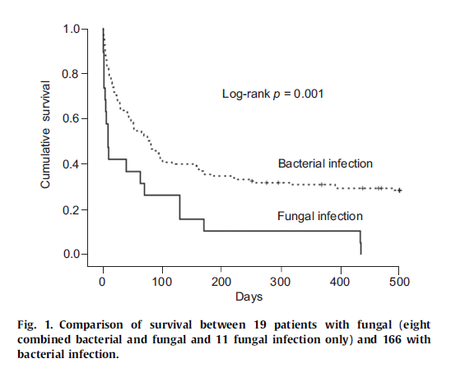

Slide 16
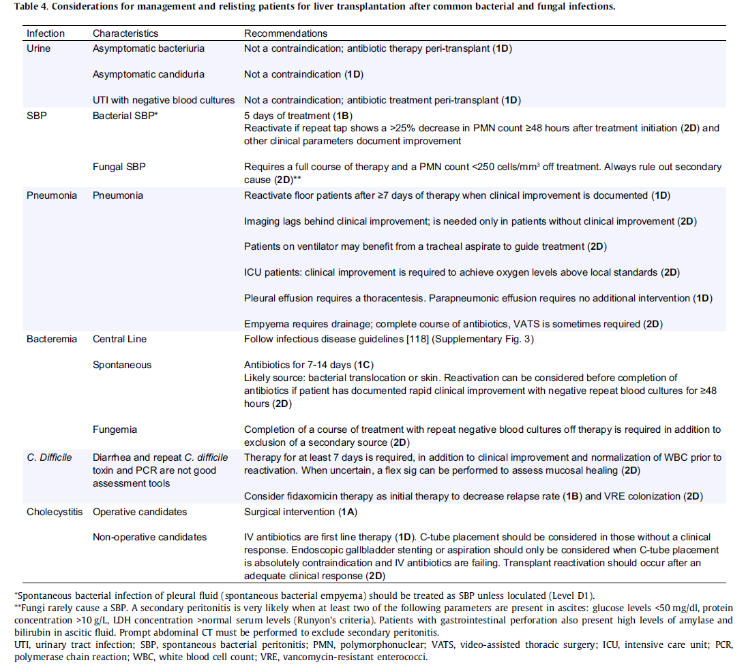



Slide 17
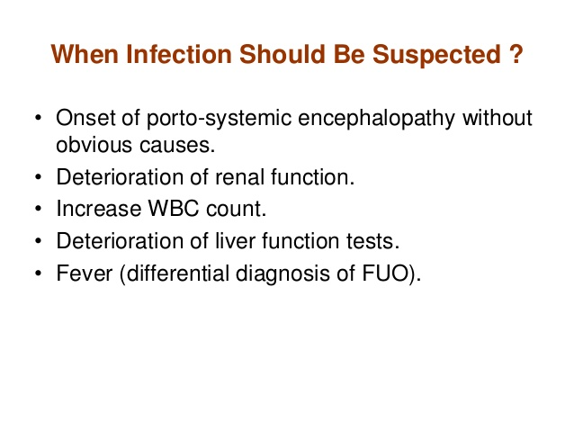

Slide 18
How likely is it that the diagnosis of sepsis is being missed? Is it...
An international sepsis survey: a study of doctors' knowledge and perception about sepsis
Total (n=497)
Intensive Care Physicians (n=237)
Extremely likely
81%
83%
Very likely
Somewhat likely
Not very likely
Not likely at all
Not sure
M. Poeze, G. Ramsay, H. Gerlach, F. Rubulotta, M. Levy
Crit Care 2004 8:R409.

Slide 19
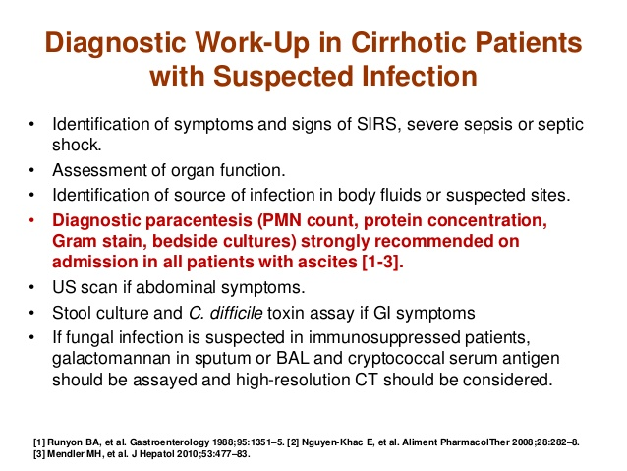

Slide 20
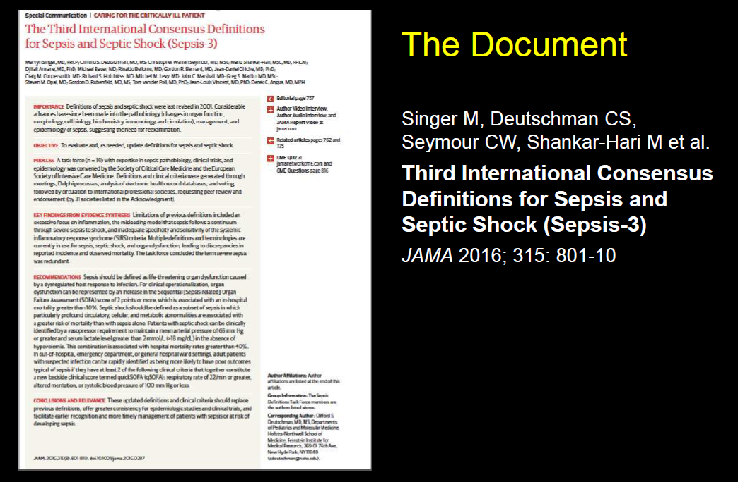

Slide 21
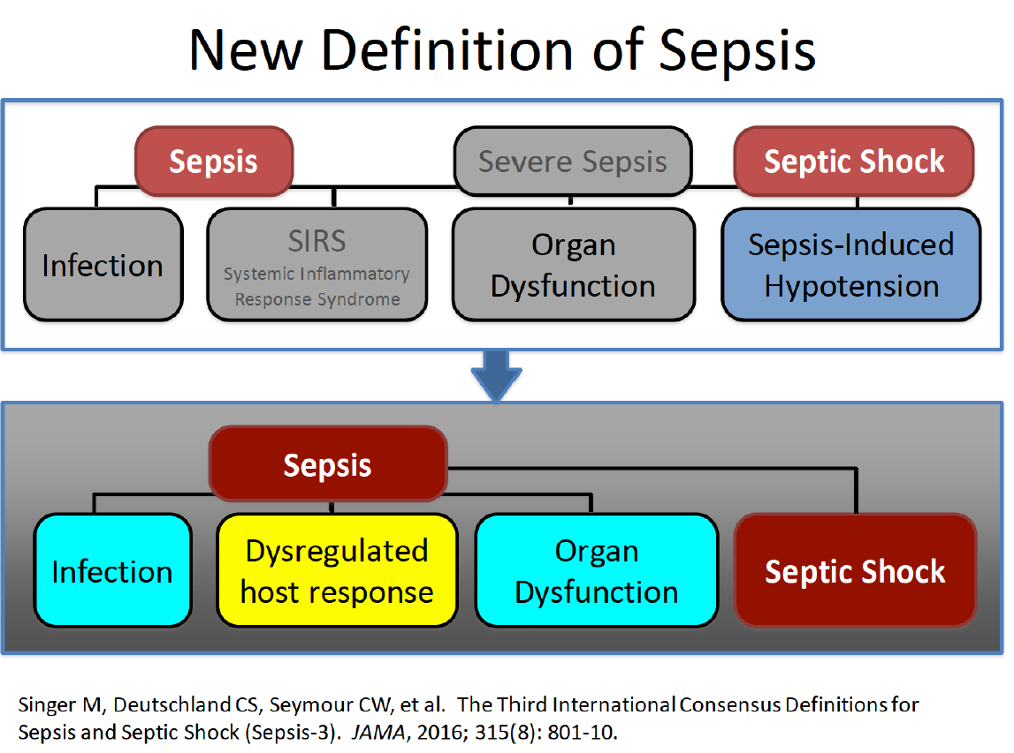

Slide 22
qSOFA (Quick SOFA) Criteria
Respiratory rate ≥22/min
Altered mentation (GCS)
Systolic blood pressure ≤100 mm Hg

Slide 23
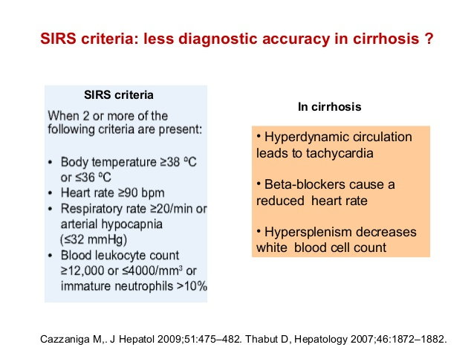
qSOFA (Quick SOFA) Criteria
Respiratory rate ≥22/min
Altered mentation (GCS)
Systolic blood pressure ≤100 mm Hg
Sensory changes are frequent during chronic hepatic encephalopathy
The increase of abdominal pressure during ascitic decompensation leads to an increase in respiratory rate

Slide 24
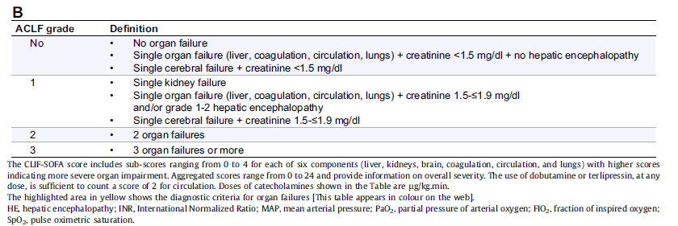

Slide 25
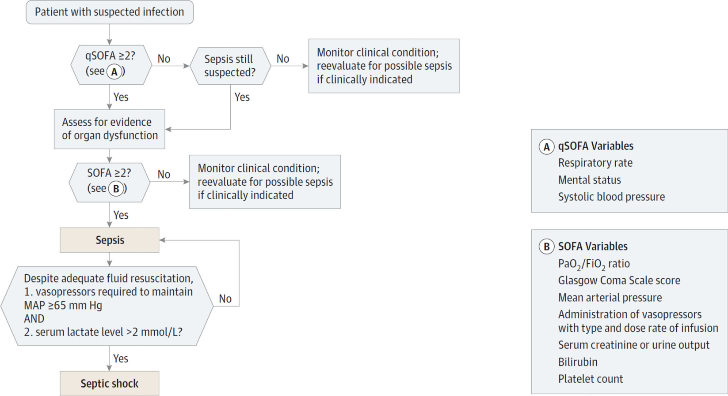
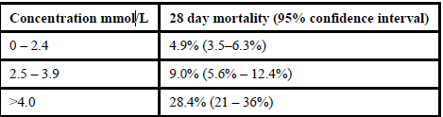
Lactate levels as predictor of mortality. Lactate levels in emergency department correlate with survival
Clin Chim Acta. 2016
Notes:
RIEPILOGANDO I LATTATI SONO BIOMARKER DI DISFUNZIONE D’ORGANO E SECONDO L’ULTIMA REVISIONE DELLA DEFINIZIONE DI SEPSI E SHOCK SETTICO UTILI PER DEFINIRE I PZ IN SHOCK. I LATTATI HANNO ANCHE UN VALORE PROGNOSTICO IN QUANTO I LIVELLI Più ALTI SONO STATI ASSOCIATI AGLI OUTCOME PEGGIORI E A MAGGIORE MORTALITA’ Lactate levels have been a useful marker for organ dysfunction and may also serve as an endpoint for resuscitation in patients with sepsis and septic shock as part of the sepsis bundles (6, 15). In the 2016 Sepsis-3 definitions lactate levels were included in defining patients with septic shock
Lactate—Sepsis may progress rapidly to septic shock that is often associated with micro-and macro-circulatory dysfunction, arterial hypotension, and decreased delivery of oxygen and nutrients into peripheral tissues. Lactate levels have been a useful marker for organ dysfunction and may also serve as an endpoint for resuscitation in patients with sepsis and septic shock as part of the sepsis bundles (6, 15). In the 2016 Sepsis-3 definitions lactate levels were included in defining patients with septic shock (3), described in more detail below.
Prognostic Value of Lactate Measurement: The diagnostic and prognostic value of lactate in septic patients have been well-documented in the setting of an emergency department, intensive care unit or in the trauma patient. High lactate is strongly associated with poor outcome and high mortality. In a study in patients admitted with an infection (n=1278), lactate levels could correctly stratify the patients’ mortality into three categories (Table 3, (16)). Those with the highest levels of lactate had the highest mortality. Howell et. al., who studied essentially the same patient population, recruited patients admitted from the emergency department with a clinically suspected infection (17), and Mikkelsen et. al. included patients with severe sepsis. Both studies confirmed that elevated lactate levels were associated with mortality, independent of shock (18). Similar observations were also demonstrated in other studies (19, 20). Indeed, the 2013 Surviving Sepsis Campaign international guidelines lists a lactate level > 2 mmol/L as one of the criteria defining severe sepsis and a lactate level > 4 as defining septic shock (5). However, the criteria have become stricter in the recently published Sepsis-3 definitions (3). Patients with septic shock can beidentified with a lactate level > 2 mmol/L after adequate fluid resuscitation and requiring a vasopressor to maintain a mean blood pressure of 65 mmHg or greater. The criteria was further verified by a systematic review of 44 studies reporting septic shock outcomes (total of 166,479 patients).
Serial lactate measurements may be useful in monitoring treatment effectiveness to various therapeutic interventions, and therefore, is recommended in the sepsis bundle for septic shock, especially when the initial level is high (5). Monitoring the clearance of lactate through serial measurements has been demonstrated to be a useful predictor of morbidity and mortality. Patients with a decrease in an initially elevated lactate level within 24 hours have significantly better outcomes than patients whose lactate remains elevated (15). In a study of 90 severe septic patients, less than 10% lactate clearance (measured upon admission and 6 hours after) could predict a higher organ dysfunction rate and mortality (3).

Slide 26
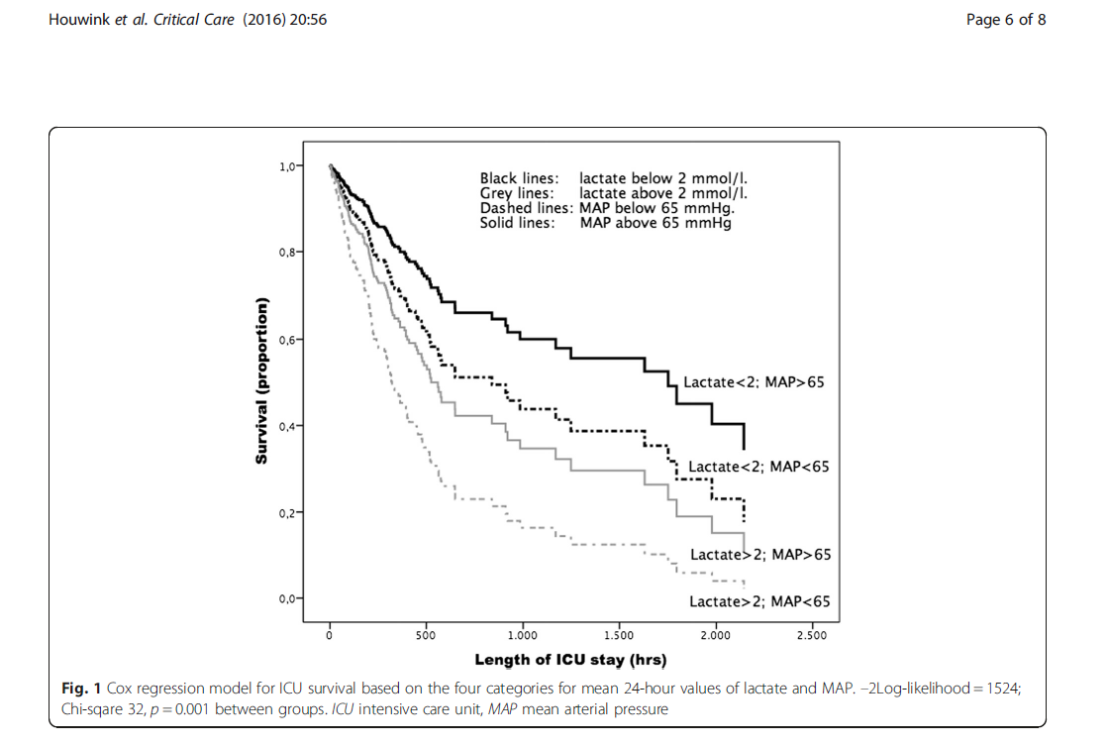

Slide 27
Biomarcatore “ideale” di Sepsi
Diagnosi precoce
Predire la prognosi della Sepsi
Predire e monitorare la risposta alla terapia
Facilmente dosabile (metodologicamente)
Elevata sensibilità e specificità
Cinetica nota
Costo-efficace

Slide 28
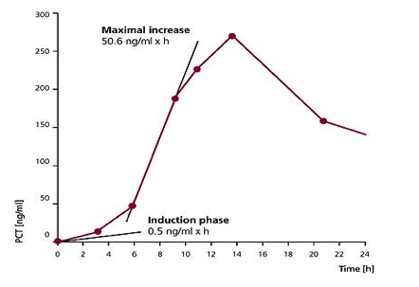
PROCALCITONIN
  Levels change rapidly in response to bacterial infection
Rapid response to bacterial infection
  After induction, e.g. by endotoxin, PCT increase is observed within 2-3 hours. Levels then rise rapidly, reaching a plateau after 6-12 hours.
Intensive Care Med. 1998 Aug;24(8):888-9. Kinetics of procalcitonin in iatrogenic sepsis. Brunkhorst FM, Heinz U, Forycki ZF.

Slide 29
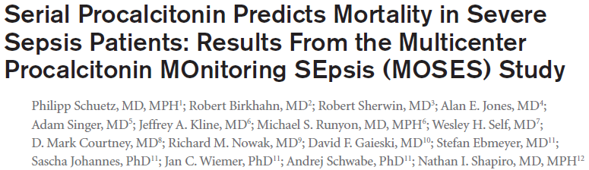
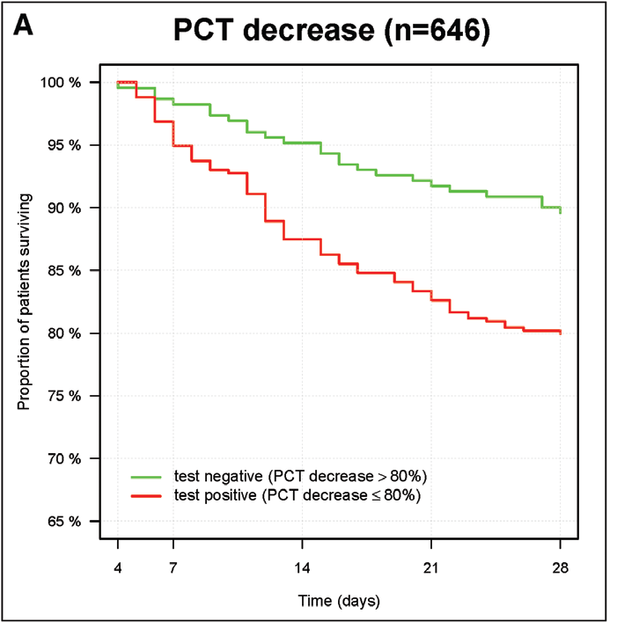
“..kinetics of PCT over the first 4 days [decrease > 80% from basal] were predictive for survival of patients diagnosed with severe sepsis or septic shock.”
Crit Care Med 2017;45:781-789
Notes:
In relazione alla prognosi è la cinetica della PCT ad essere più significativa.

Slide 30
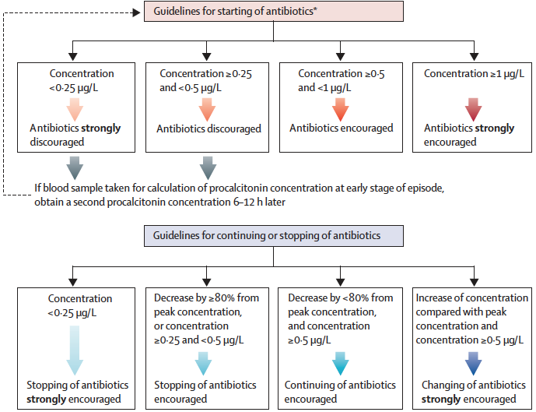
Bouadma L, et al. Lancet. 2010;375:463-74.

Slide 31
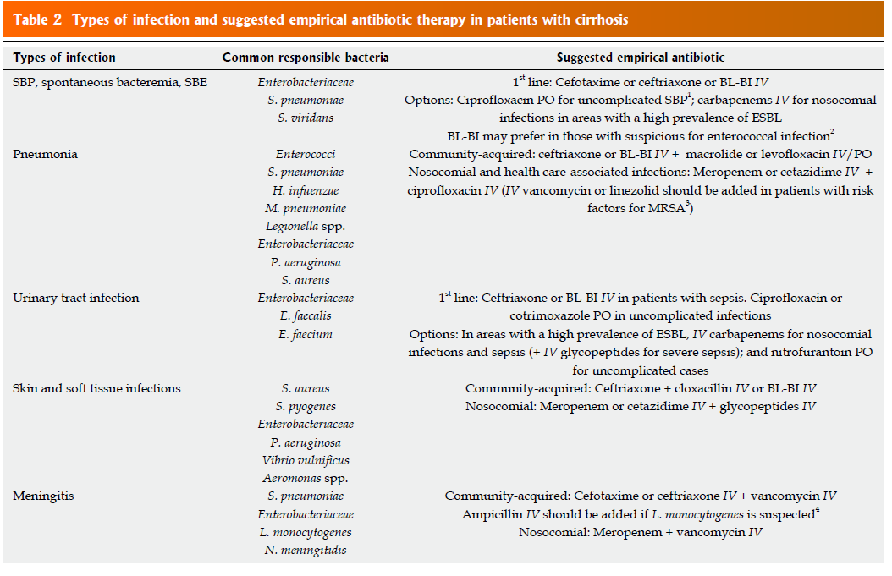

Slide 32
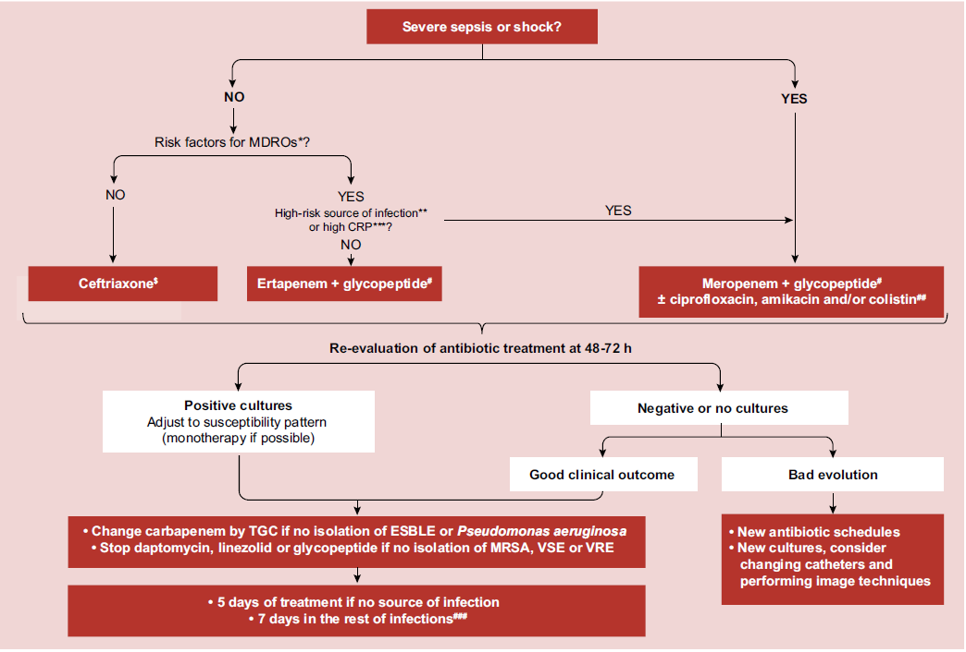

Slide 33
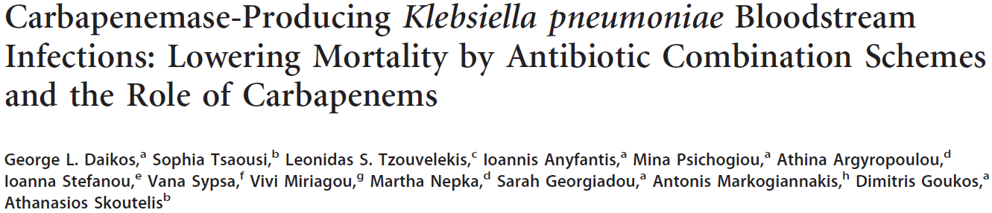
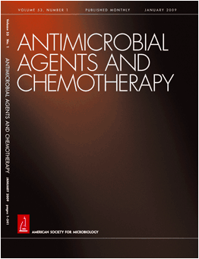
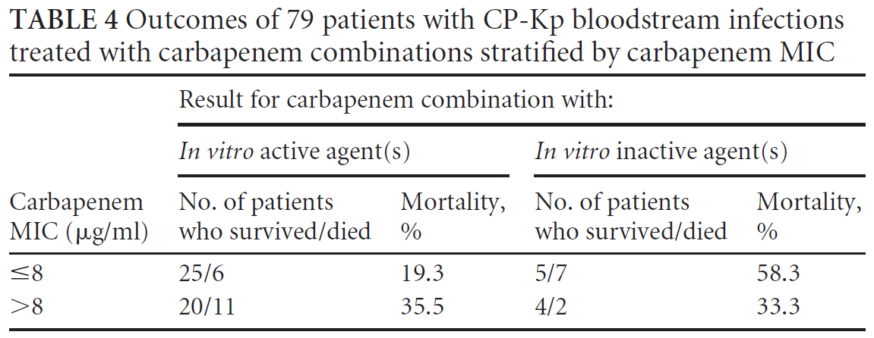
2014

Slide 34
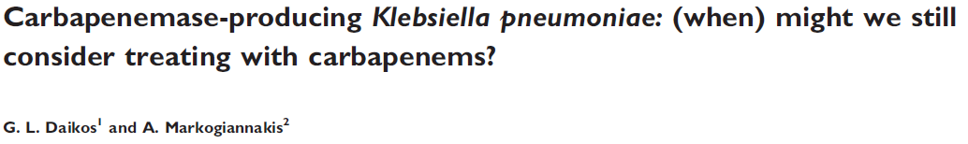
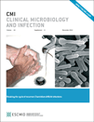
The fundamental question is whether carbapenems can still be used in the treatment of infections caused by CRKP isolates…
Daikos CMI 2011

Slide 35
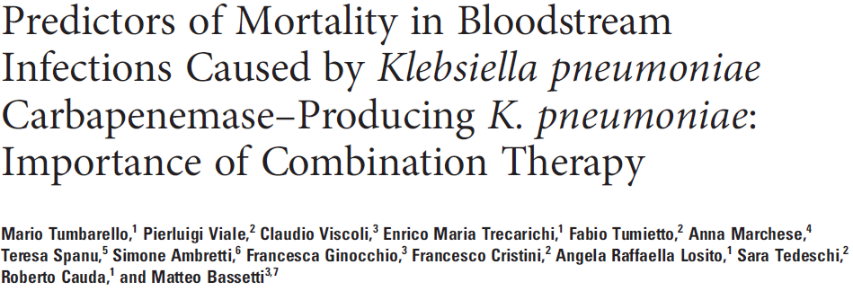
Mortality:
25 of the 46 (54.3%) whose regimens
were classified as monotherapy and 27 of the 79 (34.1%)
who were on combination regimens (P = 0.02)

Slide 36
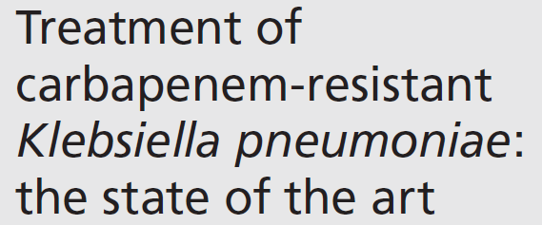
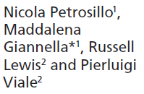
Expert Rev Anti Infect Ther 2013; 11: 159–177.
Combination treatment regimens for CR-KP infections have not been compared in prospective randomized trials.
Reviewing the published studies we found 507 patients treated ≥48 h.
Information on the type of therapeutic regimen was available for 416 of them: 206 were treated with monotherapy and 210 received combination therapy.
65 out of the 210 patients in combination therapy received a carbapenem-based treatment.
The mean mortality rates were 49.1 and 18.3% among patients with monotherapy and combination therapy, respectively.
Furthermore, lower rates of mortality were observed among those patients receiving a carbapenem-based combination therapy.

Slide 37
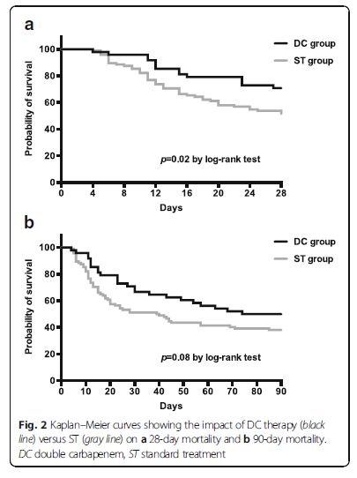
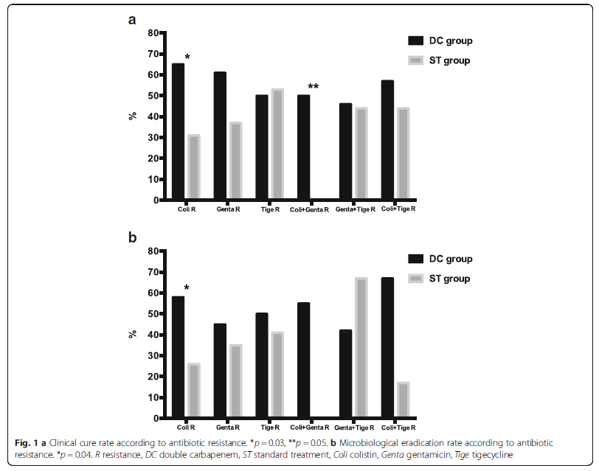
Meropenem 6 gr
+
Ertapenem 2 g
Extended Infusion strategy (3 h infusion)

Slide 38
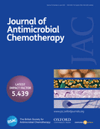
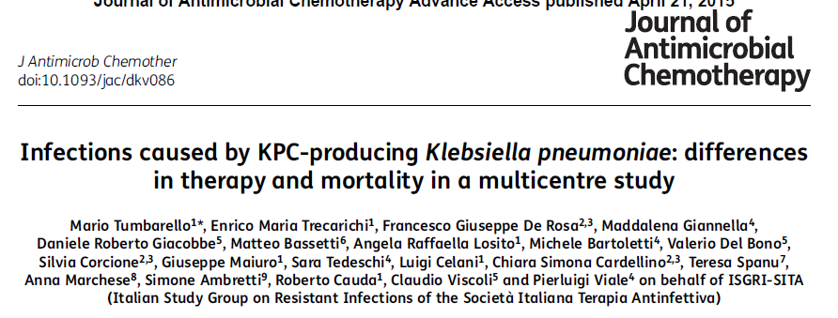
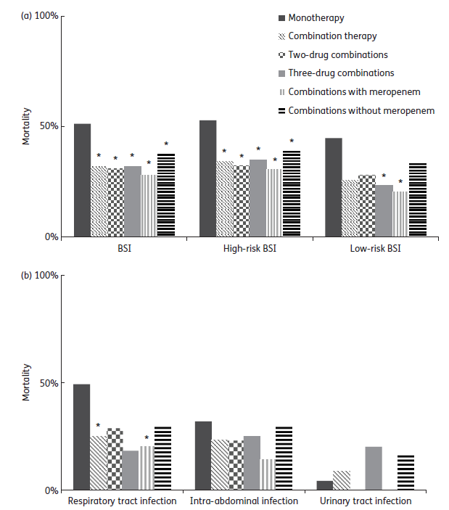
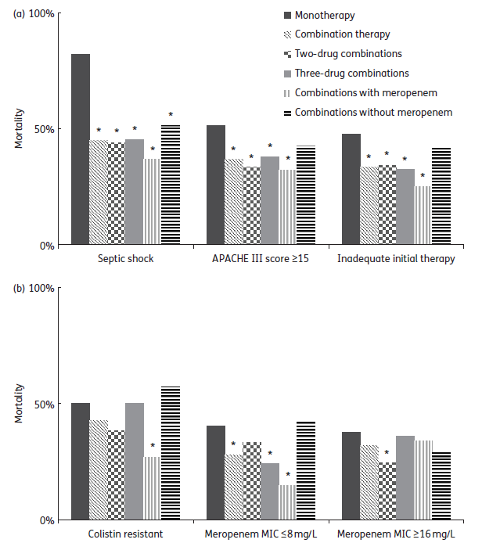
2015
+ mrm
+ mrm
3 drugs
+ mrm
3 drugs

Slide 39
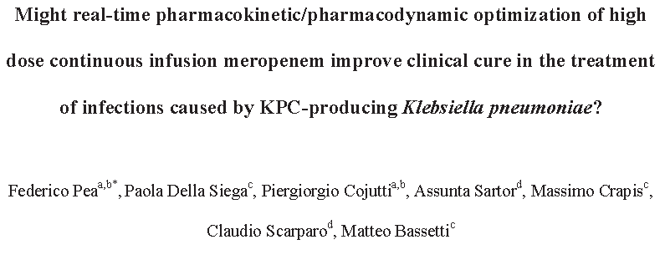
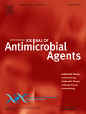
Tigecycline and colistin were the two antimicrobials most frequently combined with meropenem.
Average doses of continuous infusion meropenem ranged from 1.8 to 13.2 g/daily
High dose continuous infusion meropenem optimized by means of real-time TDM may represent a valuable tool in improving clinical outcome when dealing with the treatment of infections caused by KPC-Kp with an MIC for meropenem of ≤ 64mg/L.

Slide 40
Extended Infusion Cefepime for the Treatment of Invasive P. aeruginosa Infections
Respiratory & Blood isolates
Intermittent 1g q8h [n=51] v. Extended 2g q8h [n =35]
Extended infusion resulted in:
  Reduced LOS 18 vs. 12 days
  Reduced LOS ICU 18 vs. 10 days
  Reduced Mortality hospital 23 vs. 6%
  Reduced Mortailty 14 day 20 vs. 3%
  Reduced Cost of Care $53,000 vs. $30,000 USD
Bauer KA, et al., Antimicrob Agents Chemo 2013;57(7):2907-2912

Slide 41
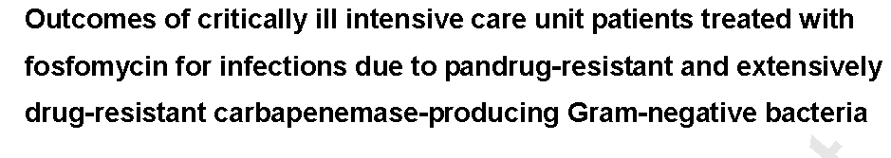



Fosfomycin was administered intravenously at a median dose of 24 g/day for a median of 14 days, mainly in combination with colistin or tigecycline. Clinical outcome at day 14 was successful in 54.2% of patients, whilst failure, indeterminate outcome and superinfection were documented in 33.3%, 6.3% and 6.3%, respectively.
Pontikis K et al IJAA 2016

Slide 42
NUOVI ANTIBIOTICI
Infezioni complicate vie urinarie
Infezioni complicate addominali
Polmoniti nosocomiali

Slide 43


Slide 44


Slide 45


Slide 46
NUOVI ANTIBIOTICI
Infezioni complicate cute e tessuti molli

Slide 47


Slide 48

DALBAVANCIN

Slide 49


Slide 50


TEDIZOLID
Once activated, tedizolid exerts its bacteriostatic microbial activity through inhibition of protein synthesis by binding to the 50S ribosomal subunit of the bacteria.

Slide 51

TEDIZOLID

Slide 52


