Slide 1
Prof. Anna Suk-Fong Lok

Slide 2
Prof. Anna Suk-Fong Lok
most remarkable aspects of a fantastic scientific route

Slide 3
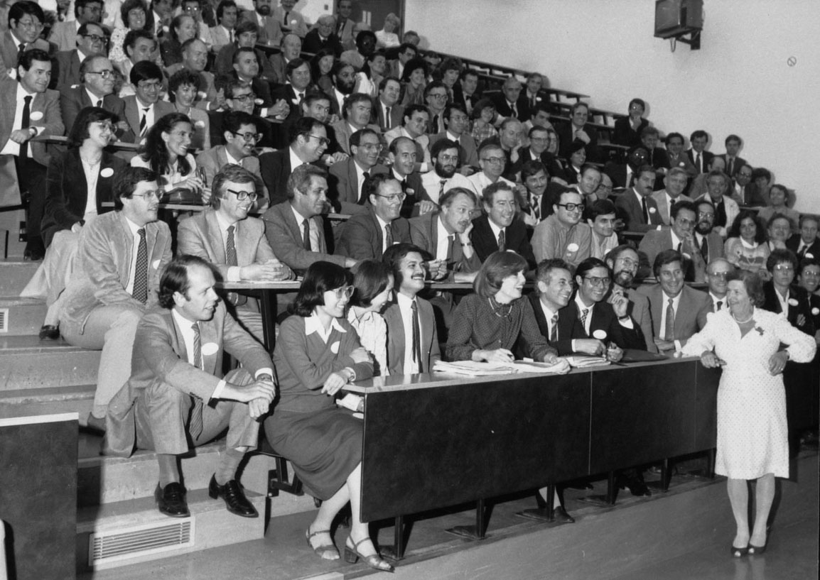
Most remarkable aspects of a fantastic scientific route
Prof. Anna Suk-Fong Lok obtained the medical degree from the University of Hong Kong
She completed her training in hepatology at the Royal Free Hospital, London, UK
under the direction of
Dame Sheila Sherlock

Slide 4
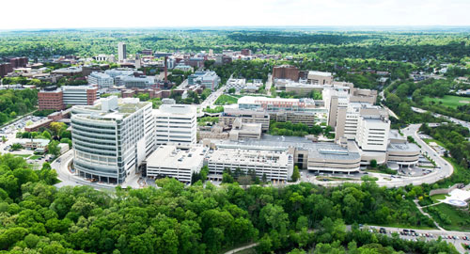
Most remarkable aspects of a fantastic scientific route
She returned to the University of
Hong Kong and taught there until
moving to Tulane University,
New Orleans, as Chief of Hepatology
in 1992.
In 1995, she left Louisiana^{[1]} and
became a Professor of Medicine at the University of Michigan in Ann Arbor.

Slide 5
Most remarkable aspects of a fantastic scientific route
Prof. Lok’s research focused primarily on
the natural history and management of
chronic hepatitis B
Some of most notable achievements in this filed are:
studies describing the fluctuating course of chronic hepatitis B and transitions from one phase to another
description of precore stop codon mutation
studies on interferon treatment and predictors of response
first reports on reactivation during chemotherapy
contribute to WHO and the AASLD guidelines for hepatitis B infection
Risk factors for hepatocellular carcinoma.
Lai CL, Lok A, Wu PC, Ng M.
Lancet. 1985 Sep 7;2(8454):552-3
Interferon alfa therapy in patients with chronic hepatitis B virus infection. Effects on hepatitis B virus DNA in the liver.
Lok AS, Ma OC, Lau JY.
Gastroenterology. 1991 Mar;100(3):756-61
Predictive value of precore hepatitis B virus mutations in spontaneous and interferon-induced hepatitis B e antigen clearance.
Lok AS, Akarca US, Greene S.
Hepatology. 1995 Jan;21(1):19-24
Update on prevention, diagnosis, and treatment of chronic hepatitis B: AASLD 2018 hepatitis B guidance.
Terrault NA, Lok ASF, McMahon BJ, Chang KM, Hwang JP, Jonas MM, Brown RS Jr, Bzowej NH, Wong JB.
Hepatology. 2018 Apr;67(4):1560-1599. doi: 10.1002/hep.29800

Slide 6
Most remarkable aspects of a fantastic scientific route
All-oral direct-acting antiviral therapy in HCV-advanced liver disease is effective in real-world practice: observations through HCV-TARGET database.
Reddy KR, Lim JK, Kuo A, Di Bisceglie AM, Galati JS, Morelli G, Everson GT, Kwo PY, Brown RS Jr, Sulkowski MS, Akuschevich L, Lok AS, Pockros PJ, Vainorius M, Terrault NA, Nelson DR, Fried MW, Manns MP; HCV-TARGET Study Group.
Aliment Pharmacol Ther. 2017 Jan;45(1):115-126
Prof. Lok’s contributes have been relevant also in other fields of hepatology research:
AST to platelets ratio index and Lok Index
initial articles on DAA for treatment of chronic hepatitis C
Effectiveness of Ledipasvir-Sofosbuvir Combination in Patients With Hepatitis C Virus Infection and Factors Associated With Sustained Virologic Response.
Terrault NA, Zeuzem S, Di Bisceglie AM, Lim JK, Pockros PJ, Frazier LM, Kuo A, Lok AS, Shiffman ML, Ben Ari Z, Akushevich L, Vainorius M, Sulkowski MS, Fried MW, Nelson DR; HCV-TARGET Study Group.
Gastroenterology. 2016 Dec;151(6):1131-1140.
Predicting clinical and histologic outcomes based on standard laboratory tests in advanced chronic hepatitis C.
Ghany MG, Lok AS, Everhart JE, Everson GT, Lee WM, Curto TM, Wright EC, Stoddard AM, Sterling RK, Di Bisceglie AM, Bonkovsky HL, Morishima C, Morgan TR, Dienstag JL; HALT-C Trial Group.
Gastroenterology. 2010 Jan;138(1):136-46

Slide 7
Most relevant aknowledgments
Most remarkable aspects of a fantastic scientific route
VA Merit Award
Distinguished Scientist Award from the Hepatitis B Foundation
Distinguished Women Scientist Award from the American Gastroenterological Association in 2008,
Distinguished Service Award from the American Association for the Study of Liver Disease in 2011,
Distinguished Achievement Award from the American Liver Foundation in 2015
Beaumont Prize in Gastroenterology from the American Gastroenterological Association in 2016.
Awards from the University of Michigan for research excellence in 2011, distinguished mentor in 2012, and clinical excellence in 2013.
Gold Medal Award from the Canadian Association for the Study of Liver

Slide 8
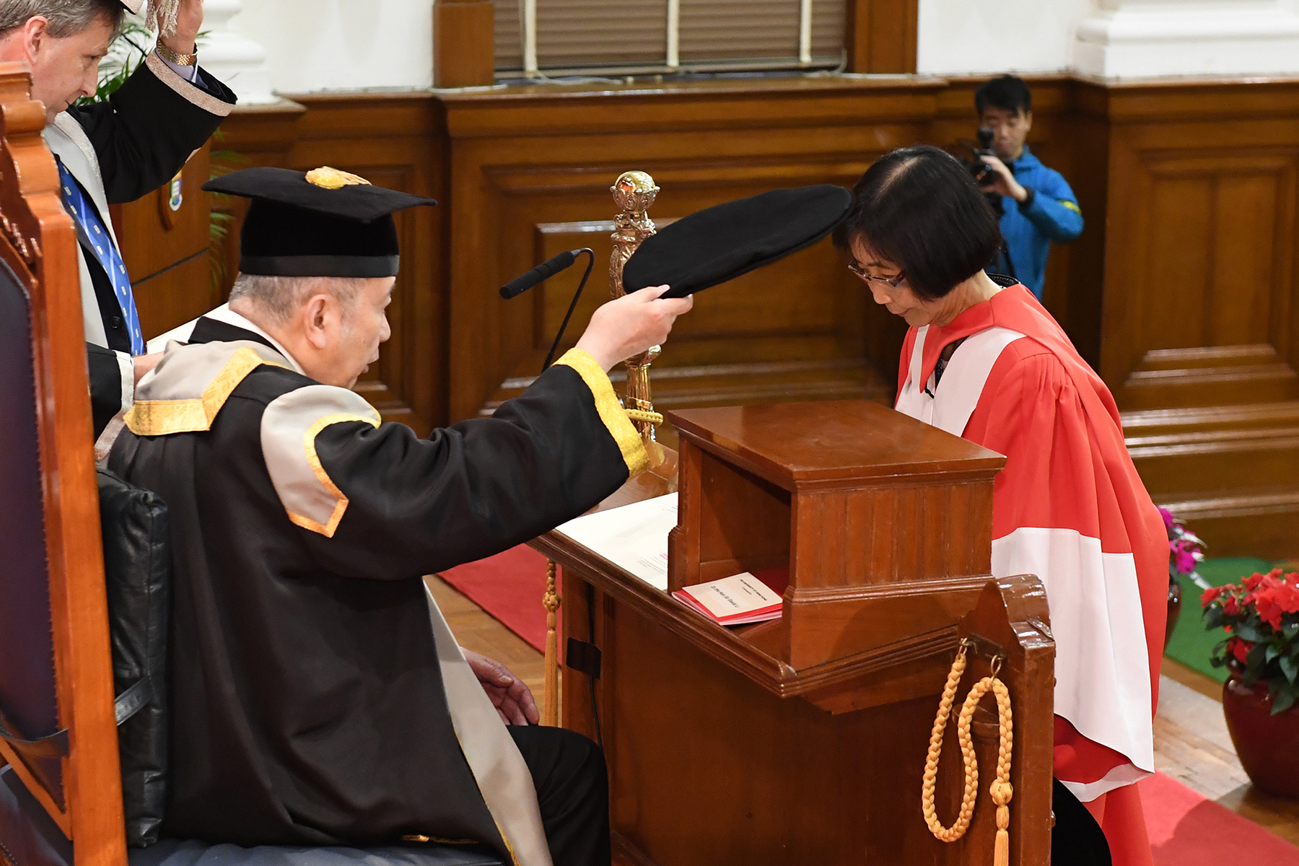
Most remarkable aspects of a fantastic scientific route
Prof Lok has published over 450 articles on viral hepatitis and liver disease
She was recognized as a top 1% most cited researcher allover the word

Slide 9
Prof. Anna Suk-Fong Lok
most remarkable aspects of a fantastic scientific route

Slide 10
Prof. Anna Suk-Fong Lok
most remarkable aspects of a fantastic scientific route
some of her unforgettable teachings about life, about being a medical doctor and about being a professor

Slide 11
some of her unforgettable teachings about life

Slide 12
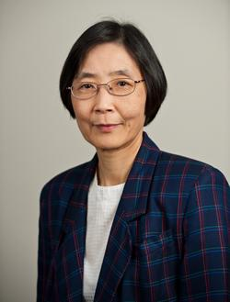
some of her unforgettable teachings about life
I have had my share of successes and failures, this is life.
It is important that young people realize that those of us who have made it had our struggles and our failures also. So do not feel discouraged when things are not going your way.
It is important to remember that our journey in life and our career is a marathon and not a sprint.
There will be ups and downs and those who persevere will reach their destination.

Slide 13
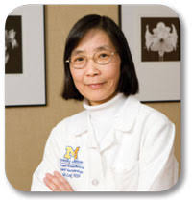
some of her unforgettable teachings about being a medical doctor
We can help others and make a big impact on their health. Recognize the impact of every little thing you do on your patients' and their families' lives.
Understand how privileged you are. While we cannot be perfect, we can and should always try our best. Also remember that medicine is not just a science, it is also an art
Even when our hands are tied and modern medicine cannot save our patient's life, we can still make a difference by being compassionate and understanding.
Learn how to communicate and how to listen; and always imagine if you or your loved one is on the other side in the consulting room.

Slide 14
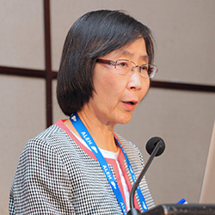
some of her unforgettable teachings about being a professor
I am able to help you now because someone helped me in the past.
I cannot pay my teachers back nor do they expect any pay back; instead. I am paying it forward, passing on my knowledge and experience to help you succeed so you can in turn pass that along to next generation.
I am pleased to say many of my mentees have become leaders in their own right and are indeed fostering another generation of physicians and researchers”

Slide 15
Prof. Anna Suk-Fong Lok
most remarkable aspects of a fantastic scientific route
some of her unforgettable teachings about life, about being a medical doctor and about being a professor

Slide 16
Prof. Anna Suk-Fong Lok
most remarkable aspects of a fantastic scientific route
some of her unforgettable teachings about life, about being a medical doctor and about being a professor
her role as AASLD president

Slide 17
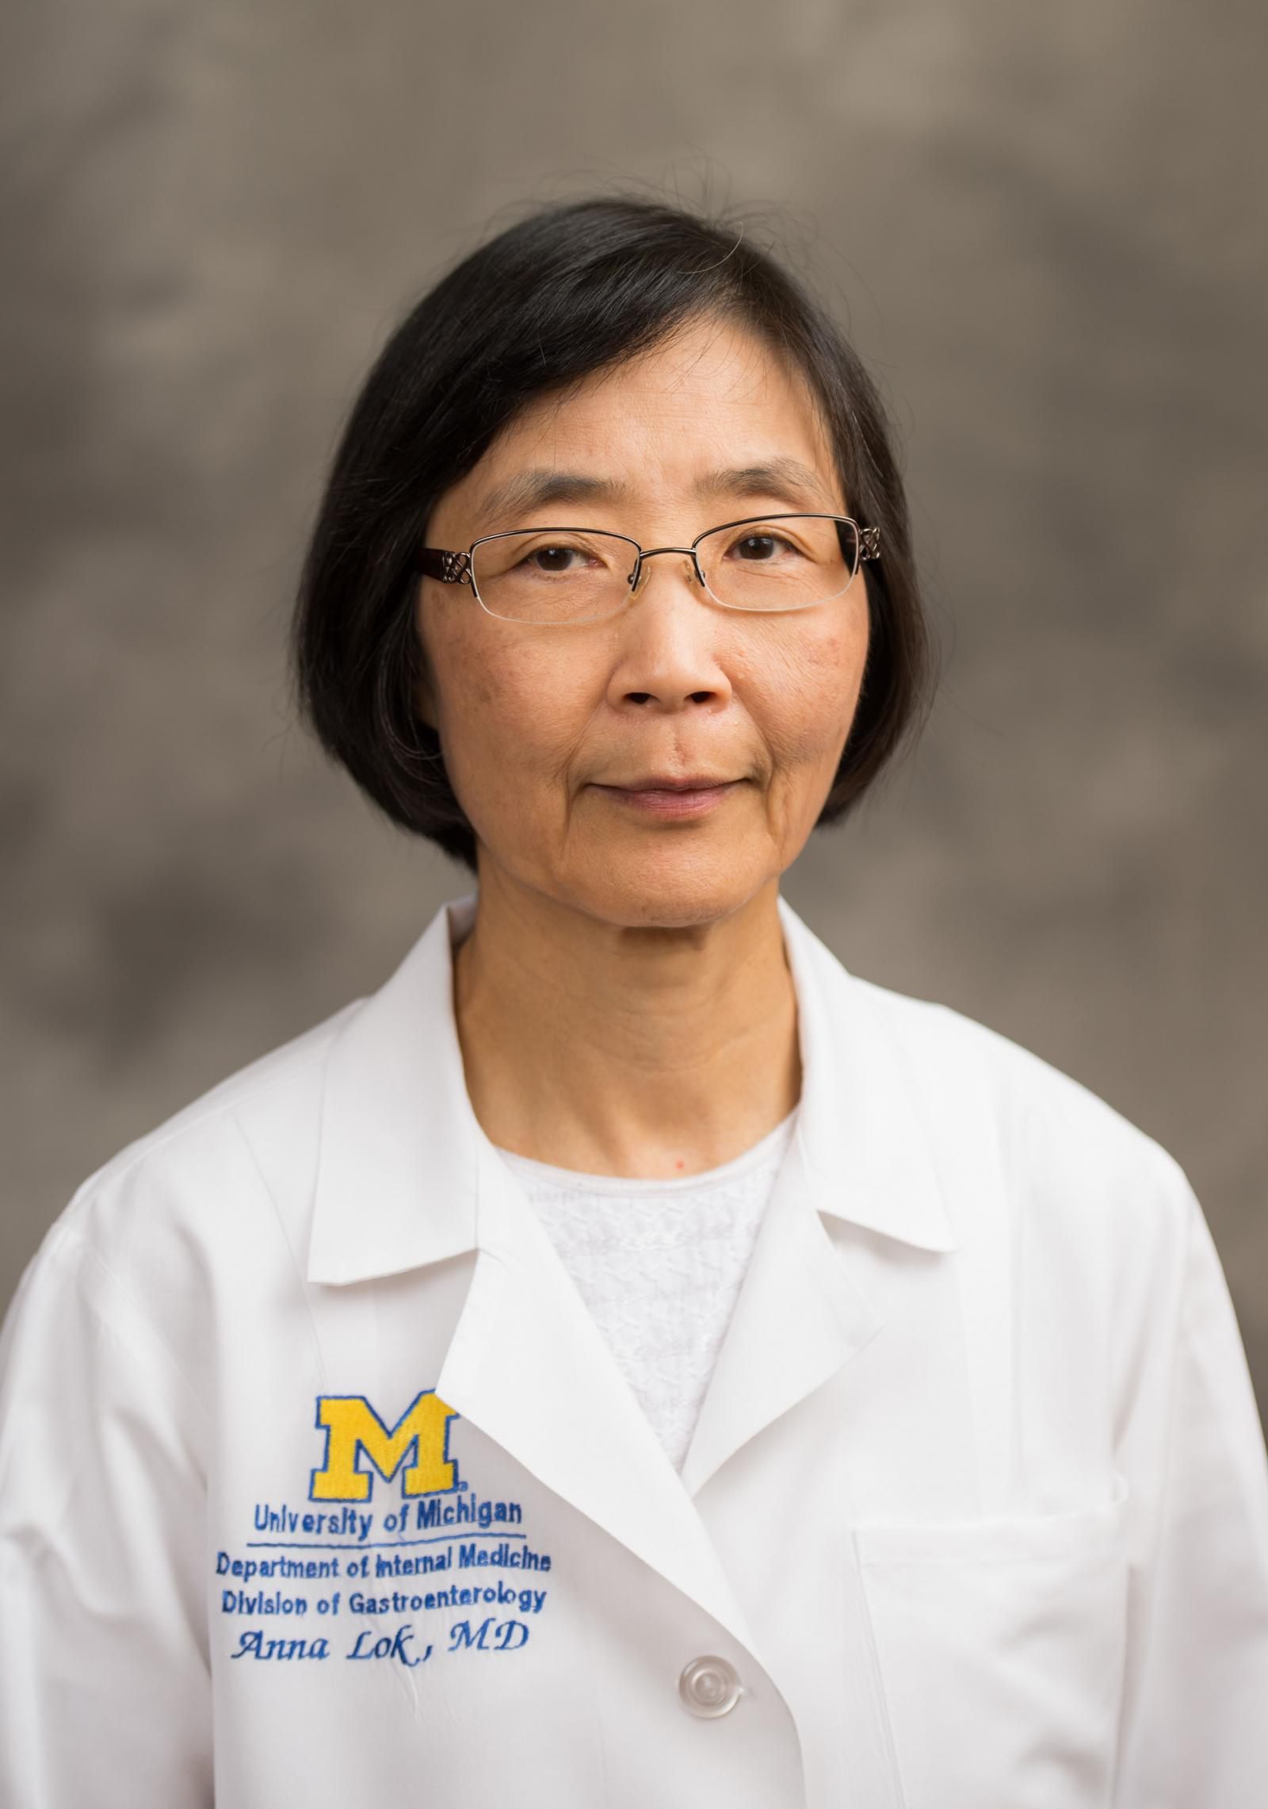
Her role as AASLD president
At a time of President Donald Trump’s executive order imposing restrictions on travel to the United States, AASLD continues to focus on fostering diversity and inclusion among our members and the global hepatology community
AASLD will always be concerned about restrictions that could potentially discourage from training or practicing hepatology in the U.S., halt critical research and collaborations, and prevent the dissemination of hepatology research and education around the world
We are proud to be a global organization that embraces diversity in our membership, meetings, publications, awards and partnerships.
Anna S. Lok, MD, FAASLD,
AASLD President

Slide 18
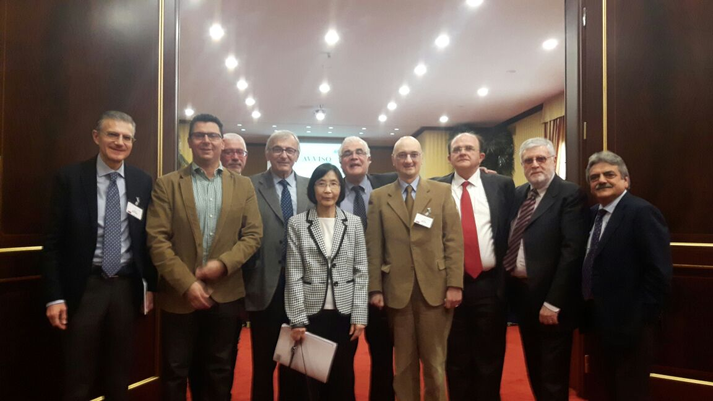
From Paestum April 24 2017 to Catania 2018 September 30 - October 1 CLEO National Congress

Slide 19
Prof. Anna Suk-Fong Lok: Thank you very much to be a great friend of our association !!

