Slide 1

Nuovi criteri di stadiazione dell’HCC
Rodolfo Sacco
U.O. Gastroenterologia ed Endoscopia Digestiva AOU "OO.RR." Foggia
U.O. Gastroenterologia e Malattie del Ricambio AOUP - Pisa

Slide 2
Summary
  Overview of current staging systems
  Application in clinical practice
  Conclusions and key messages

Slide 3
Overview of current staging systems

Slide 4
HCC reference staging systems
  HCC tumors are difficult to stage because the underlying functional status of the patient and tumor burden jointly influence survival.
  Staging systems which take into account stage of tumor at presentation, functional status of patient, biologic hepatic function, and intervention type have higher predictive value as these variables are known to affect prognosis.
  As of today, 11 staging systems have been proposed to stratify HCC patients.
  However, results from their respective studies have been inconsistent and difficult to reproduce in varying populations with different disease etiologies.

Slide 5

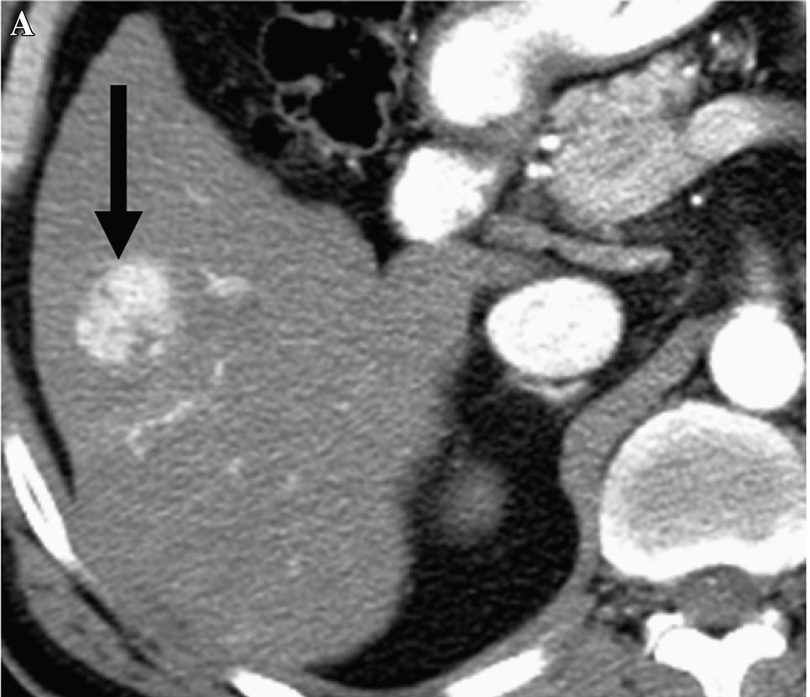
Data based staging systems
Evidence based staging systems
Combined prognostic systems

Slide 6
Data Based Staging Systems
Staging System | Year | Pts Number | Liver Function | Performance status | aFP | HCC number | Size | Vascular invasion | Metastasis | Other
Okuda | 1984 | 600 | Ascites Albumine Bilirubin | - | - | - | + | - | -
CLIP | 1998 | 435 | CPT | - | + | + | + | + | -
French (GETCH) | 1999 | 761 | Bilirubin | Karnofsky | + | - | - | + | - | Alk-P
CUPI | 2002 | 926 | Ascites Bilirubin | Symptoms | + | + | + | + | + | Alk-P
JIS | 2003 | Review* | CPT | - | - | + | + | + | +
Tokyo | 2005 | 403 | Albumin Bilirubin | - | - | + | + | - | -
TIS | 2010 | 2030 | CPT | - | + | TTV | TTV | - | -
MESIAH | 2012 | 477 | MELD Albumin | - | + | + | + | + | + | Age
Modified from Liu PH, et al. J Hepatol 2016; 64: 601-608

Slide 7
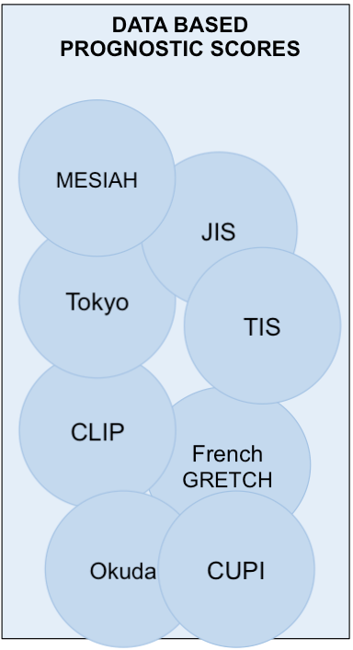



Data-Based Staging Systems
Pro & Cons
PRO: objective and reproducible variables and rigorous statistical methodology. Accurate survival prediction
CONS: often they are not suitably generalizable to populations different from the one that generated the score, and they don’ t define tumor stages for treatment selection
Treatment
Prognosis
Prognostic score
(multivariate analysis)
Staging system
(literature based)
Farinati F, et al. PLoS Med 2016; 13(4):e1002006

Slide 8
Data based prognostic scores
Evidence based staging systems
Combined prognostic systems

Slide 9
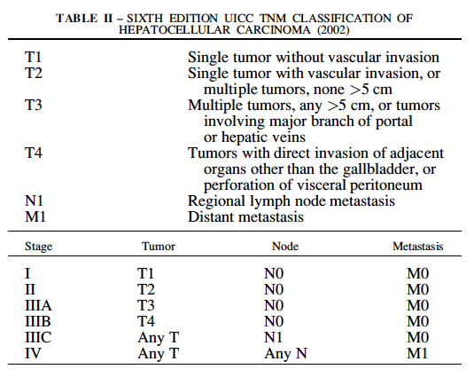
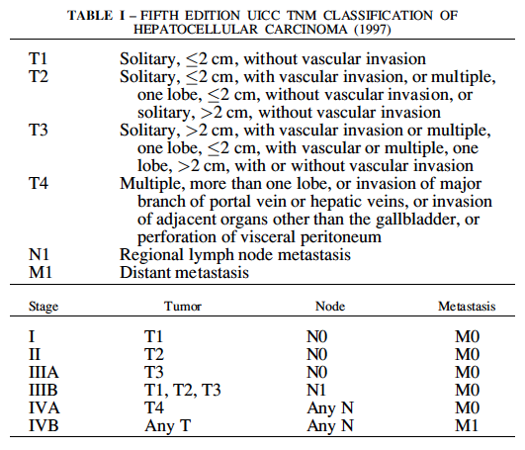
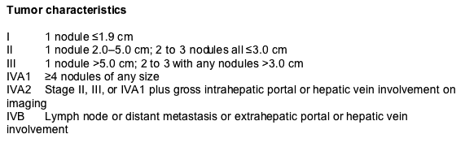
Evidence based staging systems
SURGICAL STAGING SYSTEMS
AJCC-UICC TNM 6th edition, 2002
AJCC-UICC TNM 5th edition, 1997
UNOS TNM, 2002

Slide 11
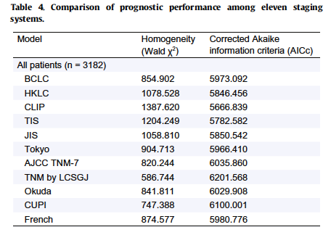
Evidence based staging systems
Liu PH, et al. J Hepatol 2016; 64: 601

Slide 12
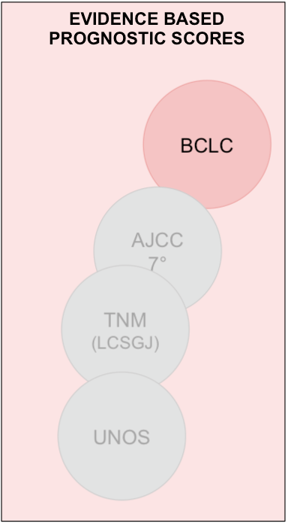

Evidence-Based Prognostic Systems
Pro & Cons
PRO: They are useful to link stages to guidelines for the management of patients with HCC and the design of clinical trials.
CONS: These systems are not based on a strong statistical methodology (variables are not weightened) and they often lack prognostic power.
Prognosis
Treatment
Prognostic score
(multivariate analysis)
Staging system
(literature based)
Farinati F, et al. PLoS Med 2016; 13(4):e1002006

Slide 13
Prognostic pitfalls of BCLC classification
ECOG PST 1 classified as BCLC B
(in original BCLC stage C)
^{Hsu CY, et al. Hepatology 2013}

Slide 17
Data based prognostic scores
Evidence based staging systems
Combined prognostic systems

Slide 18
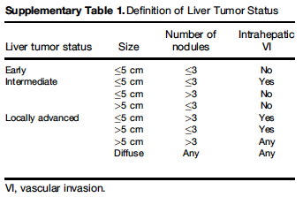
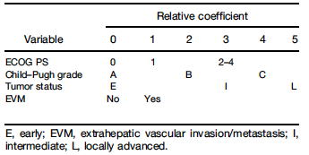
Combined prognostic systems
HKLC staging system
13 points score??
Yau T, et al. Gastroenterology 2014

Slide 19

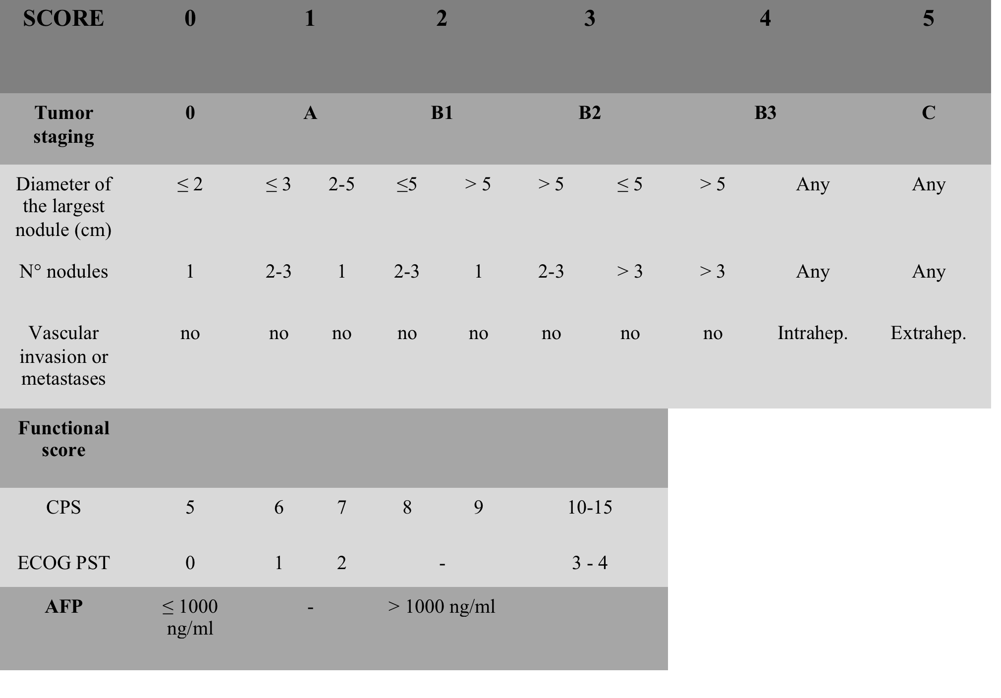
Combined prognostic systems
The ITA.LI.CA prognostic score
Farinati F, et al. PLoS Med 2016; 13(4):e1002006

Slide 20
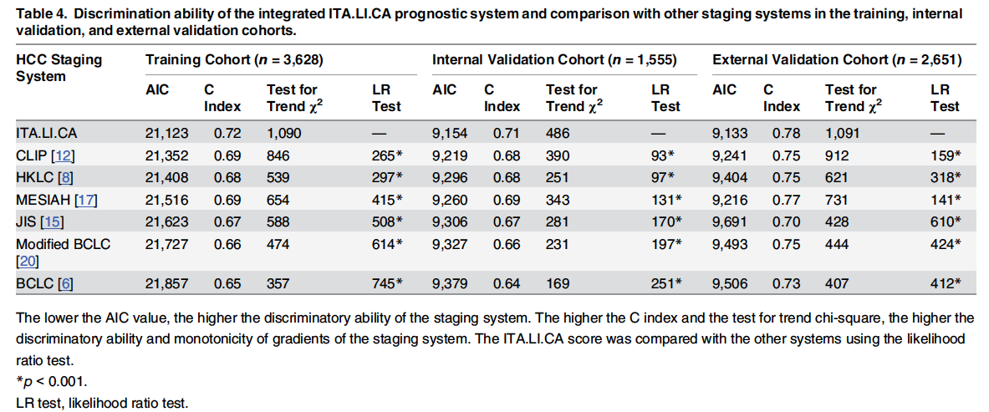
Combined prognostic systems
Farinati F, et al. PLoS Med 2016; 13(4):e1002006

Slide 21
External validation of the ITA.LI.CA prognostic system for patients with hepatocellular carcinoma: a multicenter cohort study.
Mauro Borzio¹ , Elena Dionigi¹, Angelo Rossini², Massimo Marignani³, Rodolfo Sacco⁴, Ilario De sio⁵, Emanuela Bertolini⁶, Giampiero Francica⁷, Anna Giacomin⁸, Giancarlo Parisi⁹, Susanna Vicari¹⁰, Anna Toldi¹¹, Andrea Salmi¹², Sergio Boccia¹³, Mario Mitra¹⁴, Fabio Fornari¹⁵.
Borzio M, EpaHCC study group. Hepatology 2017

Slide 22
External validation of the ITA.LI.CA prognostic system for patients with hepatocellular carcinoma: a multicenter cohort study.
HCC prognostic systems | AIC | C index | χ² test | Lrtest, p value
Study group (n=1,508)
ITA.LI.CA score [8] | 7,087 | 0.77 | 763 | -
CLIP [13] | 7,233 | 0.73 | 575 | 161, <.0001
HKLC [6] | 7,194 | 0.75 | 659 | 44, <.0001
MESIAH [7] | 7,159 | 0.76 | 642 | 87, <.0001
JIS [14] | 7,206 | 0.74 | 563 | 123, <.0001
ITA.LI.CA tumor stage [8] | 7,307 | 0.72 | 482 | 221, <.0001
BCLC [2] | 7,234 | 0.74 | 514 | 158, <.0001
Curative treatment (n=658)
ITA.LI.CA score [8] | 2,177 | 0.65 | 39 | -
CLIP [13] | 2,186 | 0.61 | 34 | 19, .0075
HKLC [6] | 2,189 | 0.62 | 33 | 18, .0112
MESIAH [7] | 2,18 | 0.65 | 34 | 14, .0601
JIS [14] | 2,193 | 0.61 | 21 | 21, .0003
ITA.LI.CA tumor stage [8] | 2,202 | 0.59 | 13 | 28, <.0001
BCLC [2] | 2,193 | 0.60 | 23 | 25, .0001
Non-curative treatment (n=850)
ITA.LI.CA score [8] | 4,855 | 0.73 | 346 | -
CLIP [13] | 4,957 | 0.70 | 220 | 109, <.0001
HKLC [6] | 4,907 | 0.72 | 280 | 18, .0015
MESIAH [7] | 4,899 | 0.72 | 316 | 51, <.0001
JIS [14] | 4,945 | 0.70 | 233 | 91, <.0001
ITA.LI.CA tumor stage [8] | 5,014 | 0.68 | 192 | 140, <.0001
BCLC [2] | 4,952 | 0.70 | 215 | 92, <.0001
Borzio M, EpaHCC study group. Hepatology 2017

Slide 23
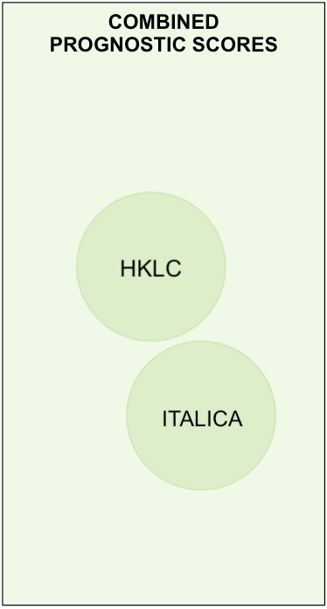

Combined Prognostic Systems
Pro & Cons
PRO: Combined systems use evidence to stratify tumor stages and to select parameters to be tested and weightened on large HCC cohorts.
CONS: They must be implemented with other biological/functional variables in order to have the most personalized therapy that is possible for each single patient.
Prognosis
Treatment
Prognostic score
(multivariate analysis)
Staging system
(literature based)
Farinati F, et al. PLoS Med 2016; 13(4):e1002006

Slide 24
Methodological quality
  The overall methodological quality of CPGs for HCC is moderate, with
  poor applicability and potential conflict of interest issues.
  The evidence-based guidelines has become mainstream for high quality
  CPGs development.

Slide 25
Application in clinical practice

Slide 26
Adherence to AASLD Guidelines
for the management of HCC
Comparison between the ideal and actual therapeutic allocation
BCLC
Real
180
120
n°
60
0
OLT
Surgery
Abl
TACE
Sorafenib
Palliative
TACE/Abl
Borzio M, Sacco R, et al. Future Oncol 2013;9(2):283-94.

Slide 27
Adherence to EASL-EORTC clinical guidelines for the management of HCC in field practice:
results from the ITA.LI.CA database
R.Sacco et.al for ITA.LI.CA group
Digestive and Liver Disease 47S (2015) e79

Slide 28
Aim
Data on adherence to guidelines for the management
of HCC issued in 2012 by the EASL-EORTC are
lacking.
We retrospectively evaluated the adherence to EASL-
EORTC guidelines in field-practice, using data from
HCC patients registered in the Nation-wide Italian
database ITA.LI.CA. and diagnosed from 2012.

Slide 29
BCLC-B
Total number of patients | 93
Transplant | 0
Resection | 17
RF | 4
PEI | 3
Other ablation techniques | 4
TACE | 45
Sorafenib | 10
Palliative | 7
Other | 4
Values represent n. of patients
% of patients

Slide 30
BCLC-C
Total number of patients | 172
Transplant | 0
Resection | 18
RF | 11
PEI | 18
Other ablation techniques | 0
TACE | 27
TAE | 2
Sorafenib | 38
Palliative | 51
Other | 8
Values represent n. of patients
% of patients

Slide 31
BCLC-D
Total number of patients | 48
Transplant | 0
Resection | 2
RF | 0
PEI | 3
Other ablation techniques | 0
TACE | 3
TAE | 2
Sorafenib | 5
Palliative | 31
Other | 2
Values represent n. of patients
% of patients

Slide 32
Conclusive considerations and key messages

Slide 33
Geographical and resource difference across countries – and regions of the same countries - make it difficult to apply the same diagnostic and treatment algorithms to very different settings.
The overall methodological quality of guidelines is moderate, with poor applicability, BUT evidence-based approach, rather than consensus-based approach, has become mainstream for high quality CPGs development.

Slide 34
Adherence to both AASLD and EASL guidelines in Italian primary and referral Centers remains poor.
Difficulties in patients staging and the high prevalence of older patients with relevant co-morbidities may partially explain these findings.
However, is adherence to guidelines associated with improved survival?
Is there room for improvement of guidelines on the basis of real-practice experience?

Slide 35
BCLC system is based on very specific treatments for each stage of disease.
Treatment alternatives and contraindications are not provided in EASL guidelines.
For instance, TACE may be contraindicated in the highly-heterogeneous population of BCLC-B HCC patients; however, the contraindications to TACE are not listed in current EASL/EORTC guidelines.
Subclassifications of BCLC-B patients should be applied in clinical practice

Slide 36
We do not strictly adhere to guidelines in
clinical practice.
But do guidelines adhere to clinical
practice?

Slide 37


