Slide 1
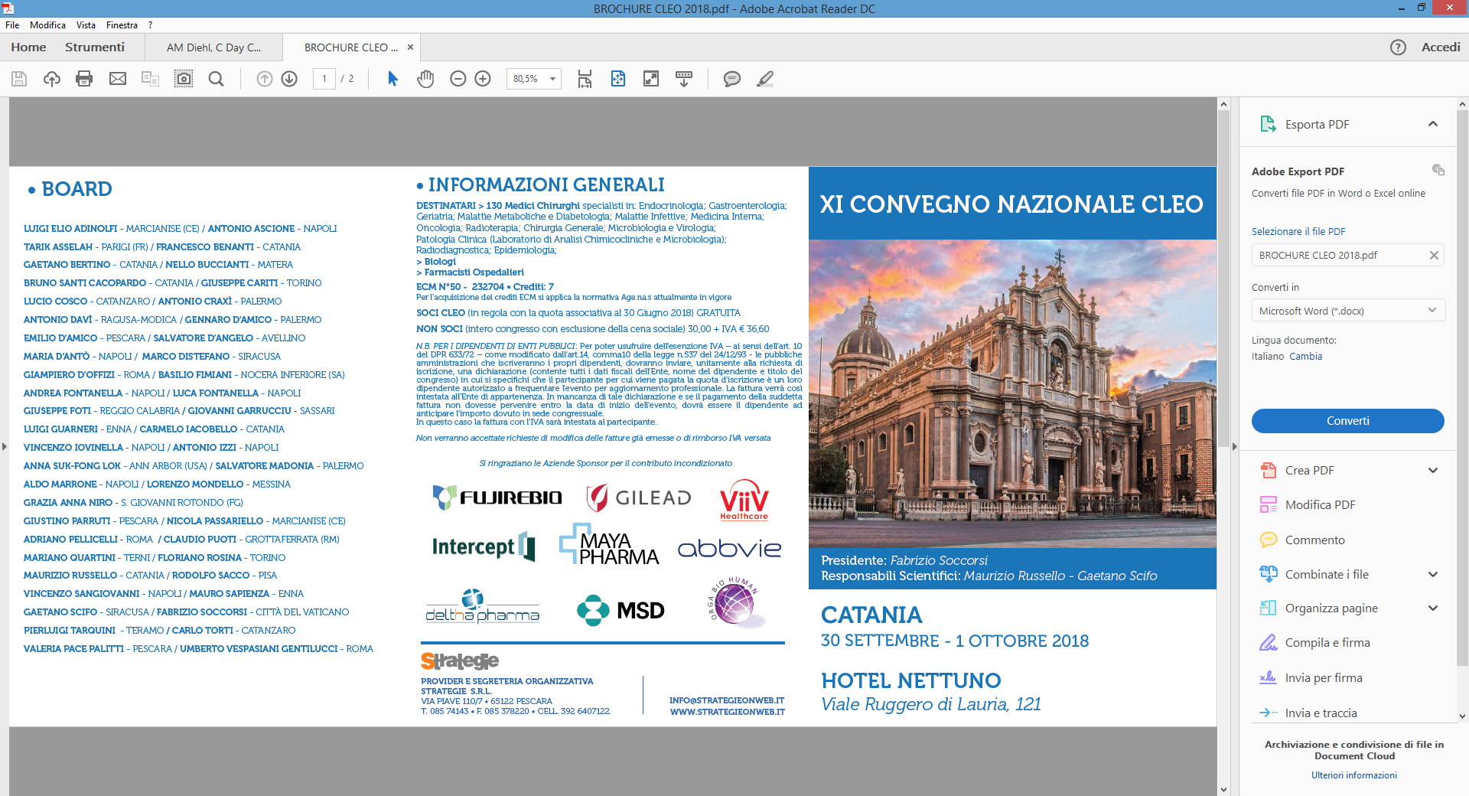
Attualità & Prospettive Terapeutiche
nella NAFLD / NASH :
dai trials alla pratica clinica
Gaetano Scifo
U.O.C. Malattie Infettive
P.O.Umberto I A.S.P. Siracusa

Slide 2
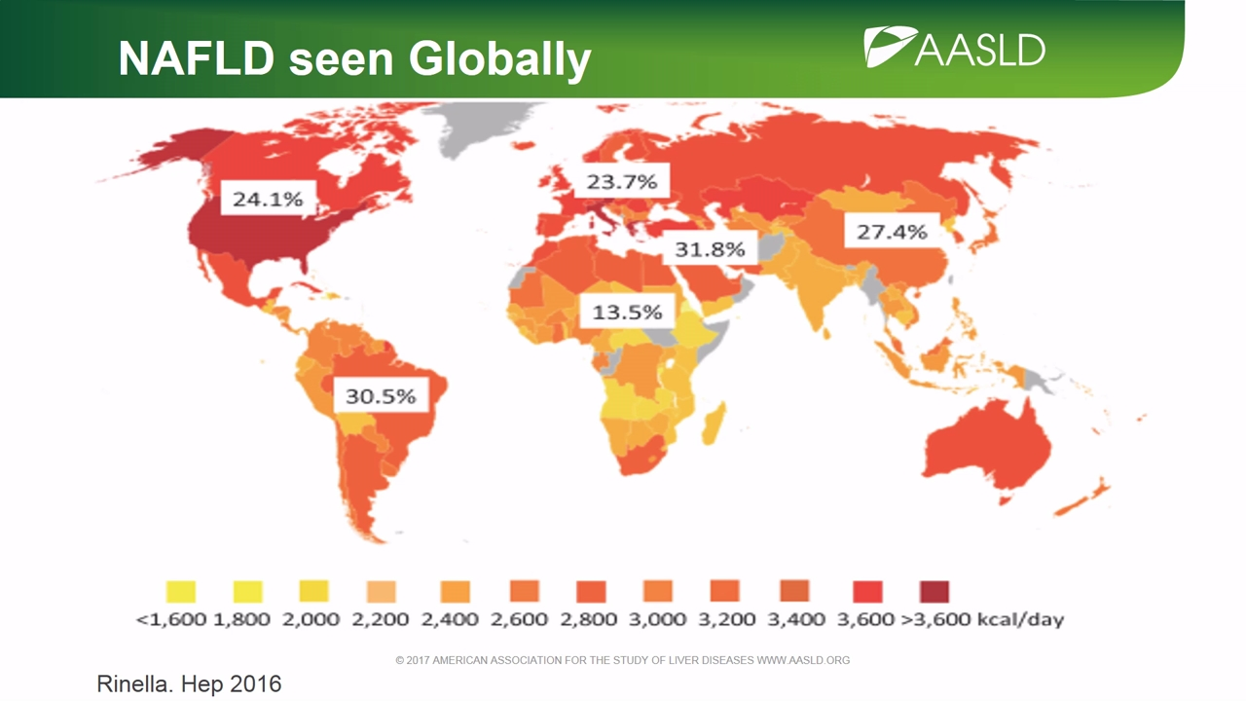

Slide 3
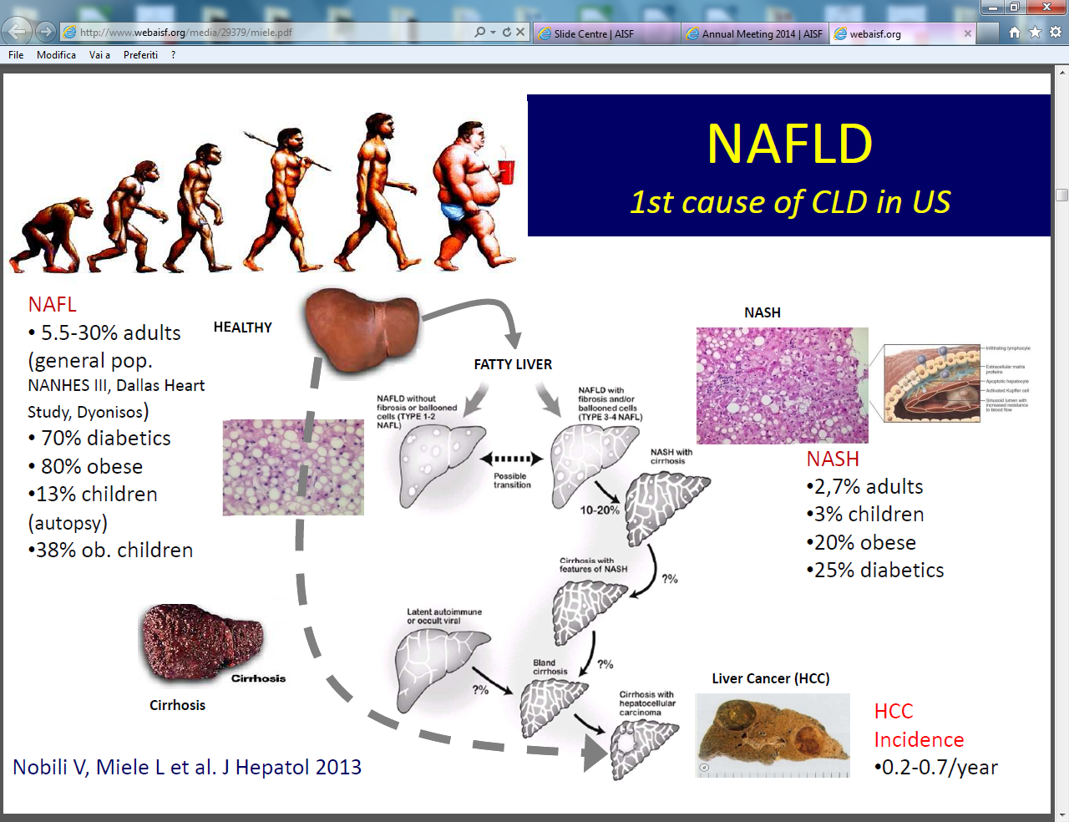

Slide 4
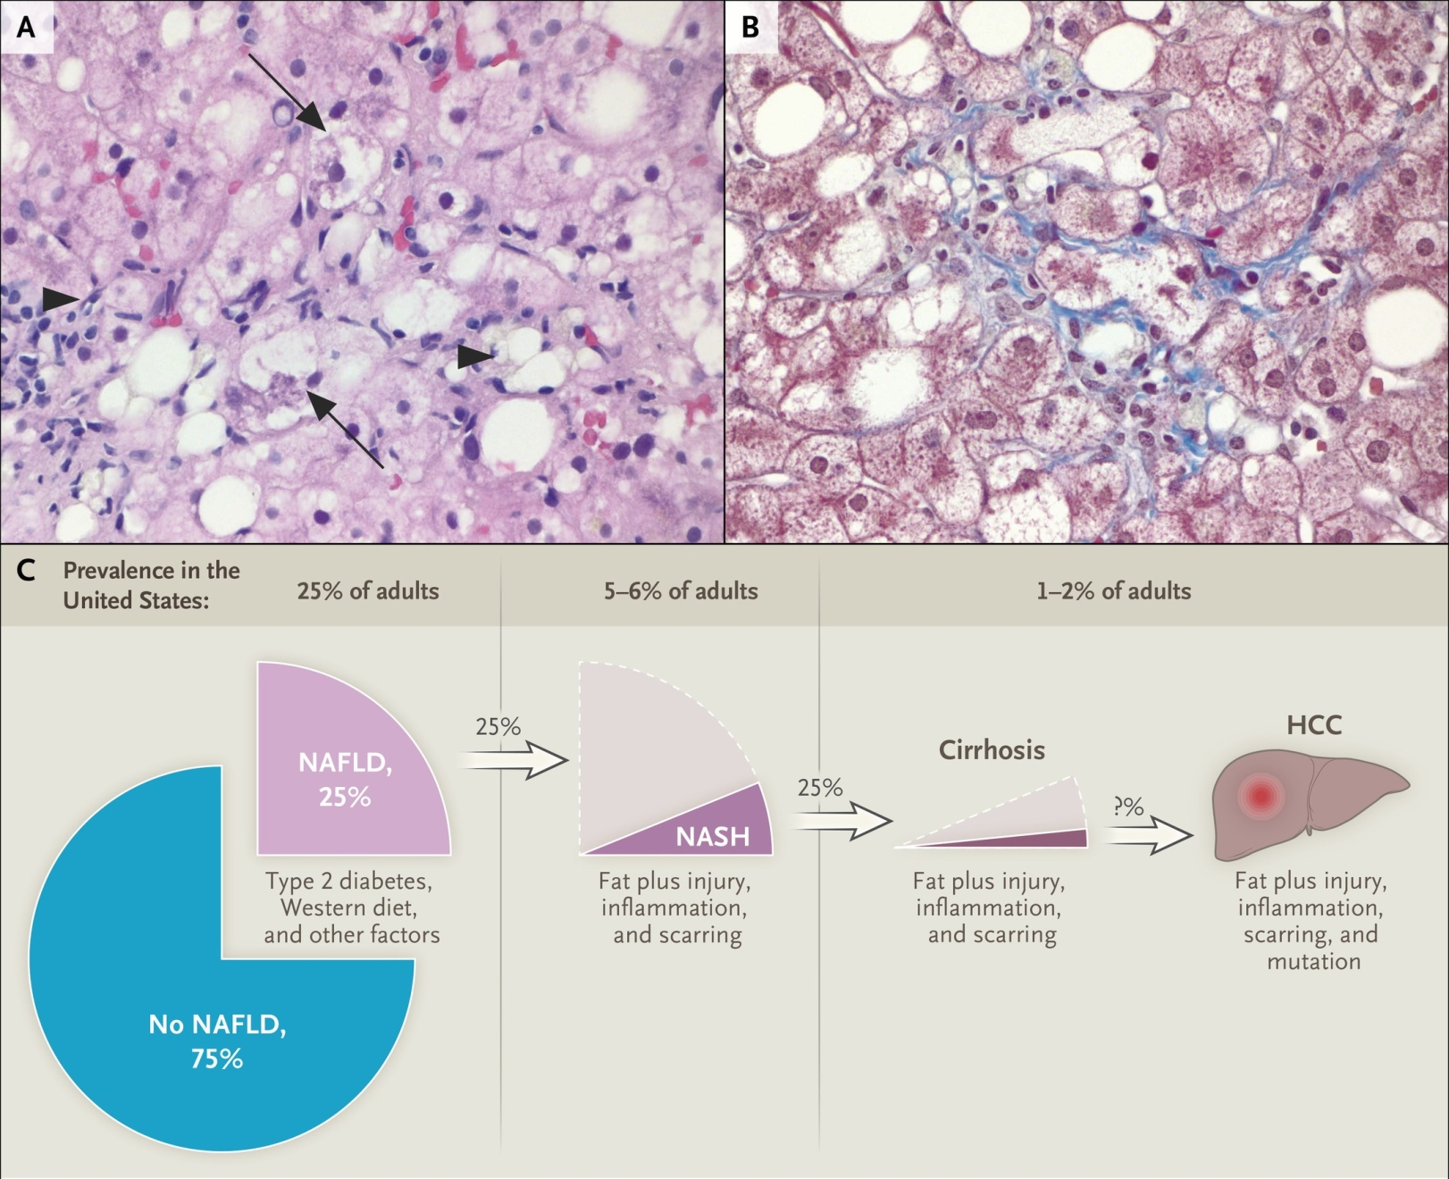

Histologic Features and Prevalence of Nonalcoholic Steatohepatitis (NASH).
Diehl AM, Day C. N Engl J Med ;377:2063-2072
Notes:
Figure 1 Histologic Features and Prevalence of Nonalcoholic Steatohepatitis (NASH). NASH is a potentially progressive type of nonalcoholic fatty liver disease (NAFLD). Panels A and B show characteristic histologic features of NASH in liver-biopsy specimens: ballooned hepatocytes (arrows), inflammatory infiltrate (arrowheads), and fibrosis. Panel C shows the relative distribution of NASH, cirrhosis, and primary liver cancer in the U.S. adult population. Data in Panel C are from Williams et al.2 and Adams et al.3 HCC denotes hepatocellular carcinoma.

Slide 5
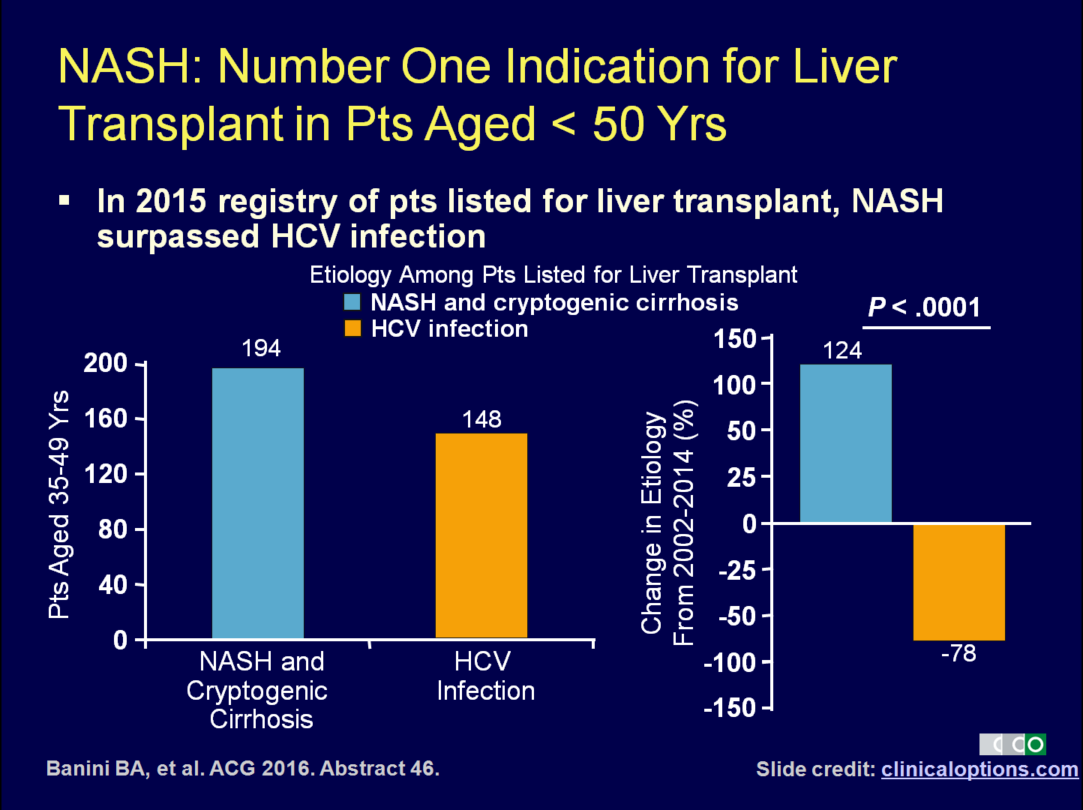

Slide 6
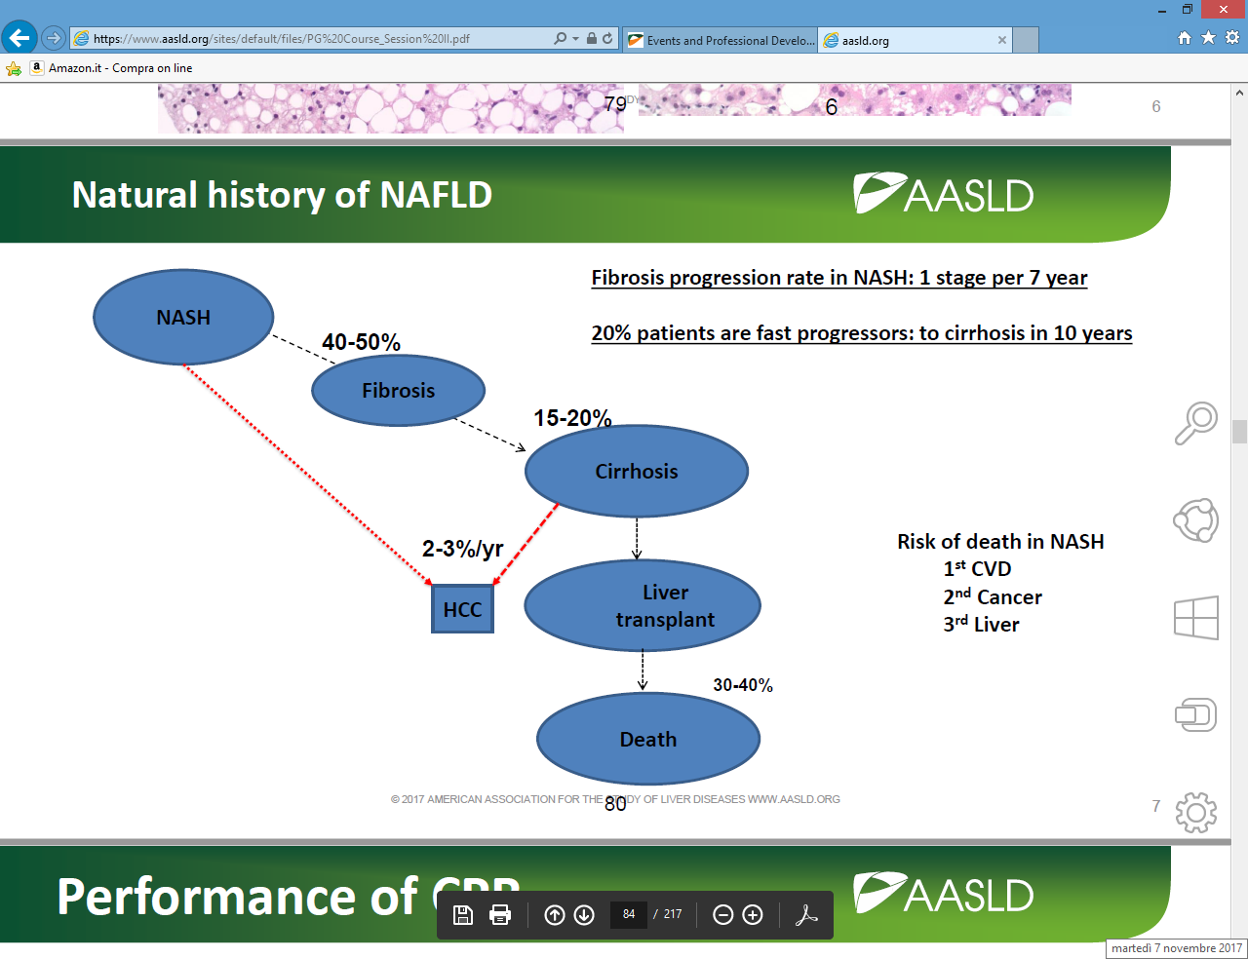

Slide 7
NAFLD PATHOGENESIS
  * NAFLD as a complex disease trait
  * Role of obesity and insulin resistance as pathogenic drivers
  * Factors leading to hepatocellular injury
    ( Oxidative stress, lipotoxicity, mitochondrial dysfunction,
    inflammatory activation and production of cytokines and
    adipokine , gut dysbiosis, and ER stress )
* Genetic modifiers of NAFLD
Notes:
CCR, chemokine receptor; ER, endoplasmic reticulum; FXR, farnesoid X receptor; NAFLD, nonalcoholic fatty liver disease; NASH, nonalcoholic steatohepatitis; PPAR, peroxisome proliferator-activated receptor.
7

Slide 8
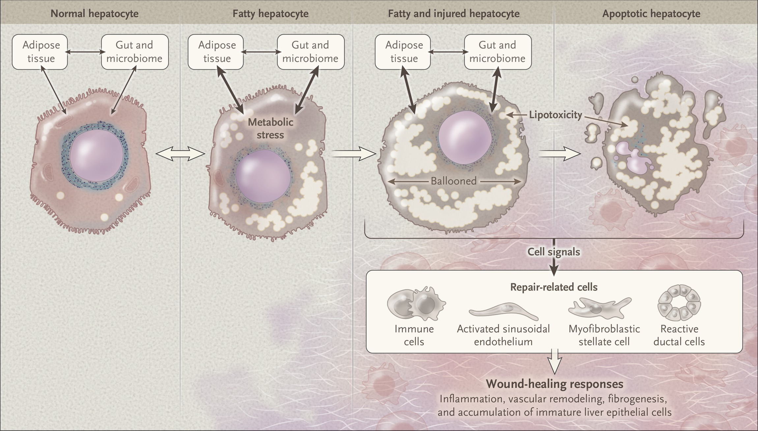
Pathogenesis of Nonalcoholic Steatohepatitis.
Diehl AM, Day C. N Engl J Med ;377:2063-2072
Notes:
Figure 2 Pathogenesis of Nonalcoholic Steatohepatitis. Various factors, including inflammation, hyperinsulinemia or insulin resistance, and altered lipid homeostasis, can induce metabolic stress, oxidative stress, and endoplasmic reticulum–related stress to develop in fatty hepatocytes (i.e., lipotoxicity). Changes from normal signaling patterns are indicated by thick double-headed arrows. When mechanisms to cope with these stresses become overwhelmed, hepatocytes die. Dying and dead hepatocytes release signals to cells that are necessary for the repair of liver damage, such as immune cells, sinusoidal endothelial cells, hepatic stellate cells, and ductal-type cells. The hepatocyte-derived, damage-associated signals cause the repair-related cells to accumulate and launch wound-healing responses, which include inflammation, vascular remodeling, fibrogenesis, and hepatic accumulation of immature liver epithelial cells. Nonalcoholic steatohepatitis is the sum of injury and repair responses triggered by lipotoxicity.

Slide 9

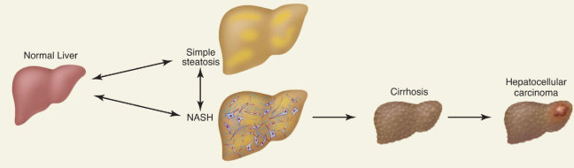
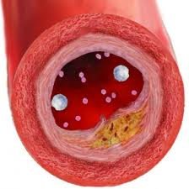

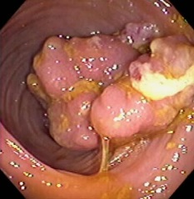
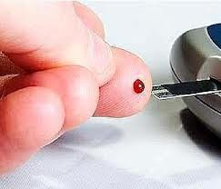
Natural History in NAFLD
Dietary Factors
Genetic
70-80%
Obesity/
IR
20-30%
Kidney Disease
Colon Cancer
Diabetes
Cardiov. Disease
Cohen et al, Science 2011
Notes:
Nel 70-80% dei casi, la NAFLD è caratterizzata dalla presenza di steatosi semplice. La steatoepatite si risocntra invece nel 20-30% dei casi, e, al contrario della semplice steatosi, può evolvere nel corso degli anni verso la cirrosi epatica e le sue complicanze

Slide 10
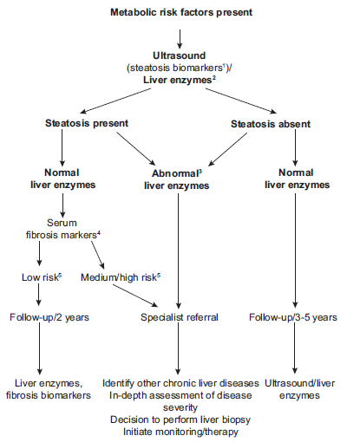
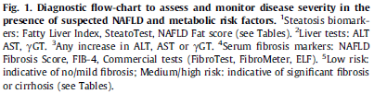
PER IDENTIFICARE LA STEATOSI
EASL-EASD-EASO NAFLD Clinical Guidelines 2016

Slide 11

PER IDENTIFICARE LA STEATOSI
Il controlled attenuation parameter (CAP) è una nuova tecnologia
che misura l’attenuazione degli ultrasuoni
generati durante la misurazione della stiffness epatica
tramite elastografia (Fibroscan)
EASL-EASD-EASO NAFLD Clinical Guidelines 2016
C. Caussy, Hepatology 2018

Slide 12

Clinical Predictors of NASH in Patients With NAFLD
Characteristic | Outcome
Advanced age^{[1]} | Greater duration of disease
Sex^{[2]} | Postmenopausal women experience accelerated disease
Race^{[3]} | ↑ Prevalence, severity in Hispanic, Asian patients; ↓ Prevalence, severity in black patients
HTN, central obesity, dyslipidemia (↑ TG, ↓ HDL), insulin resistance/diabetes^{[4]} | Risk increases with metabolic syndrome,* 66% prevalence of bridging fibrosis if older than 50 yrs of age and obese or diabetic^{[5,6]}
AST/ALT ratio > 1,^{[7]} low platelets^{[8]} | Indicators of NASH cirrhosis
Persistently elevated ALT^{[9]} | Can be associated with greater risk of disease progression
*Based on ATP III criteria.
References in slidenotes.
Slide credit: clinicaloptions.com
Notes:
ALT, alanine aminotransferase; AST, aspartate aminotransferase; ATP, Adult Treatment Panel; HDL, high density lipoprotein; HTN, hypertension; NAFLD, nonalcoholic fatty liver disease; NASH, nonalcoholic steatohepatitis; TG, triglycerides.
References
1. McPherson S, et al. Am J Gastroenterol. 2016;[Epub ahead of print].
2. Yang JD, et al. Hepatology. 2014;59:1406-1414.
3. Pan JJ, Fallon MB. World J Hepatol. 2014;6:274-283.
4. Younossi, Z M, et al. Hepatology. 2016;64:73–84.
5. Ratziu V, et al. Gastroenterology. 2000;118:1117-1123.
6. Angulo P, et al. Hepatology. 1999;30:1356-1362.
7. Neuschwander-Tetri BA, et al. Hepatology. 2010;52:913-924.
8. McPherson S, et al. Gut. 2010;59:1265-1269
9. Ekstedt M, et al. Hepatology. 2006;44:865-873.
12

Slide 13

PER IDENTIFICARE LA NASH
Elementi clinici, biochimici o strumenti di immagine
non permettono di distinguere tra NAFL e NASH
La biopsia epatica rimane il gold-standard
per la diagnosi differenziale tra NAFL e NASH
Ad oggi non vi sono strumenti non invasivi
validati per la diagnosi di NASH
EASL-EASD-EASO NAFLD Clinical Guidelines 2016

Slide 14
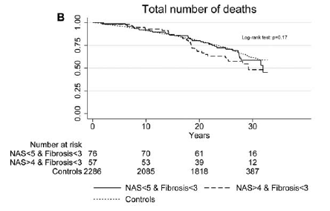
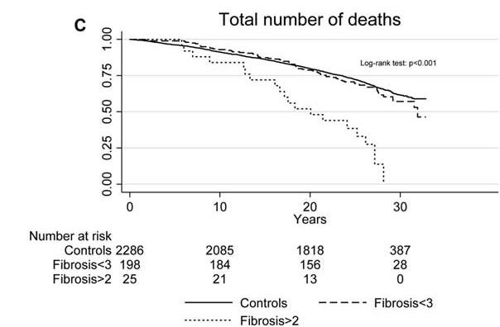
PERCHE’ E’ UTILE IDENTIFICARE LA FIBROSI ?
La fibrosi è la caratteristica prognosticamente più importante della NAFLD:
la maggior parte degli studi ha evidenziato un’associazione indipendente
tra stadio di fibrosi e mortalità globale e fegato-relata
P. Bedossa, Gastroenterology 2016
229 pazienti con NAFLD
Follow-up mediano di 26.4 anni
M. Ekstedt, Hepatology 2015

Slide 15
PER IDENTIFICARE LA FIBROSI
Diversi scores clinico-biochimici hanno mostrato
una buona accuratezza diagnostica
per l’identificazione di casi di fibrosi avanzata
Il NAFLD fibrosis score (NFS) ed il fibrosis 4 calculator (FIB-4)
sono stati validati esternamente in popolazioni di etnia differente,
con risultati riproducibili
Questi test sono utili soprattutto
per distinguere la fibrosi avanzata dalla fibrosi non avanzata (≥F3 Vs <F3)
ed il valore predittivo negativo per l’esclusione di fibrosi avanzata
è sempre superiore al valore predittivo positivo che suggerisce la stessa
Quindi, i tests clinico-biochimici possono essere utilizzati in prima linea
per escludere i casi con fibrosi avanzata

Slide 16
Noninvasive Diagnosis of Liver Fibrosis in NAFLD
Clinical or Laboratory Tests
Imaging
Simple
AST/platelet ratio index FIB-4 index NAFLD fibrosis score BARD score
Complex
NASH FibroSure ELF HepaScore
Elastography
VCTE FibroScan MR elastography ARFI
Slide credit: clinicaloptions.com
Notes:
AST, aspartate aminotransferase; ARFI, acoustic radiation force impulse; ELF, enhanced liver fibrosis; FIB-4, fibrosis-4 score; MR, magnetic resonance; NAFLD, nonalcoholic fatty liver disease; NASH, nonalcoholic steatohepatitis; VCTE, vibration-controlled transient elastography; BARD: body mass index, AST/ALT ratio, diabetes.
16

Slide 17
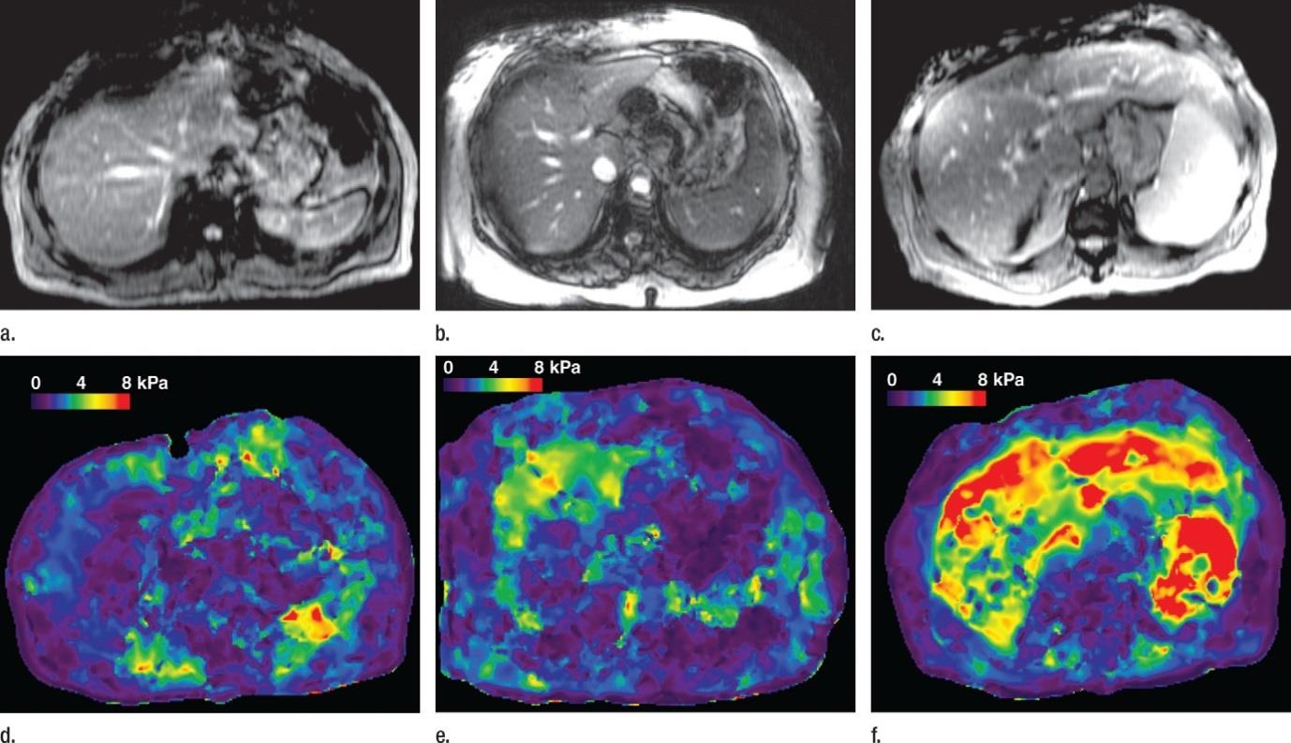

Magnetic Resonance Elastography
Stiffness^{[1]}
Low
High
Simple Steatosis
Inflammation,
But No Fibrosis
Fibrosis
In NAFLD, higher diagnostic accuracy for fibrosis vs transient elastography and CPRs,^{[2,3]} can accurately predict advanced fibrosis^{[4]}
Inflammation can increase stiffness values in the absence of fibrosis^{[1]}
Reprinted, with permission, from Radiology 2011;259:749-756. ©RSNA. References in slidenotes.
Notes:
CPR, clinical prediction rule; NAFLD, nonalcoholic fatty liver disease.
References
1. Chen J, et al. Radiology. 2011;259:749-756.
2. Imajo K, et al. Gastroenterology. 2016;150:626-637.
3. Cui J, et al. Aliment Pharmacol Ther. 2015;41:1271-1280.
4. Loomba R, et al. Hepatology. 2014;60:1920-1928.
17

Slide 18
ALGORITMO PER IDENTICARE LA FIBROSI
S. Petta, Aliment Pharmacol Ther 2017

Slide 19
NAFLD
Genetic risk profile
PNPLA3 148M/M
TM6SF2 167K+
MBOAT7 T+
APOB mutations
PNPLA3 148I+
TM6SF2 167E/E
MBOAT7 T-
Cardiovascular
Hepatic
Health risk
Treatment
Insulin sensitizers
statins?
HCC screening
PNPLA3 directed drugs?
Notes:
So, in a precision medicine approach evaluation of GRP in patients w/ NAFLD would allow the identification of two prototypes of patients: those homozygous 148M, carrying TM6SF2, MBOAT7 and APOB mutations would be a higher risk of liver disease, whereas cardiovascular complication would be more likely in the others.
This may have implications for screening, but also for treatment personalization

Slide 20
NAFLD & NASH treatment

Slide 21
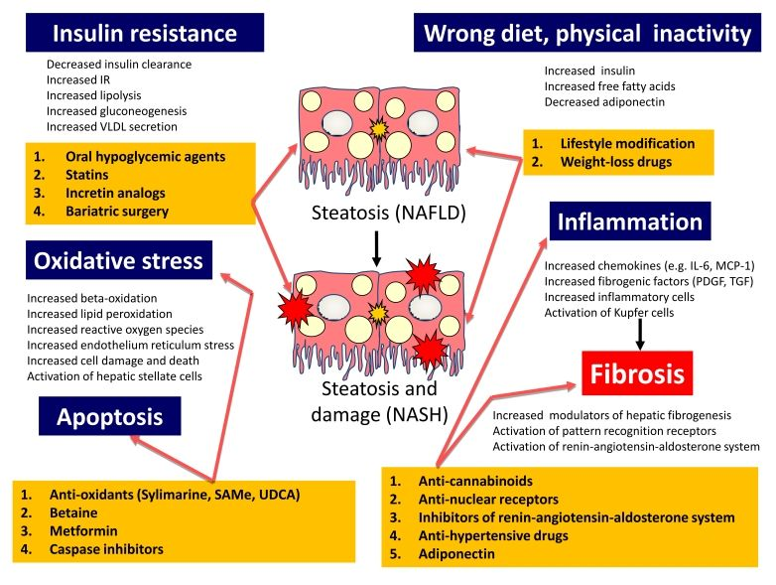
NAFLD : Pathogenetic approach to treatment

Slide 22
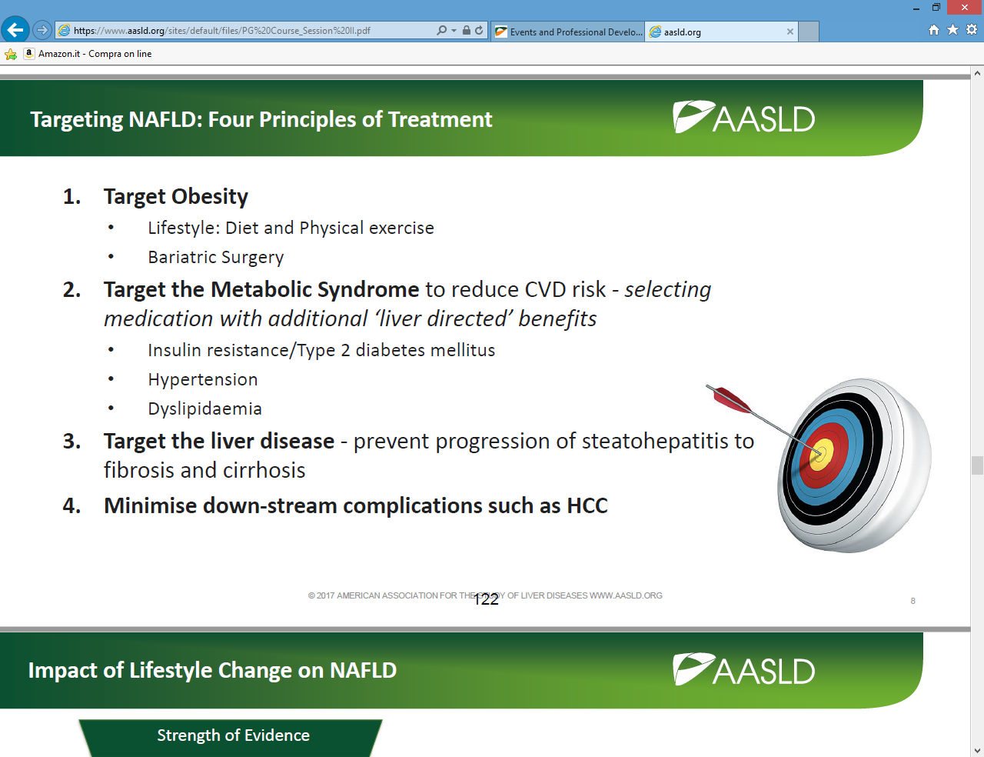
NAFLD : Clinical approach to Treatment

Slide 23
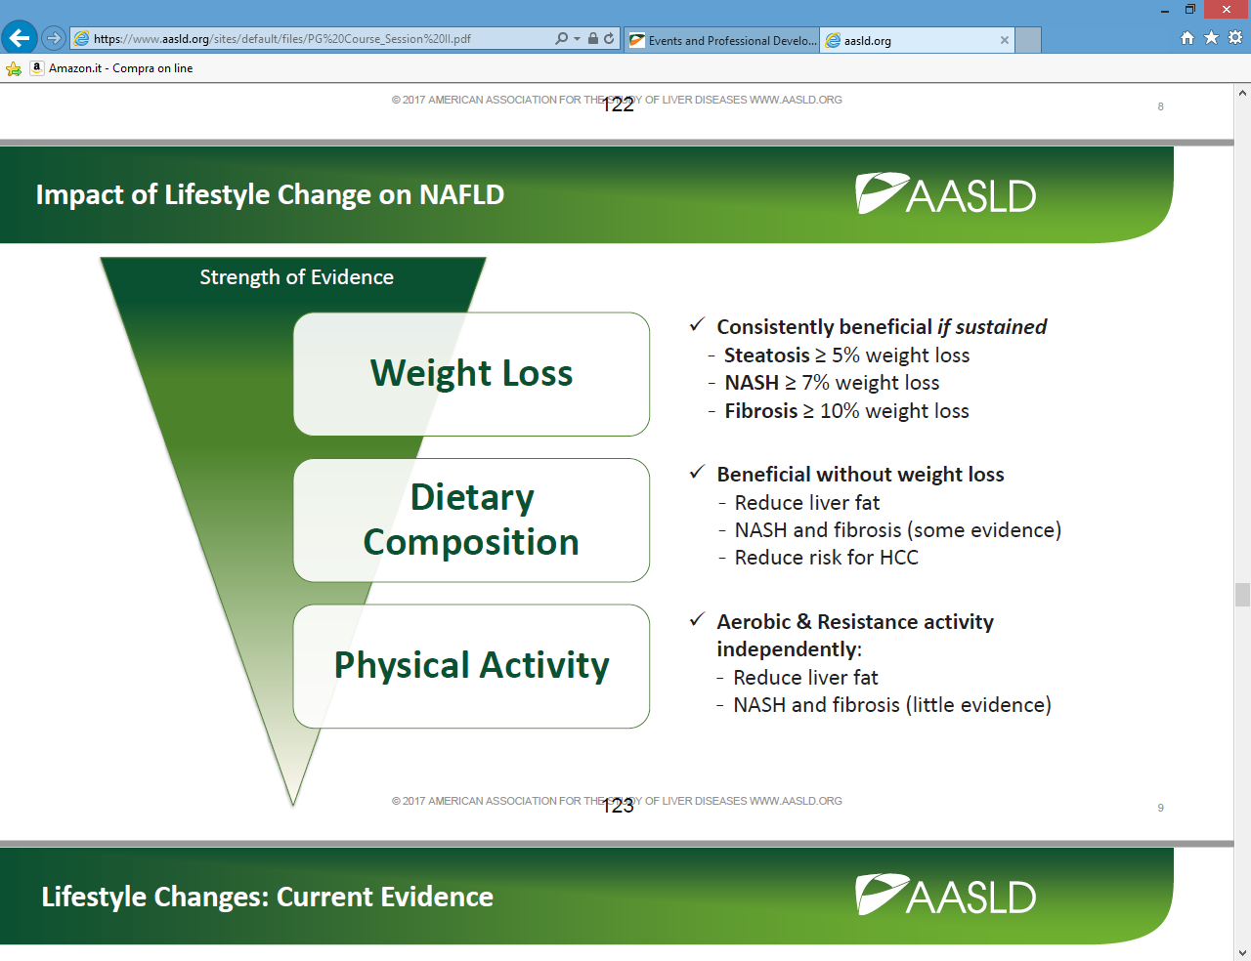

Slide 24




Weight loss via lifestyle intervention in noncirrhotic NAFL patients. Impact in liver histology based on weight loss percentage
Goal – weight loss 5-7% 7-10% ≥10%
Treatment
Intensive Lifestyle Changes
Hypocaloric diet (low fat vs. low CH)
Aerobic exercise (200 min / wks)
Behavioral therapy
How long? – 1 year
To whom?
S
E
S
Steatosis
NASH
C
C
S
U
Compliance based on weight loss (%) 12% 9% 10%
Vilar-Gomez, Romero-Gomez, Gastroenterology 2015; 149:367-378

Slide 25
Weight loss pyramid
Fibrosis
(45%)
Patients achieving:
Weight Loss ≥10%¹
<10% in 1 year¹
NASH Resolution
(64–90%)*
Weight Loss ≥7%¹
18% in 1 year¹
Ballooning / inflammation
(41–100%)*
Weight Loss ≥5%¹⁻³
30% in 1 year¹
Steatosis
(35–100%)*
Weight Loss ≥3%¹⁻⁴
*Depending on degree of weight loss
1 Vilar-Gomez E, et al. Gastroenterology. 2015;149:367-78. 2 Promrat K, et al. Hepatology. 2010;51:121-9
3 Harrison SA, et al. Hepatology. 2009;49:80-6. 4 Wong VW, et al. J Hepatol. 2013;59:536-42
Slide courtesy of S. Harrison

Slide 26
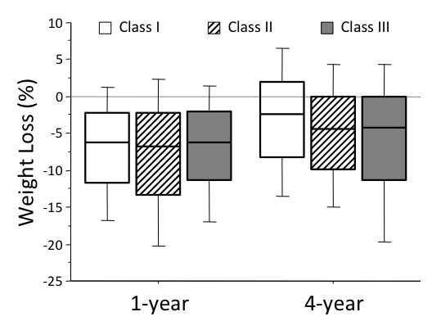
Long-term weight loss and weight loss maintenance in obesity
Long-term analysis of subjects enrolled into the QUOVADIS study
Petroni et al, submitted

Slide 27
Weight Loss Correlates to Frequency of Clinic Visits
1/100 of 1 percent
Minutes in 1 yr = 525,960
Minutes discussing weight loss and lifestyle with HCP (assuming 4 visits of 15 mins each)
Slide credit: clinicaloptions.com
Notes:
HCP, healthcare provider.
27

Slide 28
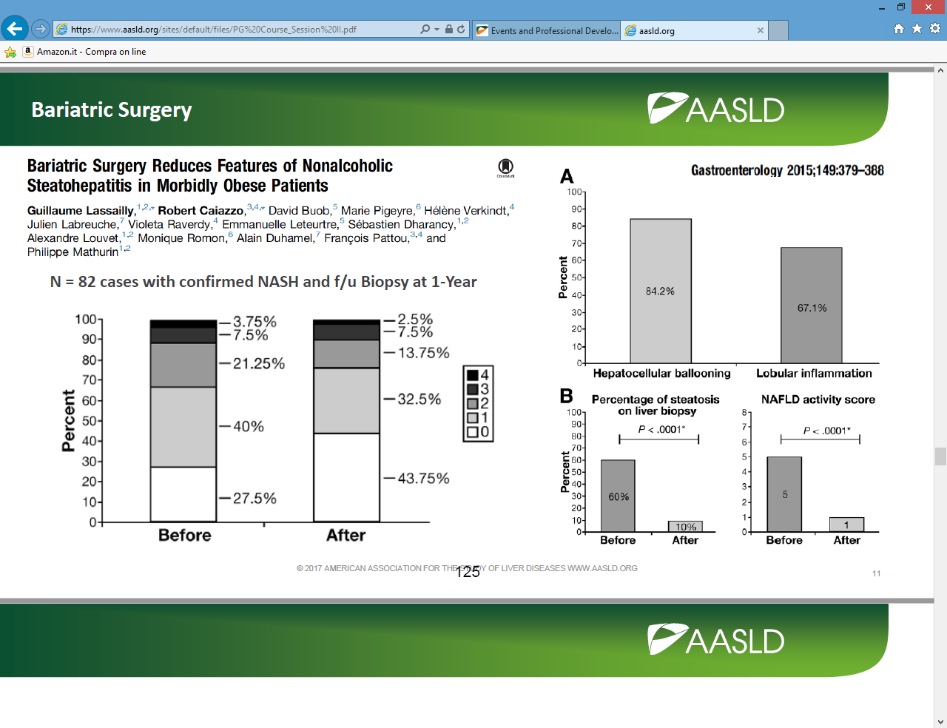

Slide 29
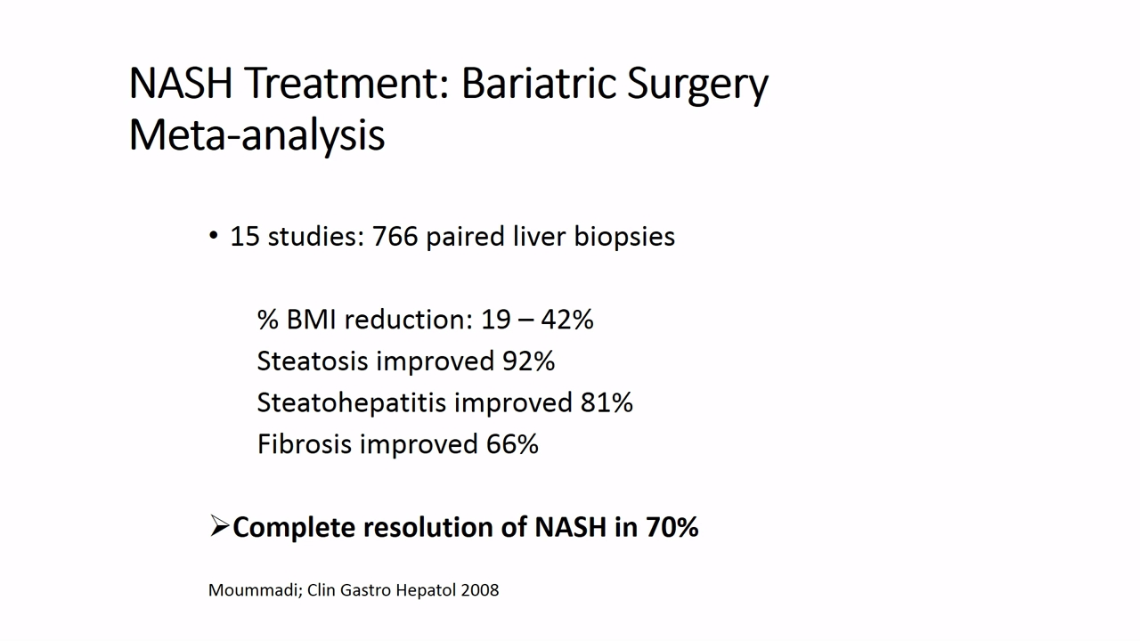

Slide 30
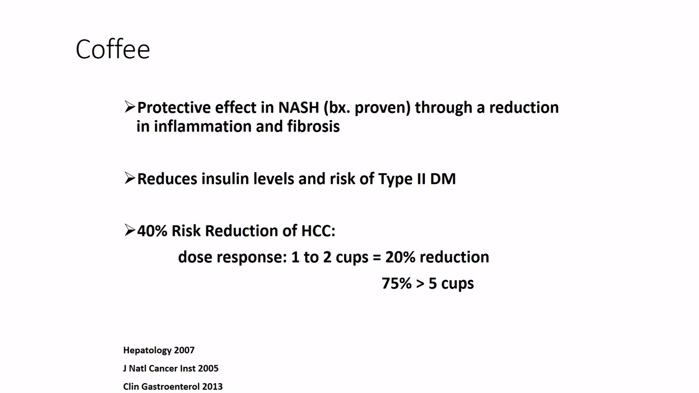

Slide 31
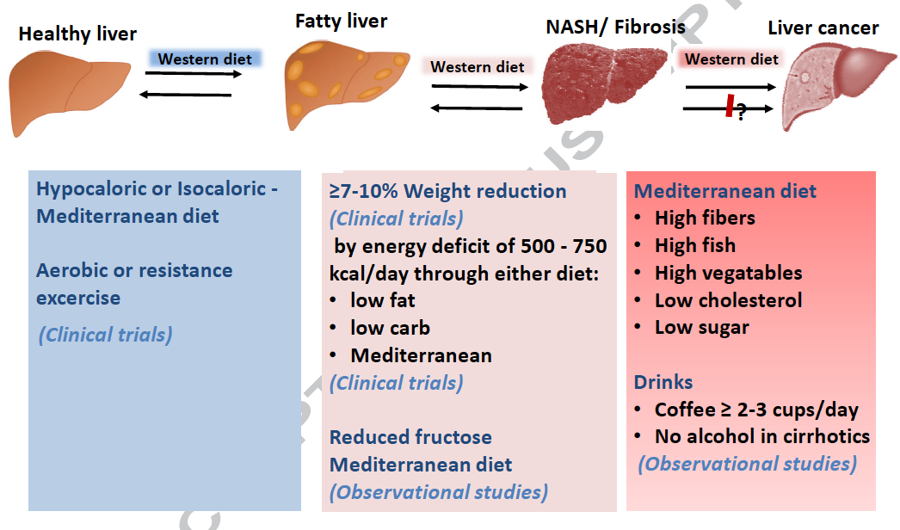
Dietary treatment options in NASH
Romero-Gomez et al., J Hepatol 2017

Slide 32
Aerobic or Resistance Exercise
R. Hashida, J Hepatol 2016

Slide 33
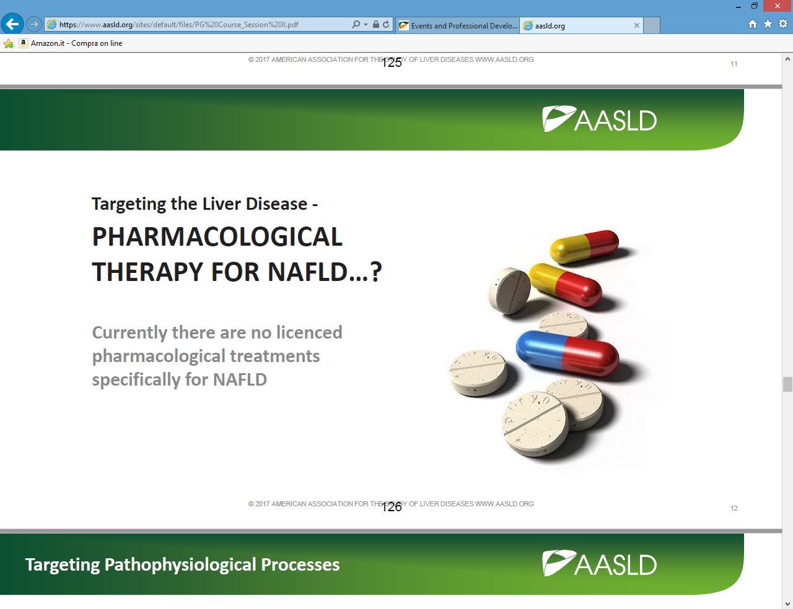

Slide 34
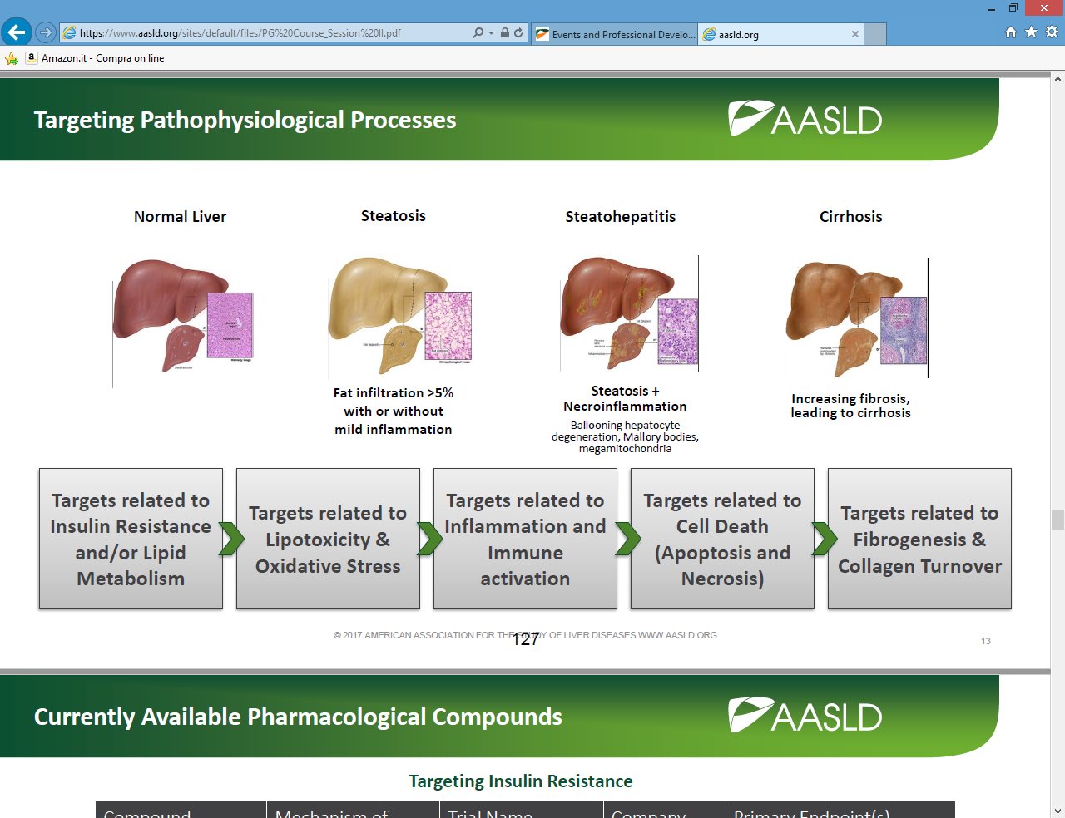

Slide 35
What drugs today ?

Slide 36
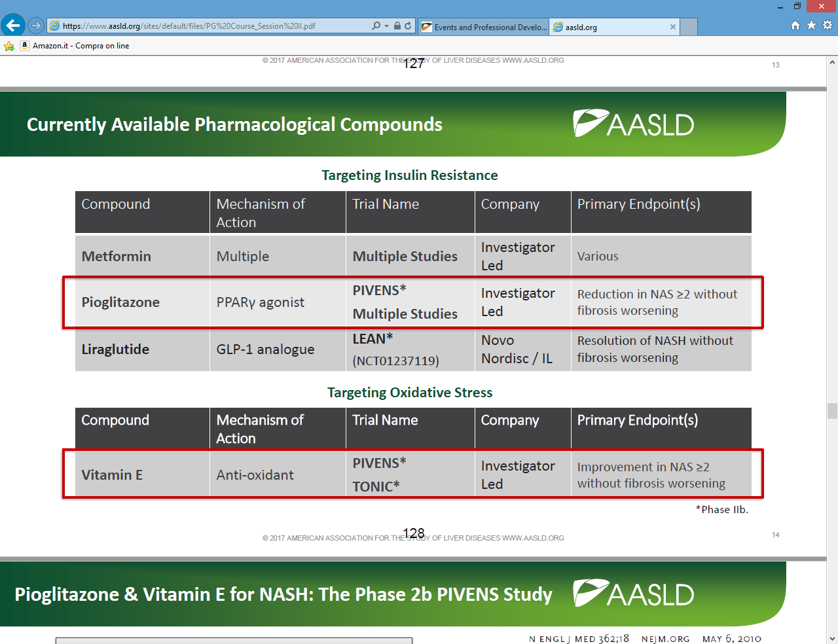

Slide 37
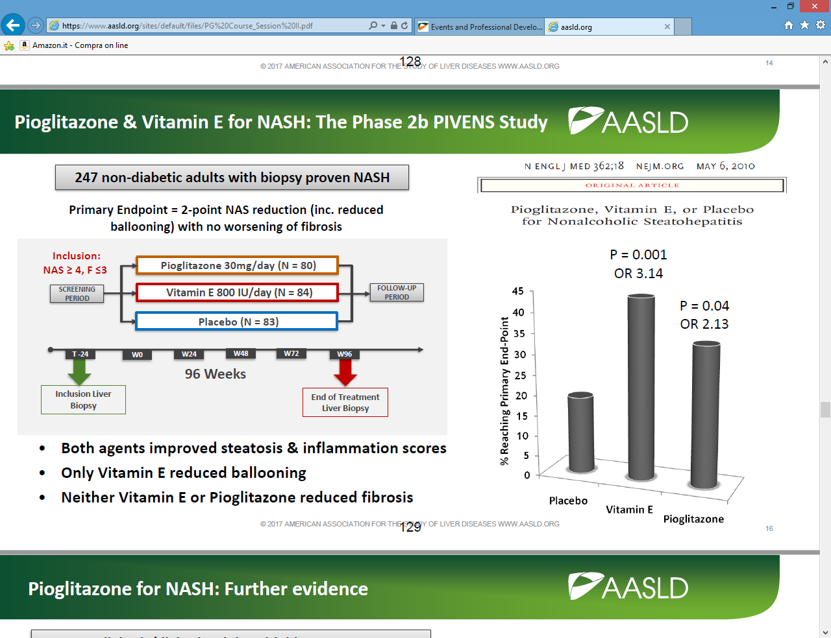

Slide 38
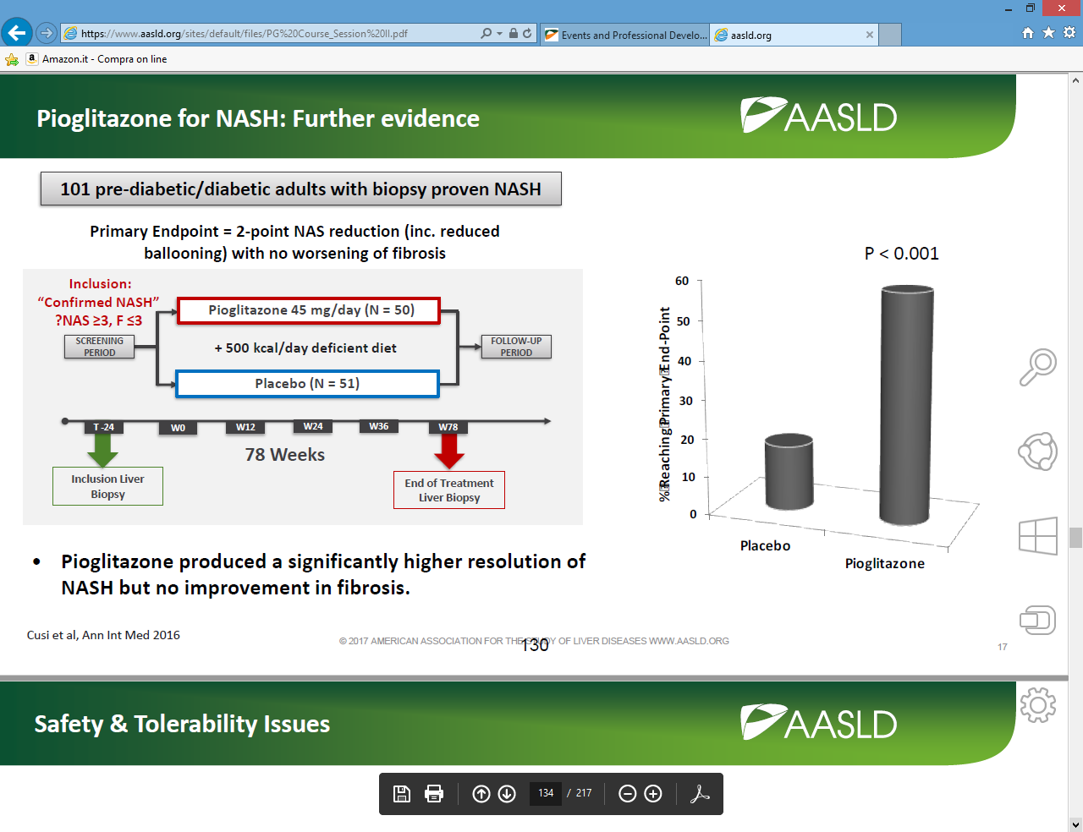

Slide 39
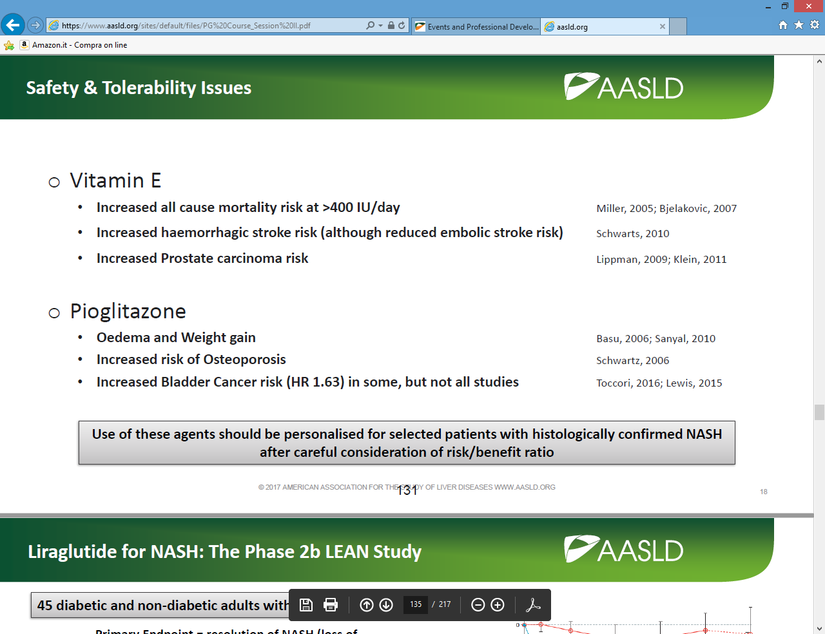

Slide 40
GLP-1 Analogues and NASH

Slide 41
LEAN: Liraglutide for 48 Wks
Randomized, double-blind phase II trial of overweight pts with NASH
100
Liraglutide (n = 23)
Placebo (n = 22)
80
P = .019
P = .05
P = .65
P = .46
P = .04
61
60
55
Pts (%)
48
39
36
40
32
26
20
14
9
9
n/N =
9/23
2/22
14/23
7/22
11/23
12/22
6/23
3/22
2/23
8/22
0
Resolution
of NASH
Improved
Ballooning
Improved
Inflammation
Improved Fibrosis
Worsened Fibrosis
Armstrong MJ, et al. Lancet. 2016;387:679-690.
Notes:
NASH, nonalcoholic steatohepatitis.
41

Slide 42
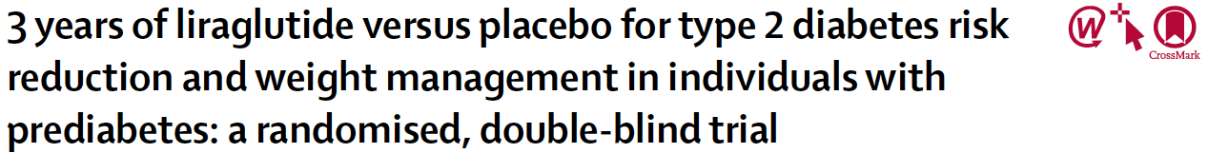
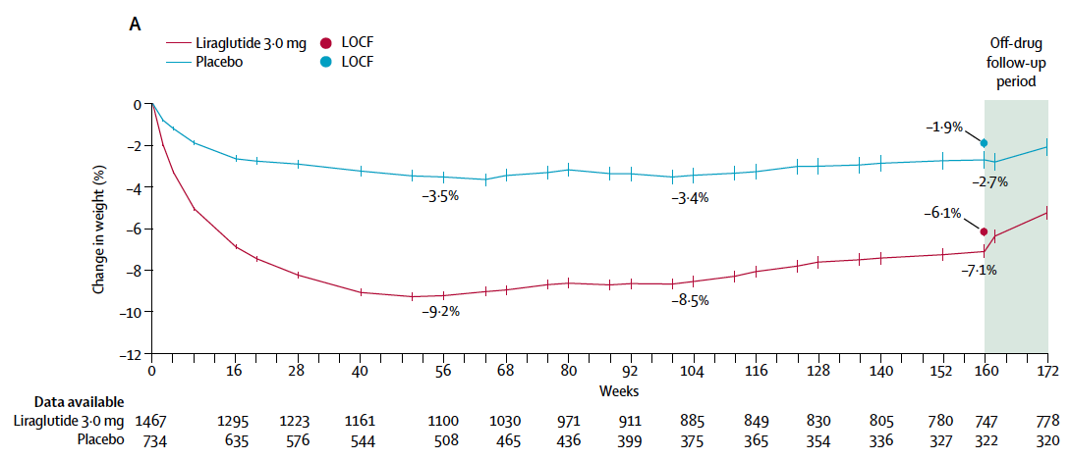
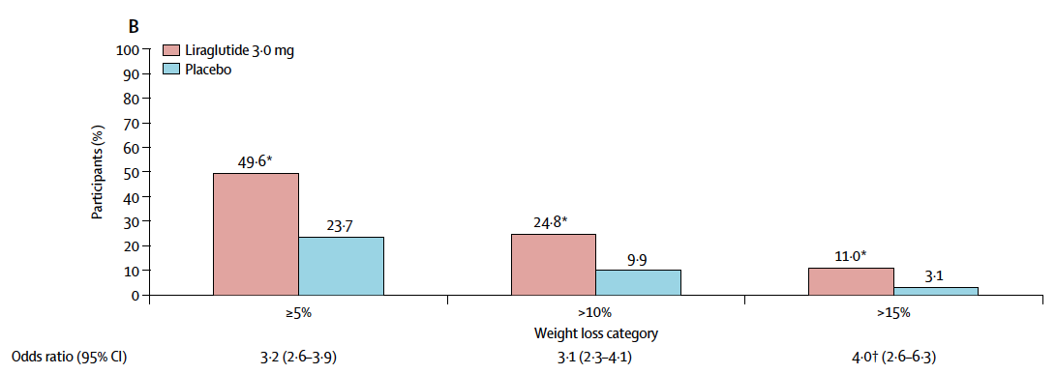
Liraglutide induced greater weight loss than PL at week 160 (–6.1% [SD 7.3] vs. –1.9% [6.3]; estimated treatment difference –4.3%, 95% CI –4.9 to –3.7, p<0.0001).
le Roux, Lancet 2017

Slide 43
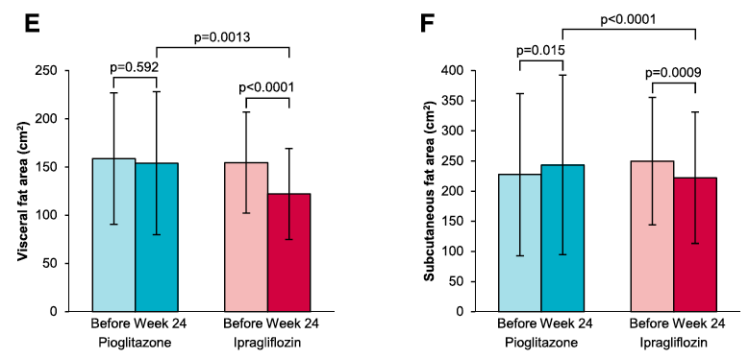
Ipragliflozin vs. Pioglitazone in T2DM
Compared with pioglitazone, ipragliﬂozin exerts equally beneﬁcial effects on NAFLD and glycemic control during the treatment of patients with type 2 diabetes compli-cated by NAFLD. Furthermore, ipragliﬂozin signiﬁcantly reduced body weight and abdominal fat area.
Ito et al, Diabetes Care 2017

Slide 44
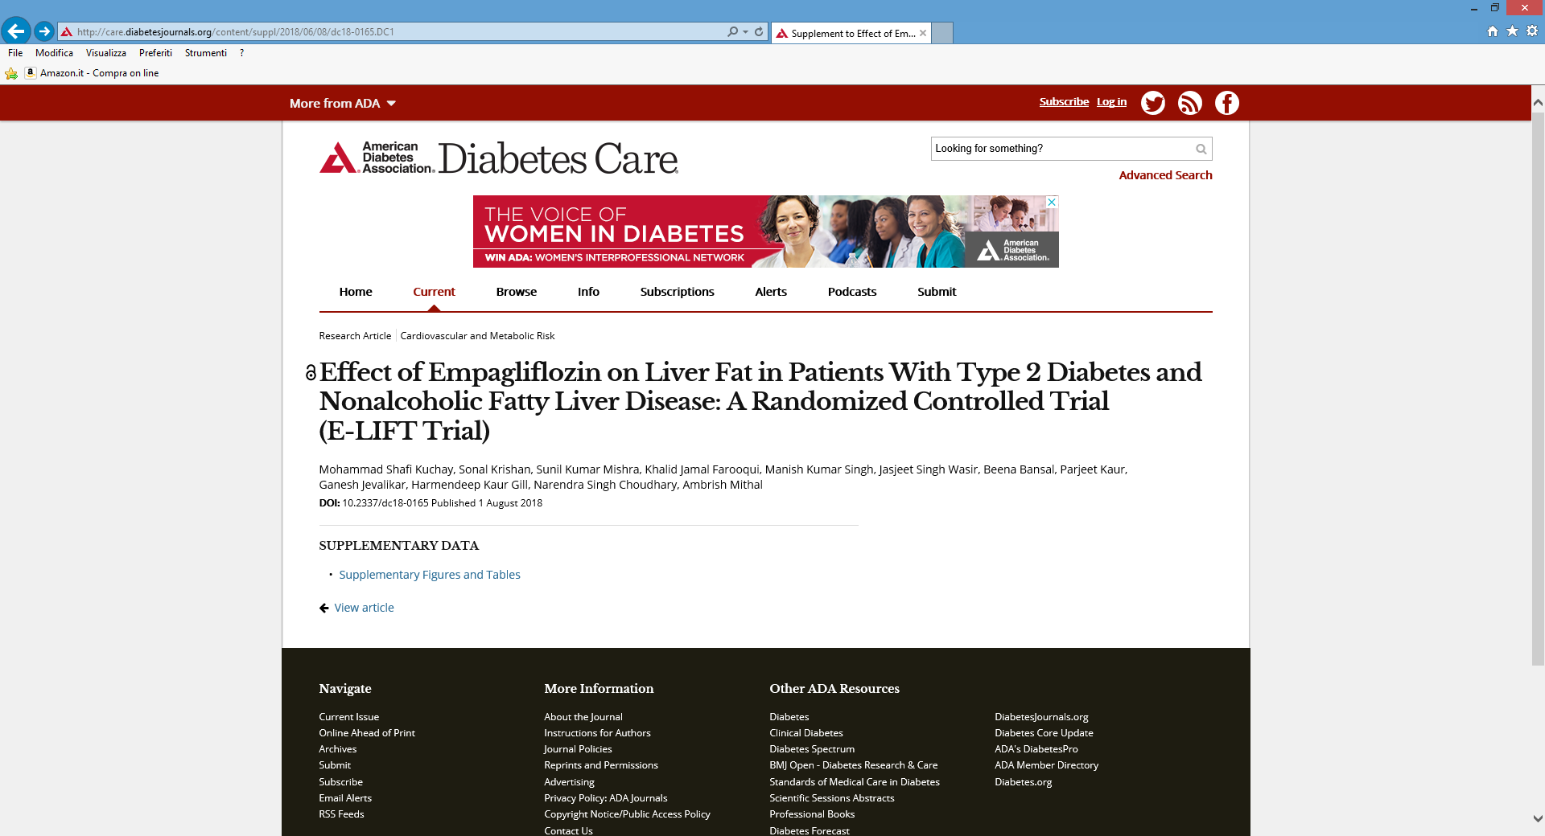
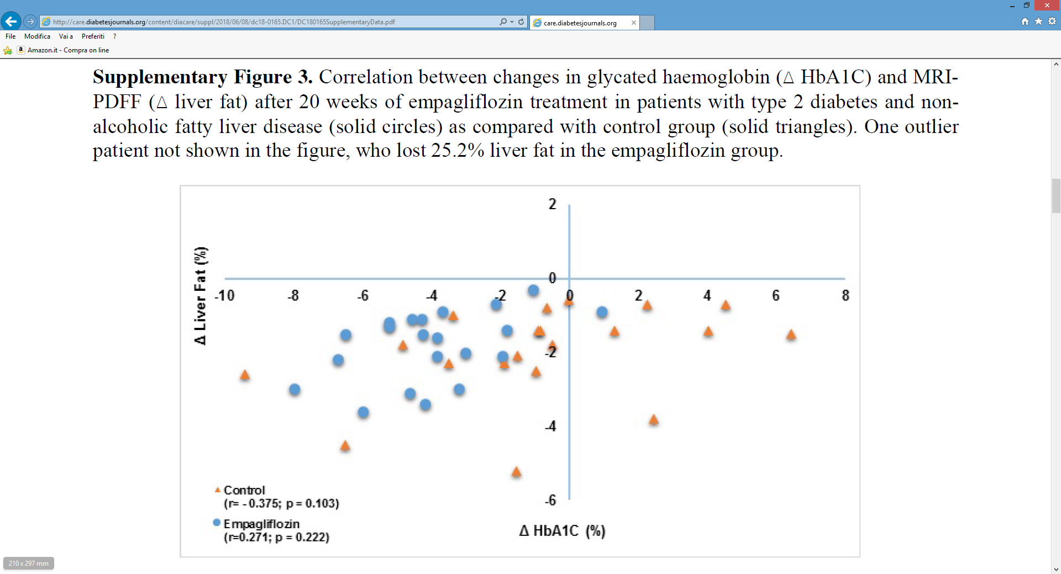

Slide 45
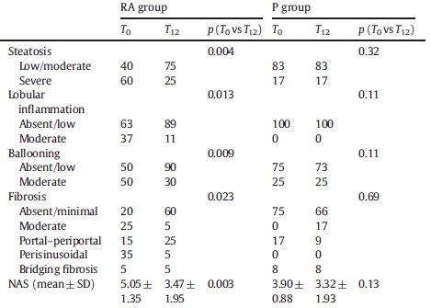
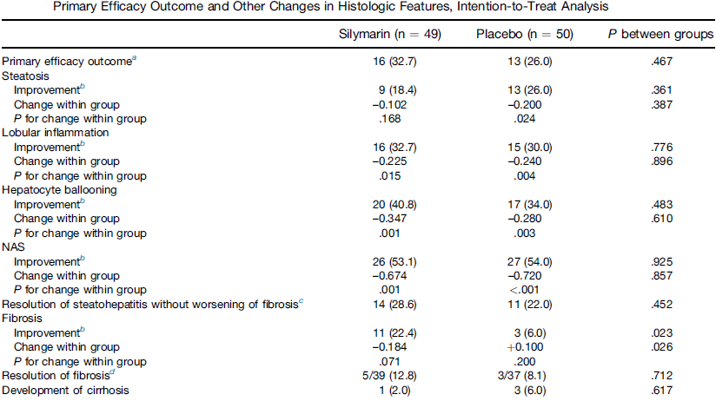
Silymarin and NAFLD
35 Patients (3 HCV):
12 months Realsil vs Placebo
99 Patients:
48 weeks Silymarin vs Placebo
Loguercio, Free Rad Biol Med 2012
Chan et al, Clin Gastr Hep 2017

Slide 46
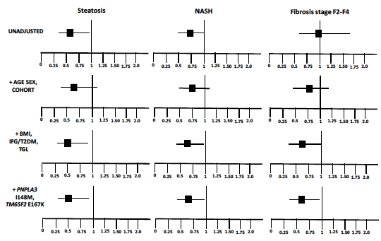
Statins: good for NAFLD
A multi-center cohort of 1201 European individuals, who underwent liver biopsy for suspected NASH. RESULTS: Statin use was recorded in 107 subjects, and was associated with protection from steatosis, NASH, and fibrosis stage F2-F4, in a dose-dependent manner (adjusted p<0.05 for all).
Dongiovanni et al; J Hepatology 2015

Slide 47
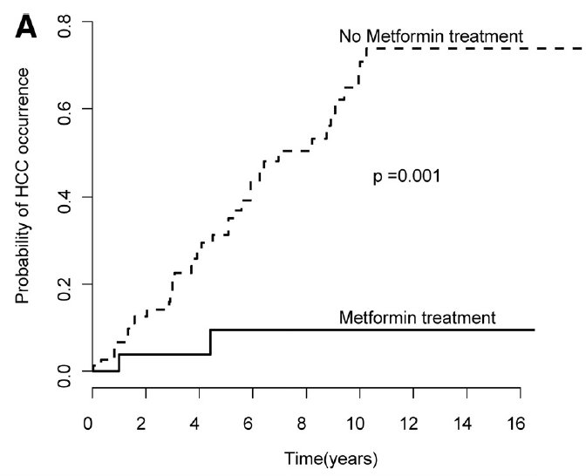
METFORMINA & HCC
La metformina ha dimostrato di ridurre il rischio di HCC
in studi clinici osservazionali
G. Nkontchou, J Clin Endocrinol Metab 2011
Ogni anno di utilizzo della metformina è stato associato ad una riduzione del 7% del rischio di HCC in epatopatie a diversa eziologia
H.P. Chen, Gut 2013

Slide 48
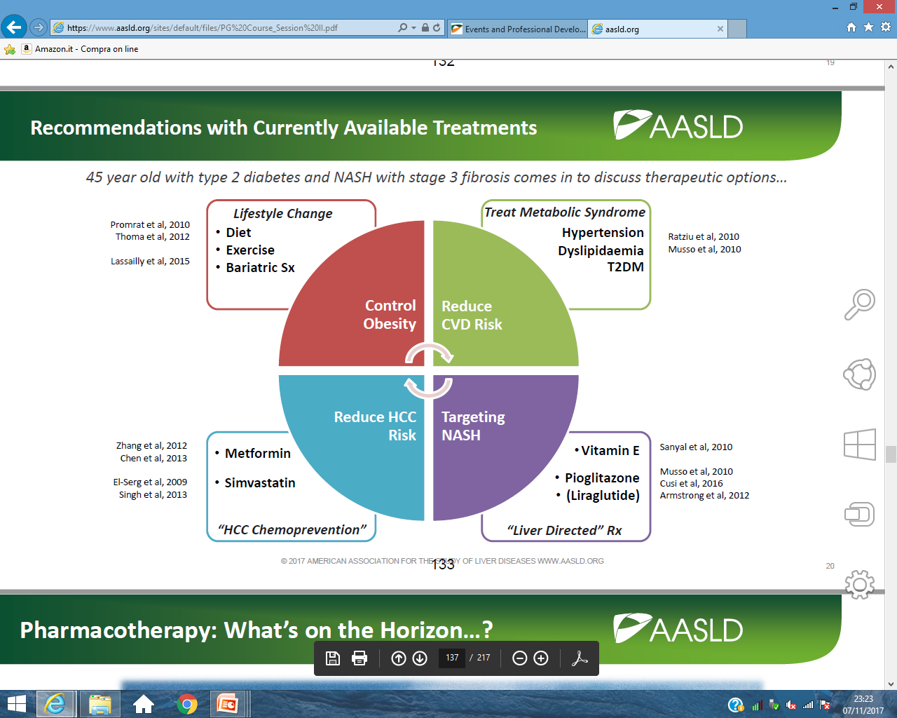

Slide 49
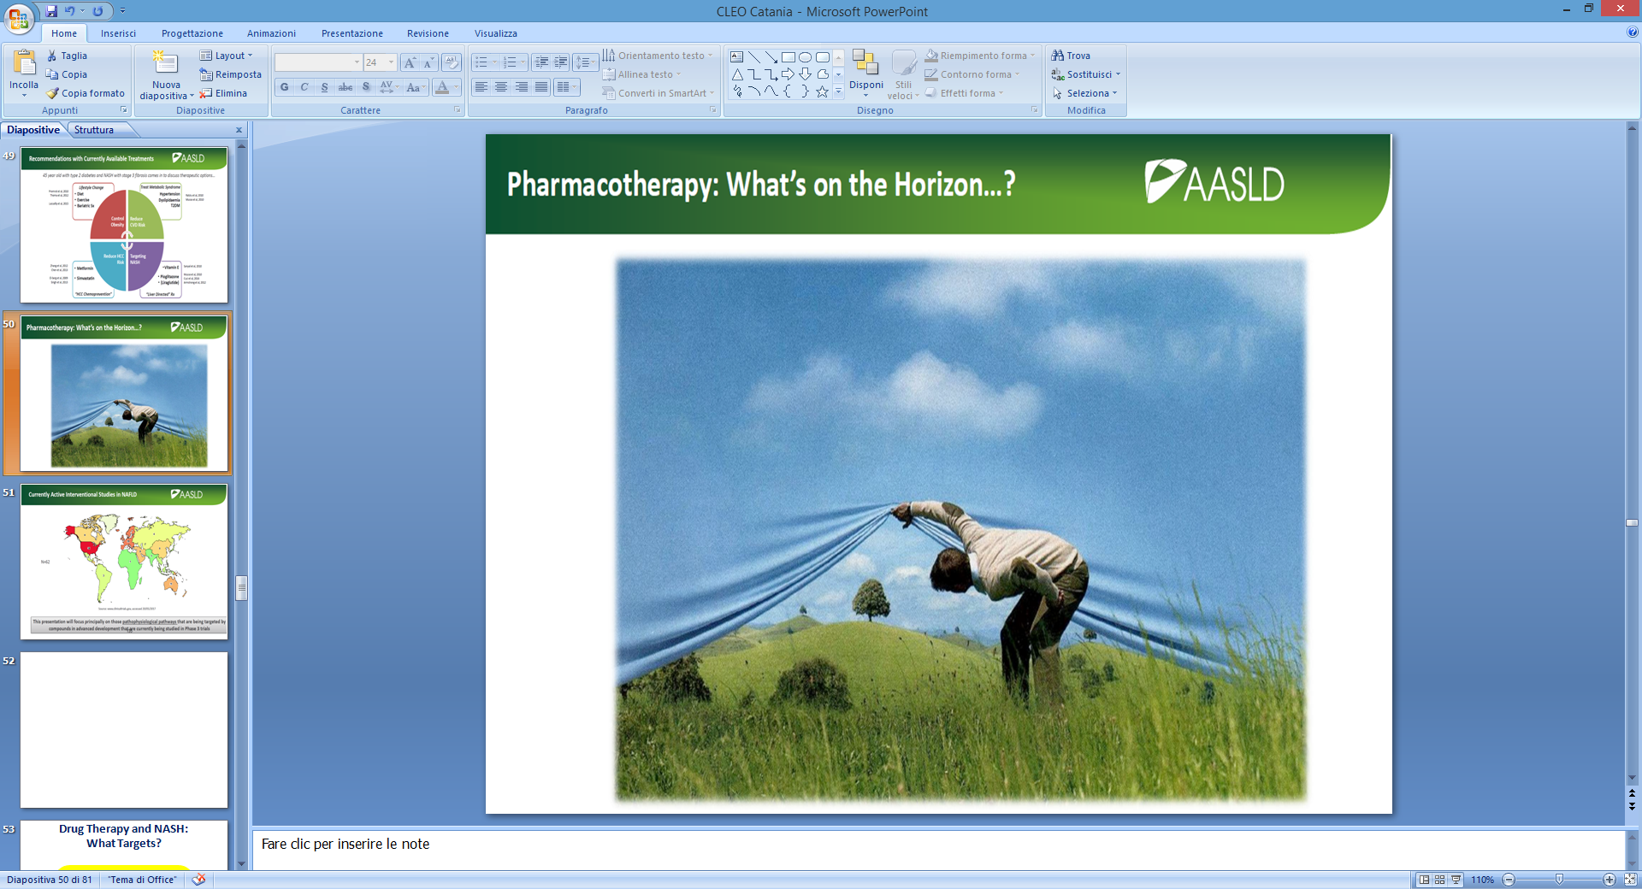
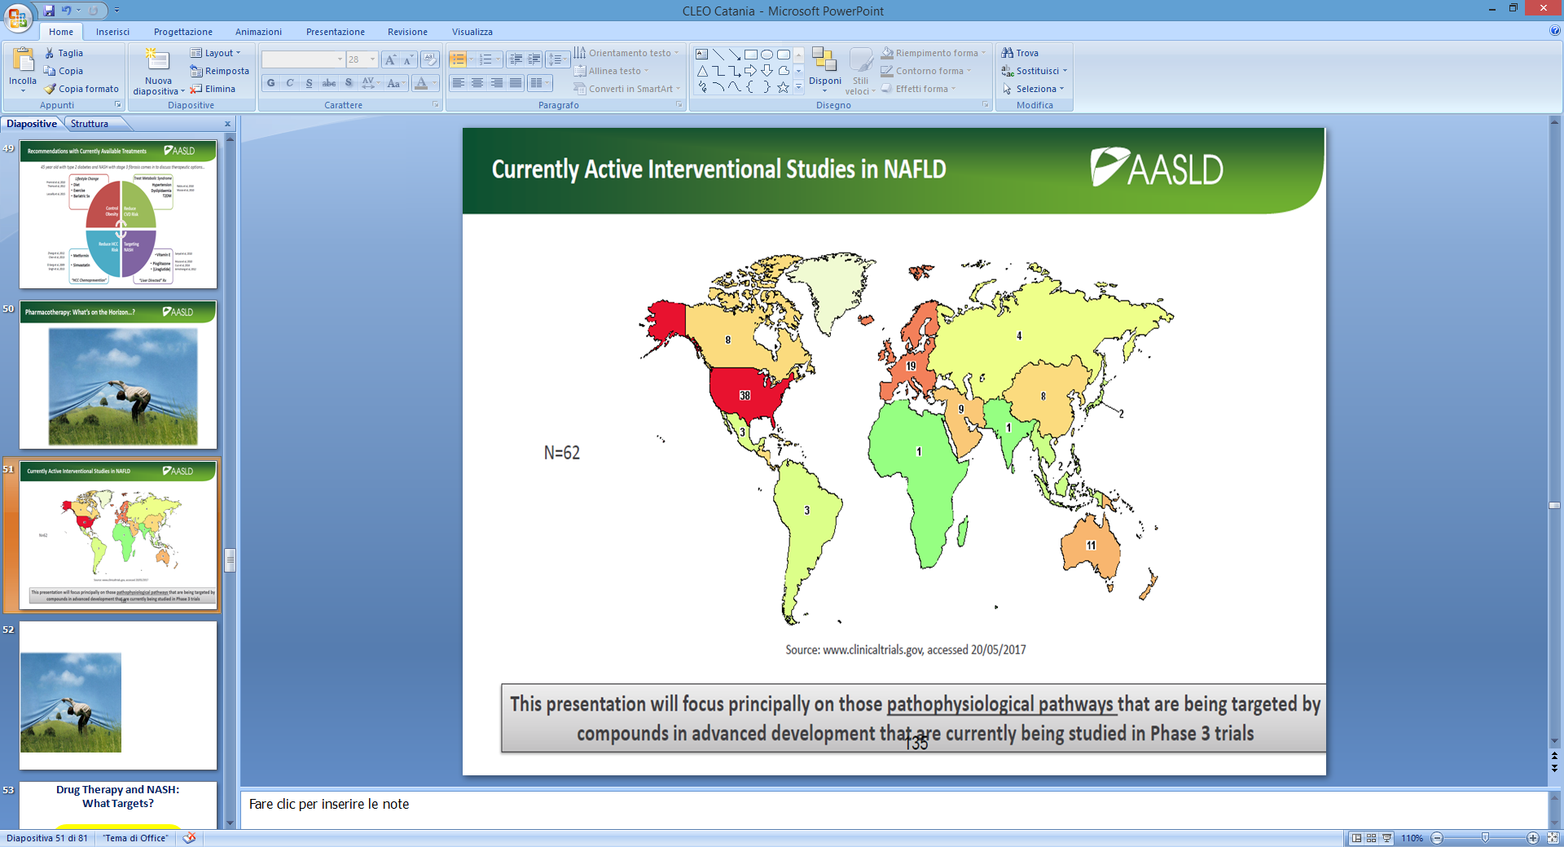
Pharmacotherapy: what’s on the horizon ?

Slide 50
Drug Therapy and NASH:
What Targets?
Drugs on
Phase III Trials

Slide 51
Agonisti ( Ligandi ) di
Fattori di trascrizione nucleare

Slide 52
Drug Therapy and NASH:
What Targets?
Rotman et al, GUT 2016

Slide 53
FXR and NAFLD

Slide 54
FLINT Study:
The Farnesoid X Receptor Ligand OCA in NASH Treatment Trial
72 weeks
Histological Improvement also confirmed in patients at high risk and after stratifying for baseline fibrosis
Neuschwander-Tetri et al, Lancet 2014

Slide 55
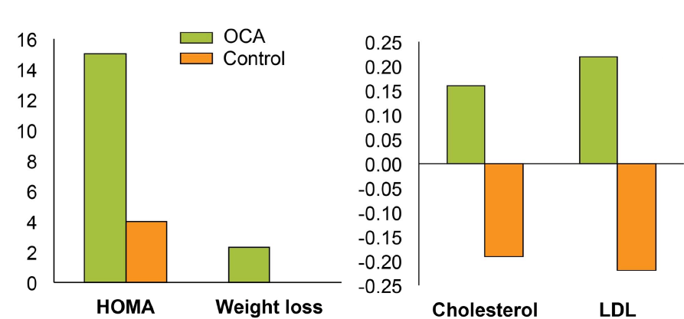
FLINT Study:
The Farnesoid X Receptor Ligand OCA in NASH Treatment Trial
Manage Pruritus
OCA : Attesa dei risultati dello studio REGENERATIVE ( 2019 )
Neuschwander-Tetri et al, Lancet 2014

Slide 56
PPARs as Targets for NASH
PPAR-α
PPAR-γ
PPAR-α/δ
⬆ β-oxidation^{[1]}
⬇ Steatosis^{[1]}
⬇ Steatosis^{[2]}
⬆ Insulin sensitivity^{[1]}
⬇ Inflammation^{[1]}
⬆ β-oxidation^{[4]}
⬇ Hepatic steatosis^{[5]}
⬆ Insulin sensitivity^{[5]}
Inflammation^{[4]}
Fibrosis^{[4]}
⬇ Dyslipidemia^{[4]}
Less effective for NAFLD in humans
Adverse events^{[3]}
? Safety concerns
Clinical data in MetS^{[4]}
Clinical data in NASH^{[5]}
Exploitable drug targets: PPARα/∂ (Elafibranor) and PPARα/∂/γ (IVA337)
References in slidenotes.
Slide credit: clinicaloptions.com
Notes:
MetS, metabolic syndrome; NASH, nonalcoholic steatohepatitis; PPAR, peroxisome proliferator-activated receptor.
References:
1. Anderson N, et al. Pharmacol Rev. 2008;60:311-357.
2. Moran-Salvador E, et al. FASEB J. 2011;25:2538-2550.
3. Wright MB, et al. Mol Endocrinol. 2014;28:1756-1768.
4. Ratziu V. Nat Rev Gastroenterol Hepatol. 2013;10:676-685.
5. Ratziu V, et al. Gastroenterology. 2016;150:1147-1159.

Slide 57
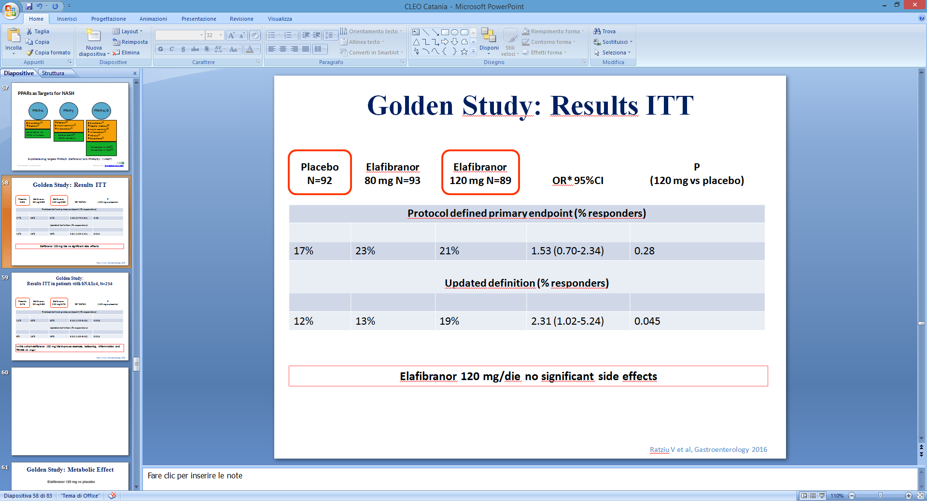
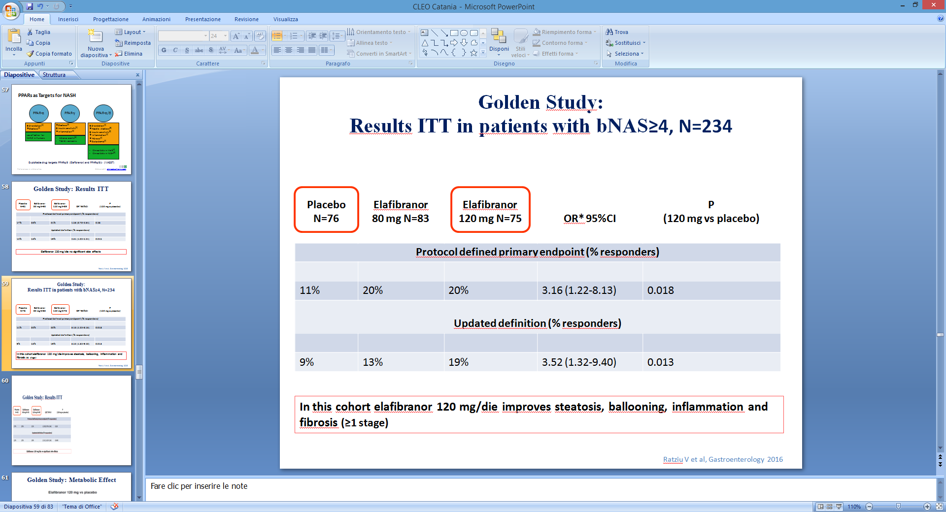
PHASE 3 Study to Evaluate the Efficacy and Safety of Elafibranor Versus Placebo in Patients with NASH

Slide 58
Golden Study: Metabolic Effect
Ratziu V et al, Gastroenterology 2016

Slide 59
Drug Therapy and NASH:
What Targets?
Rotman et al, GUT 2016

Slide 60
Cenicriviroc and NASH

Slide 61
Cenicriviroc and NASH:
1 year results
P = 0.0234
P = 0.4941
Complete Resolution of NASH AND No Worsening of Fibrosis
Improvement in Fibrosis Stage AND No Worsening of NASH
Friedman et al, Hepatology 2018

Slide 62
Cenicriviroc (CVC), a CCR2 and CCR5 inhibitor, in patients with NASH: Phase 2b CENTAUR study Year 2 analysis
Study design
Randomized, double-blind, placebo-controlled;
3 serial biopsies: Screening, Year 1 and 2
N=289 adults with NASH (NAS ≥4; F1–3)
Results
Arm A: CVC (150 mg qd) for 2 years (n=121)
Arm B: Placebo Year 1; cenicriviroc Year 2 (n=61)
Arm C: Placebo for 2 years (n=60)
n for patients who entered Year 2
Durability of antifibrotic response
(Responseª from Year 1 to Year 2) (mITT)
More CVC-treated patients achieved improvement in fibrosis by ≥2 stages AND no worsening of NASH
(Response from baseline to Year 2)
Worsened
Patients (%)
No change
Placebo
(Arm C) (n=34)
Maintained ≥1-stage improvement
Patients (%)
NS
CVC (Arm A) (n=65)
PBO
(n=10)
CVC (Arm A)
(n=30)
2x CVC-treated patients achieving ≥1-stage fibrosis improvement at Year 1 maintained benefit at Year 2 vs. placebo, particularly in Stage 3 fibrosis
Further supports Cenicriviroc’s antifibrotic MoA
Conclusions
Cenicriviroc was well tolerated and provided antifibrotic activity in adults with NASH
and liver fibrosis; Year 2 exploratory analyses supported Year 1 primary endpoint findings
Phase 3 evaluation of cenicriviroc for treatment of liver fibrosis associated with NASH
is underway (NCT03028740)
ª ≥1-stage fibrosis improvement
Ratziu V, et al. ILC 2018, #1368 (GS-002)
Notes:
Abbreviations: CCR, C-C chemokine receptor; MoA, mode of action; NAS, Nonalcoholic fatty liver disease Activity Score; NASH, nonalcoholic steatohepatitis; NS, not significant; PBO, placebo; qd, once daily

Slide 63
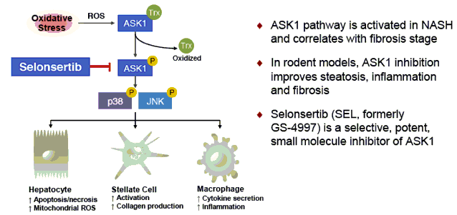
Selonsertib and NASH

Slide 64
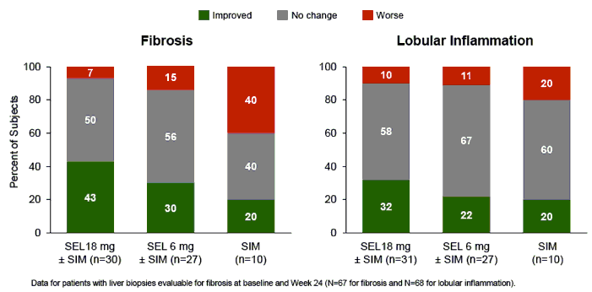
Selonsertib and NASH
24 weeks
Loomba et al, Hepatology 2018

Slide 65
Drug Therapy and NASH:
What Targets?
Drugs on
Phase I-II Trials

Slide 66
FGF-21 Analogues and NASH

Slide 67
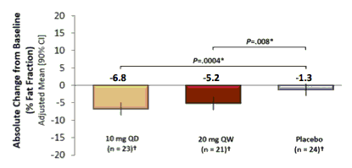
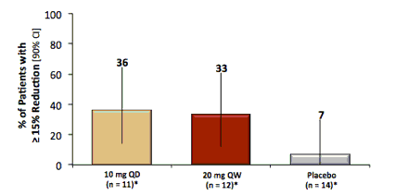
FGF-21 Analogues and NASH: 16 weeks of therapy
Fat
Reduction
Stiffness
Reduction
Sanyal et al, EASL 2017

Slide 68

FGF-19 Analogues and NASH

Slide 69

FGF-19 Analogues and NASH
Increase in LDL Levels
Harrison et al, EASL 2017; EASL 2018

Slide 70

Acetyl-CoA Carboxylase Inhibitor :
It’s fundamental in pathophysiology of NASH ?

Slide 71

Acetyl-CoA Carboxylase Inhibitors
and NASH:12 weeks of Therapy
AASLD 2017

Slide 72


IVA337 : A new generation pan-PPAR agonist
Improves insulin sensitivity
Normalises lipid and adiponectin levels
IVA337
PPARα, δ, γ agonist
Reverses established fibrosis
Inhibits
steatosis
Blocks inflammation
Wettstein et al., EASL 2016, PS068

Slide 73
TARGET : GUT MICROBIOTA
Il microbiota intestinale è implicato nella patogenesi della NAFLD/NASH,
ed il LPS gioca un ruolo chiave in questo contesto
IMM-124e: estratto di colostro ricco di IgG da bovini immunizzati contro LPS
Trattamento per os con IMM-124e in topi ob/ob
migliora enzimi epatici ed insulino-sensibilità e riduce il grasso intra-epatico
(T Adar, Clin Exp Immunol 2012)
In uno studio pilota su 10 pazienti con NASH, il trattamento con IMM-124e per 30 giorni
ha mostrato migliorare la sensibilità insulinica e lievemente anche gli enzimi epatici
(M Mizrahi, J Inflamm Res 2012)
E’ in corso un RDBPCT in pazienti con NASH per valutare l’effetto di 24 settimane
di trattamento con IMM-124e su grasso epatico (RM-Sp) ed enzimi epatici
NCT02316717
Il trapianto di microbiota intestinale da soggetti magri
ha mostrato di migliorare l’insulino-sensibilità in pazienti con sindrome metabolica
(A Vrieze, Gastroenterology 2012)
E’ in corso un studio pilota in pazienti con NASH non cirrotica
teso a valutare gli effetti di questo trattamento
sul grasso intra-epatico e sui livelli di enzimi epatici
NCT02469272

Slide 74
Combination Therapy for NASH
ASK-1 Inhibitor/Cenicriviroc +
FXR Agonist
Elafibranor + Obeticolic Acid
FGF-21 Agonist + GLP-1 Agonist
A-CoA Carb. Inhibitor + FXR Agonist

Slide 75

NASH Combination Therapy:
A Proof of Concept
EASL 2018

Slide 76

NASH Combination Therapy:
A Proof of Concept

Slide 77
Key NASH Therapies:
Resolution of NASH
Results from separate studies, not head to head
  Time points and populations may differ between studies
Active therapy
Placebo
100
85
80
P = .001
60
P = .019
P = .05
47
P = .01
P = .49
Pts (%)
P = .08
39
40
36
29
21
21
9
22
5
8
6
20
2/
22
13
29/
80
15/
72
33/
70
15/
72
9/
23
22/
102
13/
98
9/
31
2/
39
11/
145
8/
144
70/
82
n/N =
0
Vitamin E 800 IU/day^{[1]}
Pioglitazone 30 mg/day^{[1]}
Liraglutide 1.8 mg/day^{[2]}
Obeticholic Acid 25 mg/day^{[3]}
Elafibranor 120 mg/day^{[4]}
Cenicriviroc
150 mg/day^{[5]}
Bariatric Surgery^{[6]}
Notes:
NASH, nonalcoholic steatohepatitis.
References:
1. Sanyal AJ, et al. N Engl J Med. 2010;362:1675-1685.
2. Armstrong MJ, et al. Lancet. 2016;387:679-690.
3. Neuschwander-Tetri BA, et al. Lancet. 2015;385:956-965.
4. Ratziu V, et al. Gastroenterology. 2016;150:1147-1159.
5. Sanyal AJ, et al. AASLD 2016. Abstract LB-1.
6. Lassailly G, et al. Gastroenterology. 2015;149:379-388.

Slide 78
Key NASH Therapies:
Improvement in Fibrosis
Results from separate studies, not head to head
  Time points and populations may differ between studies
Active therapy
Placebo
100
80
P = .24
P = .12
60
P = .004
Pts (%)
44
41
P = .46
P = .02
40
31
31
35
34
26
20
19
20
14
10
n/N =
33/
80
22/
72
31/
70
22/
72
6/
23
3/
22
36/
102
19/
98
No data
29/
145
15/
144
27/
80
0
Vitamin E 800 IU/d^{[1]}
Pioglitazone 30 mg/d^{[1]}
Liraglutide 1.8 mg/d^{[2]}
Obeticholic Acid 25 mg/d^{[3]}
Elafibranor 120 mg/d^{[4]}
Cenicriviroc
150 mg/d^{[5]}
Bariatric Surgery^{[6]}
Notes:
NASH, nonalcoholic steatohepatitis.
References:
1. Sanyal AJ, et al. N Engl J Med. 2010;362:1675-1685.
2. Armstrong MJ, et al. Lancet. 2016;387:679-690.
3. Neuschwander-Tetri BA, et al. Lancet. 2015;385:956-965.
4. Ratziu V, et al. Gastroenterology. 2016;150:1147-1159.
5. Sanyal AJ, et al. AASLD 2016. Abstract LB-1.
6. Lassailly G, et al. Gastroenterology. 2015;149:379-388.

