Slide 1
Second-line systemic therapies

Slide 2
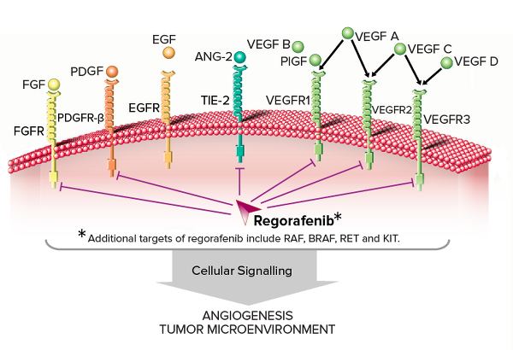
Regorafenib: Oral Multikinase Inhibitor Targeting Multiple Tumor Pathways
    Cl
    O
    O
    O
    N
    H
    F
    N
    H
    N
    H
    N
    F
    F
    F
    Regorafenib
Inhibition of proliferation
Inhibition of tumor microenvironment signaling
Inhibition of
neoangiogenesis
    KIT
    PDGFR
      RET
    PDGFR-β
    FGFR
    VEGFR1-3
    TIE2
1. Wilhelm SM, et al. Int J Cancer. 2011;129:245-255.
2. Mross K, et al. Clin Cancer Res. 2012;18:2658-2667.
3. Strumberg D, et al. Expert Opin Investig Drugs. 2012;21:879-889.
Notes:
SD, standard deviation.

Slide 3
RESORCE: Regorafenib in HCC After Progression on Sorafenib
BCLC stage B or C pts who could not benefit from resection, local ablation, or chemoembolization
Documented radiological progression while receiving sorafenib
Tolerability of previous sorafenib, defined as receiving sorafenib
≥ 400 mg/day for at least 20 of the last 28 days of treatment
ECOG PS 0/1
Child-Pugh A liver function
2-wk washout period recommended after discontinuing sorafenib
Bruix J, et al. Lancet. 2017

Slide 4
RESORCE: Efficacy
100
100
80
80
60
60
Probability of Survival (%)
Regorafenib
Probability of PFS (%)
Regorafenib
40
40
20
Placebo
20
Placebo
0
0
3
6
9
12
15
18
21
24
27
30
33
0
0
3
6
9
12
15
18
21
24
27
30
33
Mos From Randomization
Mos From Randomization
Endpoint | Regorafenib (n = 379) | Placebo (n = 194)
Median OS, mos | 10.6 | 7.8
Median PFS, mos | 3.1 | 1.5
Median TTP | 3.2* | 1.5*
ORR, % | 10.6† | 4.1†
HR 0.63; 95% CI: 0.50-0.79; P < .0001
*HR 0.44; 95% CI: 0.36-0.55; P < .001; †P = .005
Bruix J, et al. Lancet. 2017
Notes:
m, modified; RECIST, Response Evaluation Criteria in Solid Tumors.

Slide 5
RESORCE: Safety
AE, % | Regorafenib (n = 379) | Placebo (n = 194)
Any ≥ grade 3 AE | 79.7 | 58.5
Hypertension | 15.2 | 4.7
Hand–foot syndrome | 12.6 | 0.5
Fatigue | 9.1 | 4.7
Diarrhea | 3.2 | 0
Dose modifications due to AEs | 68.2 | 31.1
Deaths occurring ≤ 30 days after last dose | 13.4 | 19.7
Bruix J, et al. Lancet. 2017
Notes:
DCR, disease control rate; SD, stable disease; TTP, time to progression.

Slide 6
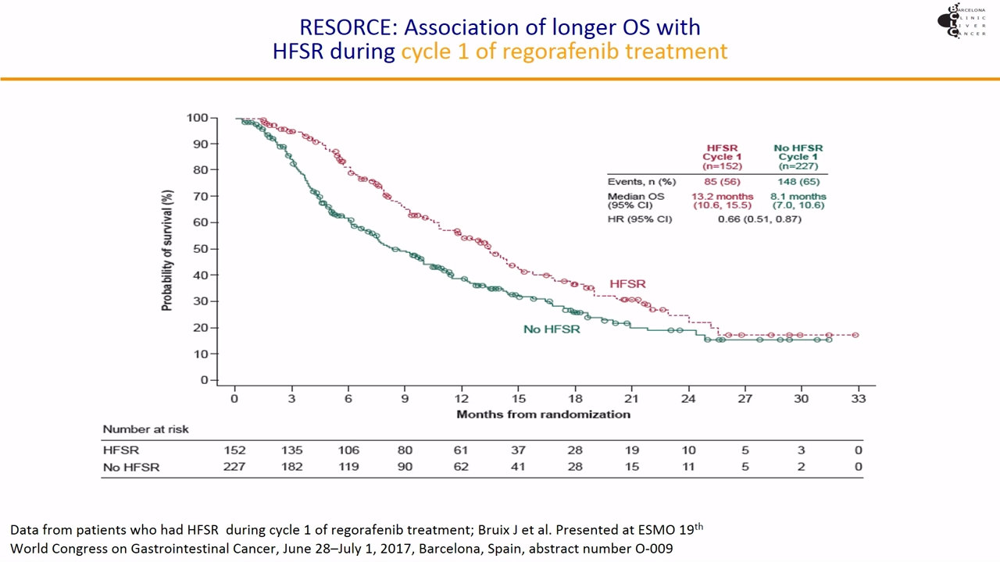
RESORCE: Association of longer OS with HFSR

Slide 7
Comparison of mOS between TACE
and SORAFENIB-REGORAFENIB sequential therapy
Kudo M, Liver Cancer 2017

Slide 8
Median OS:
- Sorafenib 24.7 months
- TACE 13.6 months
Arizumi T, Liver Cancer 2015

Slide 9
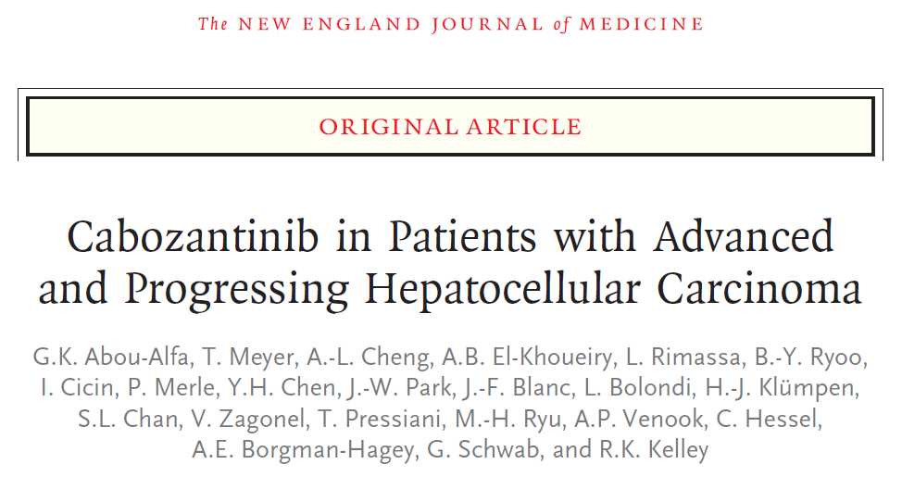
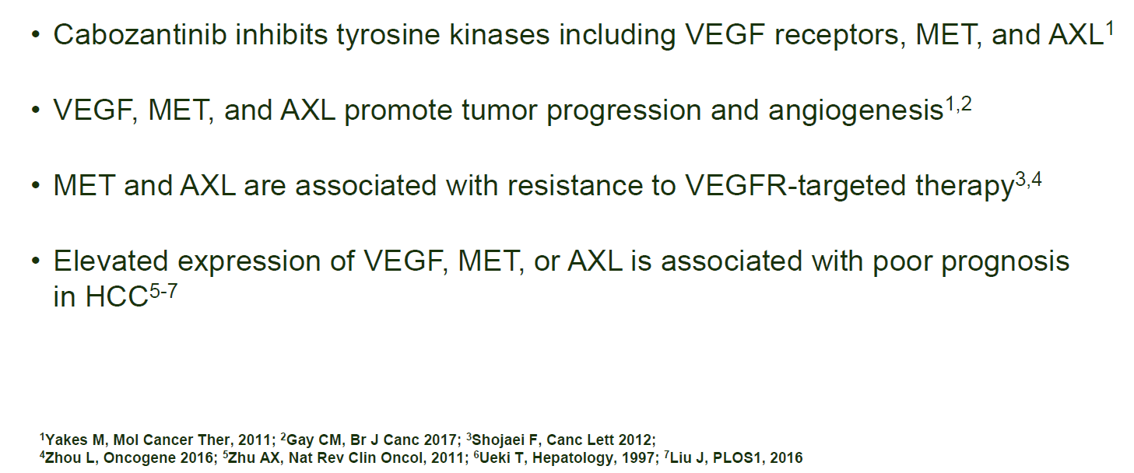

Slide 10
CELESTIAL Study Design
Abou-Alfa GK, NEJM 2018

Slide 11
CELESTIAL Baseline Characteristics
Abou-Alfa GK, NEJM 2018

Slide 12
CELESTIAL Overall Survival
Abou-Alfa GK, NEJM 2018

Slide 13
CELESTIAL PFS (RECIST 1.1)
Abou-Alfa GK, NEJM 2018

Slide 14
CELESTIAL Safety
Abou-Alfa GK, NEJM 2018

Slide 15
VEGF and VEGFR-2–mediated signaling and angiogenesis are important in CRC tumor growth and are established therapeutic targets.
Ramucirumab is a recombinant human IgG1 monoclonal antibody that binds to the extracellular domain of VEGFR-2, preventing ligand binding and receptor activation.
Ramucirumab is the first drug that showed a survival benefit
in a biomarker-selected population
Zhu A et al, 2018 ASCO Annual Meeting

Slide 16
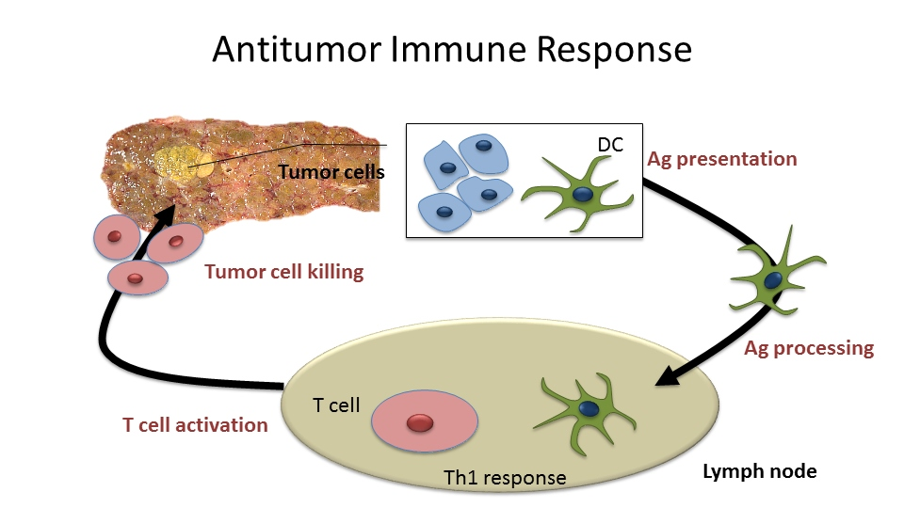
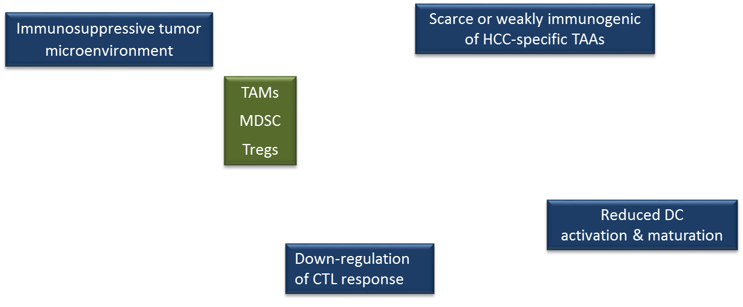
Immunotherapy may be effective in HCC

Slide 17
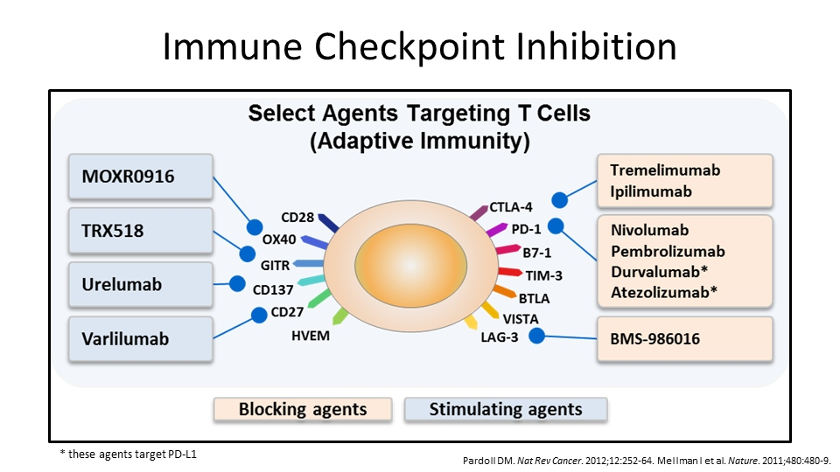

Slide 18
Nivolumab in Sorafenib-Experienced Pts With HCC ± HCV or HBV: Efficacy
Objective response of 14.5% (independent of PD-L1 expression), with 57% of responses
in ≤ 3 mos
Outcome | Infection Status
 | HCV (n = 30) | HBV (n = 43) | Uninfected (n = 72)
Objective response, n (%)* Complete Partial Stable disease Progressive disease Not evaluable | 6 (20.0) 1 (3.3) 5 (16.7) 9 (30.0) 11 (36.7) 4 (13.3) | 6 (14.0) 1 (2.3) 5 (11.6) 14 (32.6) 22 (51.2) 1 (2.3) | 9 (12.5) 0 9 (12.5) 37 (51.4) 23 (31.9) 3 (4.2)
Median time to response, mos (range) | 2.1 (1.2-7.0) | 2.0 (1.2-6.8) | 4.0 (2.6-6.8)
1-yr OS, % (95% CI) | 67.1 (46.2-81.4) | 55.6 (39.6-69.0) | 59.7 (47.4-70.0)
*By BICR using RECIST v1.1.
Sangro B, et al. EASL 2017. Abstract GS-010.
Notes:
BICR, blinded independent central review; HCC, hepatocellular carcinoma; OS, overall survival; RECIST, Response Evaluation Criteria in Solid Tumors.

Slide 19
Nivolumab in Sorafenib-Experienced Pts With HCC ± HCV or HBV: Safety
Safety profile consistent with other tumor types, with most ALT/AST elevations reversible
Endpoint, n (%) | Infection Status
 | HCV (n = 30) | HBV (n = 43) | Uninfected (n = 72)
Study treatment discontinuation Progression Toxicity | 22 (73) 17 (57) 2 (7) | 35 (81) 34 (79) 0 | 59 (82) 51 (71) 2 (3)
Treatment-related AE* Grade 3/4 | 25 (83) 9 (30) | 30 (70) 4 (9) | 53 (74) 11 (15)
Grade 3/4 ALT increase | 1 (3) | 0 | 2 (3)
Grade 3/4 AST increase | 2 (7) | 0 | 2 (3)
*In ≥ 5% pts: fatigue, pruritus, rash, diarrhea, nausea, dry mouth, decreased appetite.
No SVR in HCV-infected pts
No anti–HBs seroconversion in HBV-infected pts
Sangro B, et al. EASL 2017. Abstract GS-010.
Notes:
AE, adverse event; HBs, hepatitis B surface; HCC, hepatocellular carcinoma; OS, overall survival; SVR, sustained virologic response.

Slide 20
Immune Checkpoint Inhibitors tested in HCC

Slide 21
Treatmet strategy for systemic therapy for HCC
Kudo M, Liver Cancer 2018

Slide 22
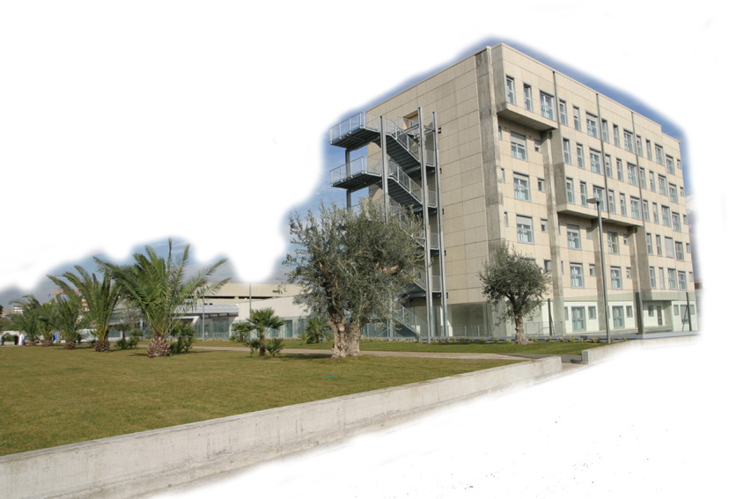
Grazie per l’attenzione !
UOD di EPATOLOGIA
R.Benigno
R.Faulisi
C.Cocuzza
C.Trovato
A.Bellia
M.Cannavò

