Slide 1
Epatiti autoimmuni e
Sindromi da overlap
Basilio Fimiani
Nocera Inferiore (SA)

Slide 2
Autoimmune diseases of the liver
Le malattie autoimmuni del fegato sono un modello di epatopatia in cui concomitano processi immunologicamente mediati diretti contro gli epatociti e o i colangiociti (autoimmunità) e autoanticorpi diagnostici (autoreattività) e che successivamente portano alla fibrosi e alla cirrosi.

Slide 3
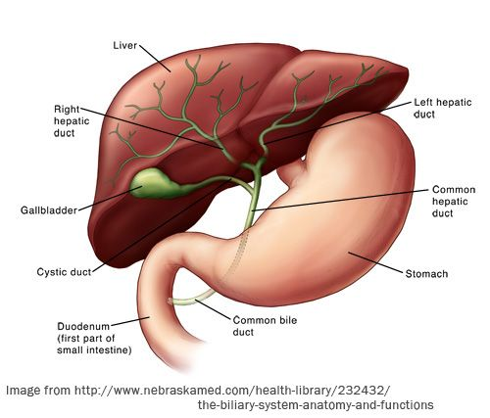
Autoimmune diseases of the liver
Main categories:
- Autoimmune Hepatitis (AIH)
- Primary Bliary Cholangitis (PBC)
Intrahepatic ducts
- Primary Sclerosing Cholangitis (PSC)
- Overlap syndrome
- ″De Novo″ Autoimmune Hepatitis (AIH)
- IgG4 related to sclerosing cholangitis

Slide 4
Pathogenesis
Not yet fully known
Immune-regulation abnormalities
-Impairment of regulatory T-cells (T-regs) as key
factor permitting uncontrolled immune responses
to autoantigens
Longhi MS et al. J Immunol 2006
Genetic predisposition
Locus HLA DR B1:
-HLA DR3,DR4,DQ2 (AIH type 1)
-HLA DR3,DR7 (AIH type 2)
Increased HUBASH3A protei levels (PSC)
Trigger factors:
- infectious agents: HCV >AIH type2,
CMV, HSV
- drugs: AntiTNF, statins, minocycline
- toxics

Slide 5
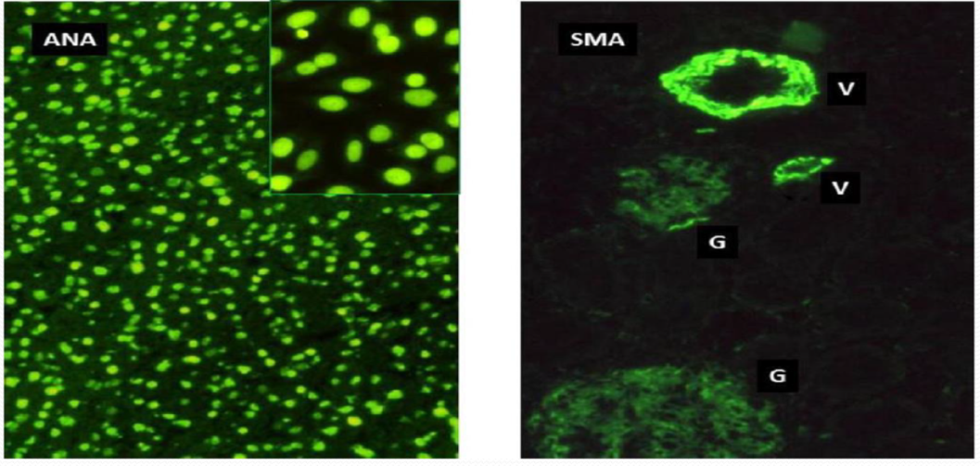

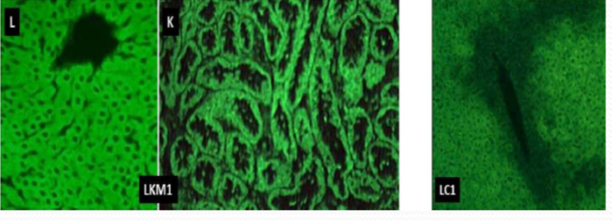

Autoimmune Hepatitis (AIH) classification
Type-1
Associated with the presence of autoantibodies to the nucleus (ANA) and / or anti-smooth muscle (ASMA)
Type- 2
Associated with the presence of either anti liver kidney microsomal-1 (LKM) they are directed against cytochrome P450 (CYP) 2D6; anti-LC1 (anti-hepatic cytosol)
Type- 3
Similar to type I. Associated with the presence of anti-soluble liver (SLA) / soluble liver-pancreas antigen (LP); more severe variant. (Not recognized as a nosological entity separated from the IAIHG)
(Other types of antibodies: anti-ASGPR (asialoglycoprotein)
pANCA (anti-neutrophil cytoplasmic)

Slide 6
Autoimmune Hepatitis (AIH)
Mode of presentation
ANA/SMA LKM1
Acute hepatitis: 50% 65%
Insidious onset: (ALF) 38% 25%
Complications of HP 12% 10%

Slide 7
Extrahepatic autoimmune disease associated with AIH
Thyroiditis | 10%-23%
Diabetes type 1 | 7%-9%
Rheumatoid arthritis | 2-5%
Celiac disease | 1-2%
Vitiligo Glomerulonephritis Sjogren's syndrome IPT, AIHA

Slide 8
Autoimmune Hepatitis (AIH)
Similarities between type I and typpe II
Females: 75% and with a peak incidence between 10 and 20 years and a second around 50 years
It is present in every breed and in every geographical region, but with a variable prevalence, (about 100 people every 100,000)
Associated AI disorders: 20%
Family history of AI disease 40%
High IgG: 80%
Notes:
>1800mg/dl

Slide 9
Autoimmune Hepatitis (AIH) differences between type I and type II
LKM1 positive AIH presents:
At a younger age (it is identified as a pediatric condition)
With IgA deficiency
Less frequently with cirrhosis
More frequently with acute hepatic failure

Slide 10
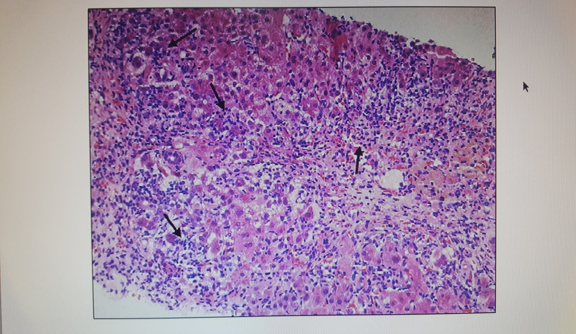
Interface hepatitis
Istologia
Diagnosi:
Grading:
- Denso infiltrato infiammatorio di linfociti, plasmacellule e macrofagi conferma la reazione cellulare autoimmunitaria
- Epatite da interfaccia (peace-meal necrosis of limiting lamina hepatic cells) - Emperipolesi (endocitosi di linfociti nell’epatocita)
- Rosette
Staging della fibrosi
D.diff:
- DILI: necrosi centrolobulare - forme colestatiche: (CBP, overlap))

Slide 11

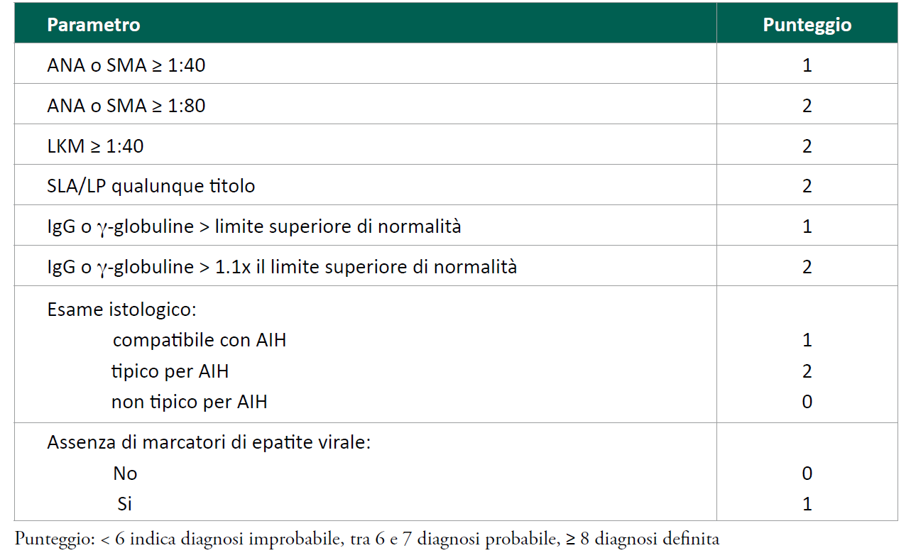
Criteria for the diagnosis of AIH
> 1.156 x il limite superiore di normalità
La diagnosi di AIH dovrebbe essere considerata in qualsiasi paziente che presenta alteazioni dei LFTs
AISF: A. Floreani et al; SIMG: I Grattagliano et al. 20/02/2018

Slide 12
Non-invasive diagnostics(AIH)
- L’imaging (ecografia, TAC, RMN) non è rilevante per la diagnosi di AIH se non documentare segni di malattia evoluta
- Utile Eco addome superiore annuale e semestrale nei soggetti con cirrosi per rischio di HCC
- Fibroscan può risentire negativamente dell’intensa attività infiammatoria sovrastimando lo stadio di malattia. Un cut-off di 16kPa identifica uno stadio di cirrosi
AISF: A. Floreani et al; SIMG: I Grattagliano et al. 20/02/2018

Slide 13
Indication for treatment of autoimmune hepatitis (adapted from Manns et al.)
Absolute | Relative
Serum AST ≥ 10 fold ULN | Symptoms (fatigue, arthralgia, jaundice)
Serum AST ≥ 5 fold ULN and IgG level ≥ twice normal | Serum AST and/or IgG less than absolute criteria
Bridging necrosis or multiacinar necrosis on histological examination | Interface hepatitis
Nicole MF van Gerven et al. World J Gastroenterol. May 21, 2016; 22(19): 4651-466

Slide 14
Autoimmune Hepatitis (AIH) therapy
Induction
Metilprednisolone e.v. 1 mg / kg / day of attack dose
Prednisone per os: starting from 50 mg to scale and / or combination Azathioprine 1-2 mg / kg / day
Budsonide 3 mg, starting from 9 mg / day (in the non-cirrhotic AIH therapy, acute portal thrombosis in the CBP stage IV) (Hempfling W, Hepatology 2003)
After 2 months or more, to normalization of AST / ALT and IgG
Maintenance:
Prednisone 5 mg / day + Azathioprine (50-150 mg / day)
Budsonide 3 mg / day + Azathioprine
Duration for at least 1 year from the acute event

Slide 15
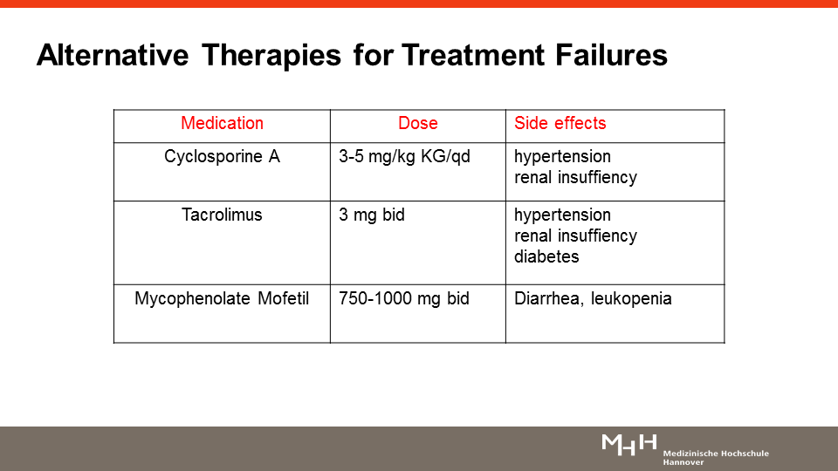
Alternative therapies for treatment failures
OLT (only 4% of transplants in Europe and USA are due to AIH)

Slide 16
Prognosis after treatment (AIH)
Remission: 65%
No response: 35% (toxicity:13%; failure:9%; incomplete response: 13%)
Relapse: 50-86%
Cirrhosis (36% of patients in 6 years)
OLT (recurrence: 4-26%; 10 years survival: 64%)

Slide 17
"De novo" autoimmune hepatitis
Le prime descrizioni della dn-AIH risalgono al 1998 in pazienti pediatrici e nel 1999 in pazienti adulti, trapiantati per una patologia epatica non autoimmune.
La dn-AIH può svilupparsi / recidivare nell'allotrapianto con un‘ incidenza stimata tra 8 e 12% a 1 anno e 36-68% a 5 anni in corso di trattamento immunosoppressivo anti-rigetto

Slide 18
"De novo" autoimmune hepatitis is a clinical entity
characterize recurrence of disease:
(ANA 1:160, ASMA, or anti-LKM)
(no component cholestatic)

Slide 19
"De novo" autoimmune hepatitis

Slide 20
"De novo" autoimmune hepatitis

Slide 21

"De novo" autoimmune hepatitis
receptor for
antigen
CMV, EBV, Parvovirus B19

Slide 22
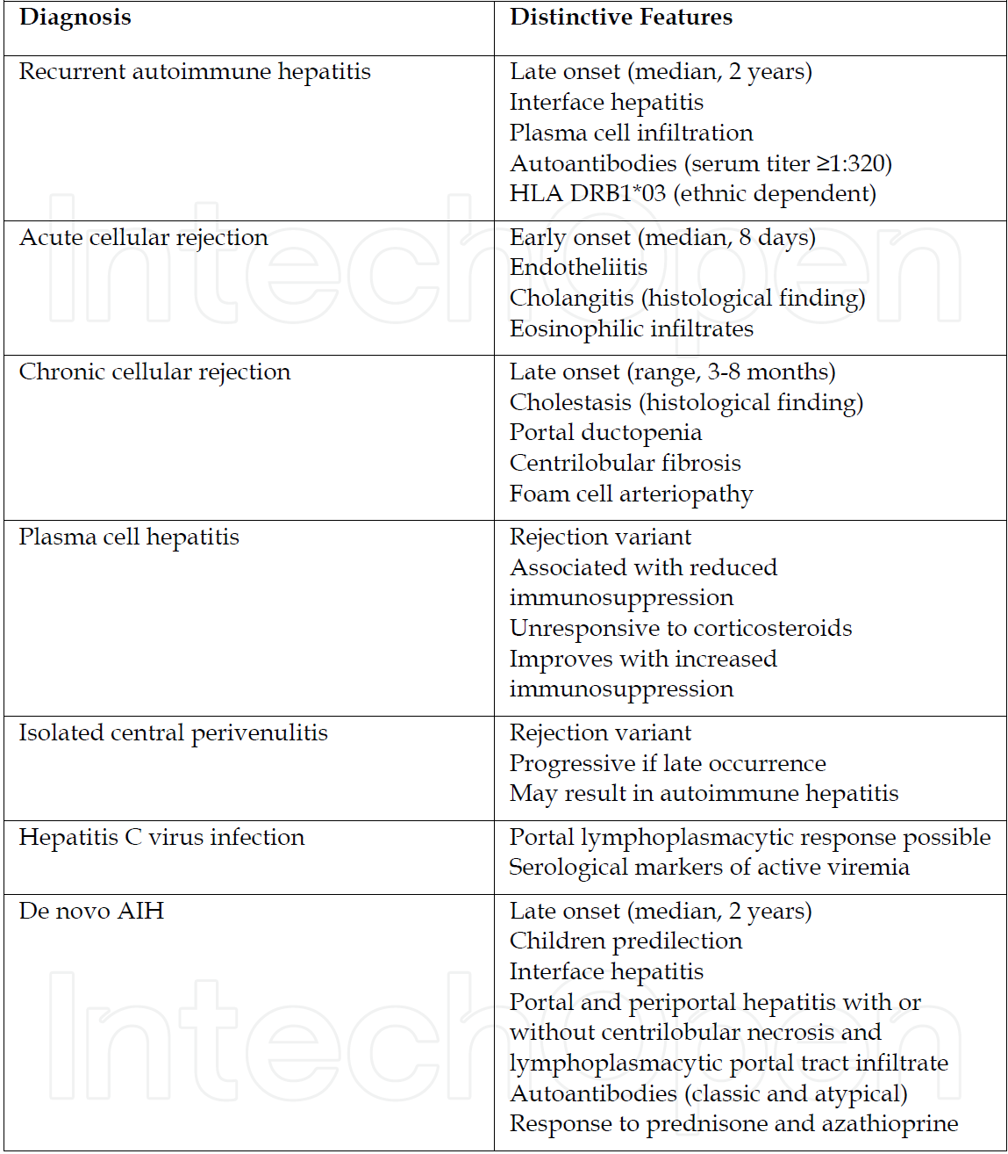
D. Diff. of Recurrent and De Novo AIH after OLT
Autoimmune Hepatitis After Liver Transplantation Pierpaolo Di Cocco et al. 2012
Considerare il rischio di possibile sviluppo di epatite immune de-novo in pazienti sottoposti
a trapianto di fegato per cirrosi HCV-correlata con HCV-RNA negativo, spontaneamente
o dopo terapia antivirale.
OLT- AISF 2008

Slide 23
Overlap syndrome
indicates the coexistence of 2 or more autoimmune diseases of the liver in the same individual, occurring simultaneously or sequentially
PBC
AIH
+
+
+
PSC
- The diagnosis of Overlap Syndrome is basically a histological diagnosis. - The suspicion is given by clinical / laboratory findings and / or a poor response to therapy

Slide 24
Overlap syndrome PBC/AIH
Is the most common form of overlap syndromes and may be associated with a poor prognosis, with earlier onset of portal hypertension and need for OLT
Several studies have reported a prevalence of 4.8-19% in patients with PBC and 5-8.3% in patients with AIH (Pooja Dhiman et al. -Saudi J Gastroenterol . 2014)
The overlap between PBC and AIH occurs in two forms: AMA-negative AIC with AIH or PBC with AIH
Relationship between woman and man: 9:1
Notes:
for liver disease at the last stage

Slide 25
Diagnostic criteria of PBC-AIH overlap syndrome
PBC criteria:
AP >2x ULN or GGT >5x ULN
AMA >1:40
Liver biopsy specimen showing florid bile duct lesions
AIH criteria: 2 of the following 3 features
ALT >5x ULN
IgG >2x ULN or SMA positive
Moderate or severe interface hepatitis on histology
EASL guidelines 2017

Slide 26
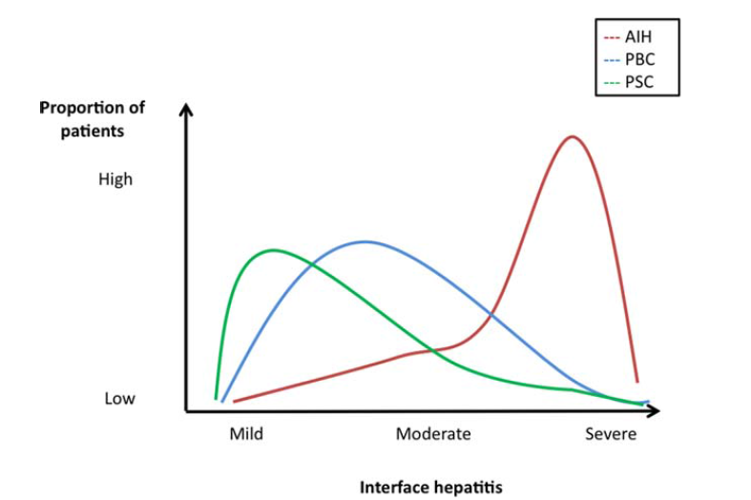
Interface Hepatits is an aspect of all autoimmune diseases of the liver
(10% of pts. bile duct damage)
Haldar D, Clin Liver Dis 2014

Slide 27
Clinical assessment and therapeutic approach to patients with PBC and features of AIH
Pts with PBC according to accepted criteria
Predominance of
cholestatic findings
Disproportionally elevated
Serum transaminases and/or
IgG levels
Therapy with UDCA
According to general
guidelines
Consider liver biopsy for assessment of histological features of AIH (interface hepatitis)
PBC with features of AIH
Consider treatment with corticosteroids ± other immunosuppressive agents in addition to UDCA
Alternatively, await response to UDCA and then consider addition to immunosuppressive
Treatment should be individualized and adjusted according to the response, with careful attention to side effects
EASL Position Paper, J Hepatol 2011; 54:374
Notes:
27
27

Slide 28
PBC first
AIH
Prognosis is worse than PBC alone
The PBC component should be treated with UDCA at a standard dose and may benefit fom additional immunosuppression in the short- and medium-term
The combined treatment with steroids and azatioprine have been shown to have a high response rate
Withdrawal of immunosuppression should be considered individually
EASL guidelines 2017

Slide 29
AIH first
PBC
It is unclear if these patients benefit from additional therapy with UDCA
Given the low rate of adverse effects and the potential long-term benefit, it may be pragmatic to add UDCA to the treatment regimen, especially in younger patients who may experience ductopenia and biliary cirrhosis during their lifetime.
EASL guidelines 2017
Notes:
Non è chiaro se questi pazienti traggono beneficio dalla terapia aggiuntiva con UDCA

Slide 30
Overlap syndrome PSC/AIH
It is more common in young patients and 6% prevalence in patients with AIH and 8% in patients with PSC (Pooja Dhiman et al. Saudi J Gastroenterol . 2014)
- Relationship between man and woman 6:5
- Both AIH and PSC can be associated with IBD
PSC
Cholestasis
ERCP or MRI abnormalities
Phlogistic infiltrates ductal and periductal
Fibrosis-obliterative periductal
AIH
ALT>5
IgG >20g/L or SMA (anti-actine antibodies)
Interface hepatitis
Notes:
Criteria: association Of Both disease

Slide 31
Overlap AIH/PSC
B. L. 20 a.
Prednisolone
Prenisolone
UDCA
UDCA
200
500
180
450
160
400
140
350
- Alta attività ALP - ALP/AST>1,5
120
300
ALP
100
ALT
250
UI/L
UI/L
80
200
60
150
40
AST
100
GGT
20
50
0
0
0
2
4
6
9
12
0
2
4
6
9
12
mesi
mesi

Slide 32
Patients with overlap AIH/PSC: immunosuppressive therapy
UDCA 15-20 mg/Kg/day + prednisolone (with a tailored maintenance dosage of 10-15 mg/day) + Azathioprine (50-75 mg/day)
AIH/PSC
PSC
CUMULATIVE SURVIVAL
FOLLOW-UP (months)
Global median survival 272.7 (CI 95%: 219.9-325.4)
Cumulative probability of survival at 240 months: AIH/PSC 87.5%
PSC 73,6%
Antoniazzi, Floreani AISF 2010

Slide 33
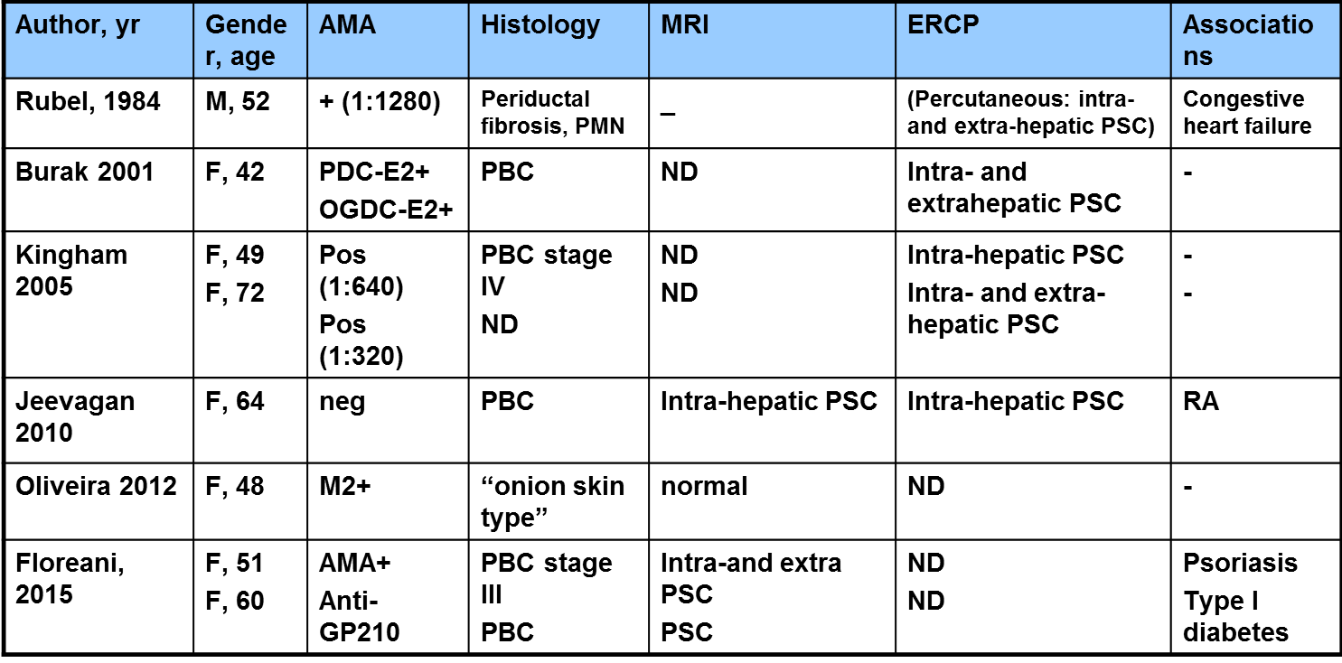
Reported cases of PBC/PSC overlap syndrome
ND= not done
Notes:
Tuttavia, una revisione della letteratura ha rivelato che sono stati segnalati solo 10 casi di sovrapposizione PBC-PSC. -9

Slide 34
Case reports : overlap syndrome between PBC and PSC in a woman of 35 years
Investigations | Values | Serology | Results
Total/direct bilirubin | 4.0/3.1 mg/mL | HBsAg ELISA | Negative
AST/ALT | 117/41 U/L | antiHCV ELISA | Negative
ALP | 1,047 U/L | antiHBc Total | Negative
Albumin | 2.4 g/mL | HIV ELISA | Negative
PT/INR | 18 sec/1.58 | ANA | Positive (1:640)
Creatinine | 1.0 mg/mL | ASMA | Negative
Hemoglobin | 8.1 g/mL | AMA M2 | Positive
Platelets | 140,000/mm³ | Total IgG | 1,998 (up to 1,500)
Total leukocyte count | 4,400/mm³ | CA 19-9 | 31 U/L
GGTP | 353 U/L | IgG4 | 110 mg
S-AAG > 1.1 gr/dl, No PBS

Slide 35
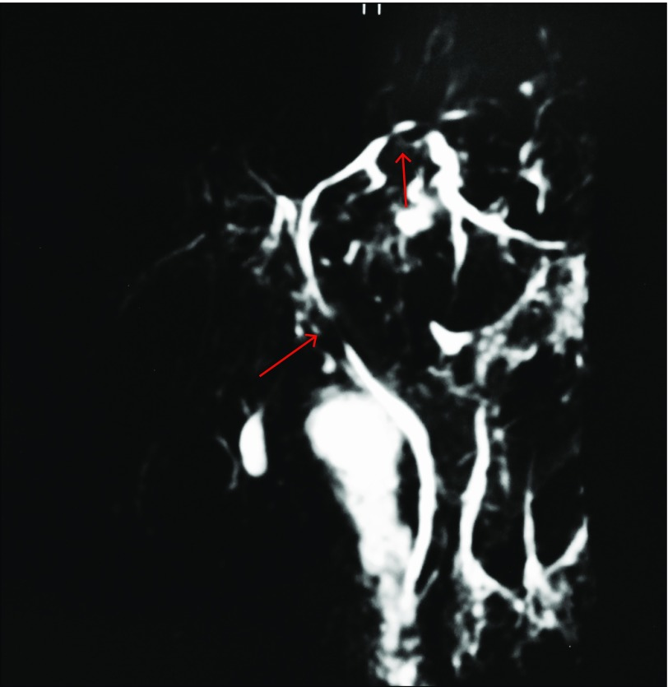
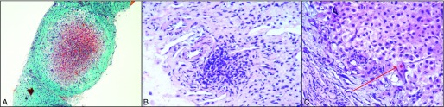
Case reports : overlap syndrome between PBC and PSC in a woman of 35 years
Liver biopsy showing
a cirrhotic nodule as a seen with Masson’s trichrome,
ductocentric inflammation,
canalicular bile plugs with intrahepatic cholestasis
-PSC: dominant stricture at the C-NMR, ERCP, IBD, ANA positivity
-PBC: positive AMA and features of chronic cholangitis with cirrhosis
- Dominant stricture on magnetic resonance cholangiopancreatography
- Early IBD on colon biopsies
- ERCP: dilatation of the stenosis of the common bile duct

Slide 36

Grazie per l’attenzione

